Slide 1
Contingency Plan (CP)
Table Top Test Training

Slide 2
Agenda
Table Top Test (TTT) Introduction
Scheduling Process and Requirements
Communications
Roles and Responsibilities
Scenario Library and Recommendations
Preparation Tips
Conducting TTT
After Action Report (AAR), Results and Recommendations
TTT Evaluation
Lessons Learned
AAR Conclusion
Certificate of Completion

Slide 3
Table Top Test Introduction
Table Top Testing (TTT) is a discussion and scenario-based exercise conducted in groups where participants discuss their roles and responses to emergency situations.
The exercise is conducted by a facilitator who presents an emergency scenario to participants and asks questions related to that scenario.
The questions are meant to initiate discussions regarding roles, responsibilities, coordination, and decisions that need to be made during emergency situations.

Slide 4
Reasons for Improvement
Consistency
Minimal Guidelines/Direction
Scenarios
Understanding of Responsibilities
Lack of Approval/Improvement Process

Slide 5
Enhancements to the Program
Created TTT SOP and Workflow
Established Core Questions and Expected Response(s)
Developed ISSO Approval Process
Standard Templates
Scenario Library
Centralized Program Location
TTT Committee

Slide 6
Schedule and Requirements
CMS requires Table Top Testing (TTT) of CPs as follows:
GSS: Four (4) TTT events annually (one event each quarter, with at least two being considered a “major” event)
Moderate FISMA systems: Two (2) TTT events annually (at least one scenario should be considered a “major” event)
Low FISMA systems: One (1) TTT event annually
Note - The ISSO has the authority to direct an ADO to conduct as many TTTs as they require.
TTT Schedule and Requirements

Slide 7
Scheduling Process
The CCOM Security Compliance Team will manage the CP Testing Schedule on the Quality Net Confluence Security page in the Quality Net Library.
The ADO will reach out to the systems ISSO at least two weeks prior to:
  Determine ISSO availability
  Receive approval of TTT Scenario
  Collaborate and include additional system specific questions and expected results into the TTT/AAR template
  ADO will draft the TTT/AAR and forward to the ISSO for review and approval

Slide 8
Communications
The ADO will schedule the TTT exercise at least one week prior to the scheduled time. The following should be used when sending the meeting invitation:
  Email template
  Please reference the TTT SOP for the distribution list.
Email Template and TTT SOP can be found here

Slide 9
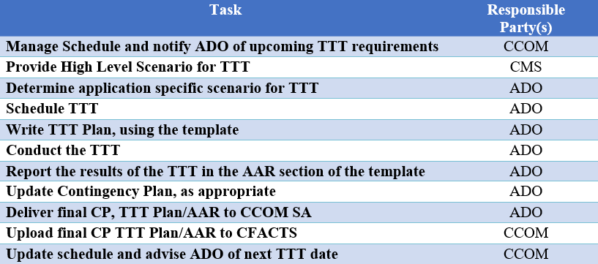
Roles and Responsibilities
Unlike a Contingency Plan (CP), the roles and responsibilities in this document are focused on what each role is responsible for regarding the TTT itself.

Slide 10
Scenario Library
A library of scenarios was developed to include a list of “high-level” topics, example scenarios and “additional” questions that can be used during a TTT exercise.
Below is where you will find the TTT Definition Library as well as the TTT Scenario Library:
  CP/TTT Resources
Note – The scenarios should be tailored to the application, environment and/or to test any major changes.

Slide 11
Scenario Library Recommendations
Scenario Tips
Before selecting a scenario, be sure to visit the TTT Definition Library. This provides information regarding the different types of scenarios that may be presented as well as definitions for each type.
When reviewing the TTT Scenario Library, which will be restricted to a select audience, keep in mind the provided scenarios are examples for you to build off of and customize to suit your system.
While creating your own detailed scenario, keep in mind how you found out about the event in the scenario, and how each person with a role within the Contingency Plan is expected to respond.

Slide 12
Preparation Tips
Make sure the Contingency Plan Coordinator (CPC) is identified as well as anyone with an active role within the CP. They will need to be in attendance for the TTT.
If any of the identified participants are not able to attend the TTT, a knowledgeable replacement is to be present.
Make sure they have read, understand their role within the CP and identify their responsibility in the process prior to the TTT. CP training will need to be provided on a yearly basis.
The high-level scenario should be provided to all participants prior to the TTT, however the detailed scenario is only to be revealed during the TTT.
Note- If the above criteria are not met, the TTT could be ended early at that time, based on ISSOs’ determination. A lessons learned session as well as a repeat TTT could also result based on ISSOs’ determination.

Slide 13
Conducting TTT
The facilitator makes sure to take attendance identifying the key roles that should be present, then kicks off the exercise by presenting the participants with the scenario.
  It may be useful to present a PowerPoint during the TTT showing the scenario and questions.
As the participants respond to the first question and each subsequent question, the facilitator manages the discussion (regarding the recovery procedures in the CP) until normal operations would have been restored.
The “expected results” for scenario questions are not to be provided and/or displayed during the exercise.

Slide 14
Conducting TTT Continued
Upon conclusion, the facilitator will compile and document all answers and discussions within the TTT/After-Action Report (AAR).
The TTT/AAR will be sent to the attending ISSO, two business days after the TTT exercise concludes, to complete their evaluation, then returned to the facilitator.
The ISSO will sign and return the document to the facilitator within five working days of receiving it.
The facilitator will finalize the TTT/AAR and schedule a lesson learned session, with all participants, if requested by the ISSO.

Slide 15
After Action Report
The After-Action Report (AAR) will be used to provide feedback to participants on their performance during the exercise.
It will summarize exercise events and analyze performance of the tasks identified as important during the planning process.
It will also evaluate achievements of the selected exercise objectives and demonstrate the overall capabilities being validated.

Slide 16
AAR-Summary of Test Results
The “Summary of Test Results” section of the TTT/AAR template, should contain observations made by the facilitator during the exercise and incorporate the documented ISSO’s evaluation results and comments.
After Action Report Template can also be found within the CP/TTT Resources Page

Slide 17
AAR-Recommendations
Comments and/or recommendations that surface during the exercise, ISSO documented recommendations, and lessons learned session should be documented in the “Recommendations” section of the TTT/AAR template.
Following the development of the AAR, the facilitator may assign action items to select personnel to update security-related documents, processes/procedures and perform other actions based on the exercise.

Slide 18
TTT Evaluation
The facilitator will provide the attending ISSO with the TTT/AAR, two business days after the TTT concludes.
The ISSO evaluates the results of each step and provides comments where applicable.
Evaluation results will be documented within the TTT/AAR to include Satisfactory/Unsatisfactory responses and ISSO comments and recommendations.

Slide 19
TTT Evaluation
The ISSO will determine if the outcome of the exercise was satisfactory or unsatisfactory and include their recommendation(s).
This outcome, with recommendations, will be documented within the “Outcome” section of the TTT/AAR template.
The ISSO will sign and return the document to the facilitator within five working days of receiving it.

Slide 20
TTT Evaluation
The ISSO has the authority to fail and/or halt the TTT at any time during the exercise.
Any weakness or deficiency in the CP that cannot be addressed in a timely manner (i.e. prior to the next CP testing date) will require a POA&M to be created in order to identify the vulnerability.
Corrective Action Plans will also be necessary to reduce the weakness to an acceptable level based on any POA&Ms created.

Slide 21
Lessons Learned
If requested by the ISSO, a lessons learned meeting should be conducted within three business days of receiving ISSO comments and recommendations in the TTT/AAR.
Lessons Learned sessions are used to discuss the exercise results, any identified shortcomings, enhance general awareness, and to validate plans, procedures and improvements necessary to make the next TTT a success.
All suggestions and action items should be documented within the AAR under the Recommendations section.

Slide 22
After Action Report Conclusion
The facilitator will review all ISSO comments and recommendations to determine if additional actions are needed (e.g., require a lesson learned meeting, update the CP or other documentation, re-do TTT, etc.).
Once all requested actions have been completed, the facilitator will provide the CCOM Security Compliance Analyst with the completed report to be uploaded into CFACTS. This serves as evidence that this deliverable has been completed as required by CMS.

Slide 23
Thank you

