Slide 1
This ppt is a tool for you to use as a visual training aid during your TTT exercise. It includes the 17 questions from the TTT-AAR form and can assist you in keeping your TTT discussion on track. You may use it as you see fit, or you may choose to not use it at all. It is not a requirement of the TTT exercise, and you will not be penalized for not using it. Again, it is merely a visual training aid for your audience to see the presented questions to help facilitate the discussion. You may add/remove additional slides as you deem necessary to fit your scenario. Please feel free to reach out to your system Security Analyst if you have any questions about the use of the ppt.
ATTENTION ADOs
NOTE: REMOVE THIS SLIDE BEFORE TTT PRESENTATION

Slide 2
(Insert FISMA System) Table-Top-Test Scenario and Questions
Hosted By: <Insert ADO Organization>
ADO: Name
ISSO: Name
Security Analyst: Name

Slide 3
TTT Attendees
NAME | ROLE | ORGANIZATION | PRESENT
 | Business Owner | CMS
 | System Developer/Maintainer | CMS
 | Information Systems Security Officer | CMS
 | ADO – CPC Lead | <ADO Org>
 | ADO – CPC Alternate | <ADO Org>
 | ADO Dev OPS | <ADO Org>
 | Security Analyst
 | SOC Analyst
 | Service Desk Tech Support
 | Cloud Account Engineer
 | Customer Success Manager
Notes:
Add additional attendees as needed. Delete any unused rows

Slide 4
House Keeping
Session will be recorded for AAR note taking
Please state your name and role if speaking for the first time
Ensure all mics are muted when not speaking
Allow others to finish what they are saying when engaging in conversation
Actively participate and listen
Be ready to learn
Have fun
There are no wrong answers, this is training
Notes:
ADO add in any additional housekeeping or remove any above.

Slide 5
Table-Top-Test Scenario: Card 1
Time Event Occurred: Click here to enter text.
Time Event Reported to CP Coordinator: Click here to enter text.
Facility Report: [Example: Facility Okay]
Casualty Report: [Example: No casualties]
Damage Estimate: [No equipment is damaged, no facilities damaged.]
Event Description/Scenario: Example: Users report that the [FISMA] System is missing user ID’s and data.
Notes:
Insert the ADO High Level Scenario: Card 1 Here

Slide 6
Question 1: Initial Report of the Incident
The Service Desk begins receiving calls from users confirming the scenario/issue. What are the Service Desk’s responsibilities?
Or
2. The issue was identified internally, and the ADO was notified of the issue. What are the ADO’s next steps?
Notes:
ADO determine if the Scenario is Service desk oriented or internally driven and remove one of the two presented questions

Slide 7
Question 2: Initial Notification to Key Personnel
The ADO is now aware of the issue.
Who internally is contacted?
Notes:
ADO determine if the Scenario is Service desk oriented or internally driven and remove one of the two presented questions

Slide 8
Question 3: Initial Notification to Users
Now that the key personnel have been contacted, how are the users made aware of the issue?
Notes:
ADO determine if the Scenario is Service desk oriented or internally driven and remove one of the two presented questions

Slide 9
Table-Top-Test Scenario: Card 2
Time of Assessment: Click here to enter text.
Time of Report: Click here to enter text.
Damage Assessment Summary: [Additional details regarding the scenario is provided for further discussions more in-depth answers to how to respond to the issue].
Security Report: [Example: No outside security breaches occurred at this time].
IT Services Report: [Example: No data loss or users deleted from user tables]
Notes:
ADO determine if the Scenario is Service desk oriented or internally driven and remove one of the two presented questions

Slide 10
Question 4: Damage Assessment
Who is responsible for the damage assessment?

Slide 11
Question 5: Infrastructure, Application, Database and Data Recovery Requirement Evaluation
What will the Damage Assessment Team be assessing?

Slide 12
Question 6: Additional Impacted Systems
Are there any subsystems involved and how are they addressed / notified?

Slide 13
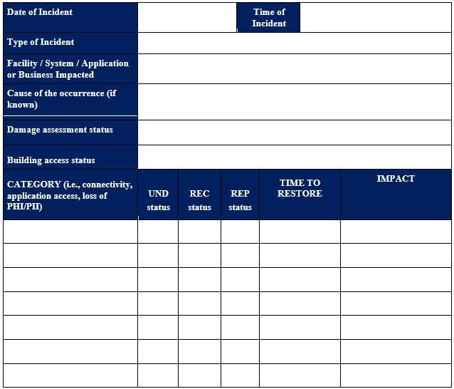
Question 7: Damage Assessment Checklist
How is this documented and what items should be documented?

Slide 14
Question 8: Declaration of CP/Disaster
DA Team Lead completes and distributes report to CPC who provides report to leadership for evaluation.
DA report indicates that this will exceed the systems Return To Operations (RTO)
  What is the systems RTO and is the CP activated? If so, who makes that decision and who should be immediately notified?

Slide 15
Question 9: Communications to Leadership
Who is responsible for providing updates throughout these efforts to leadership and stakeholders?

Slide 16
Question 10: Communications to Users
How are users updated throughout the restoration process?

Slide 17
Question 11: Restoration Efforts
Now that the CP has been activated and the damage has been assessed, what are the sequences for recovery of the system?

Slide 18
Question 12: Backups
If the system needs to be restored from a backup, who should be notified and where are the backup procedures documented/saved?

Slide 19
Question 13: Validation and Recovery
After the damage assessment has been completed and following the notification and activation of the CP, key personnel will perform appropriate testing to confirm successful recovery and validation of all systems to include a return to normal operations.
Who are these key personnel and how will they complete their validation?

Slide 20
Question 14: Data Validation
Is data validation needed for this type of disaster? If so, what will be done to confirm that the data files and/or databases have been recovered?

Slide 21
Question 15: Return Systems to Operation
Upon successfully completing testing and validation who is responsible for formally declaring recovery efforts complete, and that the system is in normal operations?

Slide 22
Question 16: Communications to Users
What efforts will be taken to notify the application users?

Slide 23
Question 17: Postmortem/ Lessons Learned
It is important that all recovery events be well-documented, including actions taken and problems encountered during the recovery and reconstitution effort, and lessons learned for inclusion and update to this Plan.
It is the responsibility of each team or person to document their actions during the recovery and reconstitution effort and to provide that documentation to the CPC.
What types of documents are required and collected by the CPC after the contingency activation?

Slide 24
AAR/Hotwash and Closing Comments/Questions
ISSO AAR/Comments
ADO (Facilitator) AAR/Comments
Business Owner closing comments
System Developer/Maintainer closing comments
All other participants with feedback
Any Questions?

Slide 25
Thank You for Attending Todays Table-Top-Test

