Slide 1
Slack Huddles

Slide 2
Join Us in Channel
Be sure to join us in QualityNet Slack at our Huddles training #channel:
#slack-huddles-training-june1
We will be practicing together in the channel during the training.
**PLEASE NOTE: While sharing your screen, please be aware that if you have access to sensitive information in Jira and/or Confluence, it could inadvertently pop up.

Slide 3

Agenda
What are Huddles?
Setting up a Huddle
  Starting a Huddle
  Three views
    Opening different views
  Inviting participants
  Joining a huddle
  Backgrounds
    Camera
    Theme
Working in a Huddle
  Huddle Thread
  Huddle Topic
  Share Screen
  Reactions
  Captions
Navigating Between Views
  Back to grid
  Returning to sidebar view
  Leaving Huddle
Help & More Information

Slide 4
**PLEASE NOTE: While sharing your screen, please be aware that if you have access to sensitive information in Jira and/or Confluence, it could inadvertently pop up.
4

Slide 5
What are Huddles?

Slide 6

What are Huddles?
Connect instantly with coworkers.
Huddles are a quick and easy way to meet live with anyone in QualityNet Slack, especially while working remote.
If talking something out is faster than typing it out, you’ll want to start a huddle.

Slide 7
Huddles are Quick, Informal Discussions
Work in real time alongside your teammates
Start in any channel or direct message (DM)
Up to 50 participants
Invite anyone to participate
  Must be a member of the channel or DM to contribute/view huddle thread
Include:
  Video
  Multi-person screen sharing
  A dedicated thread for notes
  Emoji reactions
**Huddles typically have no communicated agenda and are open to anyone within the QualityNet Slack workspace.

Slide 8
Setting up a Huddle

Slide 9
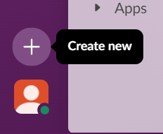
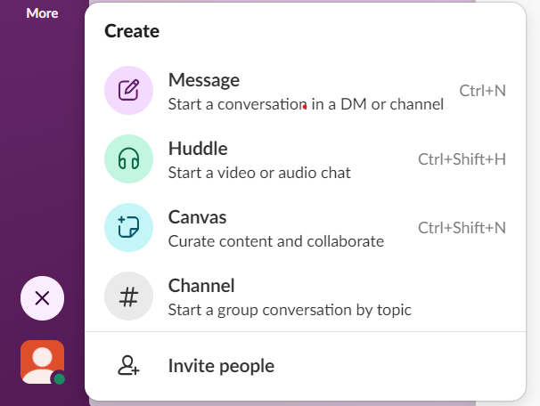
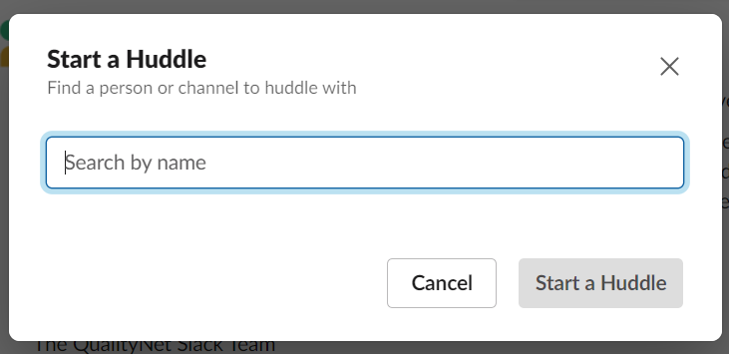
Start a Huddle
Click the Create new button to start a Huddle.
Select Huddle in the pop-up.
Fill in the person(s) or channel you’d like to huddle with.
Click Start a Huddle

Slide 10
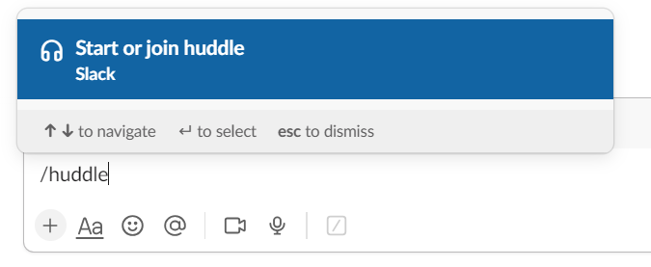
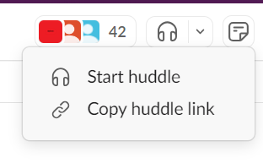
Huddle Start Alternatives
Click the shortcuts command and fill in /huddle.
Click the Huddles icon at the top right of a channel to hold a channel huddle.

Slide 11
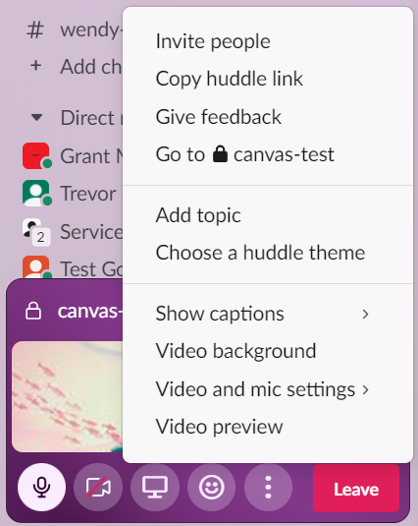
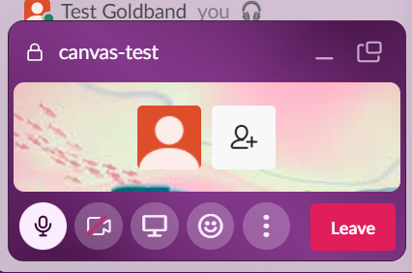
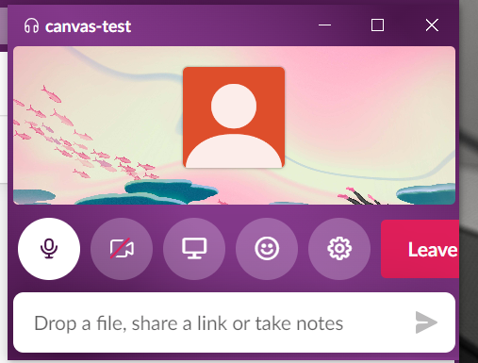
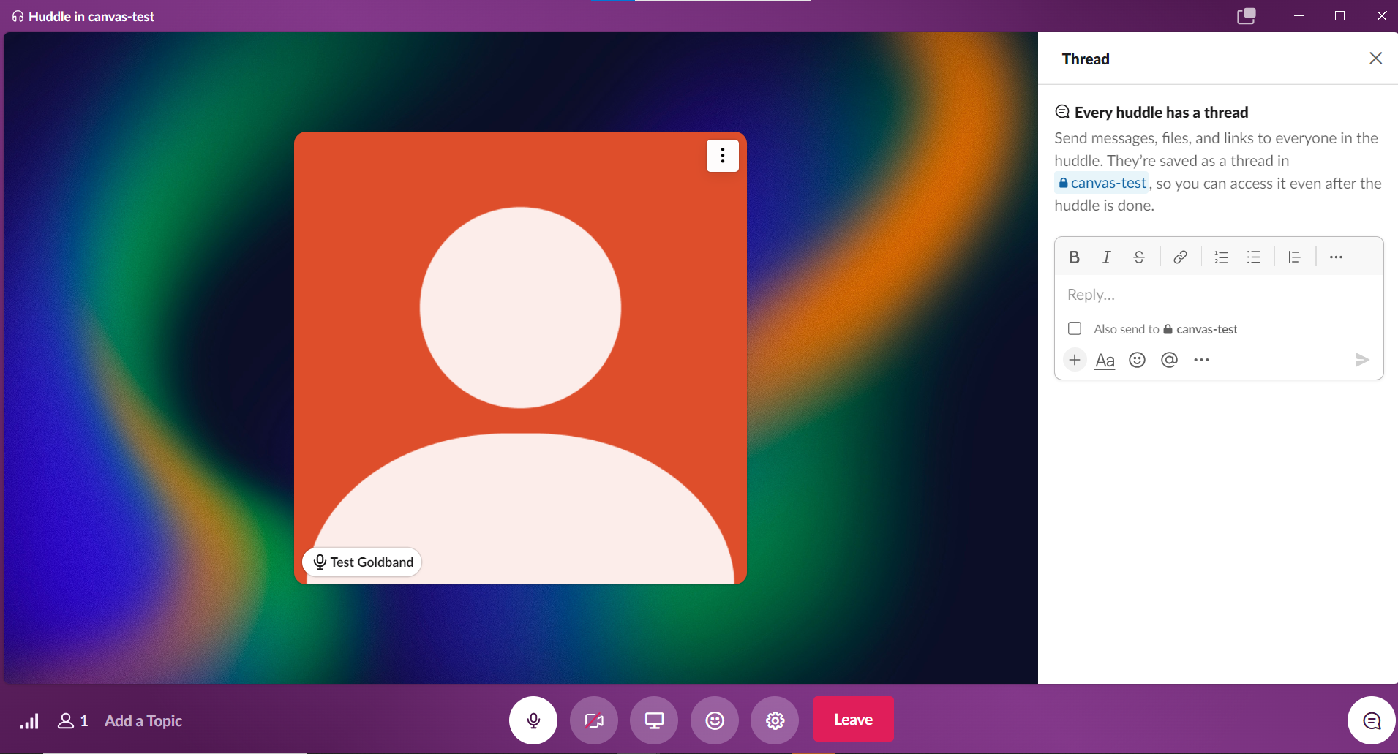
Huddle Windows 3 different views
Sidebar view
More options pop-up
Mini-window pop-out in upper right corner
Open mini-window
Mute
Video
Screenshare
More options
Emojis & reactions
Large window view
Thread
Notes:
SHOW THIS SLIDE TO DEMO THE COMMANDS

Slide 12
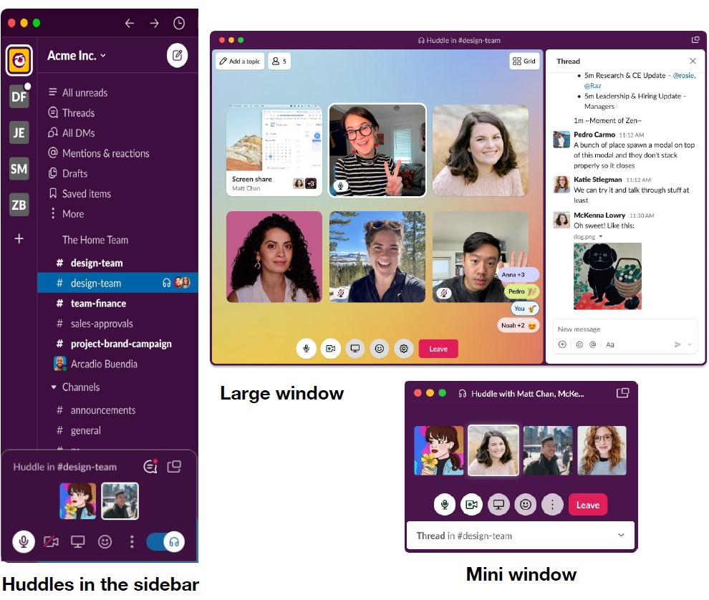
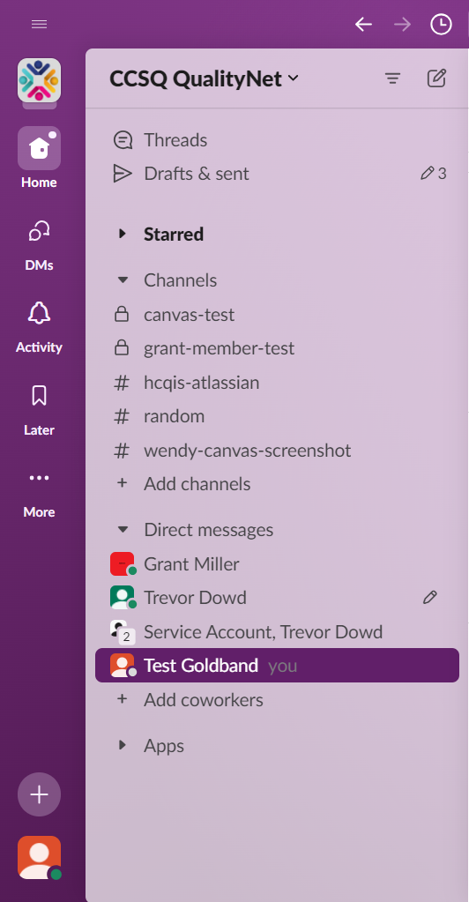
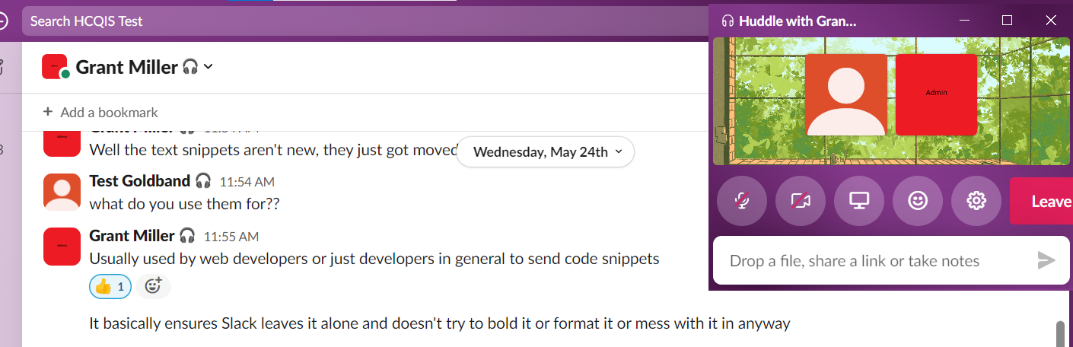
3 Different Views Available
Slack sidebar: where the huddle starts
Mini window: pop out for a small view
Large window: for screen shares and seeing bigger sized video

Slide 13
Mini Window
  Click mini window icon.
  See participants and message thread.
Mini window appears in upper right corner
Message thread

Slide 14
Open Large Window from the Mini Window
  Click the enlarge screen icon above the mini window to open a large window.
Click enlarge screen icon

Slide 15
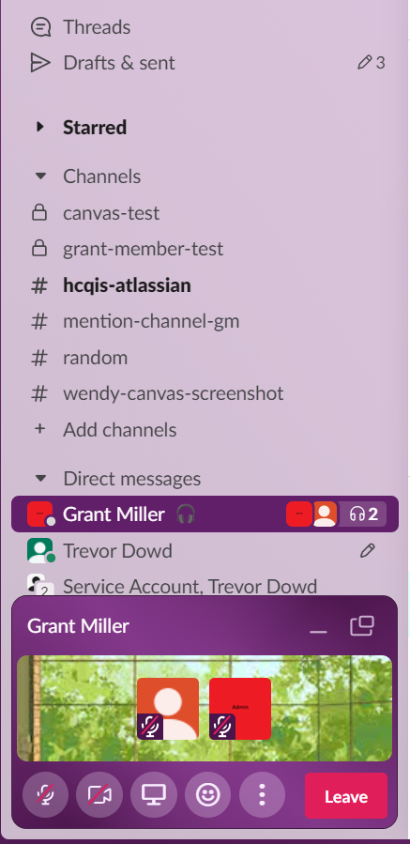
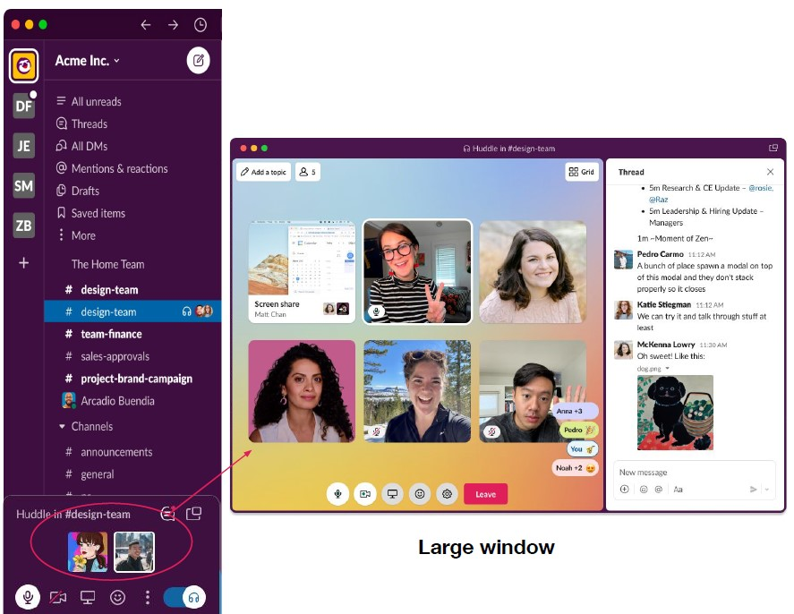
3 Alternatives for Opening a
Large Window
Click a participant’s avatar.
Click the screen share icon.
Click the enlarge screen icon above the mini window.
Avatars
Enlarge Screen
Video
Screen Share
15

Slide 16
Large Window Advantage
Get a better look at:
  your team
  participants’ screens
  thread
16

Slide 17
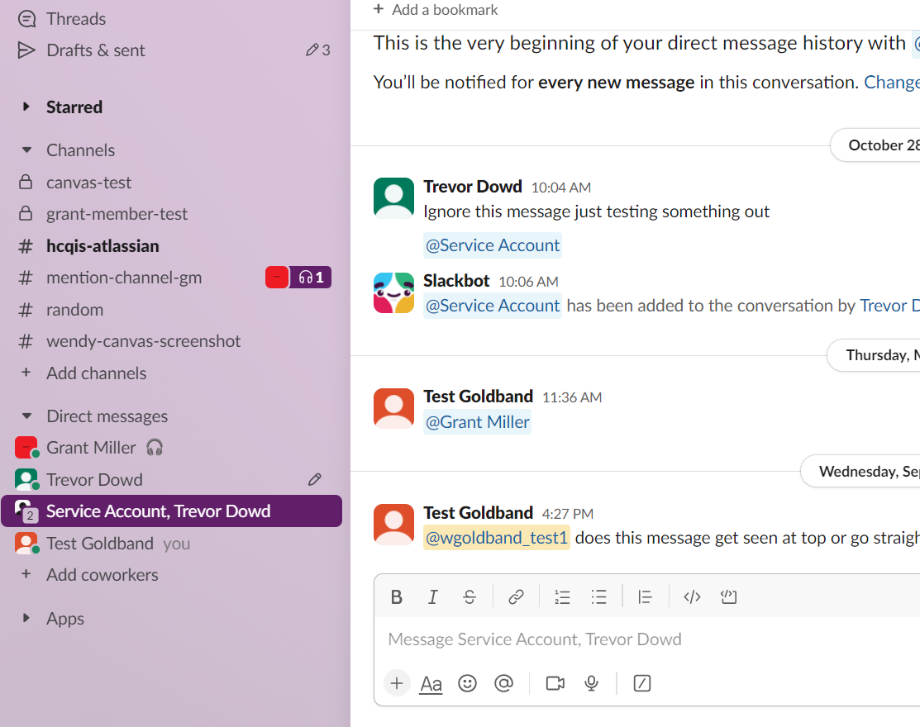
Huddle in a Channel
Active huddle taking place
  Channel members will see the active huddle in the sidebar, and you can invite any member to join you.

Slide 18

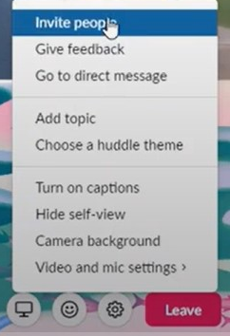
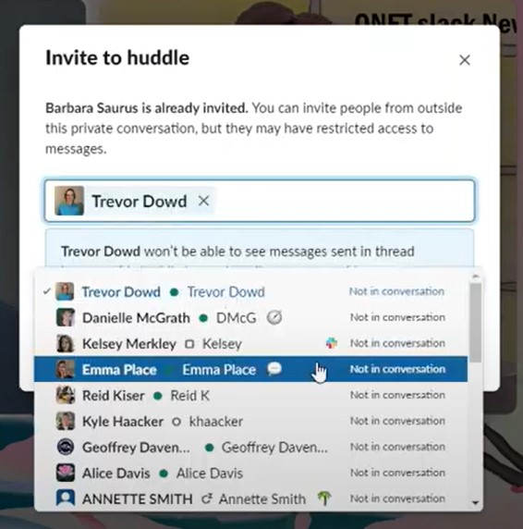

Invite Participants While in Huddle
Click
Click Settings cog at bottom center of screen.
Select
Select Invite people option.
Add
Add people to invite and click the green Send Invite button.

Slide 19
Huddle Links
All huddles have links people can use to join from anywhere, e.g. a message in Slack or a calendar invitation.
To create a link:
From a channel or DM on desktop, click the conversation name in the bottom left corner of your sidebar.
Alternatively, right click on the conversation in the sidebar to find the link under 'copy'.
Click Copy huddle link.
Paste link wherever you’d like, including calendar invites.
Huddle will start when someone clicks the link to join.

Slide 20
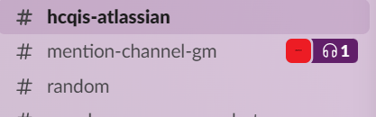
Join a Huddle
When huddle starts within a channel:
  See a headphone icon next to the conversation in your sidebar.
When huddle starts in a DM or if you're invited to a huddle in a channel:
  You’ll be notified to join.

Slide 21
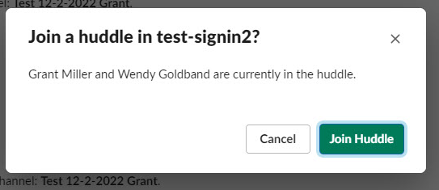
Join Huddle from a Link
To access a huddle from a link:
  Must be logged in to Slack and have access to huddle channel or conversation.
  Before joining, you’ll see a message with who is already in the huddle.

Slide 22
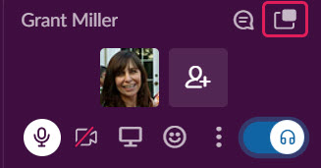
Steps to Join a Huddle in Progress
Open the channel or DM where huddle is taking place.
GRANT _ WHAT DO YOU CLICK TO JOIN HUDDLE?
By default, you will be in Audio only and in Slack sidebar view.
To see larger view of huddle, click mini window icon.

Slide 23

Video
To enable your video , click the camera icon .
** Note: You can choose to hide your self-view while video is on.
  This will hide your view of yourself, but everyone else in the huddle can still see your video.

Slide 24
Backgrounds
Select 2 different types of backgrounds
  Camera background
  Huddle Theme

Slide 25
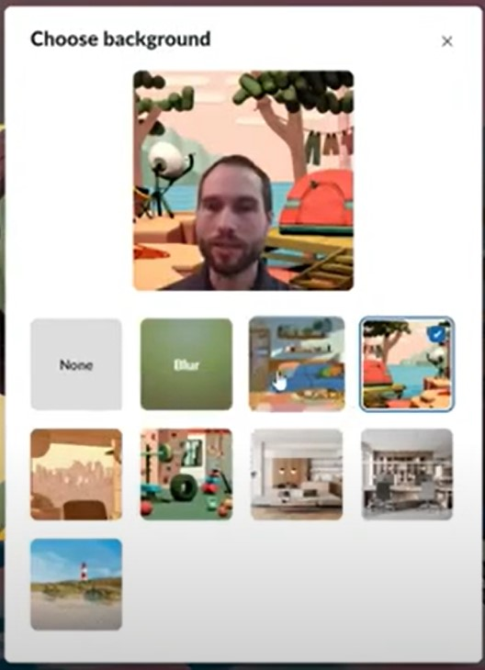
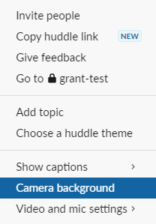
Camera Background
  Appears behind you when your video camera is on.
  Go to Settings cog.
  Select Camera background.
  Select background.

Slide 26
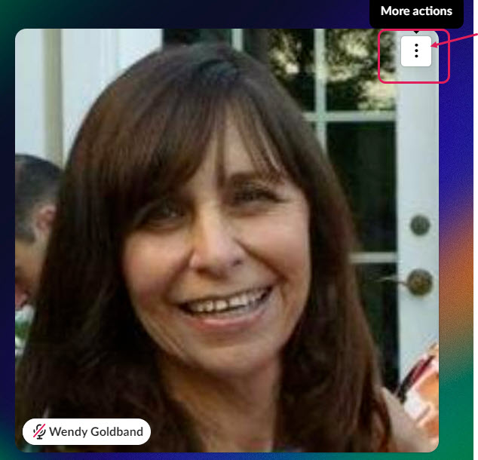
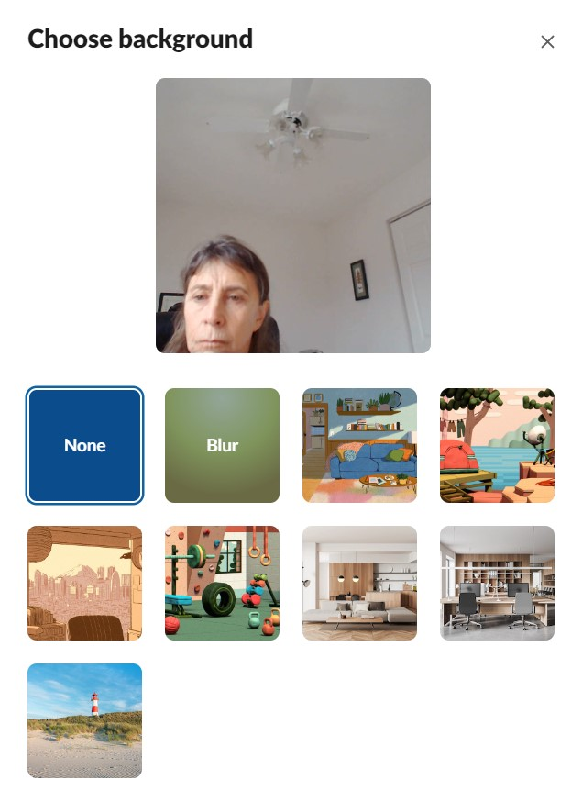
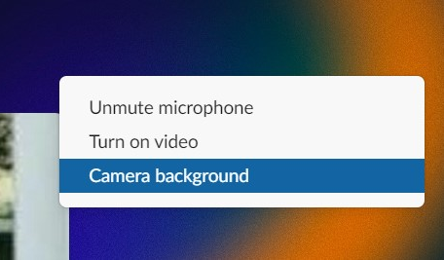
Camera Background From Large Window View
Click More actions 3 ellipses.
Select Camera background.
Choose background.

Slide 27
Huddle Theme
Background for large window
Sets the mood
Different than Camera background
**All huddle participants see the same theme. Changing the theme changes it for everyone in the huddle.

Slide 28
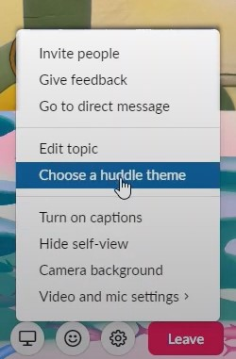
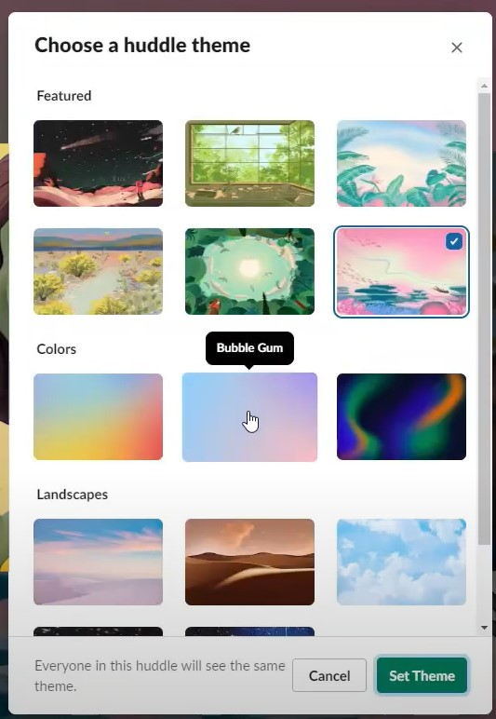
Huddle Theme
  Go to Settings cog.
  Select Choose a huddle theme.
  Select theme and click green Set Theme button.

Slide 29
Working in a Huddle

Slide 30

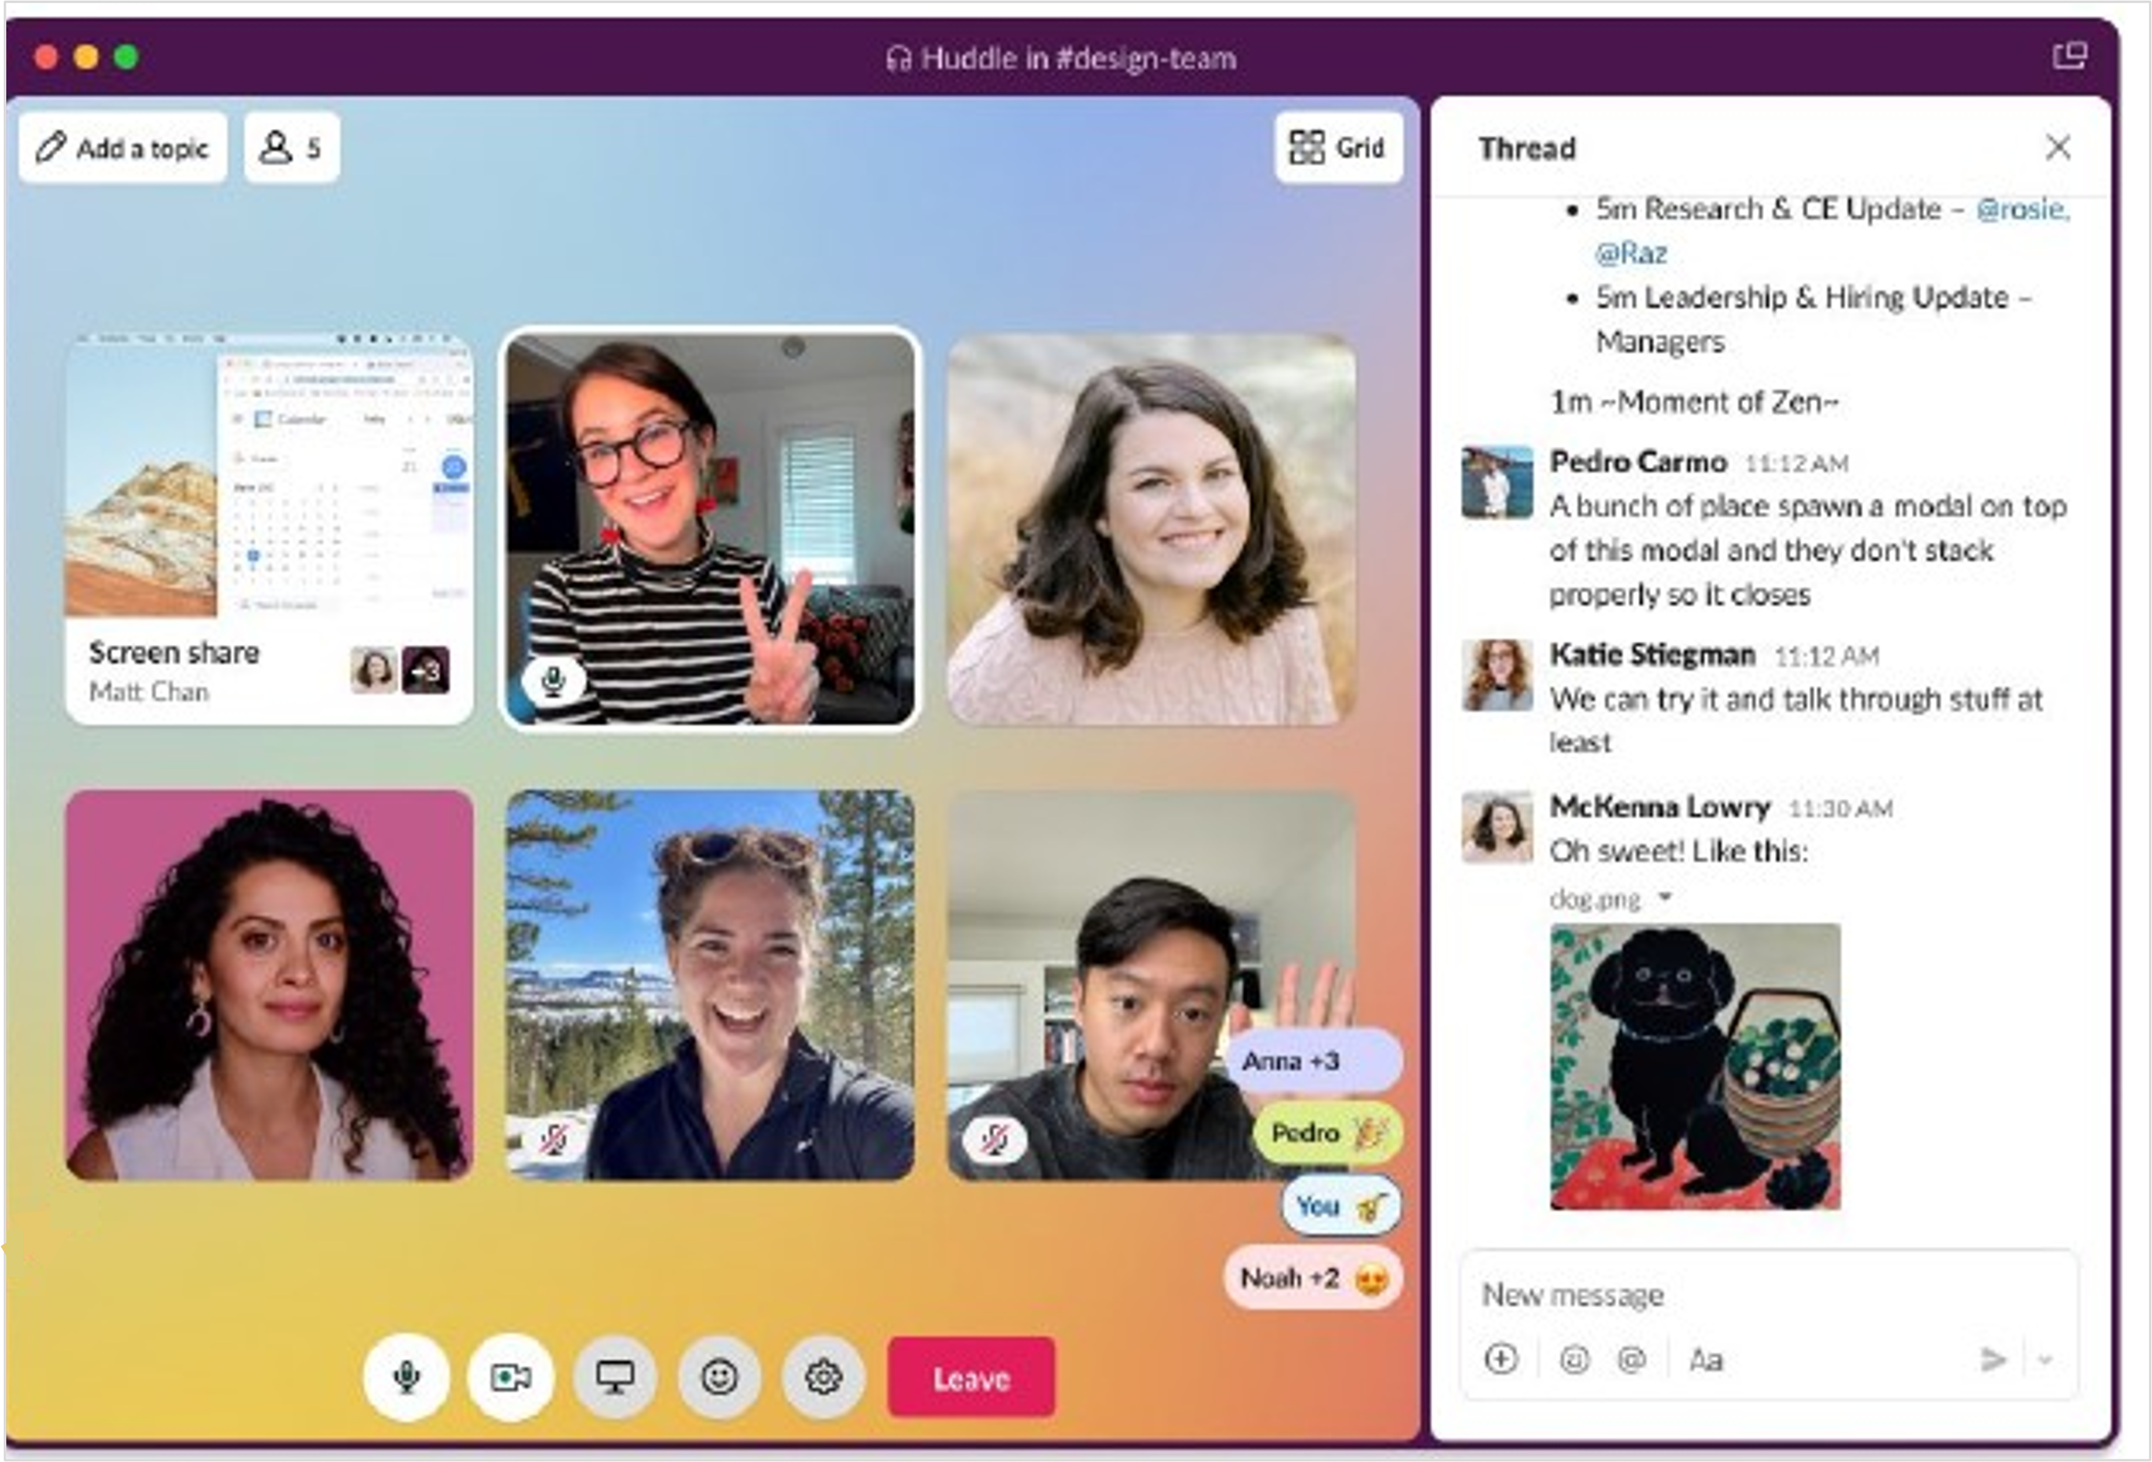
Threads
Dedicated message sidebar to share notes, links, and files during the discussion.
Thread

Slide 31
Opening Threads
Open large window.
Click Thread icon in bottom right corner (if Thread not already appearing).
Thread

Slide 32

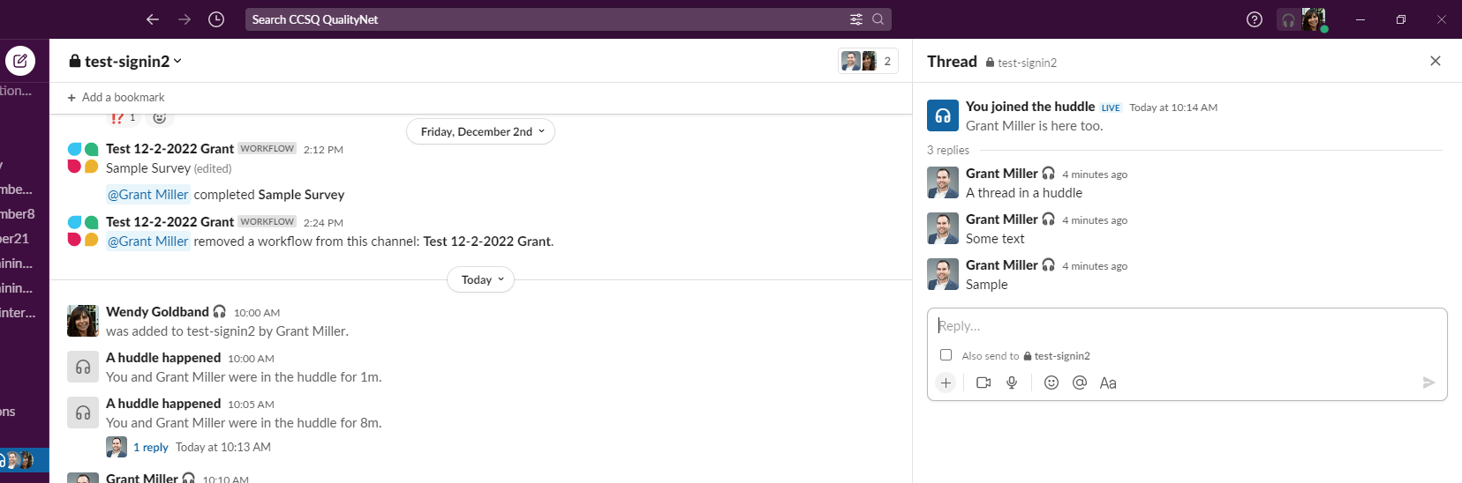
Active Huddle Thread
When Huddle is active:
Channel members NOT participating can still view Huddle Thread
  Click blue replies View thread link to view.
Opens
Thread
Click

Slide 33
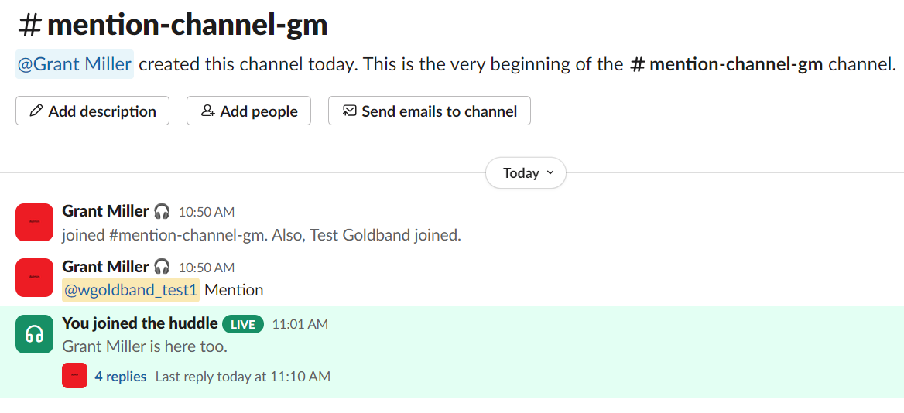
Saved Threads
After Huddle ends, Thread automatically saves in channel.

Slide 34
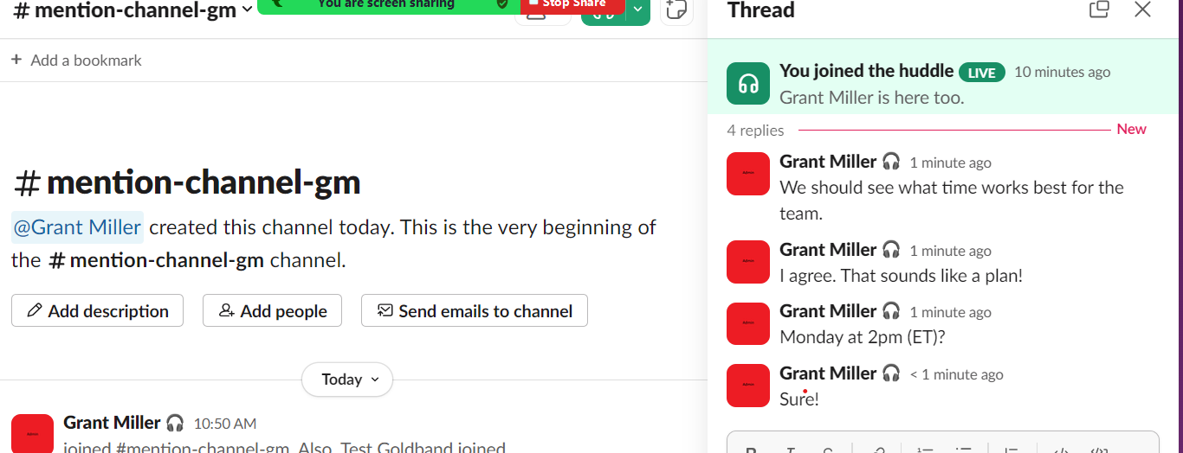
View Saved Threads
Click #replies hyperlink to view thread in right sidebar.

Slide 35

Saved Threads
Enable you to research a past conversation Topic
Click blue replies link under ‘A huddle happened’ to view Thread.
No Topic name given to this Huddle
Topic name given to this Huddle
Replies link

Slide 36
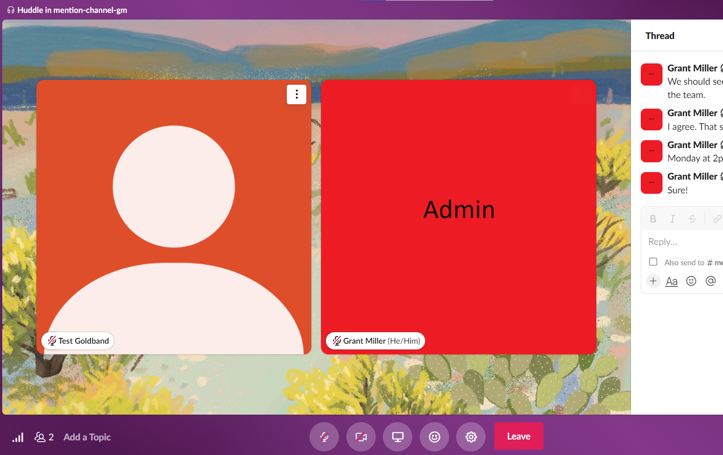
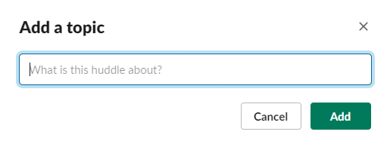
Huddle Topic
Add a topic to update the header displayed with your Thread and to easily search for the conversation in the future.
Click Add a topic in bottom-left corner of huddles window.
Fill in your topic.
Click green Add button.
Topic now appears at bottom-left of window where it originally said Add a topic, and as the Thread header.

Slide 37
Share Screen
Up to 2 people can share at once.
Can switch between screens.
Screens appear in the huddles window.
Click on a teammate's screen to enlarge it.
Can draw on screens.

Slide 38
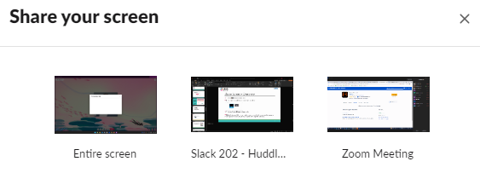
Share Screen - Overview
Click the share screen icon.
Select a screen, window, or application to share.
Click the pencil icon to draw on it.
**Note: To draw while screen sharing, you'll need to share your entire screen. It's not possible to draw if you've only shared a specific window.

Slide 39
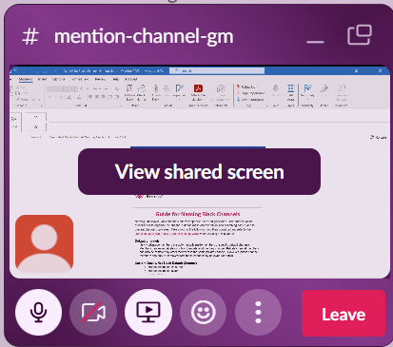
Share Screen – From Left Sidebar View
When in bottom left sidebar view
Once you share your screen --
  Shared screen appears in bottom left window.

Slide 40
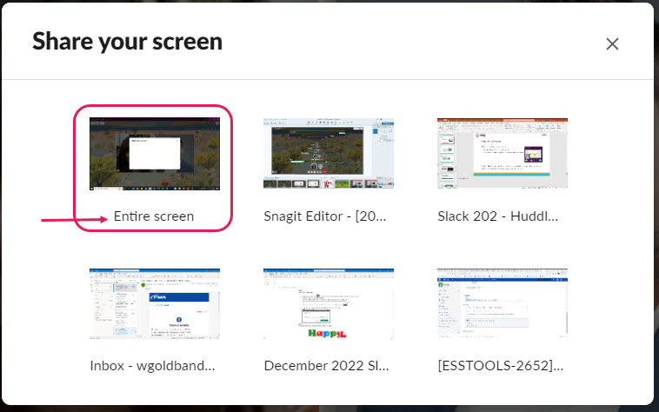
Share Screen – From Left Sidebar View
If you select to share your Entire screen (sometimes labeled Screen1), you will be taken directly to your working screen.

Slide 41
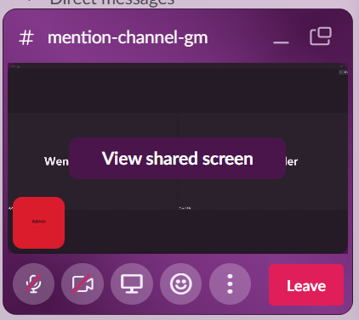
Share Screen – From Left Sidebar View
To see someone else’s shared screen:
Click on your View shared screen window in the Slack sidebar view.
It appears in the Large window view.

Slide 42
Share Screen – From Left Sidebar View
If you select to share a screen other than the Entire Screen (Screen 1), work from the screen you’ve actually shared.

Slide 43

Share Screen - From Large Window View
If in large window view --
  Select shared screen icon from toolbar at bottom.

Slide 44
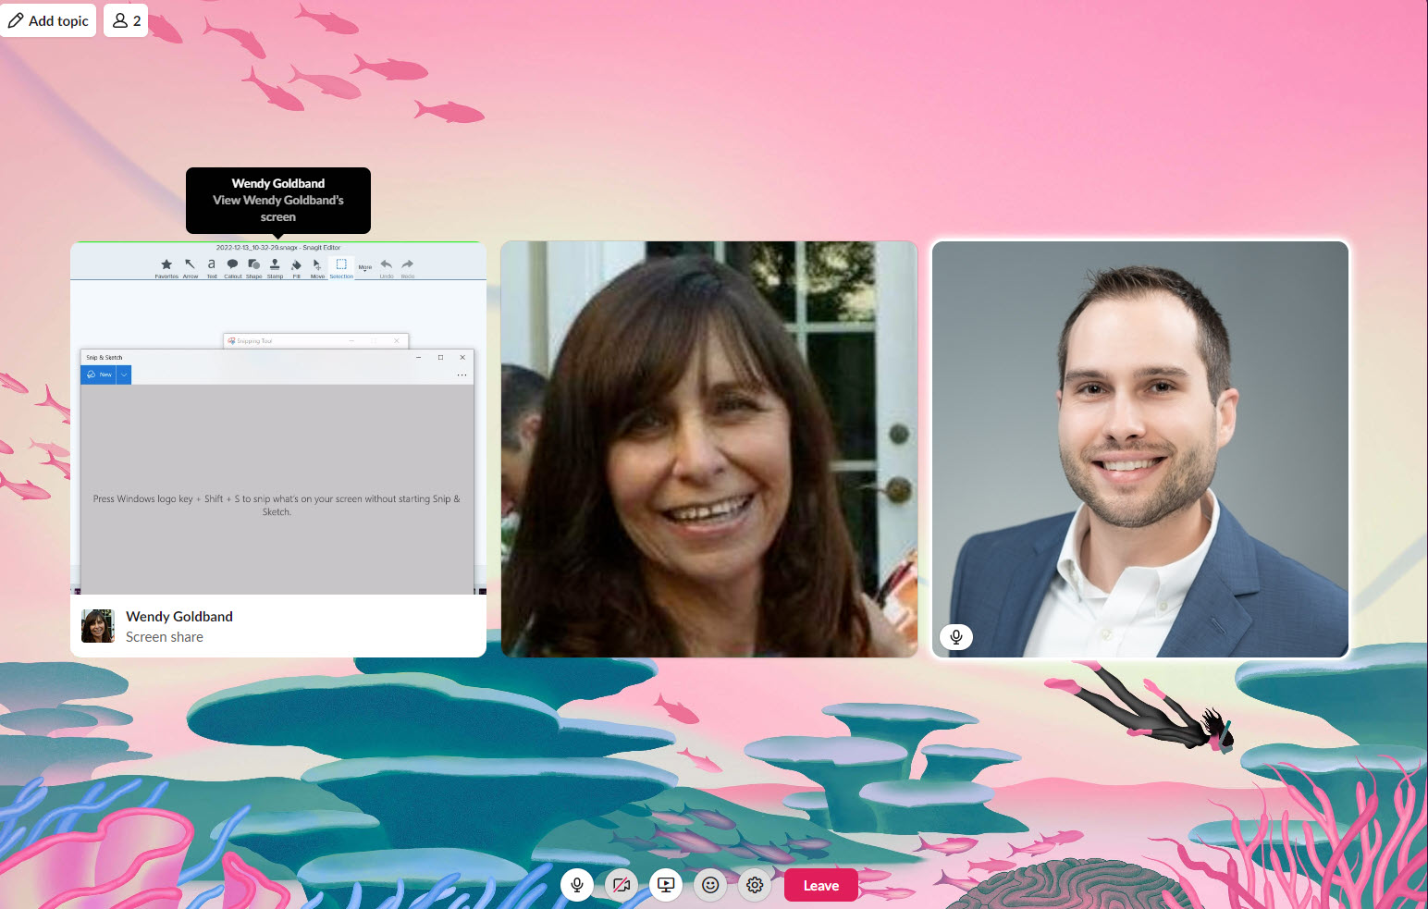
Share Screen - From Large Window View
If in large window view --
  Shared screen opens in larger window next to avatars.

Slide 45
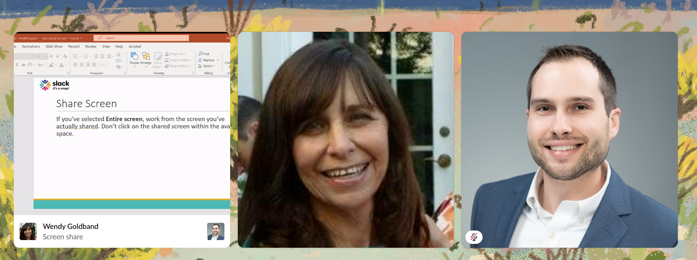
Share Screen From Larger Window View
If you’ve shared your Entire screen (screen 1) --
Don’t click on the shared screen within the avatar space! (We’ll show you why in the next 2 slides.)
Don’t Click!

Slide 46
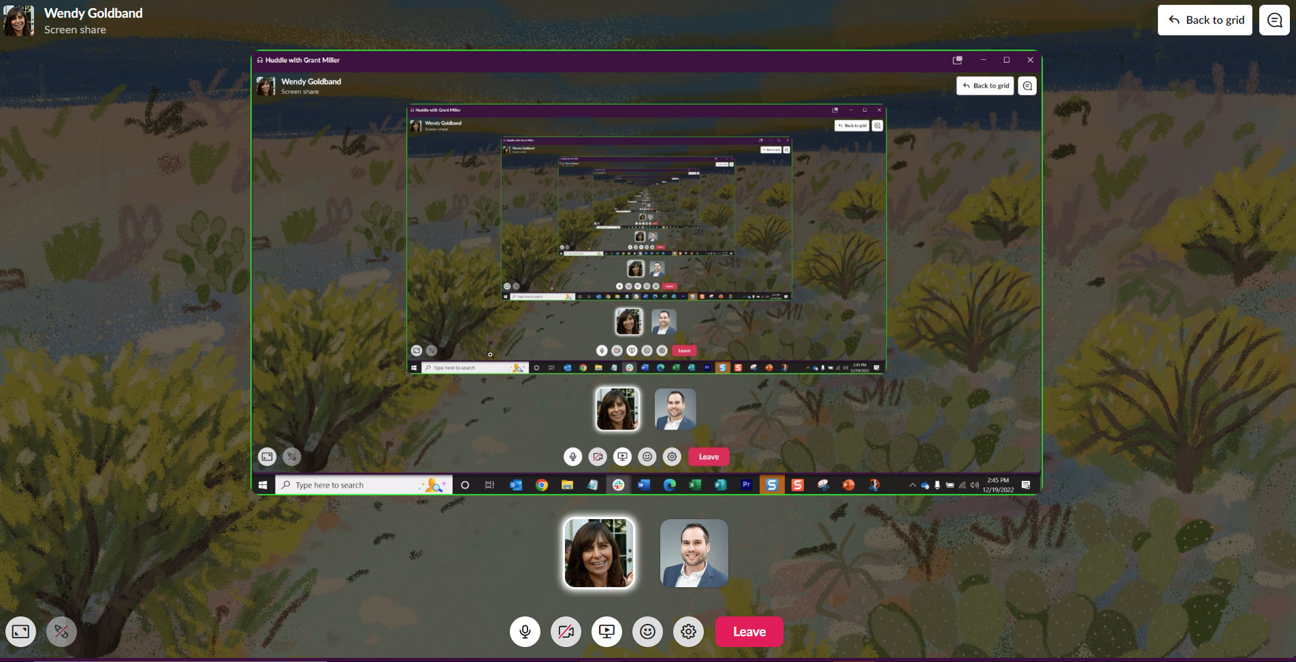
Share Screen - From Large Window View
  Careful! If you click on your shared screen in that avatar space, you’ll end up in an infinite loop of your screen share.

Slide 47

Get out of the endless loop
To get out of the endless loop, click Back to grid.

Slide 48
Share Screen - From Large Window View
You must work directly from the document you’ve chosen to share!
You cannot work from this screen.
Go directly to your document.

Slide 49
While Screen Sharing
Toolbar appears at bottom center of large window.

Slide 50
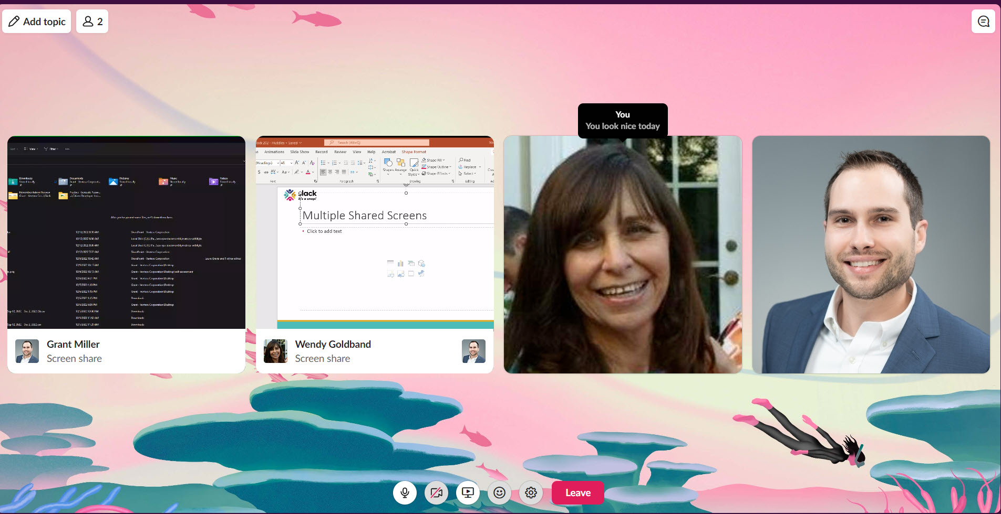
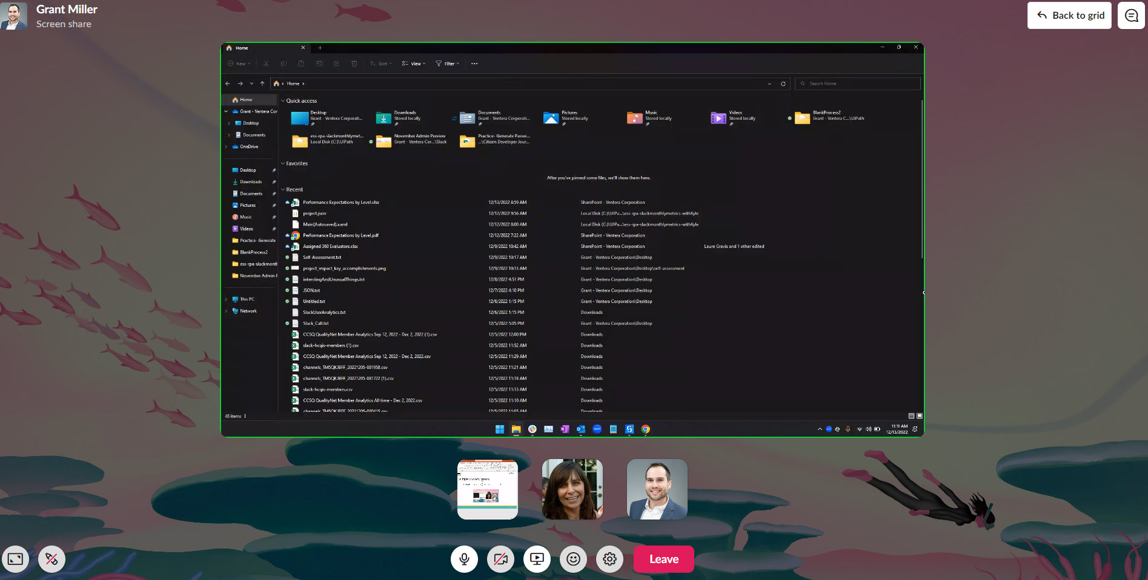
Multiple Shared Screens
Click on either shared screen view to see it enlarged.
You can toggle between the two shared screens.
Other shared screen

Slide 51
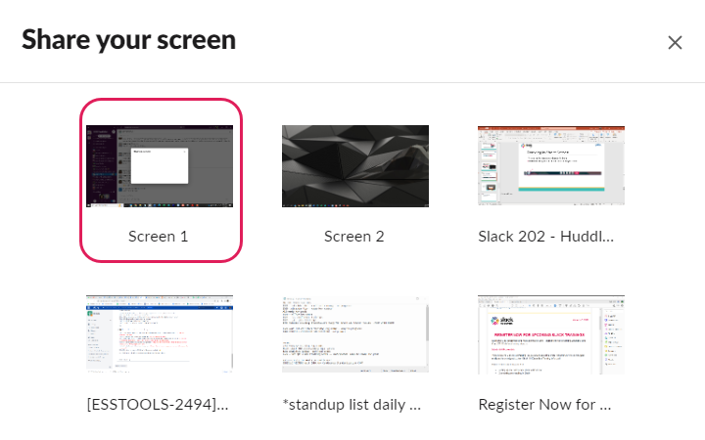
Drawing in Share Screen
You must select the screen 1 window (or in some cases it may say entire screen) in order to allow drawing on a shared screen.

Slide 52
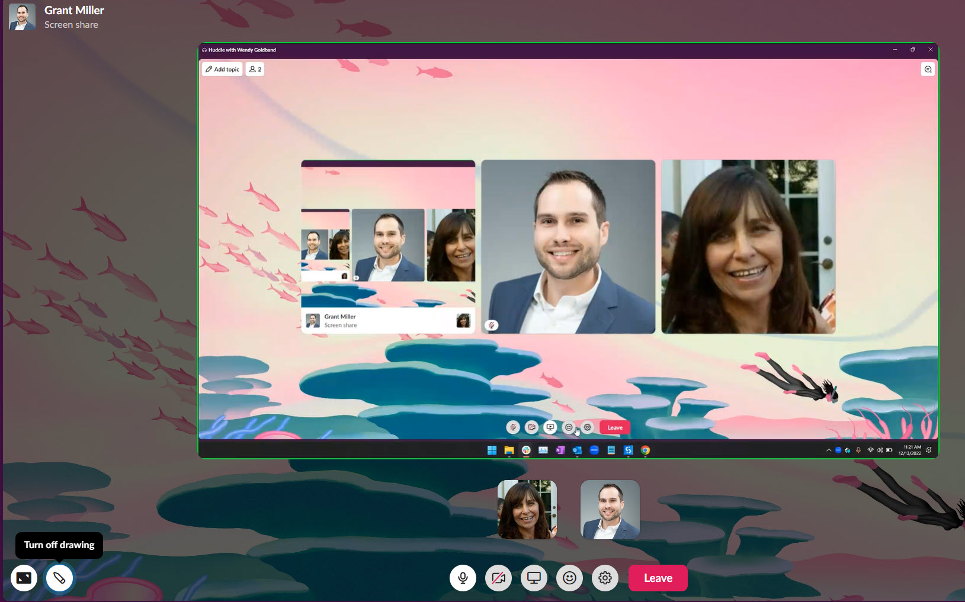
Drawing in Share Screen
Click on and enlarge desired screen to draw.
Draw Toolbar appears in bottom left of enlarged screen.

Slide 53
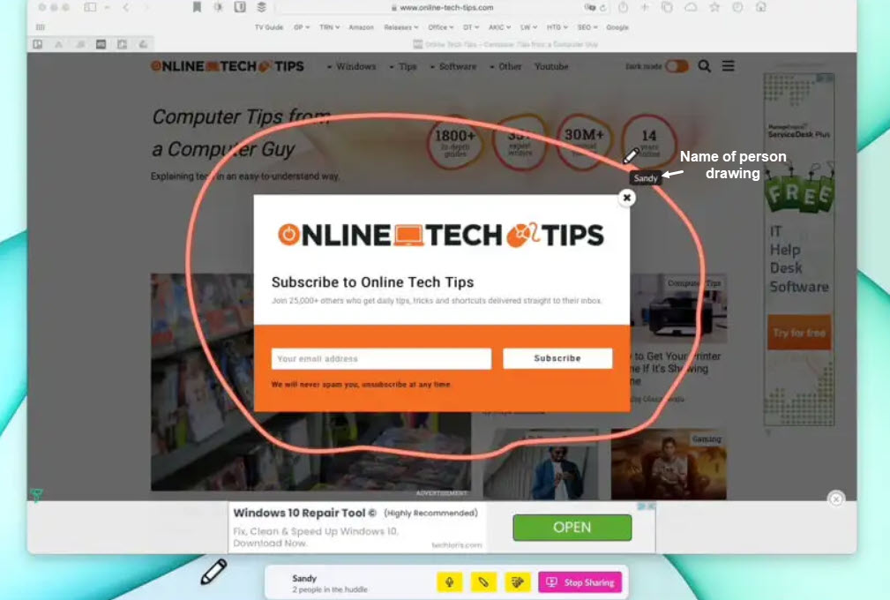
Drawing in Share Screen
Drawing appears briefly for everyone to see; then disappears. Drawing does not save.
** Note - All participants except the person sharing screen will see name of person drawing.

Slide 54
To Stop Sharing Screen
Select Stop Sharing in toolbar.

Slide 55
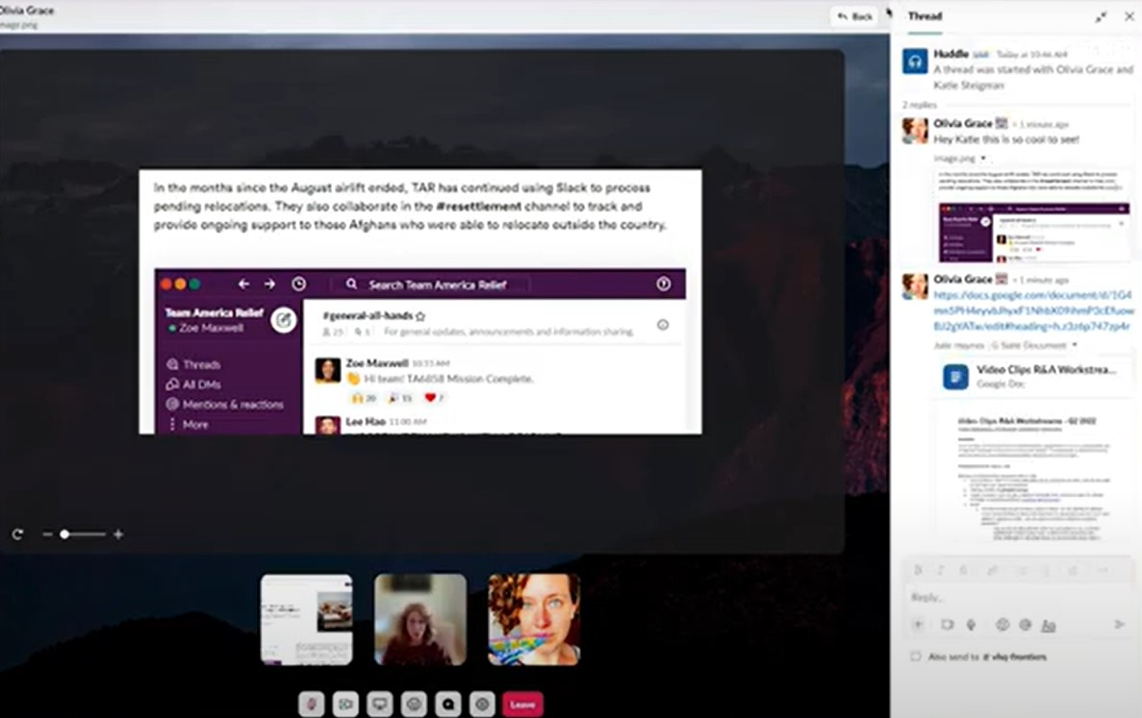
Option to use File or Screenshare
File viewed in larger screen
Shared file in Thread
Can share file in channel rather than thru Shared Screen when you attach it.
File will appear in Thread.
Click on file in Thread to view in larger screen.

Slide 56
Add Reactions
Emojis, effects, or stickers
Appear to everyone
Reactions and effects temporarily appear.
Stickers remain until removed.

Slide 57

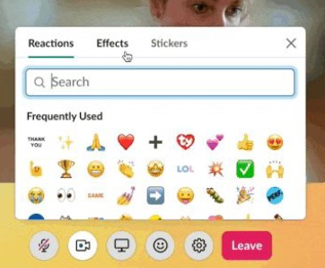
Add Reactions
Steps
Click the emoji icon on your toolbar.
Click the Reactions, Effects, or Stickers tab to make a selection.

Slide 58
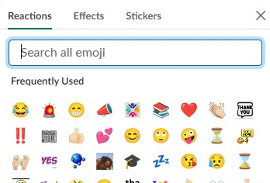
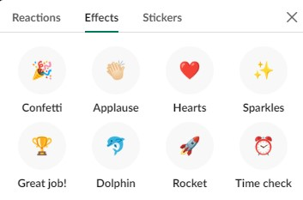
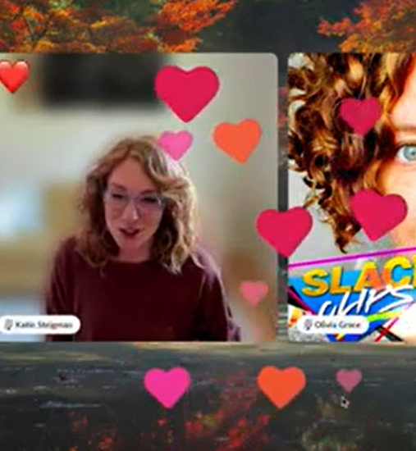



Add Reactions
Emojis
  Reactions tab
  Temporarily appear on your avatar
Effects
  Effects tab
  Send an animation across the window
  Temporarily appear
  Some have sound
Stickers
  Stickers tab
  E.g., “Raise hand”, “Yes”, “No”
  Remain until removed
  Appear on your avatar

Slide 59



Captions
Transcribe all conversation taking place in real time.
Click More options “3 ellipses”. Or click Settings cog from large window.
Click Turn on captions.
Click Captions tab in upper right sidebar.

Slide 60


Captions

Slide 61
Captions
**Captions do NOT save once the Huddle ends. Only Threads automatically save.
To save Captions for a complete transcription of your Huddle:
Copy/paste the Captions before ending the Huddle.

Slide 62
Navigating Between Views

Slide 63

Return to Large Window
Click Back to Grid.

Slide 64
Return to Slack Sidebar View
Click x at top right of screen.
Brings view down to Mini window.

Slide 65

Return to Slack Sidebar View
Click mini window icon in lower left Slack sidebar view.
Mini window now pops back into sidebar view.

Slide 66

Leaving a Huddle
Click Leave button

Slide 67
Help and More Information
#help-slack
#announcements-slack
Also refer to the Slack Confluence space for in-depth resources and information at: https://qnetconfluence.cms.gov/display/HS/QualityNet+Slack
Feedback Survey Link --https://www.surveymonkey.com/r/95SJKHB

Slide 69
REMINDER! Do NOT Access QualityNet Resources from Outside the U.S.
Lately, there has been an increase in the number of users accessing QualityNet resources from outside the United States (U.S.). This is particularly evident for the Slack application. This notice is a reminder that contractual requirements and security policy prohibit this type of access. When access from outside the U.S. is detected, the user’s HARP roles will be removed (i.e., access will be disabled) until the investigation is complete and the user returns to the U.S. It is recommended that you remove the Slack app from your phone if you are traveling abroad and reinstall it after you return to the U.S. If this is not feasible, you must log out of CCSQ Slack before you leave the U.S. and do not log in again until you return. Take these steps to ensure you are logged out from all devices: From your desktop, navigate to your Account settings by following this link: https://my.slack.com/account. Click Sign out all other sessions and follow the prompts. Thank you for your attention and cooperation. If you have any questions, please reach out to your CMS Information System Security Officer (ISSO) or Contracting Officer’s Representative (COR).

