Slide 1
CCSQ QualityNet Slack
Slack 101 Essentials

Slide 2
Login to CCSQ QualityNet Slack
Navigate to hcqis.slack.com
Log in using your HARP or EUA ID
Open the Slack app.
Join us in #qnet-slack-training-August15 channel!
Find the channel by typing in qnet-slack-training in the search bar at the top of the Slack screen.
Click the green Join Channel button.
**PLEASE NOTE: While sharing your screen, please be aware that if you have access to sensitive information in Jira and/or Confluence, it could inadvertently pop up.

Slide 3
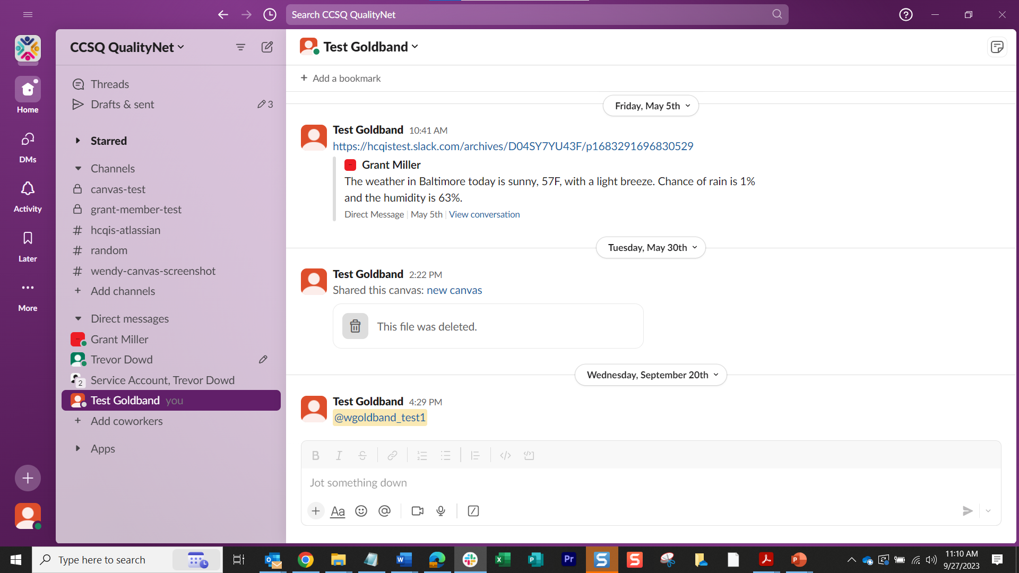
What is Slack?
A real-time collaboration platform
Connect with individuals and groups
within the CCSQ community
  Screen share
  Direct private messages
  File share
  Video calls
  Channels (similar to chat rooms)

Slide 4
The Big Picture – What is a channel?
Channels are dedicated spaces that organize conversations.
Channels bring order and clarity to work — you can create them for any project, topic, or team. With the right people and information in one place, teams can share ideas, make decisions, and move work forward.

Slide 5
Channels have a variety of uses
Projects
Team meetings
Work groups
Sharing documents and collaboration
Sharing screens
Private messages between individuals
Video calls
“Hey, are you coming to this meeting?”
Notes:
SKIP TO SLIDE 7 THE BIG PICTURE and SHOW SLACK SCREEN

Slide 6
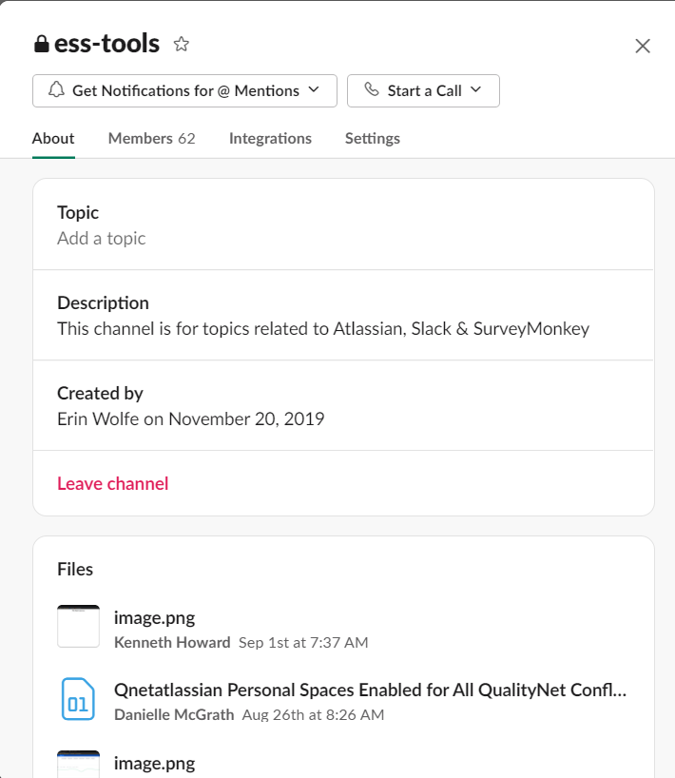
Project Channel
Work on specific projects with project teams
Share ideas, make decisions, and move work forward
Add a topic and description of your project
Attach needed files
Add members
Use the @ symbol to mention someone if you have a question or need something approved

Slide 7
Important Concepts
Workspaces | A Slack workspace maps to an organization or a department—think of it as an office building that you need to be invited into. The Slack desktop and mobile apps allow you to log into multiple workspaces at once.
Channels | Channels are like large conference rooms or offices inside the office building, and can be created for any project, topic, or team. Channels can be public, meaning anyone in the workspace can read or join, or private. Channel names always start with a # (pound sign or hashtag).
Direct Messages | Direct messages (also known as DMs) are smaller conversations in Slack that happen outside of channels. DMs work well for one-off conversations that don’t require an entire channel of people to weigh in, like if you wanted to ask a teammate to reschedule a meeting. You can DM a single person, or several people at once.
Conversations | Channels and direct messages are structured similarly in Slack. We refer to them jointly as conversations.
Threads | Threads help you create organized discussions around specific messages within a conversation.
Mentions | Mentions are a direct way to notify people of something that needs their attention in Slack. They start with an @ (at symbol).
Reactions | An emoji reaction can be attached to a message to replace the need for a follow-up message. You can add multiple emoji reactions to a message.

Slide 8
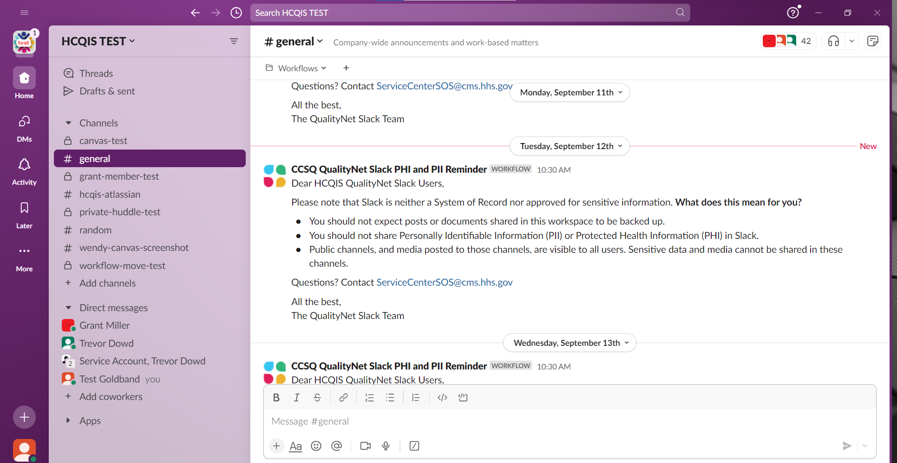
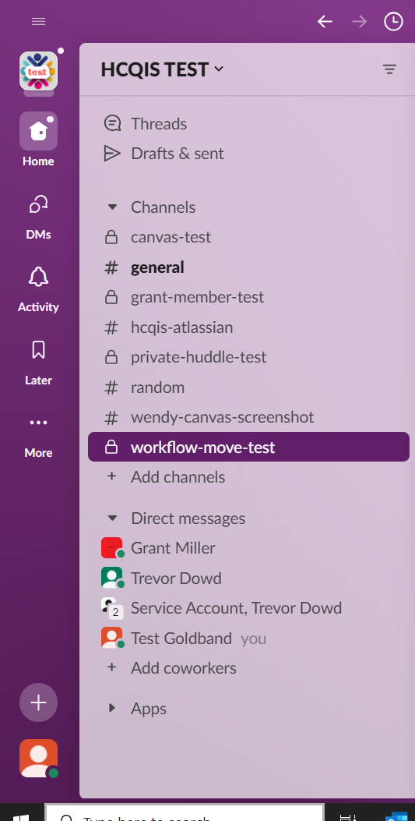

The Big Picture
CCSQ QualityNet Workspace
Name of channel you’re viewing
Search Bar
Canvas
CCSQ QualityNet
Bookmark Bar
Channels
Create Button
Message Composition Box
Your Profile

Slide 9
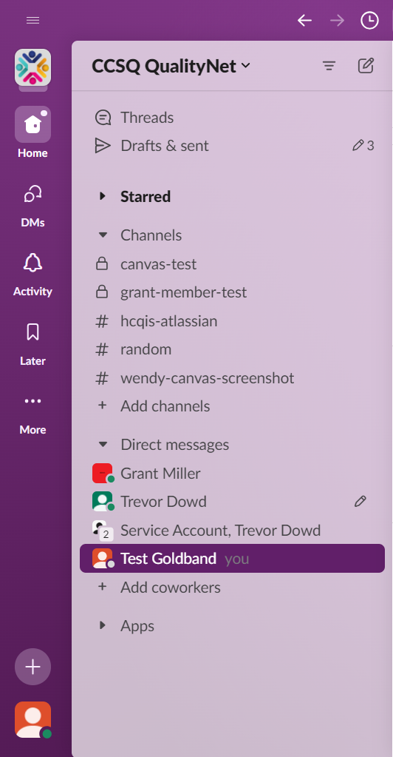
Left-Hand Navigation Panel
Workspace Name
Identify if you are in CCSQ QualityNet workspace (CCSQ community and contractors).
Workspace Menu
Find your profile, account settings, and more.
Filter
Narrow down what activity
you’d like to view.
Workspace Icon
Identify if you are in CCSQ QualityNet workspace. Click and toggle to switch to another workspace to which you belong.
Threads
Read side conversations and replies in conversations you follow.
Home
See all your conversations in both channels and DMs.
Drafts & sent
View messages that you’ve started drafting, but not yet sent. Also view Scheduled and Sent messages.
DMs
A list of all DMs that can be searched and filtered.
Starred
Star channels or DMS to bring them to the top your list.
Activity
View all your mentions, reactions, threads, and app notifications.
Channels
Collaboration happens in channels, open to anyone in your workspace.
Later
View your reminders and saved messages in one place. The folder is divided into In progress, Archived, and Completed tabs.
Private Channels
Invite others to confidential conversations in channels signified by a lock icon.
More
View canvases, files, workflows (located in Automations), people and user groups, and more.
Direct messages
Talk 1:1 or in groups up to 9 people.
Create button
Kick off a new huddle, canvas, message or channel.
Profile
Your profile information and Preferences settings.

Slide 10
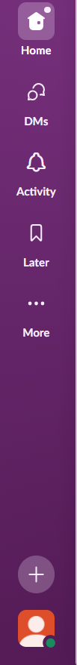
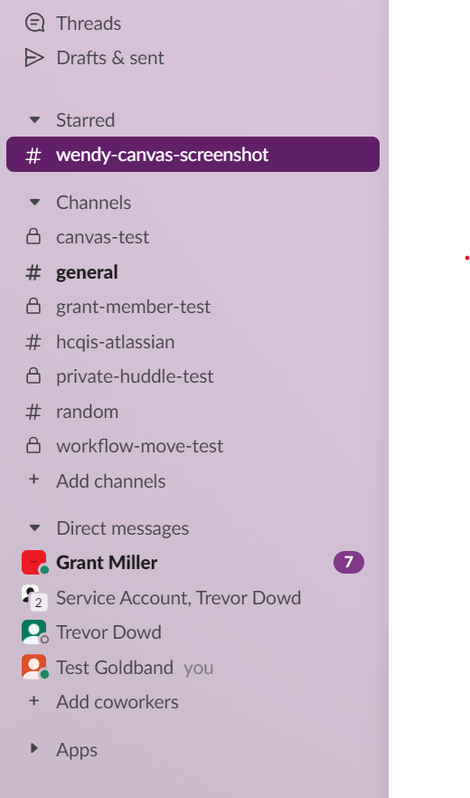

# Channel Icons
Public Channel Signified with
a pound sign.
Private Channels signified
with a lock. Members by invitation only.
Unread channels are in Bold text.
Unread direct messages are both bold and have a number
in a badge to the right signifying number of messages waiting to be read. After viewing the messages, the number disappears, and the channel name is no longer bolded.
You can also go to Activity to view any mentions of you, threads, or emoji reactions to your messages.

Slide 11

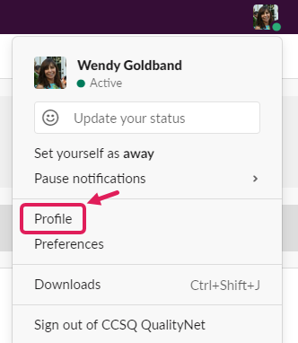
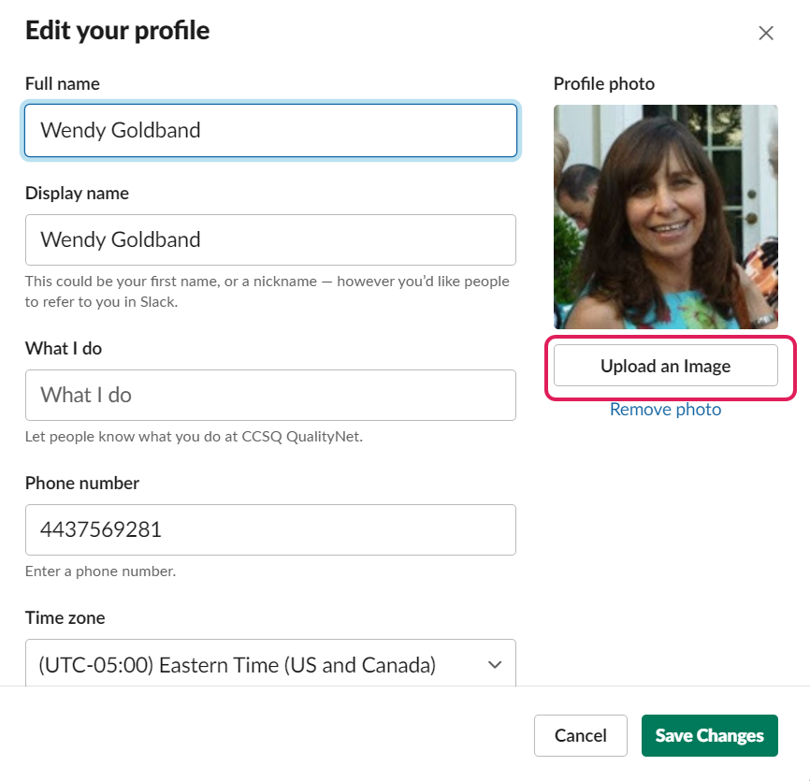
Profile
Navigate to your profile icon.
  Bottom left-hand navigation sidebar.
Click Profile in dropdown box. Then click
Edit Profile in the next dropdown box.
Fill in the Display name you’d like to use.
  Must be standard first name/last name format.
  No initials
  No numbers
  No unidentifiable nicknames like Shorty, Superman, or Pwxn
  No symbols like %&?!
Profile photo on the right. Click Upload an Image to
personalize your Slack messages.
Click Save Changes green button.

Slide 12
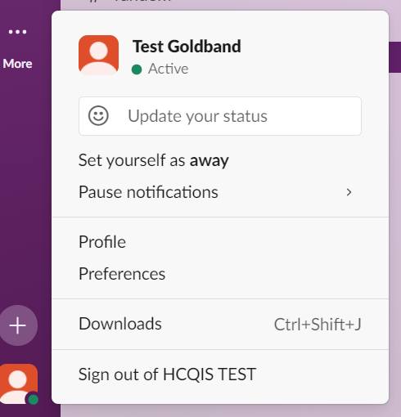
Preferences
Navigate to your profile icon.
  Bottom left navigation panel
Click Preferences.
  Preset with defaults. Let’s change a few things.

Slide 13
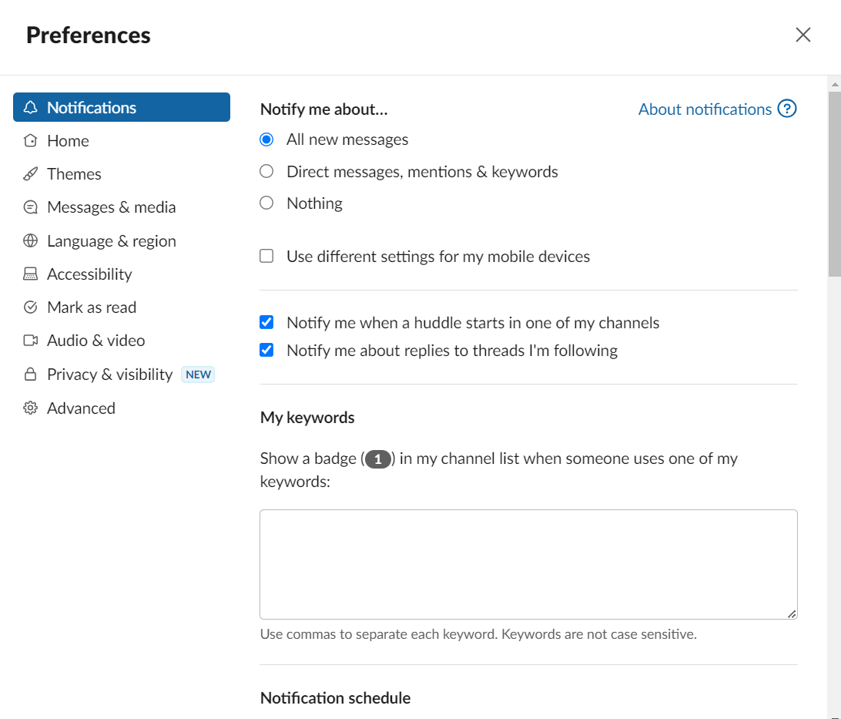
Keywords
Select keywords you’re interested in that might be mentioned in any
CCSQ QualityNet Slack channel
Enter in My Keywords box
Keywords send alerts (message notifications) in the channel

Slide 14
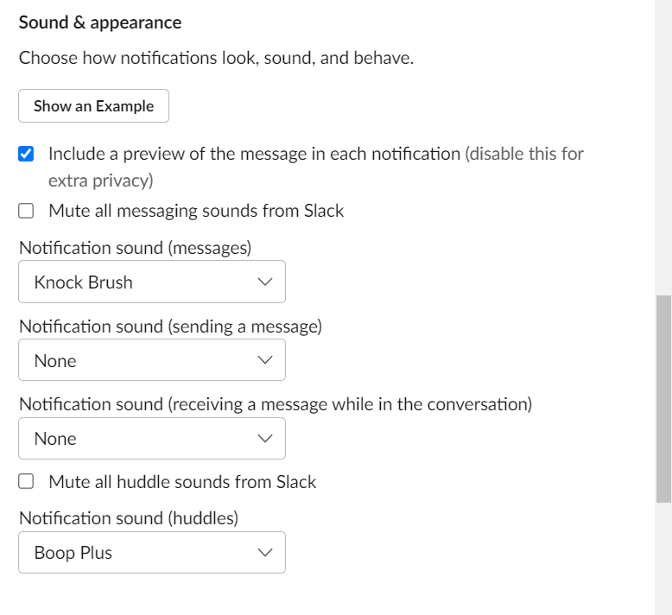
Notification Sounds
Notifications for direct messages (DMs) make
a sound.
You can make it silent if you prefer. However, the idea behind Slack is that it’s instant messaging so it’s logical that you’d want to know about your DMs right away. Examples:
  “Are you coming to the meeting?”
  “Can you help me with this problem for a minute?”
Notification sound automatically set to knock brush
  Can change to a different sound
Sound can also be changed for Huddles.

Slide 15
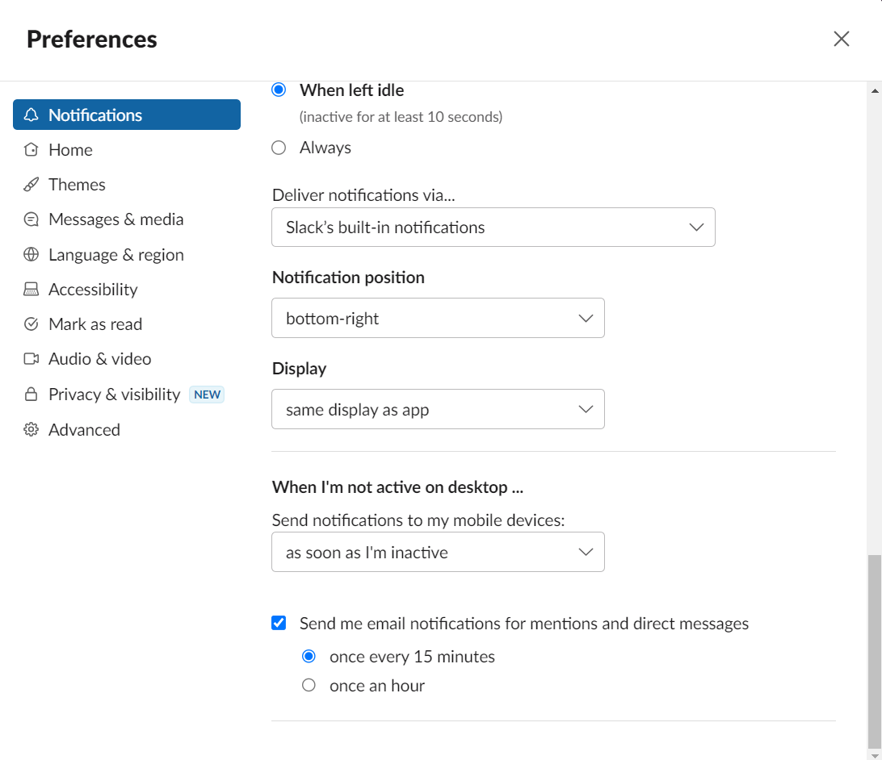
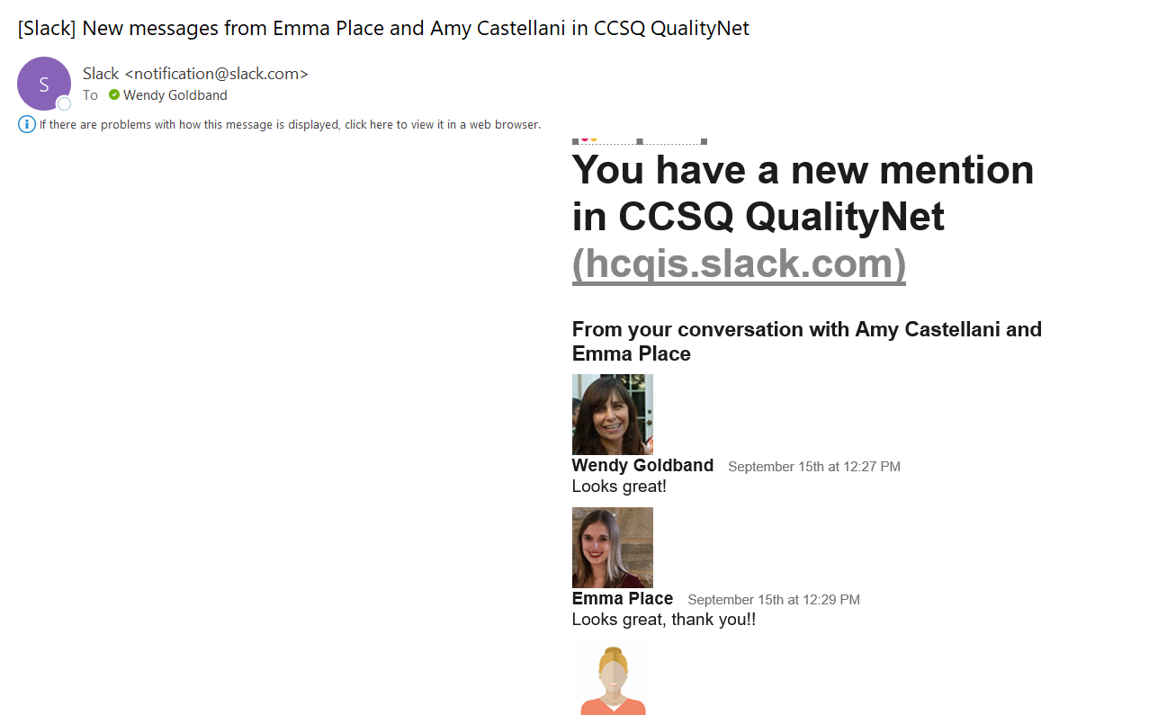
Message Notification
Click Notifications. If you don't open and view the direct message after 15 minutes, default is set to notify you by email. Scroll down to When I’m not active on desktop…
  Option to change the default from 15 minutes to no notification or different length of time.
  (Slack) New message from “Name of person/.”
Notes:
SKIP – GO TO SLIDE 16

Slide 16
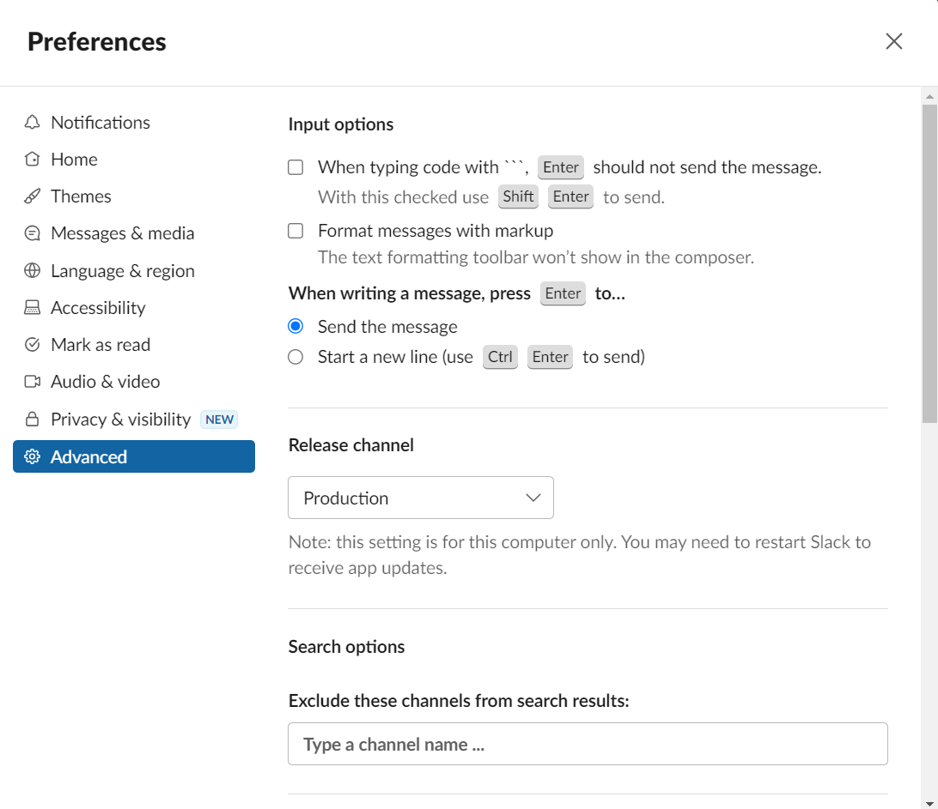
Press Enter
Travel to Advanced tab
Scroll to When writing a message, press Enter to…
Select how you’d like to use the Enter key when composing messages.

Slide 17
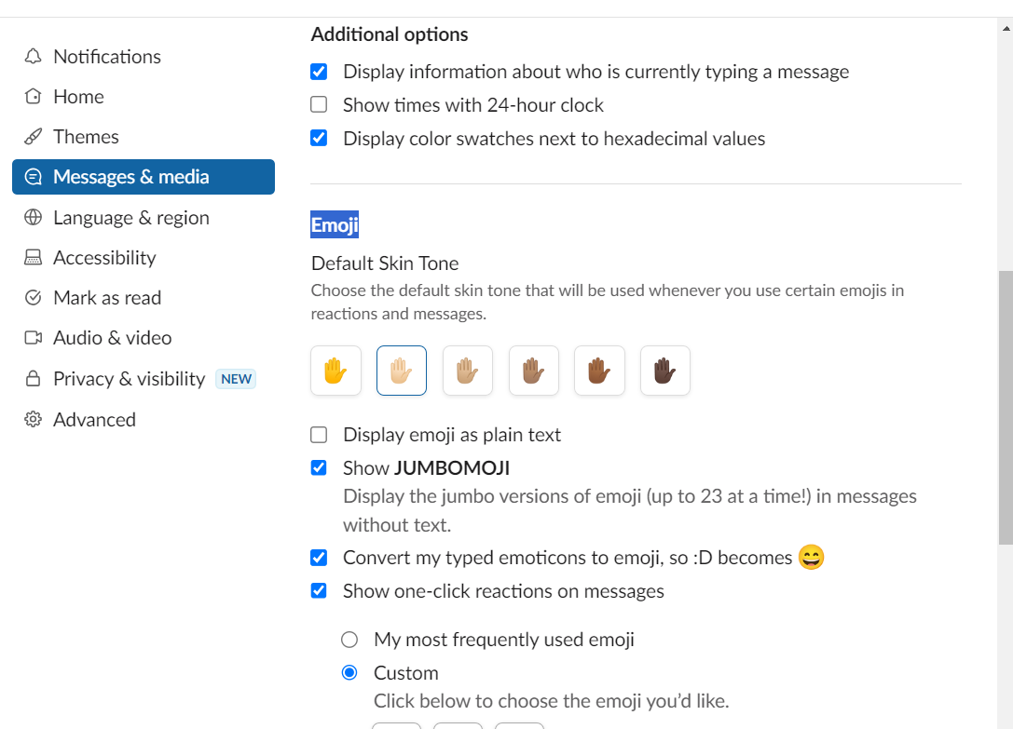
Colors
Click Profile.
Click Preferences.
Click Messages & Media.
Scroll down to Emoji.
Select different emoji options.
Can choose other options on this tab including:
  Clean or Compact
  Bring emails into Slack

Slide 18
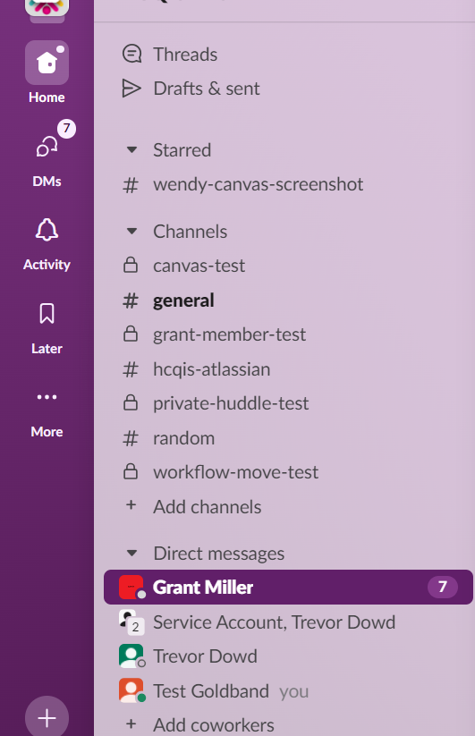
Direct Messages (DMs)
Someone mentions you and tags you with the @sign -- @yourname
Someone sends you a message specifically addressed to you
When preferences are set to specifically notify about messages in a channel or keywords
Get notified whenever there's a direct message
  Channel or name of person is bolded on the left-hand navigation panel
  Number of unread messages on right side of channel name in circular badge
Direct messages are private!
  Only the individuals addressed can read the message
Multiple people (up to 9) can be on a DM
Find all DMs in 2 folders:
  Click DMs icon
  Click Activity icon

Slide 19
@Mentions (Direct Messages)
Known as a Direct Message (DM)
Powerful way to get the attention of someone
Small, private conversations that happen outside of channels
They get notification that you’d like them to view your message
Perfect for private conversation with one person or up to 9 people
Click on a colleague’s name to send them a message
Notes:
SKIP – GO TO SLIDE 16

Slide 20
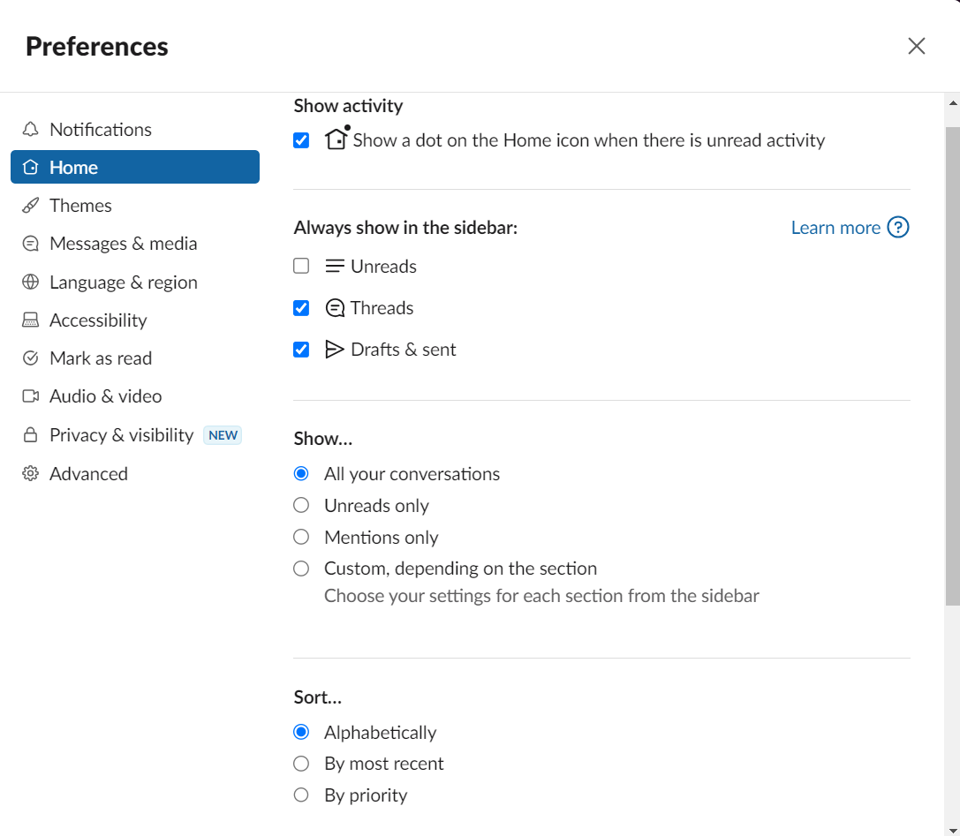
Message Visibility Preferences
Select which messages display
Click Profile
(bottom left navigation sidebar)
Click Preferences.
Click Home.
Scroll down to Show.
Select your preferred option.

Slide 21
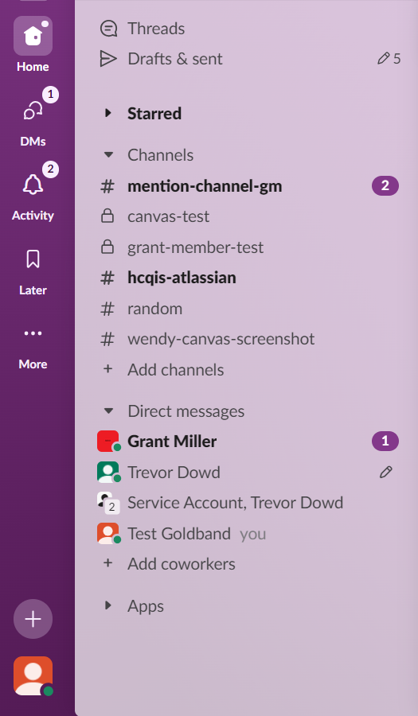
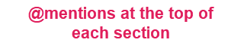
@Mentions Sort to Section Tops
@Mentions sort to top of each section.
Once @Mention is read and you move on from the channel, that channel goes back down to original position.
@Mentions also are found in the Activity folder.

Slide 22
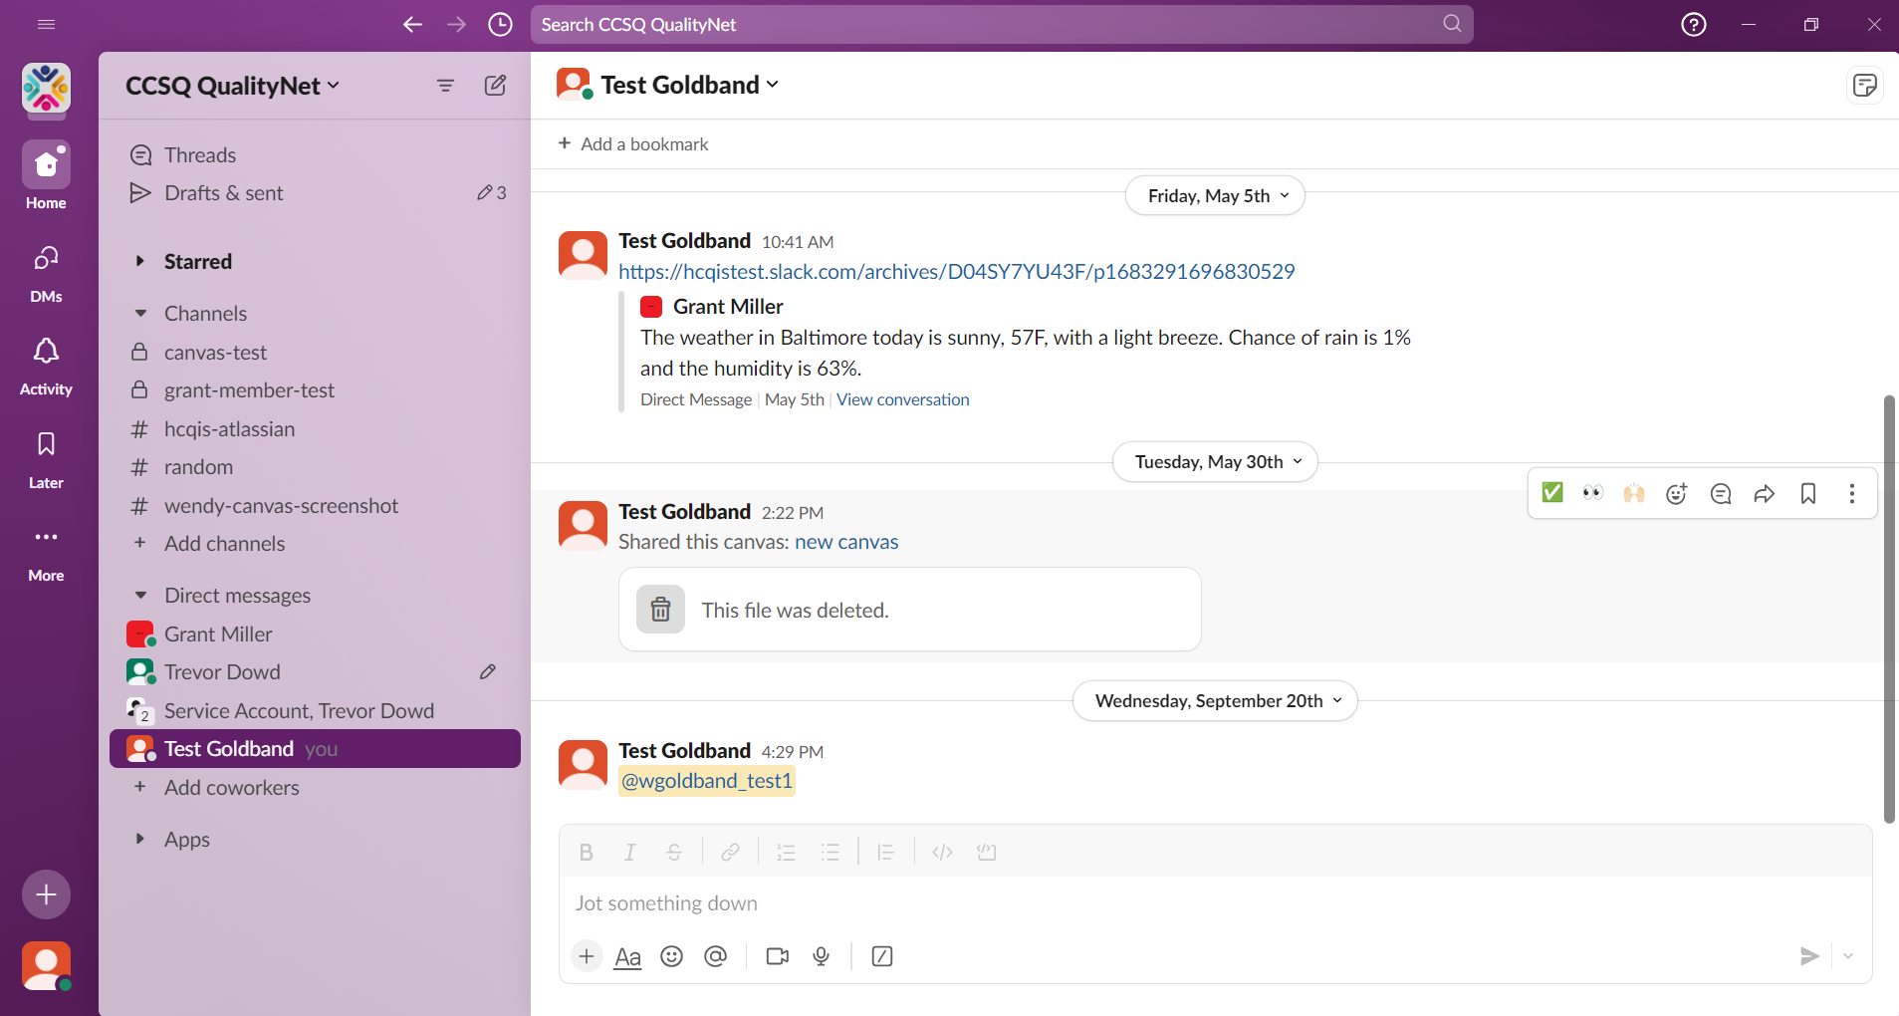
How to Compose a Message in a Channel
Click the channel name and start composing in the white message box at the bottom of the channel message stream.
Composition box for
sending message inside channel

Slide 23
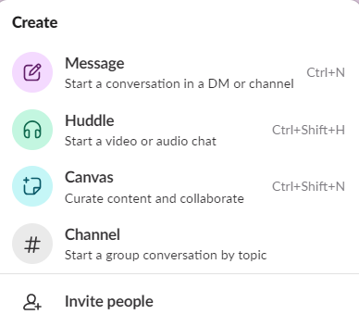
How to Compose a Message to a Specific Individual
Click New Message icon.
Or
Click Create button
Select Message in pop-up window.

Slide 24
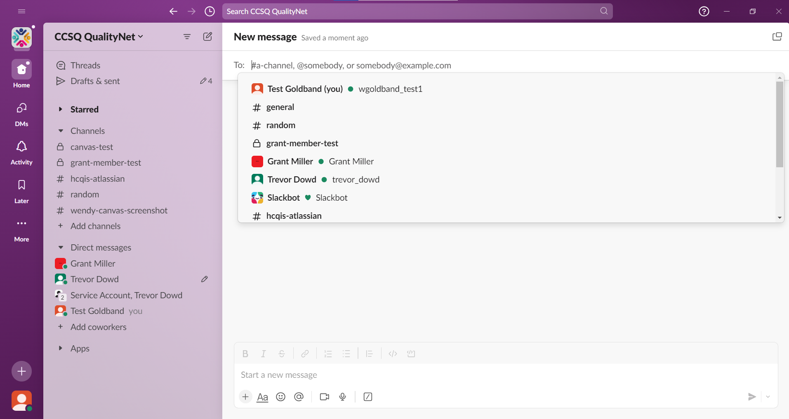
Message To Specific Individual(s)
Fill in name of person.
Name will pop up.

Slide 25
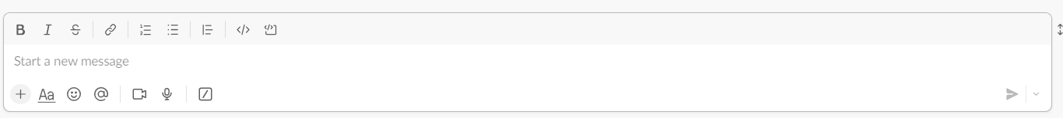
How to Compose a Message
Messages
Write and send messages
Formatting Toolbar
Appears after Formatting icon is clicked.
Send
Click to send your message
Attachments
Click to add attachments up to 1GB in size
Emoji
Add an emoji (or two) to your message
Mentions
Find people you want to mention in messages
Video Clips
Record a video message
Audio Clips
Record an audio message
Shortcuts
Click for shortcuts like GIFs
Formatting
Click to open text formatting toolbar

Slide 26
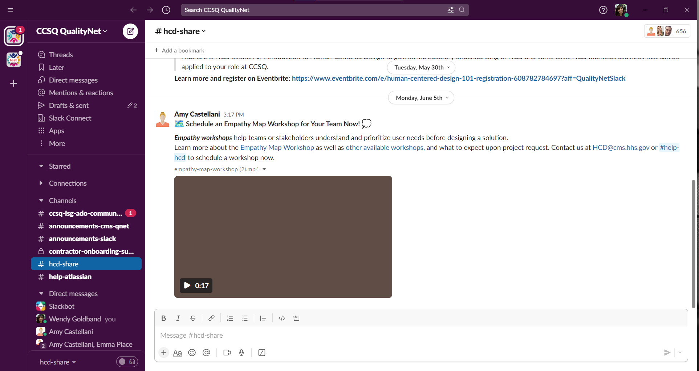
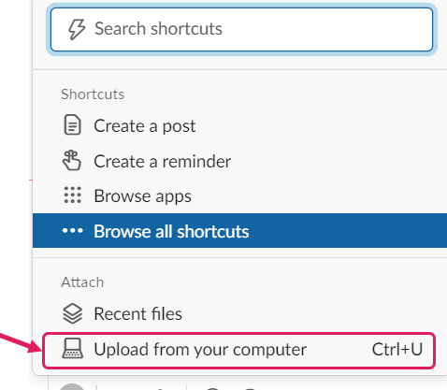
Attachments
Attachments (up to 1 GB) are inserted using the + sign.
Click the plus icon and select Upload from your computer.
Alternatively, you can double-click on the plus icon and upload faster!
You also have the option to drag and drop files into the message field.

Slide 27

Try sending me a DM!
I will reply back!

Slide 28
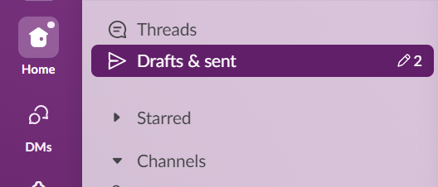
Drafts are Never Lost
Unfinished messages are in the Drafts folder.
Number to the right shows how many drafts are awaiting completion.
TO DO:
Compose a reply to me, but don’t send it. Move to another channel. Now look for the draft. You’ll find it in the Drafts folder.
Unfinished messages

Slide 29
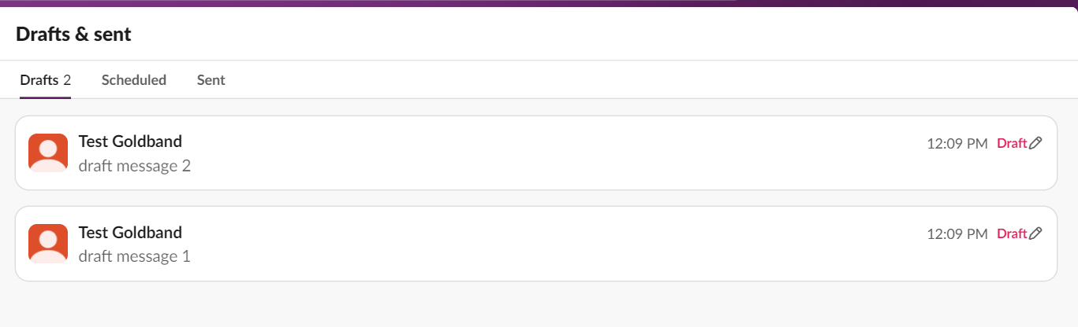
Tabs in Drafts Folder
3 Tabs
Drafts
Scheduled
Sent

Slide 30
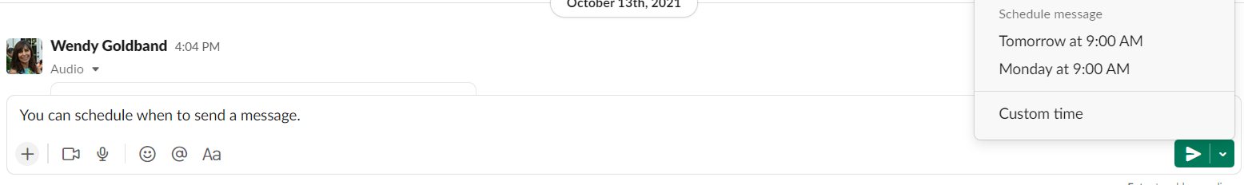
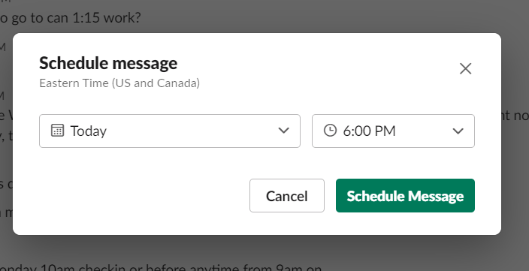
Schedule Message
Scheduled messages will wait indefinitely until they are sent.
They can be edited or deleted.
Click green dropdown arrow

Slide 31
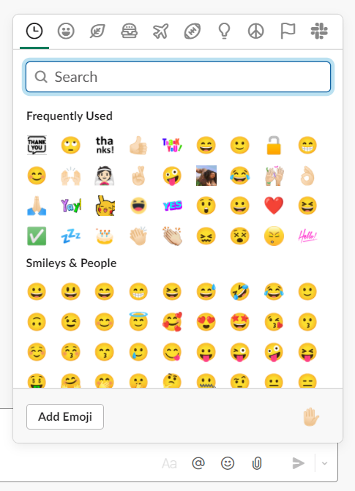
Emojis
Fun and efficient
  Don't have to write words
  e.g. Send a thumbs up if you like what was said.
Emoji box pops up to your right
Search for desired theme

Slide 32
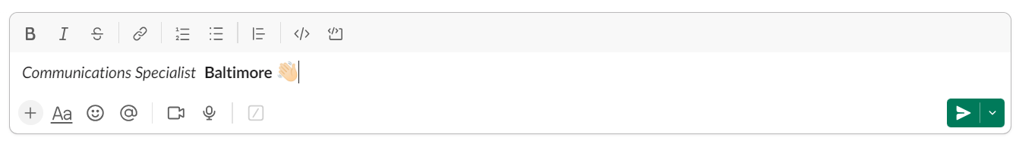
Let’s Try This In Channel
Write your role in Italics
Write your location in Bold
Add an emoji
Send

Slide 33
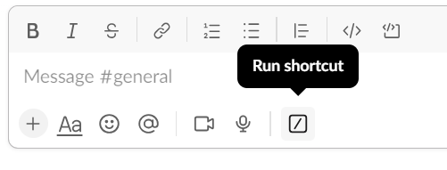
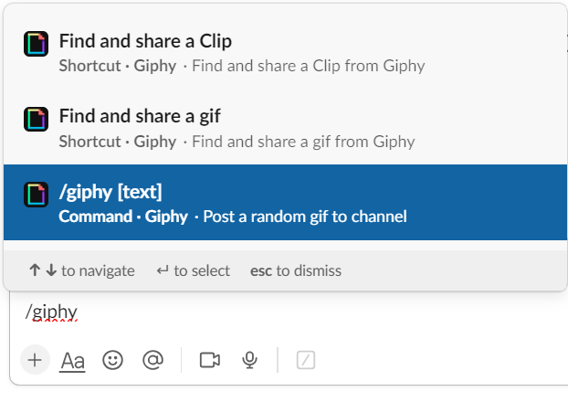
Giphy App & Online Library of Animated Gifs & Stickers
1.Click
3. Select
Click on the shortcuts slash icon in message field
Enter the word giphy in pop-up box
Select find and share a gif
2. Enter word giphy

Slide 34
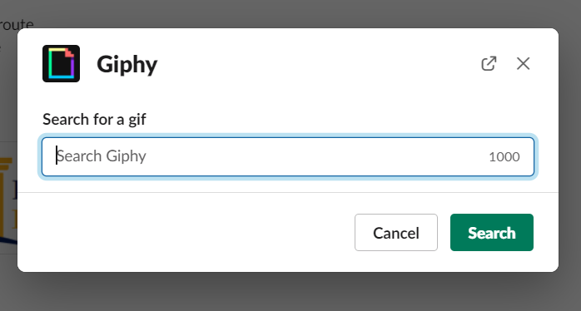
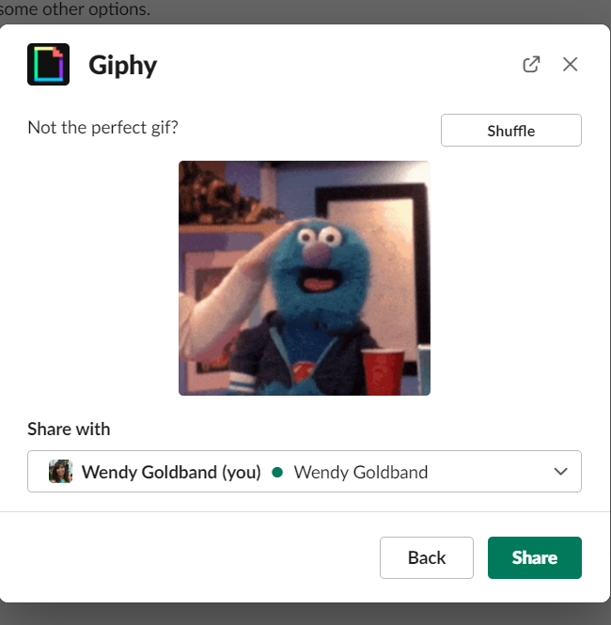
Giphy App
Fill in type of gif you’d like to search
Click Search
A gif will load into your message box
Don’t like the selection? Then search for another by clicking Shuffle
Once you find the animated gif you like, click Send

Slide 35

Huddle
Huddles include:
Screen share
Annotation
Video
Multi-person screen sharing, drawing and cursors
Fun, relaxed atmosphere filled with your favorite emoji, reactions and “stickers”
Message thread that automatically saves to channel
Up to 50 participants
Notes:
SHOW THIS SLIDE TO DEMO THE COMMANDS

Slide 36
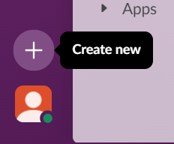
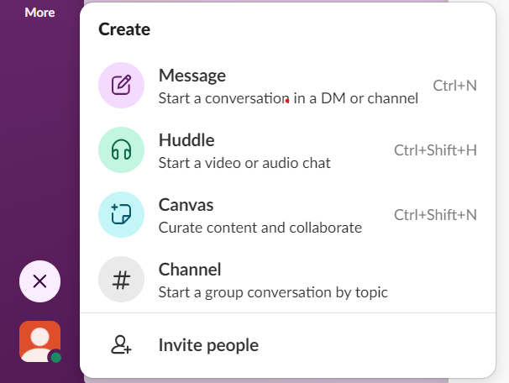
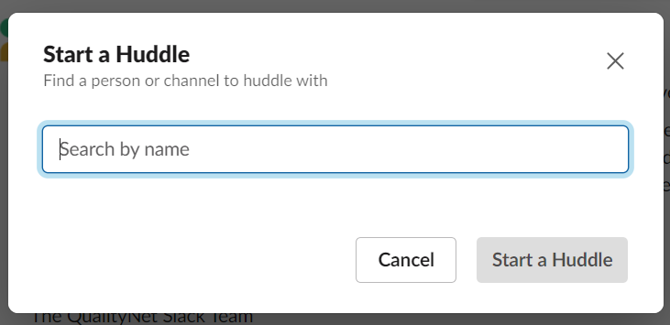
Start a Huddle
Click the Create new button to start a Huddle.
Select Huddle in the pop-up.
Fill in the person(s) or channel you’d like to huddle with.
Click Start a Huddle

Slide 37
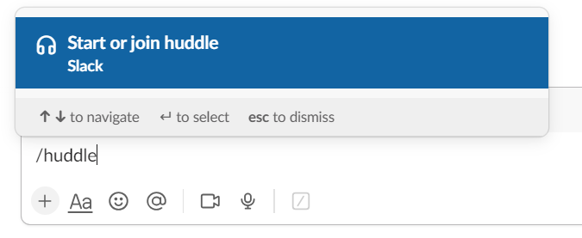
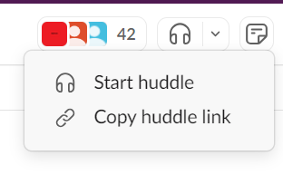
Huddle Start Alternatives
Click the shortcuts command and fill in /huddle.
Click the Huddles icon at the top right of a channel to hold a channel huddle.

Slide 38
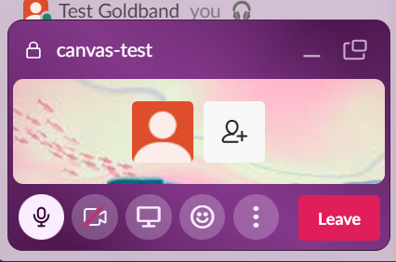
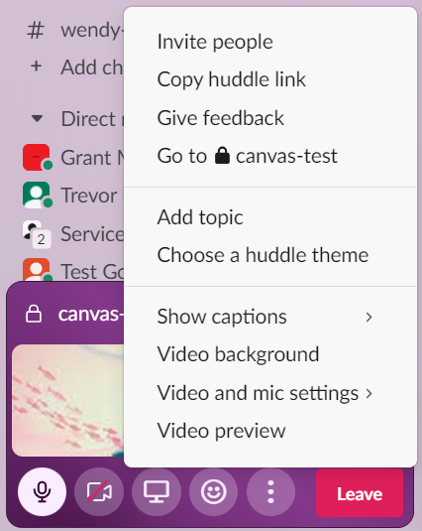
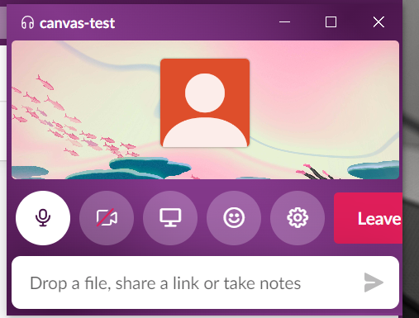
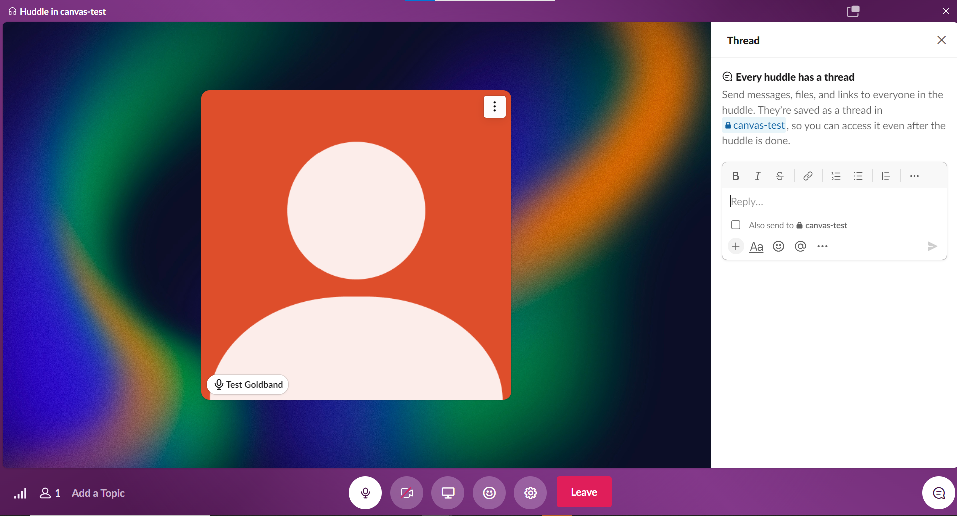
Huddle Windows
Open mini-window
More options pop-up
Mini-window pop-out in upper right corner
Mute
Video
Screenshare
More options
Emojis & reactions
Large window view
Thread
Notes:
SHOW THIS SLIDE TO DEMO THE COMMANDS

Slide 39
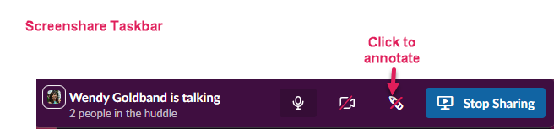
Huddle Toolbars
Large Window Taskbar
Invite people
Hide thread
Notes:
SHOW THIS SLIDE TO DEMO THE COMMANDS

Slide 40
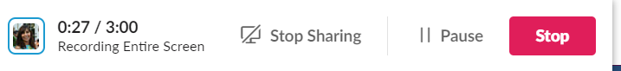
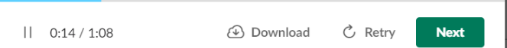
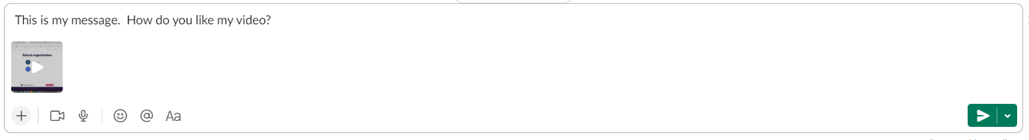
Recording a Video Clip
From a channel or (DM), click the camera icon in the message field.
You can either record yourself speaking or a screen you’d like to share. Select with a click. You can also start sharing once you’re recording and stop sharing at any time.
Click Record.
When you’re finished, click Stop.
You will now have the option to re-record, by selecting Retry. You will also have the option to download your recording
When complete, click Next and add a message if you’d like.
Click the paper plane icon to send your clip

Slide 41
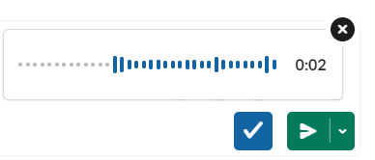

Recording an Audio Clip
From a channel or DM, click the microphone icon in the message field. Slack will start recording automatically.
When you’re finished, click the blue check mark button to stop recording.
Add a message if you’d like, then click the paper plane icon to send your clip
.

Slide 42


Reminders
Set reminders about conversations, tasks, etc.
Hover over conversation and click the 3 More Actions dots on toolbar that pops up in upper right of message.
Click Remind me about this.
Select time.
Alternative options include:
  Select Mark unread.
  Select Add to my TODOs.
  Select Add ToDo and Edit.

Slide 43


Protect Your Time – Set Your Status
Click your profile
Click Update Your Status
Select the status emoji
Emoji will be placed next to your name in the left sidebar

Slide 44
Protect Your Time – Away Status
Click your profile
Select Set yourself as away

Slide 45

Protect Your Time – Pause Notifications
In a meeting?
Click your profile
Click Pause Notifications
Select time or customize

Slide 46
Canvas
Every channel has a dedicated canvas all its own.
Think of it as a bulletin or announcement board.
Canvas is accessed in upper right of every channel and Direct Message.
Can also create stand-alone canvas.
Share in any channel, conversation, or Huddle to co-edit or get feedback.

Slide 47
Why Use Canvas?
Share your canvas to involve multiple editors.
Leave comments on canvases.
Mention people in the body of a canvas to notify them.
Add meeting notes
  There’s a Meeting Notes template you can use, or create your own.
Add action items.
Drag and drop content like files, images and videos.
Embed data from third-party apps.

Slide 48

Canvas Layout Features
Choose variety of formatting features:
File and link previews
  Files and links displayed as URLs or as cards displayed as a preview.
In-line objects
  Add link previews, images, or files directly to your canvas.
  Objects no longer sit at bottom of message as attachments.
  Need to move something? Simply drag and drop.
Dividers
Columns
Formatting toolbar with option of 4 different heading sizes
  Paragraph
  Big heading
  Medium heading
  Small heading
Checklists – included in the formatting toolbar
FOR MORE ON CANVAS, VISIT SLACK CONFLUENCE SPECIAL FEATURES SECTION AND/OR WATCH QNET SLACK JEOPARDY VIDEO.

Slide 49


Canvas Creation – 2 Methods
Method 1 – Click the Canvas icon in the upper right of channel you’d like the canvas.
Method 2 – Click More> Select Canvases> Click Create button on upper right.

Slide 50

Canvas Views
Open as a full-page message in channel.
Further open, if desired, in new tab as standalone window.

Slide 51
Creating Channels
Create public channels when possible
Private channels
  Use rarely and only when confidential information needs to be shared
Browse existing channels before you create a new channel
  Check whether something exists that is similar

Slide 52
Creating Channels
Channel names
Letters, numbers, dashes, and underscores only
Lowercase with no spaces or periods
International (non-Latin) channel names are supported
Limit of 80 Characters

Slide 53



Creating Channels – First Search
1.
2.
Hover over Channels in the left-hand navigation panel and click the down arrow on the right.
Check whether something exists that is similar. Click Manage. Then click Browse channels to see existing channels.
Search by channel name or description. Then click Create a channel to create a new one
3.

Slide 54


Creating Channels
1.
Click Create Channel button in upper right corner.
Fill in your channel name. Add description. Click Create.
2.

Slide 55
Channel Members
View the individuals in a channel.
Click the channel.
Click top right where member icons and a number are located.
Number signifies number of members in the channel.
Click to see member names, search for members, and add members.

Slide 56


Channel Members
Search
members
Click to add members

Slide 57

Mute or Leave a Channel
Don’t want notifications from a channel? Mute it.
No longer want to be a part of a channel? Leave it.
How?
  Right-click the channel and select the desired option in
  the drop-down box.

Slide 58

Keep Track of What’s Important to You
Organize channels, messages, and apps into custom, collapsible sections.
Hover cursor over Channels and click dropdown arrow on the right. | Dropdown box gives three options – Create Manage Show and Sort | Click Show and Sort. Select: Which type of messages are displayed in the section If messages sort alphabetically, most recent, or by priority

Slide 59


Star a Channel
Have a favorite channel? Star it
Right-click the channel and select
Star channel
Channel will now appear under the
Starred section
Starred section is above the Channels section

Slide 60


Declutter Channels by Using Threads
Hover over conversation and click speech bubble in toolbar that pops up in upper right
Threads create “mini sidebar” conversations in a
channel on the right-hand side

Slide 61

Declutter Channels by Using Threads
Threads help you create organized discussions around specific messages.
They let you discuss a topic in more detail, keeping conversations intact and uninterrupted without adding clutter to a channel or direct message (DM) conversation.
Hyperlink with number of replies takes you to the conversation thread.

Slide 62

Declutter Channels by Using Threads
Select Threads at the top of your left sidebar to see all the conversations you’re following. Threads with unread replies will appear at the top of the list.
Threads remain inside the channel, but only read by all members if they click on the thread.
Only those who have contributed or who have followed the thread will be notified of new replies.
Thread replies won’t appear in the conversation’s main view.
Keeps conversations intact and uninterrupted with other messages.
Keeps the channel less cluttered.
Tip: Threads are not private!

Slide 63
Try responding to my question in a Thread
Reply to my question in the channel as a thread:
“What’s your favorite meal of the day – breakfast, lunch, dinner, or snack time?”
You’ll be notified of new replies to a thread if you started a thread, replied to a thread, or were mentioned in the original message or any thread replies.

Slide 64

Multiple Windows
View multiple conversations/channels in different windows.
Right-click channel or DM.
Click Open in new window in dropdown.

Slide 65

Locate Files
Locate documents, clips, and attachments that were shared with you, created by you, or recently viewed
Click More.
Click Your organization.
Click Files.

Slide 66


Downloads
Find any artifacts you have downloaded in the past.
Click Profile.
Click Downloads.
Scroll to find artifact.

Slide 67

Download in Channel:
Slack Beginners Guide and Quick Reference Guide
NEED NEW DOCS TO SWITCH IN

Slide 68
Important Channels
#help-slack
#announcements-cms-qnet
#announcements-slack
#slack_apps
#help-atlassian
Slackbot – ask a question
Also refer to the Slack Confluence space for in-depth resources and information at: https://qnetconfluence.cms.gov/display/HS/QualityNet+Slack
FEEDBACK SURVEY LINK -- https://www.surveymonkey.com/r/9SR5J35

Slide 69
REMINDER! Do NOT Access QualityNet Resources from Outside the U.S.
Lately, there has been an increase in the number of users accessing QualityNet resources from outside the United States (U.S.). This is particularly evident for the Slack application. This notice is a reminder that contractual requirements and security policy prohibit this type of access. When access from outside the U.S. is detected, the user’s HARP roles will be removed (i.e., access will be disabled) until the investigation is complete and the user returns to the U.S. It is recommended that you remove the Slack app from your phone if you are traveling abroad and reinstall it after you return to the U.S. If this is not feasible, you must log out of CCSQ Slack before you leave the U.S. and do not log in again until you return. Take these steps to ensure you are logged out from all devices: From your desktop, navigate to your Account settings by following this link: https://my.slack.com/account. Click Sign out all other sessions and follow the prompts. Thank you for your attention and cooperation. If you have any questions, please reach out to your CMS Information System Security Officer (ISSO) or Contracting Officer’s Representative (COR).

