Slide 1

Welcome to Slack 101
Intro & Slack Basics

Slide 2


Training Topics
Intro to Slack
Slack Basics

Slide 3
Why Slack
Increase knowledge sharing
Increase access to relevant information
Eliminate redundancies
Reduce standup meeting time

Slide 4
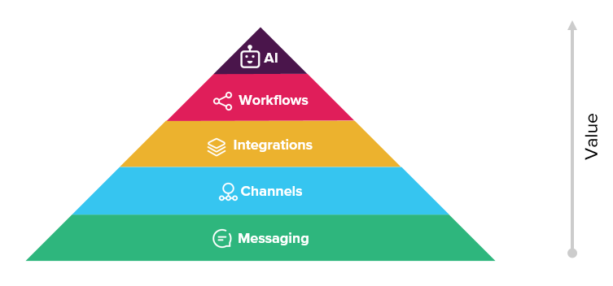
How Slack Works

Slide 5
Slack Access

Slide 6
User Access
Slack is HARP integrated. Instructions for registering for HARP and requesting a Slack User Role can be found on Confluence: https://confluence.hcqis.org/display/HS/Slack
Once access is granted, log into Slack at https://hcqis.slack.com using HARP credentials.
Contact the HIDS Slack team via email at HCQIS-Ops-Tools@hcqis.org with any Slack-related questions.

Slide 7
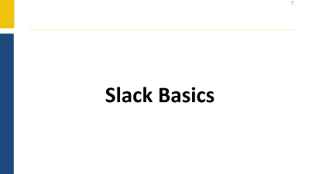
Slack Basics

Slide 8
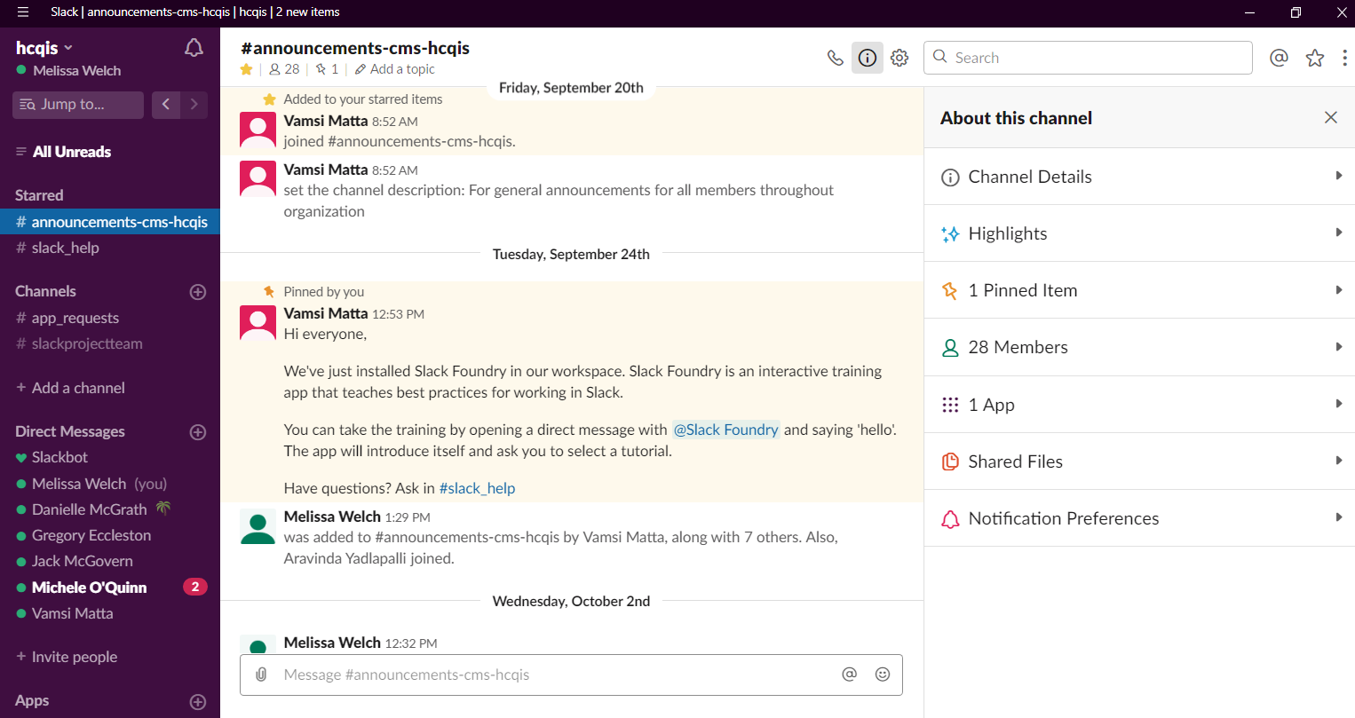
Get to Know Slack
Main menu: your personal settings
Everything in Slack is automatically indexed, archived, and easily searched
View and edit channel details & settings
Collaboration takes place in channels
Sidebar shows:
• channel details
• members
• pinned files
• activity on your posts
• starred items
direct messages and group messages
Message input box. Upload files, create snippets or posts, type rich messages, or use slash commands or emoji in any conversation

Slide 9



Managing Your Channels
Channels are focused areas of conversation and can be public or private.
We recommend you do the bulk of your work in public channels.
Public Channels can be joined freely by any member of your Slack team.
Private Channels can be joined by invitation only.

Slide 10
Notes on Channels
Quick facts:
Letters, numbers, dashes, and underscores only
Lowercase with no spaces or periods
International (non-Latin) channel names are supported
Can convert group DMs → private
Can convert public → private
Cannot convert private → public
Cannot convert DMs → public

Slide 11
Create Channel Naming Conventions
Channel Naming Conventions Help:
Keep the channel sidebar organized
Make discoverability and searching easier
Prevent channel duplicates
Channel Naming Conventions :
Use standard prefixes
Create channels for things like:
  Teams:#ado-team, #pm3-team, #hids-team
  Help: #help-it, #help-hr
  Projects: #project-dev, #project-planning

Slide 12
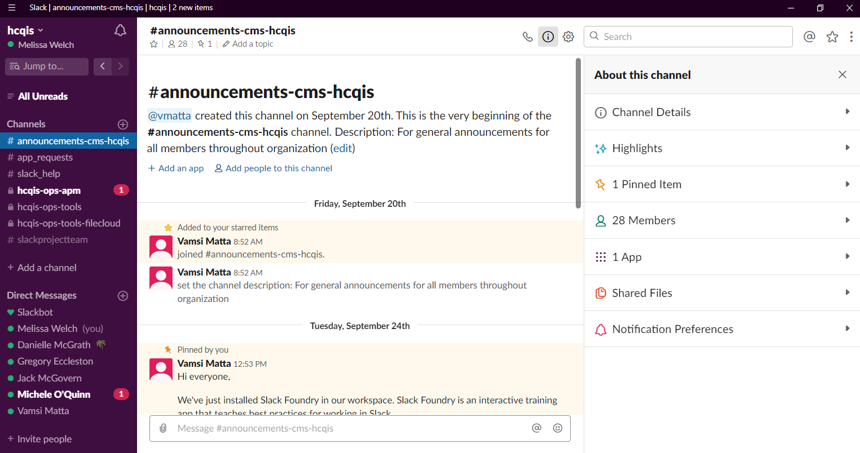
Find and Create Channels
Click on Channels to view all public workspace channels
Click on Plus Button to create a new public or private channel
Click on Direct Messages or Plus Button to start a DM

Slide 13
Default Channels
#help-slack
#announcements-cms-hcqis
#app-requests

Slide 14
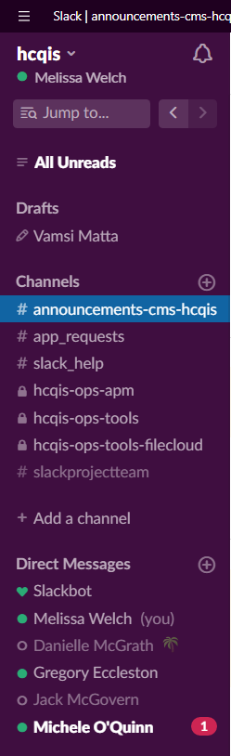

Reading in Slack
Bolded channel names indicate unread activity
Red dots/numbers indicate @mentions, @usergroup mentions or keywords notifications
Pencil icon means you have an unfinished draft
1

Slide 15
Staying Focused -
Protect Your Time and Attention!

Slide 16

Pull Not Push
Information will not be pushed to you like email
Information is posted to #channels
The channels you read determine the information you have
It is important to make the flow of information in Slack work for you
Pro Tip:
/leave

Slide 17
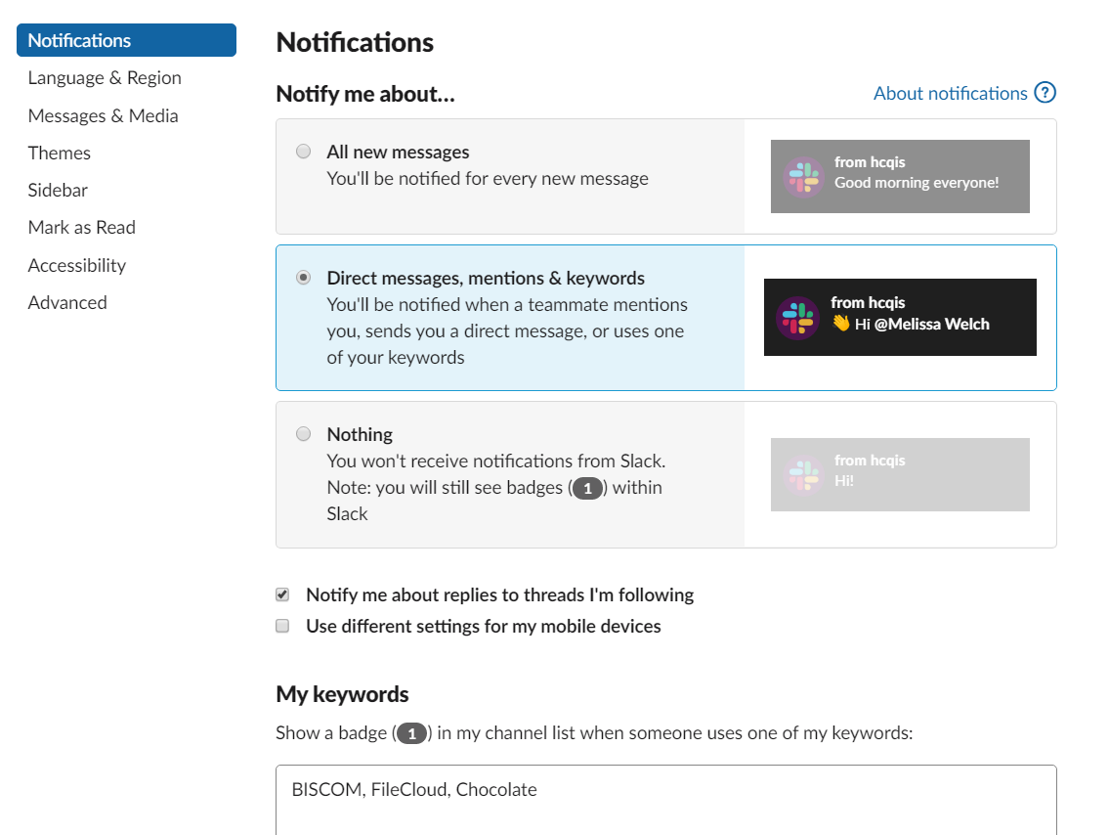
Customize Slack to Work For You
1
2
3

Slide 18
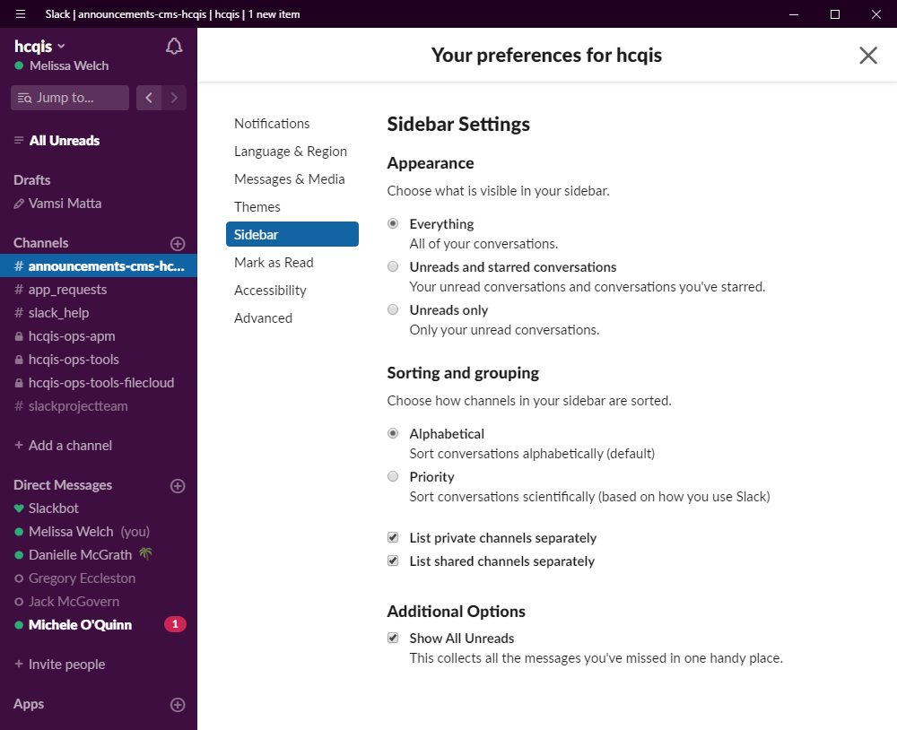
Organized Your Slack Sidebar
1
2
3

Slide 19
Keep Important Channels/DMs Above the Fold

Slide 20
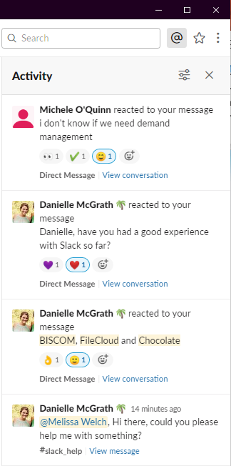
Activity Feed
Click the @ Activity icon in the top right corner of Slack. This will open the Activity pane and show:
All mentions of your @display_name
Emoji reactions to your messages
Keywords

Slide 21
Collaborating In Channel

Slide 22
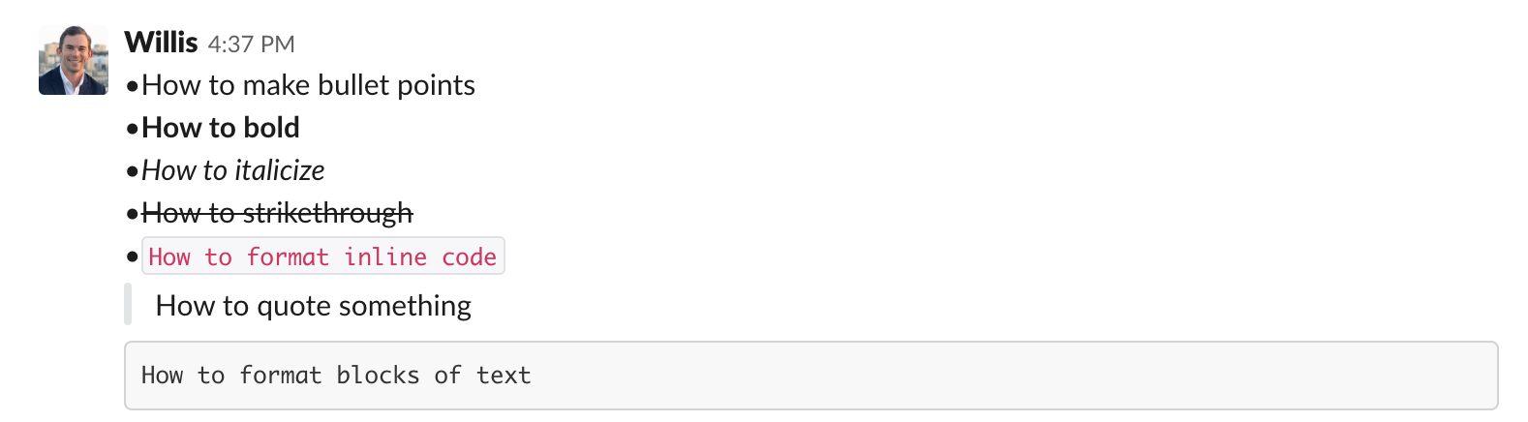
Format Messages
Use keyboard shortcuts: On desktop, you can also use keyboard shortcuts to format your text.

Slide 23
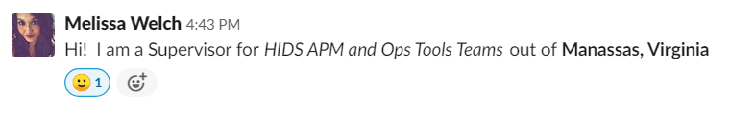
Let’s Try This In Channel
Write your role in Italics
Write your location in Bold
Add an emoji if you’d like

Slide 24
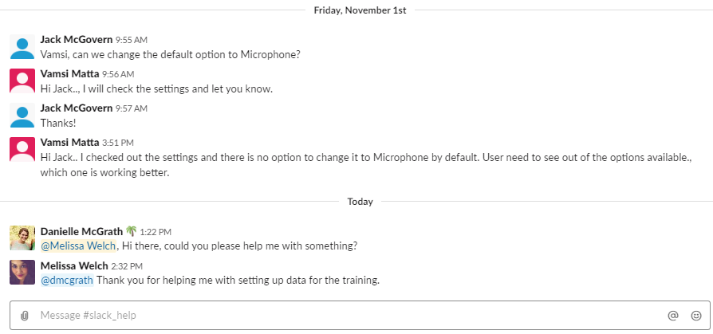
@mentions

Slide 25
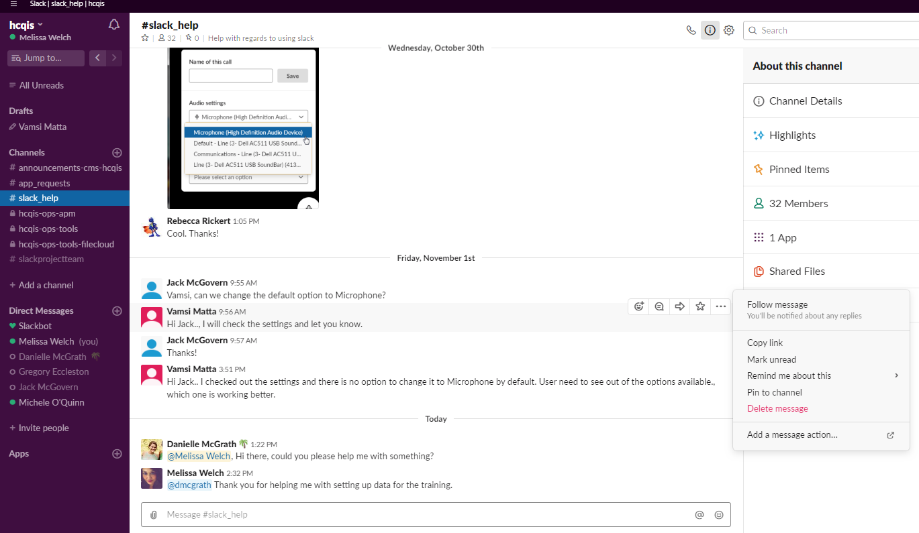
Do More With Your Messages

Slide 26








Leveraging Functional Emojis
Start with a dot to indicate your urgency:
= Immediate action needed
= Timely action required (today sometime)
= Non-critical request (this week, please)
React to your teammate’s questions:
= Know the answer? Add :eyes: to show you’re looking at it
= Once answered - add the green check mark
= Sorry, I can’t help
= Agree with the post? (Like a retweet)
= Thank you (use this everywhere - save typing “thank you”)

Slide 27
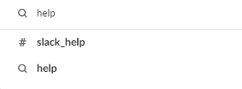
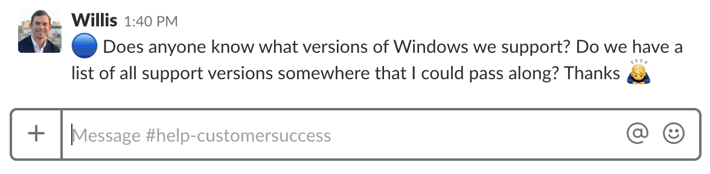
#help-slack - process
Medium Priority

Slide 28
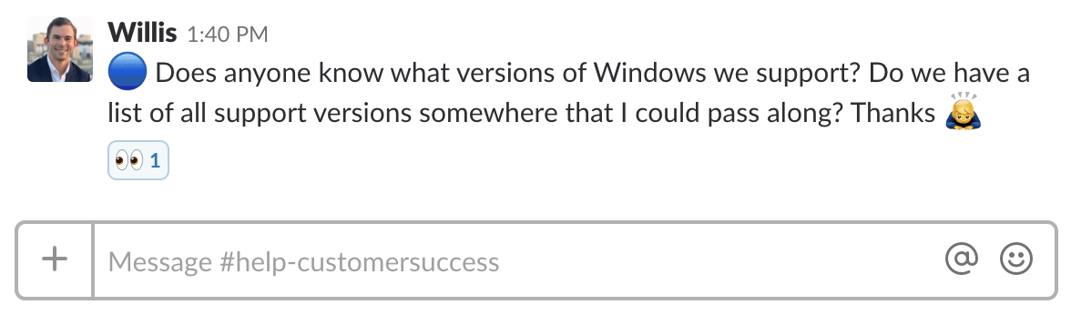
#help-slack - process
Medium Priority
HIDS Slack team acknowledges receipt: “I’m working on it”

Slide 29
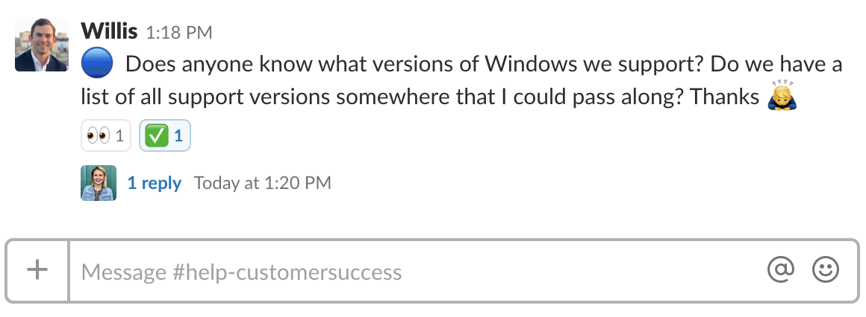
#help-slack - process
Medium Priority
HIDS Slack team acknowledges receipt: “I’m working on it”
Responds in thread. Question answered!

Slide 30
Keeping Slack Organized

Slide 31
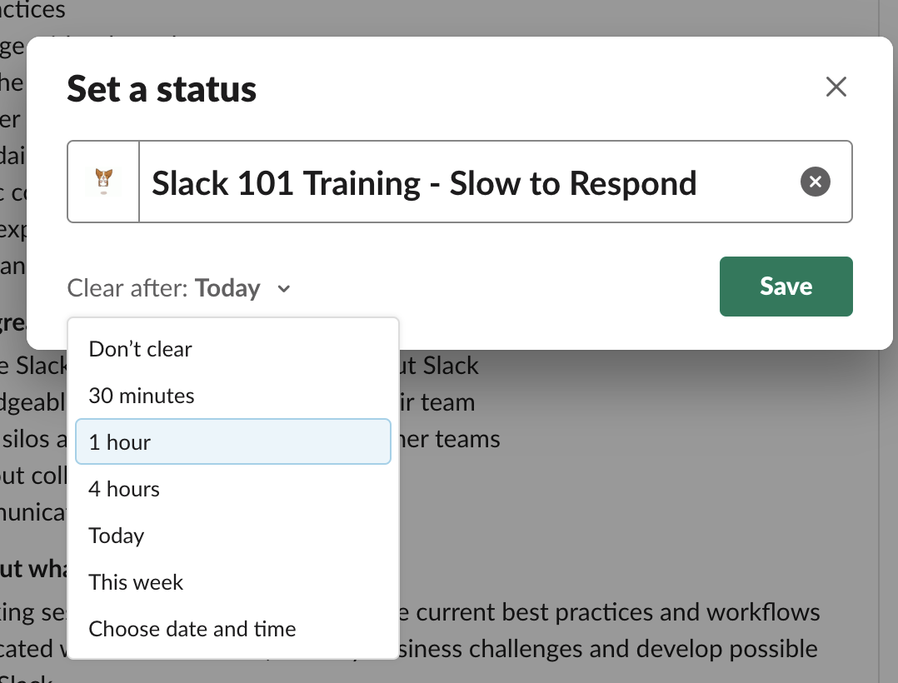
Protect Your Time
Custom Status

Slide 32
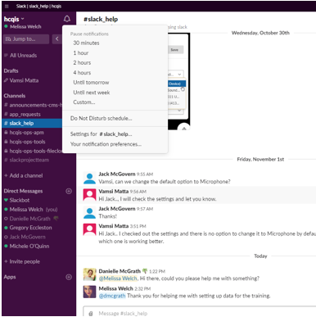
Protect Your Time
In-the-Moment DND

Slide 33
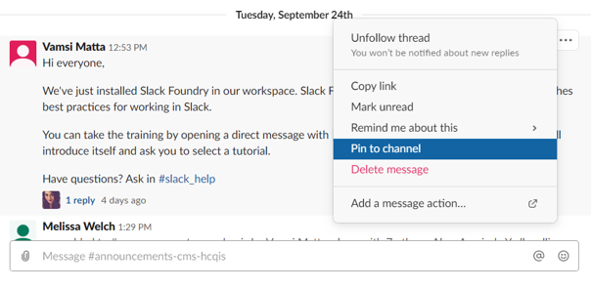
Pin Important Information to Channel
Get Pinning!
Allows for easy access to important information in channel
Pinned items are the same for everyone in the channel
Pin a message / file by:
Hovering over message
click •••
select Pin to...

Slide 34
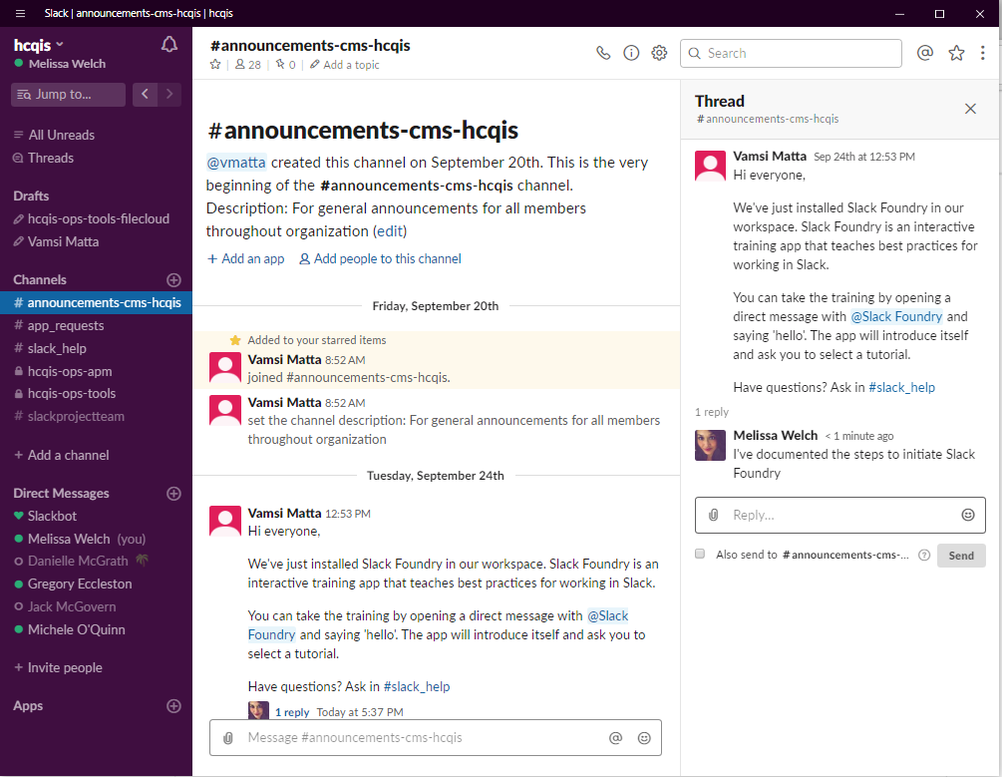
Declutter Channels by Using Threads
Use Slack’s Thread Feature:
Creates “mini sidebar” conversations in a channel
Use “All Threads” to quickly respond to threaded convos
Pro Tip: you still must @ mention someone in a thread & threads are not private!

Slide 35
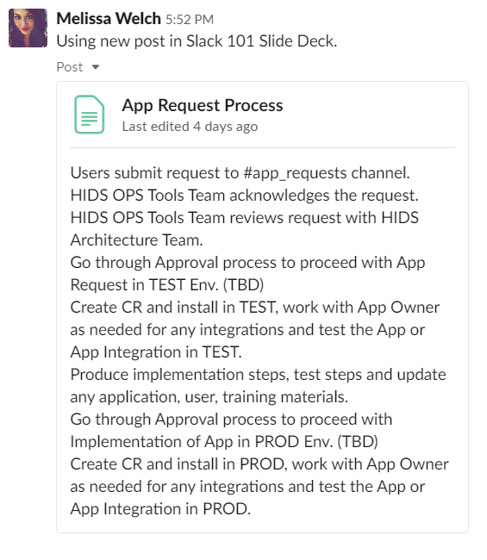
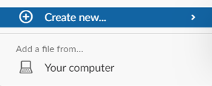

Create a Post
Create a Document/Post in Slack:
Allows for better formatting of message
Can create a task/checklist
Can be edited by other colleagues
Can be easily shared between channels

Slide 36
Reduce Time in Meetings
Instead of hosting a weekly status meeting, encourage teammates to post updates in channel
Gives visibility into everyone’s projects
Keeps the team abreast of everyone’s tasks
Managers and executives can monitor progress on projects
Saves time by eliminating an in-person meeting

Slide 37
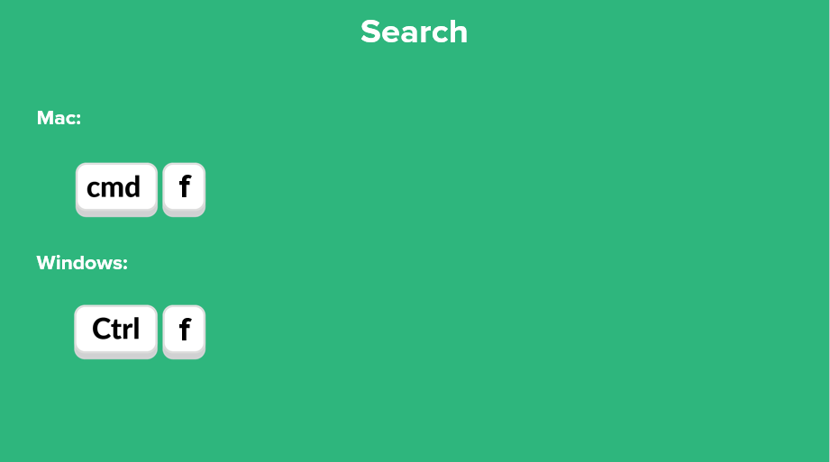
Use Desktop Shortcuts
Use your Slack Quick Reference Guide for Additional Desktop Shortcuts to Save Time

Slide 38
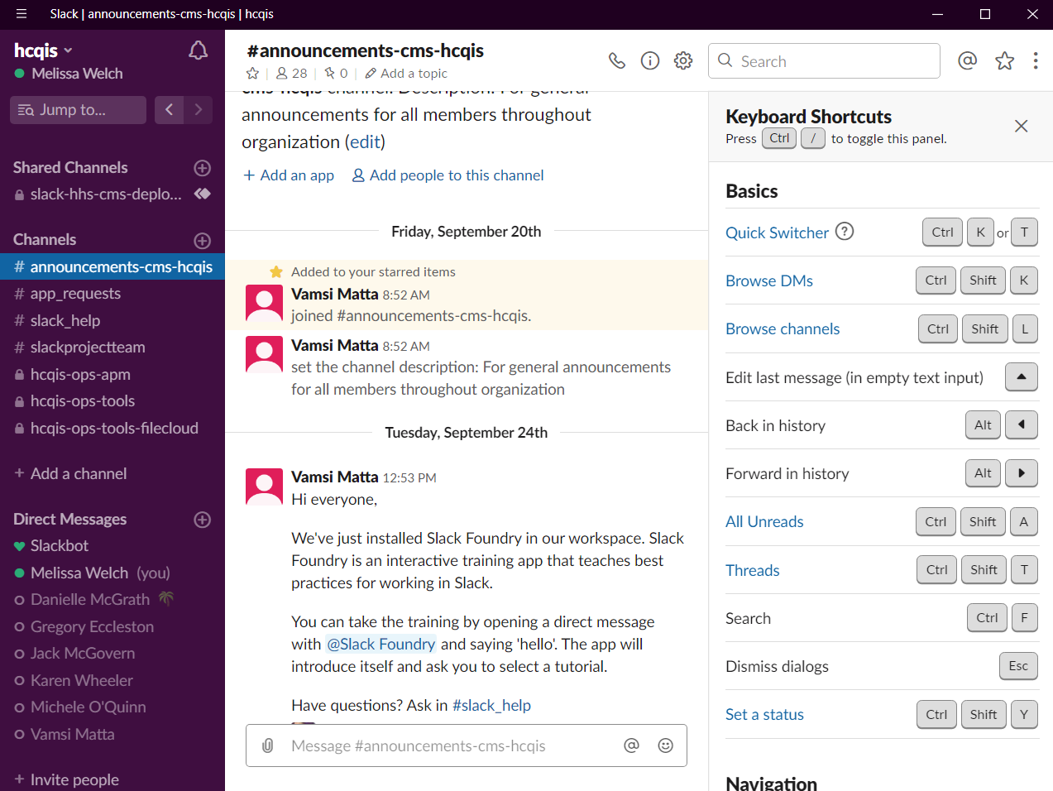
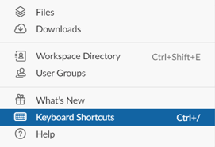

Use Desktop Shortcuts

Slide 39
Use Cases
Create announce-only channel: For monthly communications to a larger population. Enable threads so people can ask follow up questions. (i.e. #announcements-cms-hcqis
Onboarding channels: Run an onboarding process in Slack and minimize the email back and forth.
Team Collaboration: Team channels are used for internal team communication to reduce email traffic and increase transparency across the team, especially as you onboard new people.
Help Channels: Help channels can be used to seek help from experts on certain topics in one centralized place - and search for answers to questions that have already been asked! (i.e. #help-slack)

Slide 40
@slackbot
Reminds you about things and can answer simple questions.

Slide 41
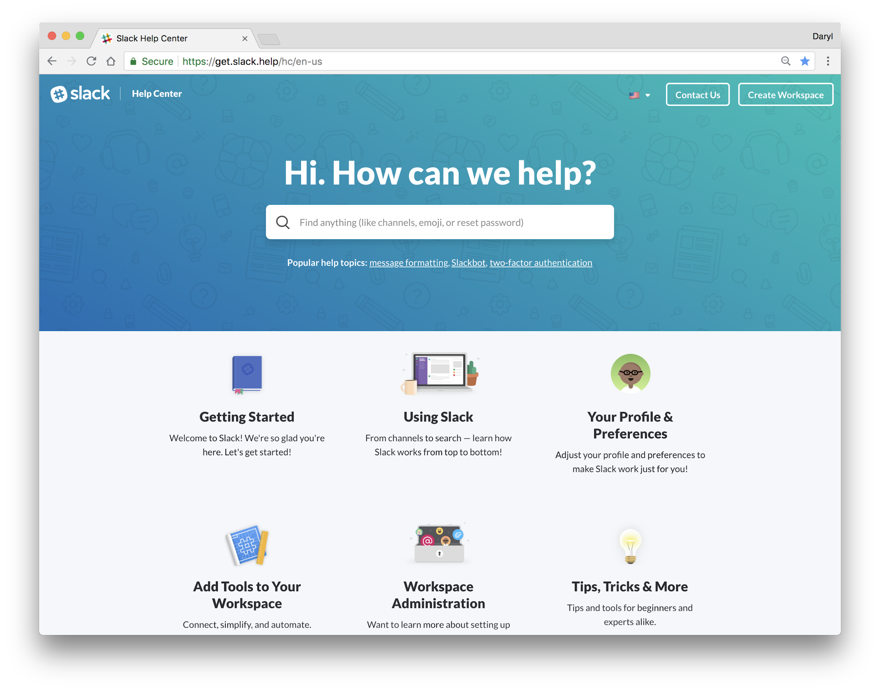
Easily Get Help
Slack Channel: #help-slack
Slackbot: ask a question
/feedback: type question/comment
Email Us: feedback@slack.com

Slide 42
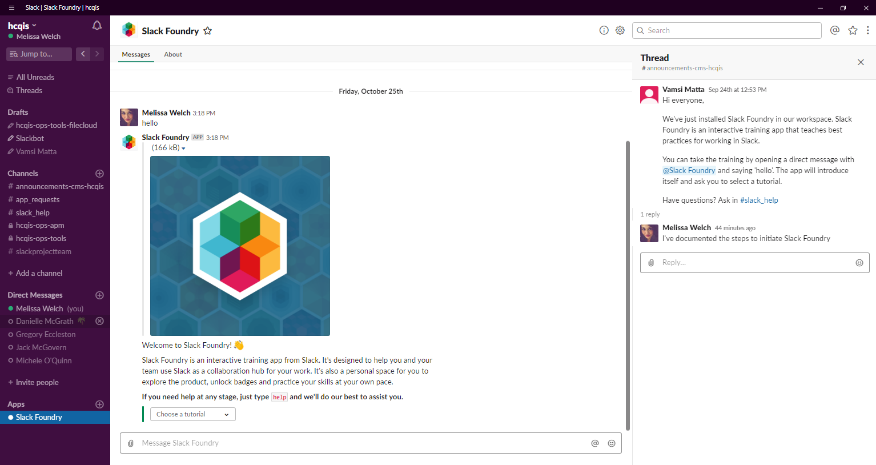
Slack Foundry
From Direct Message, add Slack Foundry
Send Message Hello
Choose Tutorial

Slide 43
Thank You!
For additional assistance with Slack, use #help-slack or contact HIDS Slack team via email at HCQIS-Ops-Tools@hcqis.org.

