Slide 1
Virtual Reality:
Leveraging Innovative Technologies to Increase Empathy and Improve the Patient Experience
November 2024
Jen Chapin, MSN, RN, CPHQ, FCX-I
Tools & Implementation (T&I)
Department of Veterans Affairs, National Veterans Experience Office (VEO)

Slide 2


Slide 3

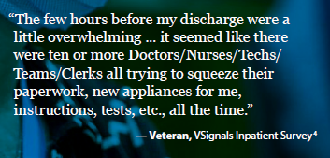
What if every Veteran patient could have the ideal care transition from hospital to home?

Slide 4
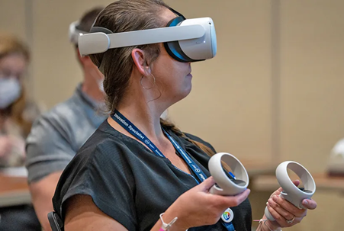

Audience Poll
Have you used a virtual reality (VR) headset?
  Yes, at home or for entertainment/games
  Yes, at work
  Both a and b
  I have never used a VR headset before

Slide 5
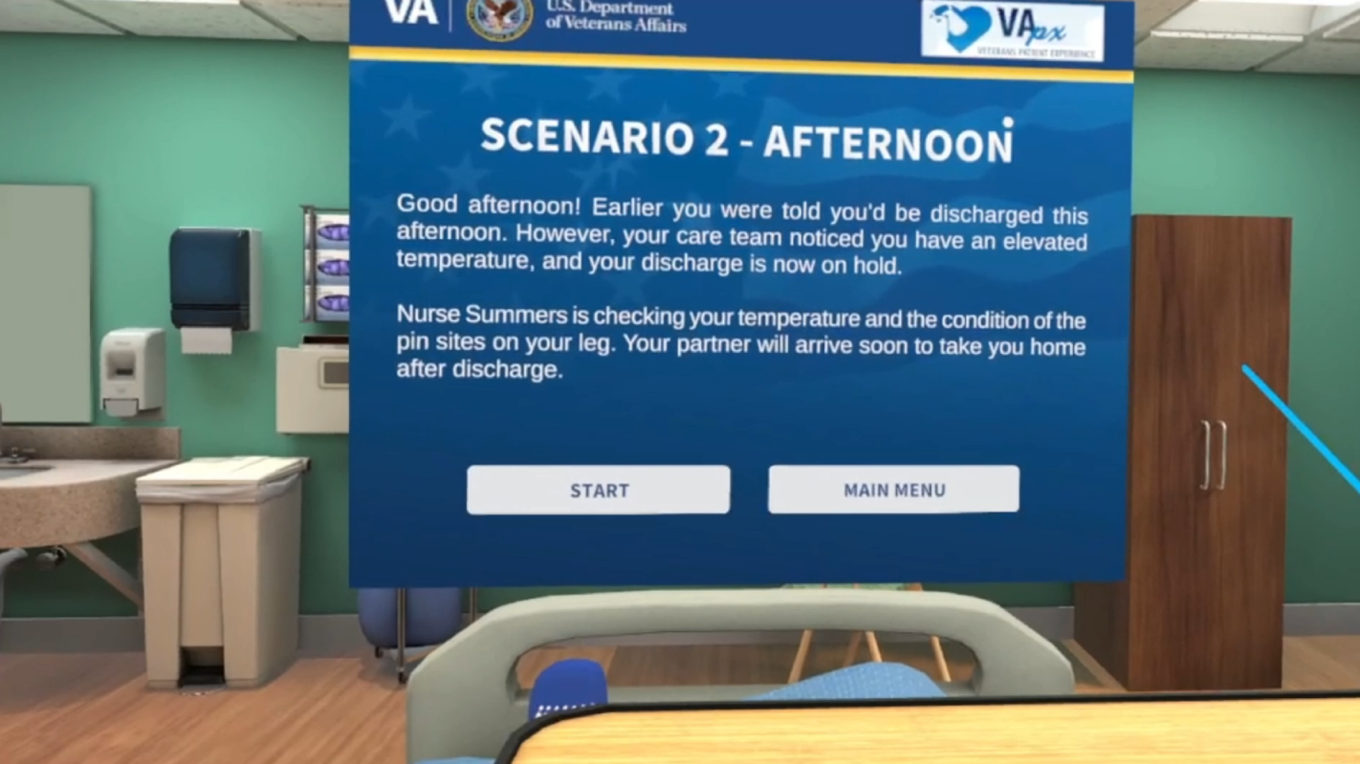

Slide 6
Communication Discrepancies – JAMA Article
Question | Patient Perception | Provider Perception
Would you say there is one main doctor in charge of your care? Can you name them? | 18% of patients correctly named the provider | 67% of providers thought patients knew their name
What is your hospital admission diagnosis? | 57% of patients correctly named their diagnosis | 77% of providers thought their patient understood their diagnosis
Before giving you any new medication, how often did hospital staff tell you what the medicine was for? | 25% of patients answered never | 100% of providers said they at least sometimes tell patients what meds are for
Before giving you any new medicine, how often did hospital staff describe possible side effects in a way you could understand? | 90% of patients answered never | 19% of providers answered never
Did a doctor discuss any anxieties or fears about your condition or treatment with you? | 54% answered never | 2% answered never
Notes:
https://jamanetwork.com/journals/jamainternalmedicine/fullarticle/775589
Hospital surveys indicate lack of patient awareness of diagnoses and treatments, yet physicians report they effectively communicate with patients.
Although 73% of patients thought there was 1 main physician, 18% correctly named that physician, compared with 67% of physicians who thought patients knew their names (P < .001).
Most physicians (77%) believed patients knew their diagnosis; however, 57% of patients did (P < .001).
Two-thirds of patients reported receiving a new medication in the hospital, yet 90% noted never being told of any adverse effects of these medications.
Nearly all physicians (98%) stated that they at least sometimes discussed their patients' fears and anxieties, compared with 54% of patients who said their physicians never did this (P = .001).

Slide 7

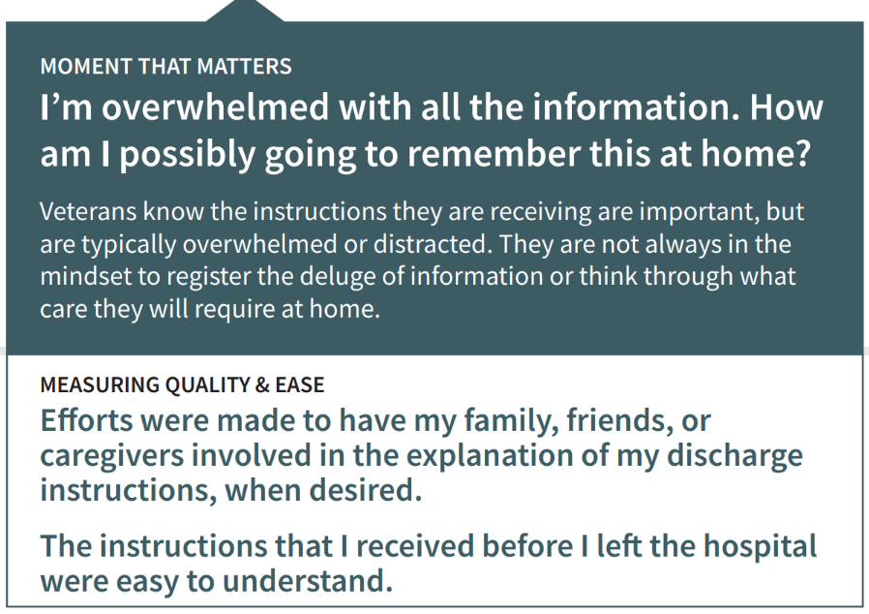
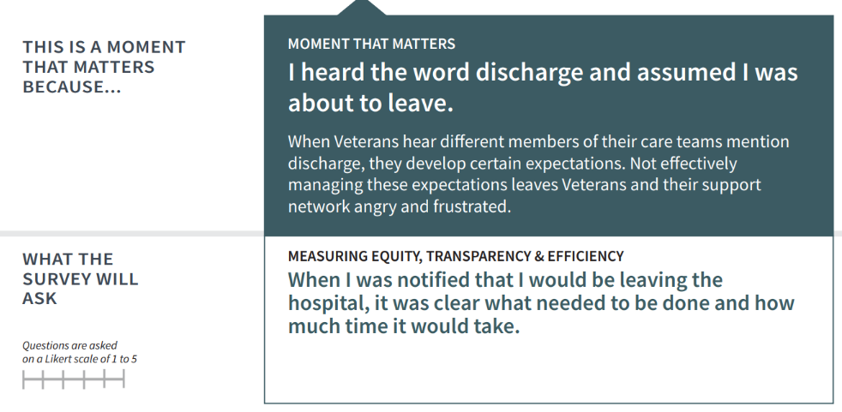

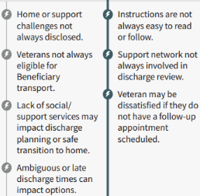
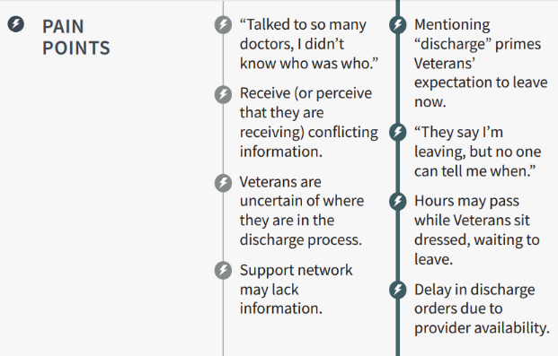


Inpatient DC Experience Journey Map
HCD in Action

Slide 8
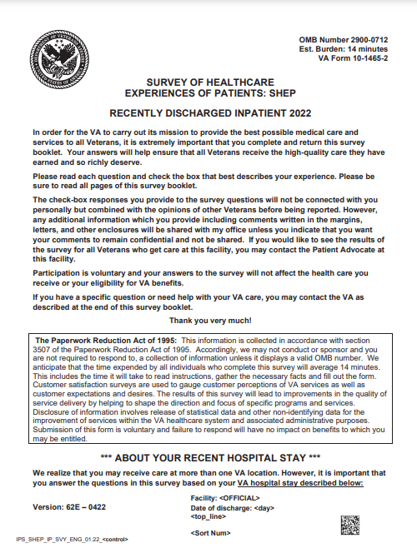
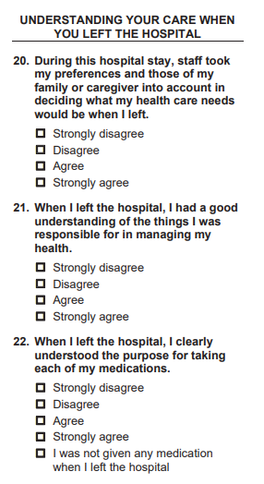
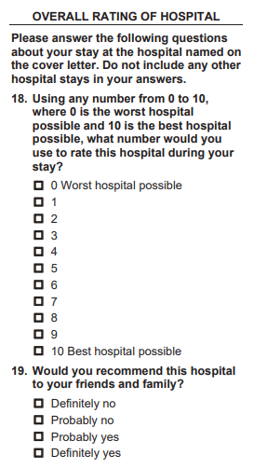
Measuring the Inpatient Experience – Survey of Healthcare Experiences of Patients (SHEP)

Slide 9

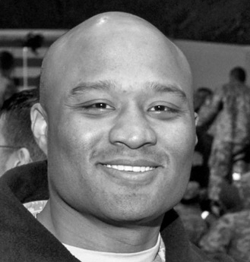


The Opportunity
The Discharge Experience is an Integral Part of the Hospital Stay
5.1%
It seemed like there were ten or more doctors, nurses, techs, and clerks…
…all trying to squeeze their paperwork, new appliances for me, instructions, tests, all the time.
of Veterans feel that they did not understand their discharge instructions.
I was pressuring them to hurry up, so I’d be able to have a ride home…
The few hours before my discharge were a little overwhelming…
…I didn't know who it was, and I didn't know
it was a part of the discharge process.
…if it wasn’t for my ride, I don’t know how I would have gotten home that day.
Notes:
CITATIONS
1. U.S. Department of Veterans Affairs, Office of Quality and Patient Safety, Analytics and Performance Integration Division (2021). The Survey of Healthcare Experience of Patients.

Slide 10

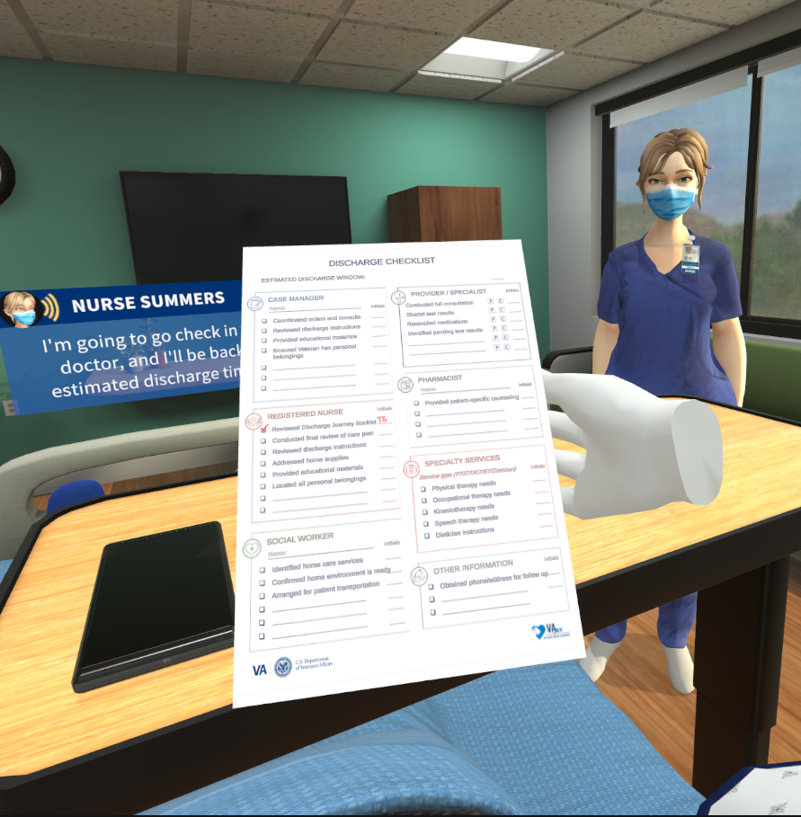
If you or a close family member has been in the hospital when you were discharged, did you understand your instructions, and what would you be responsible for in managing health at home?
  I disagree that I understood my instructions and what I would be responsible for.
  I partially agree that I understood my instructions and what I would be responsible for.
  I agree that I understood my instructions and what I would be responsible for.
  Not applicable

Slide 11

The Opportunity
“I feel like the nurses don't feel like they're really doing a good job…they feel like they have to fly through the motions to get it done ASAP so they can make space for the next person.”
~ Nurse Manager at VA
In the rush of routines,
Veterans’ voices can sometimes get lost.

Slide 12
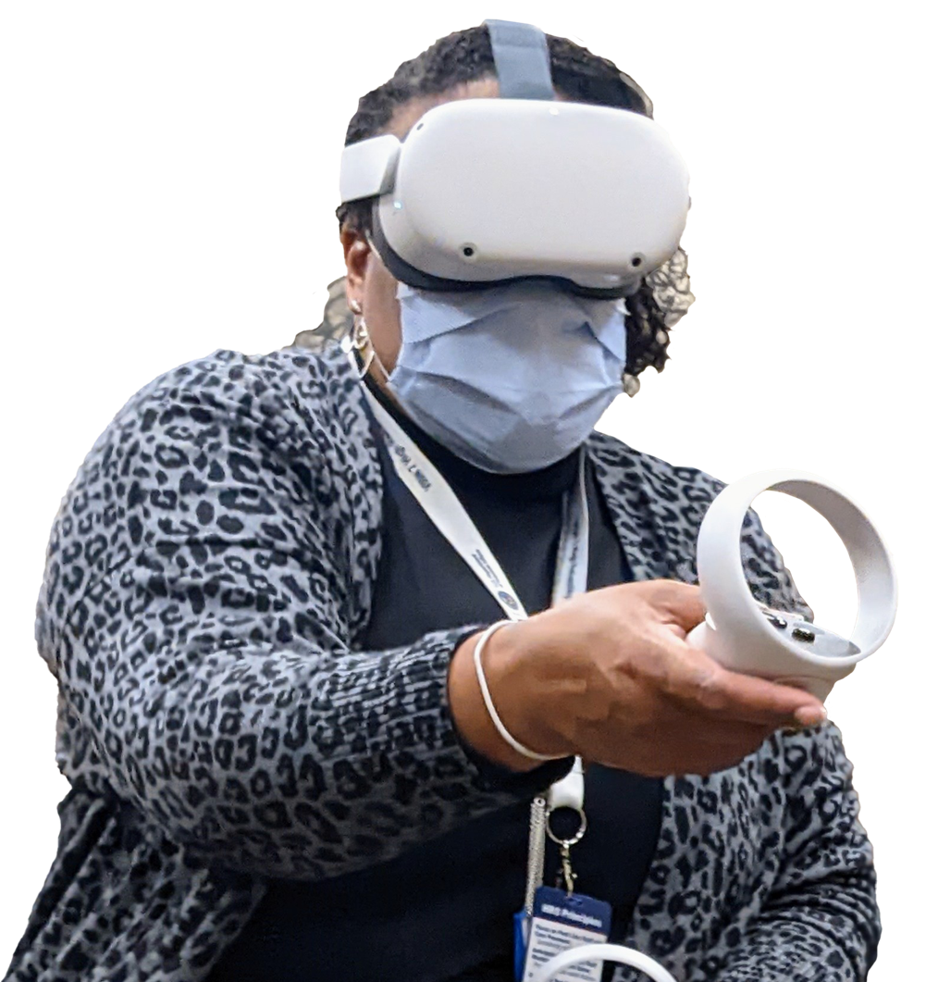
Moments that Matter:
Virtual Reality Training on Discharge Experiences
Created by the VHA Office of Healthcare Innovation and Learning’s VA Immersive and VA Veterans Experience Office Patient Experience

Slide 13

The Opportunity
What if you could truly understand the Veteran experience?
Not just know it, but feel it?

Slide 14

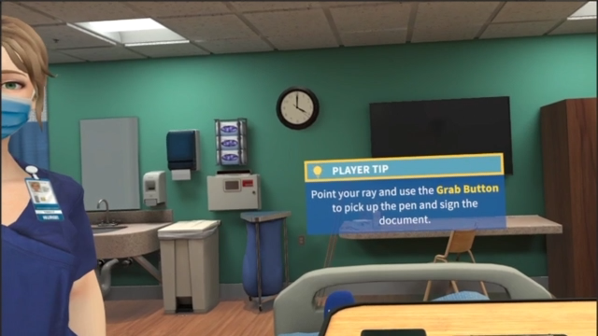
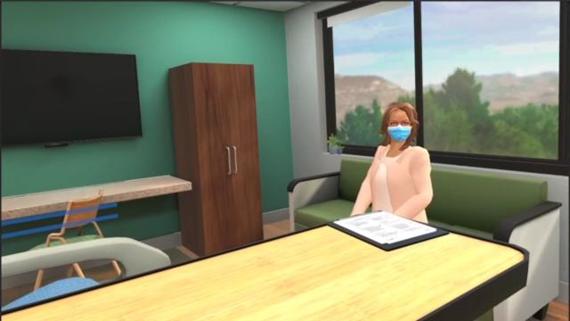
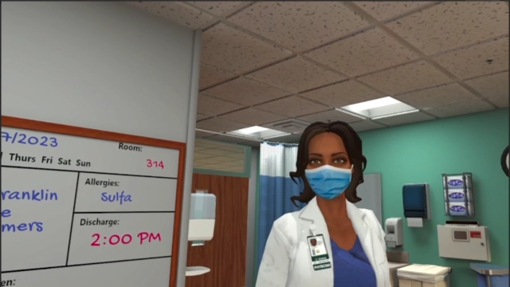
The Solution
Moments that Matter: Virtual Reality Training on Discharge Experiences
Garnering Empathy to Inspire Action
Step into a new realm of understanding and empathy with Moments that Matter: Virtual Reality Training on Discharge Experiences, a groundbreaking leap forward in training VA staff. By immersing staff in a virtual reality journey that mirrors the challenges, emotions, and moments that define a Veteran's inpatient discharge, the training aims to foster a deep sense of empathy that inspires new discharge solutions at VAMCs nationwide.

Slide 15
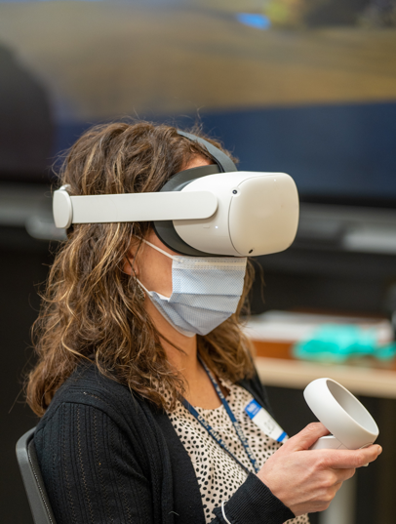
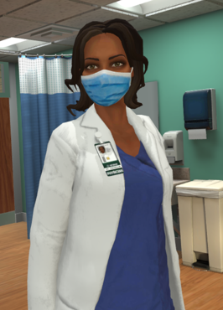
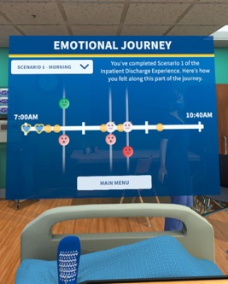
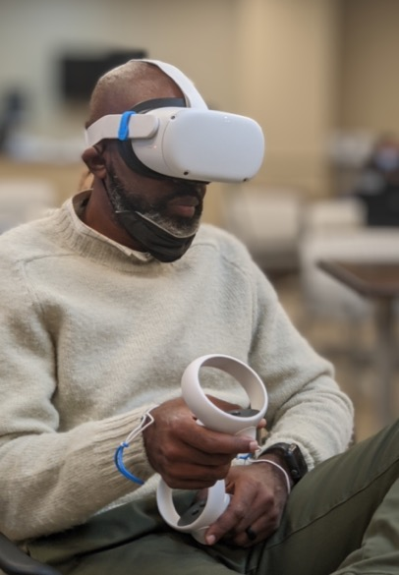

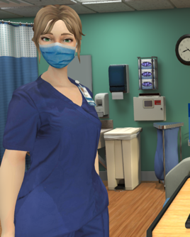
The Solution
Cultivating Empathy Through Immersive Experiences
65%
of patients said that provider empathy was the most important factor in their satisfaction with care
2
3.75x
more likely that learners emotionally connect to content in virtual reality than in classroom learning
3
Notes:
CITATIONS
2. American Academy of Orthopaedic Surgeons. (2016, March 1). Physician empathy a key driver of patient satisfaction. PR Newswire. https://www.prnewswire.com/news-releases/physician-empathy-a-key-driver-of-patient-satisfaction-300228070.html
3. Likens, S., & Mower, A. (2022). What does virtual reality and the metaverse mean for training?. PricewaterhouseCoopers. https://www.pwc.com/us/en/tech-effect/emerging-tech/virtual-reality-study.html

Slide 16

The Solution
Embark on an Immersive Journey
Change Your
Point of View
Immerse yourself in a Veteran's experience as you follow their journey from discharge through a "day-in-the-life” simulation. Gain empathy and insight.
Engage and
Interact
Move through the interactive environments, handle objects, and communicate with providers and your caregiver for an immersive, hands-on learning experience.
Instill “VA Way” Behaviors
The training highlights Moments that Matter and incorporates VA’s Patient Discharge Checklist, practices such as Commit to Sit, and
the SALUTE Model for
Service Recovery.
Take Time
to Reflect
These are real Veteran experiences. Witness the ups and downs of Veteran stories to reflect on how experiencing their journey feels.

Slide 17
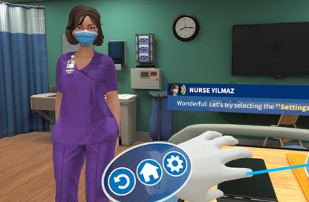
The Solution
Embark on an Immersive Journey
Change Your
Point of View
Immerse yourself in a Veteran's experience as you follow their journey from discharge through a "day-in-the-life” simulation. Gain empathy and insight.
Engage and
Interact
Move through the interactive environments, handle objects, and communicate with providers and your caregiver for an immersive, hands-on learning experience.
Instill “VA Way” Behaviors
The training highlights Moments that Matter and incorporates VA’s Patient Discharge Checklist, practices such as Commit to Sit, and
the SALUTE Model for
Service Recovery.
Take Time
to Reflect
These are real Veteran experiences. Witness the ups and downs of Veteran stories to reflect on how experiencing their journey feels.

Slide 18
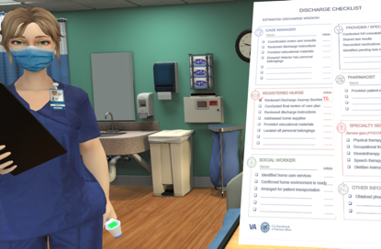
The Solution
Embark on an Immersive Journey
Change Your
Point of View
Immerse yourself in a Veteran's experience as you follow their journey from discharge through a "day-in-the-life” simulation. Gain empathy and insight.
Engage and
Interact
Move through the interactive environments, handle objects, and communicate with providers and your caregiver for an immersive, hands-on learning experience.
Instill “VA Way” Behaviors
The training highlights Moments that Matter and incorporates VA’s Patient Discharge Checklist, practices such as Commit to Sit, and
the SALUTE Model for
Service Recovery.
Take Time
to Reflect
These are real Veteran experiences. Witness the ups and downs of Veteran stories to reflect on how experiencing their journey feels.

Slide 19
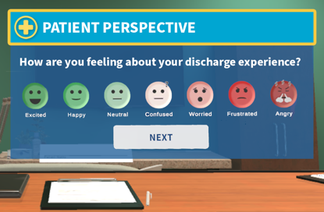
The Solution
Embark on an Immersive Journey
Change Your
Point of View
Immerse yourself in a Veteran's experience as you follow their journey from discharge through a "day-in-the-life” simulation. Gain empathy and insight.
Engage and
Interact
Move through the interactive environments, handle objects, and communicate with providers and your caregiver for an immersive, hands-on learning experience.
Instill “VA Way” Behaviors
The training highlights Moments that Matter and incorporates VA’s Patient Discharge Checklist, practices such as Commit to Sit, and
the SALUTE Model for
Service Recovery.
Take Time
to Reflect
These are real Veteran experiences. Witness the ups and downs of Veteran stories to reflect on how experiencing their journey feels.

Slide 20
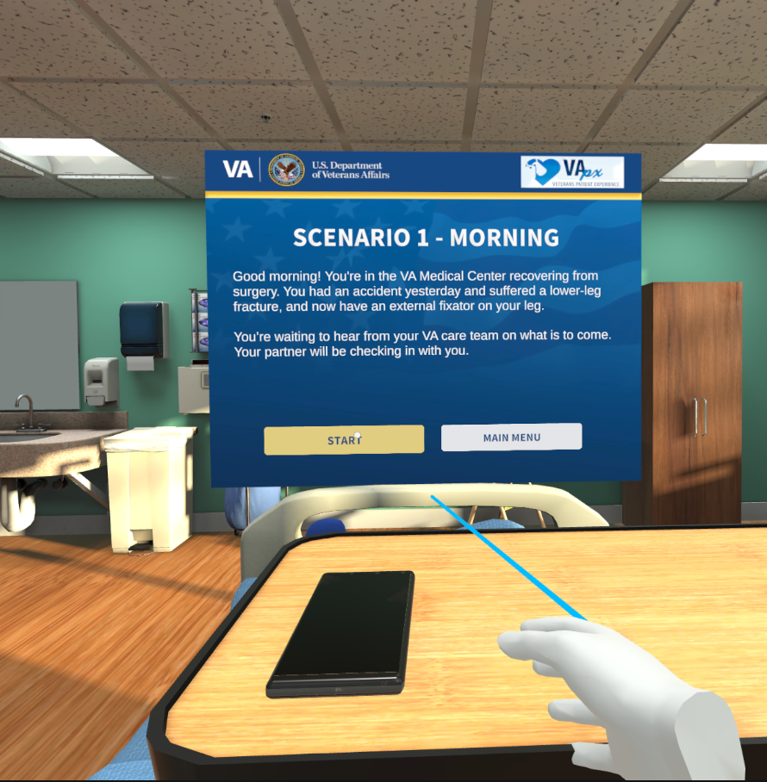
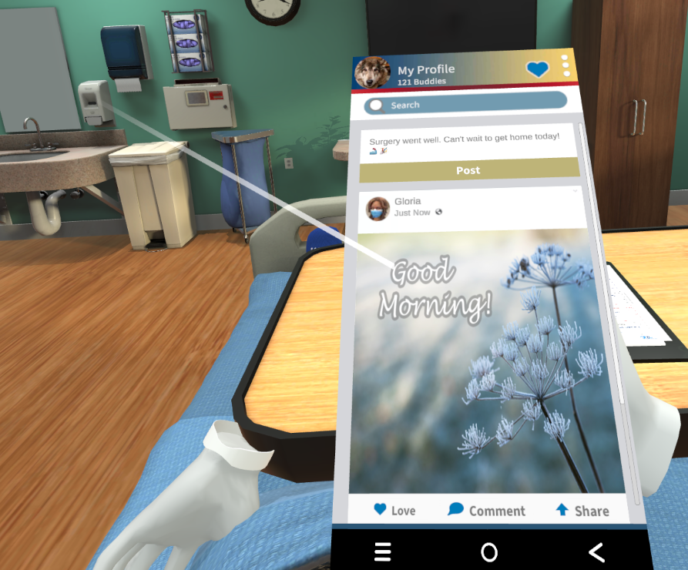
Building Empathy through Virtual Reality as the Next Step
This experience, brought to you by the Office of Healthcare Innovation & Learning and VEO, is designed to inform and empower staff and, ultimately, improve the inpatient experience at VA Medical Centers.
Shifting Staff’s Perspective
As staff enter the application, they experience a day in the life of the discharge journey, from the Veteran patient's perspective.
Instilling ‘VA Way’ Behaviors
The application highlights “Moments that Matter,” and incorporates VEO’s Patient Discharge Checklist, Commit to Sit and SALUTE behaviors.
Showing Real-Life Experience
The application is not designed to show the perfect discharge journey, but instead it’s meant to reflect real-life experiences.
Players post on "social media" when they learn they're being discharged
Players "wake up" in the VAMC after a complex leg fracture
Nurse Summers is ready with a copy of the Discharge Checklist

Slide 21




The Proof
Moments that Matter Pilot: By the Numbers
10
70%
of pilot participants said they would recommend Moments that Matter:
VR Training to a colleague
92%
VA Medical Centers
Piloted Moments that Matter: VR Training over
a 6-week period in 2023
SHEP Hospital Rating
7/10 VAMCs had an overall improvement in their hospital rating score
5.7%
4.6%
80%
of VA hospitals that participated in the pilot experienced an improvement in SHEP Care Transition questions
Care Transition Improvement
the average %-point improvement of sites that noted improvement in care transitions
Hospital Rating Improvement
the average %-point improvement of sites that noted improvement in hospital rating

Slide 22
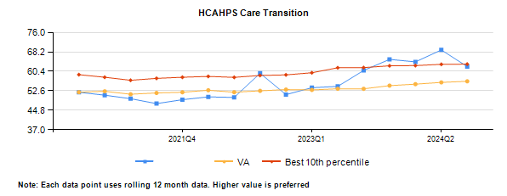
Results – HCAHPS Survey Care Transition
62.3%
54.4%
Facility
Survey questions in composite include:
During this hospital stay, staff took my preferences and those of my family or caregiver into account in deciding what my health care needs would be when I left.
When I left the hospital, I had a good understanding of the things I was responsible for in managing my health.
When I left the hospital, I clearly understood the purpose for taking each of my medications.

Slide 23
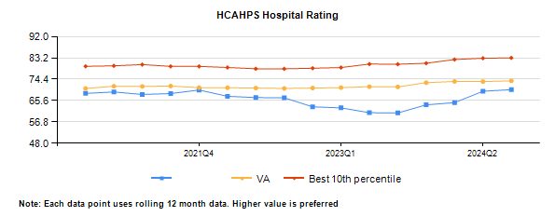
Results – HCAHPS Survey Hospital Rating
70.1%
60.6%
Facility
Survey question:
Using any number from 0 to 10, where 0 is the worst hospital possible and 10 is the best hospital possible, what number would you use to rate this hospital during your stay?

Slide 24
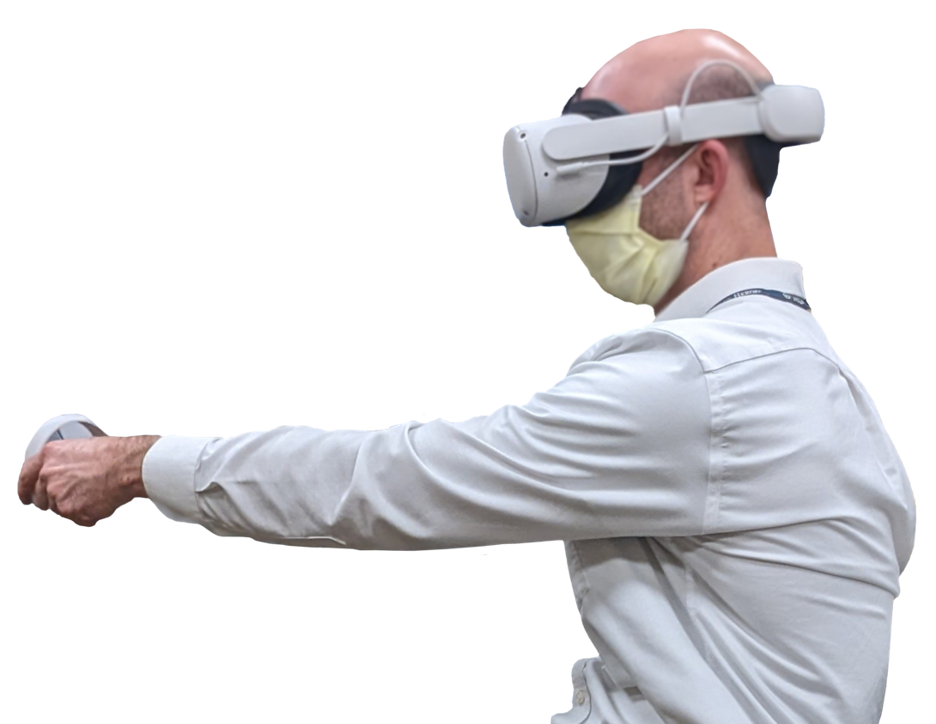
The Proof
“We as clinicians do not have access to
“Feel” what [Veterans] feel…to feel the
uncertainty. I believe this is a great
opportunity to develop and improve empathy and view our practice from the patient’s perspective.”
The Participant Perspective
92%
“[The training] made me want to go back to so many of my patients and apologize for the discharge care they received.”
of participants said the Moments that Matter: VR Training will positively impact how they engage with Veterans during their discharge journey.
“To virtually be in the Veteran’s position greatly impacts my future thoughts about my care to Veterans. I felt like I was empathetic before, but this training modality really brought it home.”

Slide 25
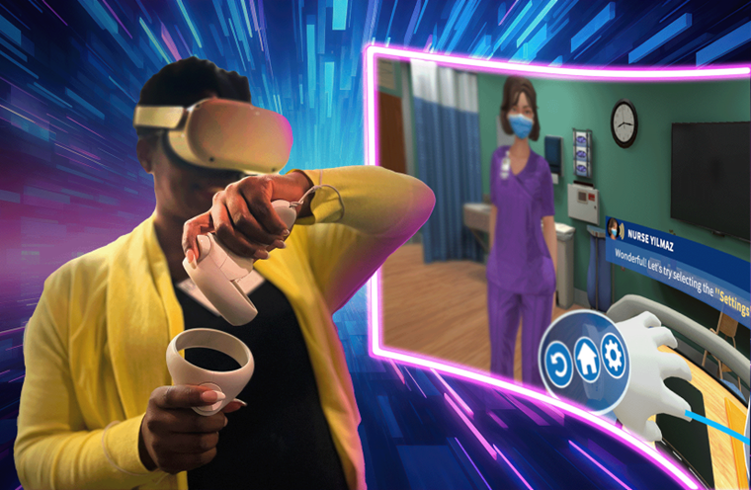
Let’s hear from you!
Now that you have seen how VR can be used to improve empathy in clinical staff, what are some other scenarios or applications in your own work where you can see this technology being utilized?

Slide 26
Questions?
Contact Jennifer.chapin@va.gov

