Slide 1
Building Panels to Improve CX
CDC’s Engagement Panel
HHS CCSQ World Usability Day
Technology Strategy Office // Suzi Soroczak // November 14, 2024

Slide 2

Bio
Suzi Soroczak is the human-centered design research strategist for the Technology Strategy Office (TSO) at the Centers for Disease Control and Prevention (CDC) Office of Public Health Data, Surveillance, and Technology. Our mission is to improve the customer experience for CDC products and services for state, tribal, local, and territorial (STLT) jurisdictions. Prior to joining CDC, Suzi was a Digital Services Strategist as the US Digital Service, where she was the lead researcher on project that launched the childtaxcredit.gov website.
Suzi came to federal service after over 20 years in industry leading user research teams at UserTesting.com, Tencent, and Google Cloud Services Big Data unit. Suzi holds a master's degree in information science, with specialization in natural language processing (NLP), computer-supported cooperative work (CSCW), and human-centered design (HCD).
ttd8@cdc.gov

Slide 3
What is an engagement panel?
Notes:
A pre-recruited panel of potential participants

Slide 4

Centering on people
It’s a human-centered design tool that brings people to the center of the design process.

Slide 5
The problem:
7 contract companies with product teams and 50+ designers reaching out to state, territory, local, and tribal health departments simultaneously
Each team was managing their own list of customers / participants
We’re asking people the same questions in screeners over and over again
Some teams were having difficulty recruiting for specific job roles
A growing burden

Slide 6
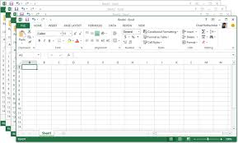
Managing multiple spreadsheets
Each product team was keeping their own list
Managing these lists grew to be too complex in Excel or SmartSheets
Burden on public health professionals was high, because they were receiving multiple invitations each month
No way to see across the communities we were engaging with and more importantly which communities we are not engaging with
We were tracking sessions after the fact in yet another spreadsheet!
Notes:
Each product team was keeping their own list! There was tons of overlap. And some generous public health professionals were getting multiple requests every month to participate!

Slide 7
How it works
Volunteers opt-in to receive invitations for upcoming research and design activities.
Pre-recruiting allows us to monitor who we are engaging with, to increase the breadth of engagement
We can easily send out HTML capable screener surveys via Qualtrics
Distribution sample lists allows us to access people quickly
Volunteers

Slide 8
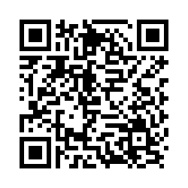
Are you interested in joining CDC’s engagement panel?!?
CDC’s Office for Public Health Data, Surveillance and Technology (OPHDST) is kicking off the Engagement Panel for Public Health Data to incorporate the perspectives of public health partners into planning for Data Modernization and the Public Health Data Strategy.
The Engagement Panel will serve as a catalog of public health professionals who can be called upon to provide input on a technology product, a data policy, or modernization strategy. Engagements may include participation in:
    focus groups to identify needs and opportunities,
    expert panels for in-depth discussion on specific topics or potential strategies,
    pilots to test initial versions of tools or services, or
    surveys to support user research into challenges and priorities.
Participation from all levels of public health is needed. Add your name and encourage participation by others involved in data modernization and data strategy.
Or you can email our mailbox directly: DataEngagement@cdc.gov for a link
Notes:
Example recruitment slide

Slide 9
Benefits
Allows more participants to engage directly
Reduces burden on STLTs by allowing us to spread out invitations
Speeds up the development process ~3 weeks by cutting down recruit time
Increases reach by allowing admins to identify and connect with under-represented communities
Supports a continuous feedback loop and year-round activities

Slide 10
What have we accomplished so far?

Slide 11
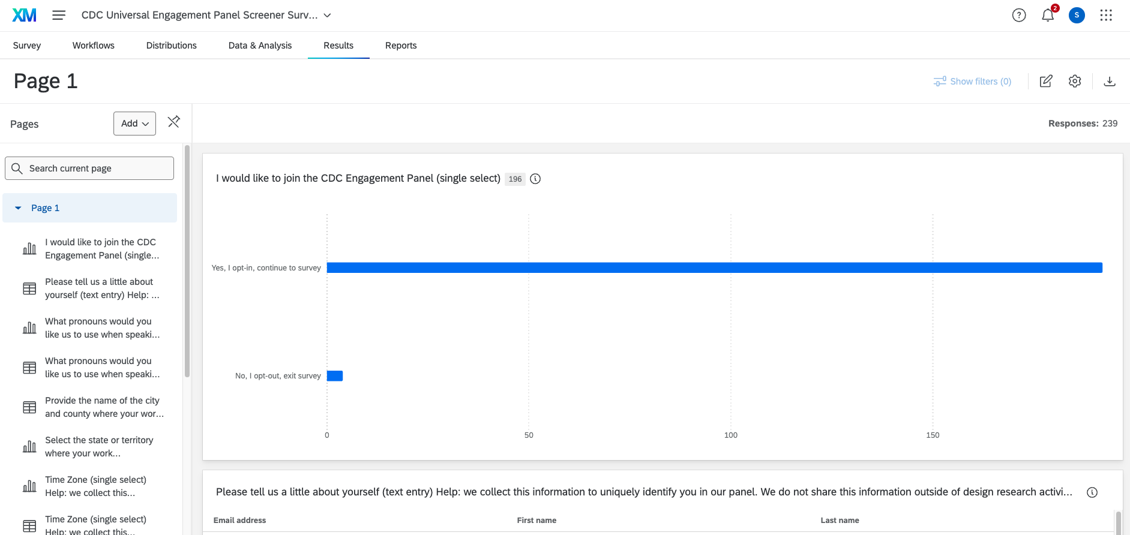
Built a Qualtrics XM Prototype
Panel recruitment & request process in place for greater HCD team
Created a training guide for researchers for accessing the global list and for sending invitations
Received PRA approval
Created CDC branded email templates in Qualtrics
Notes:
s

Slide 12
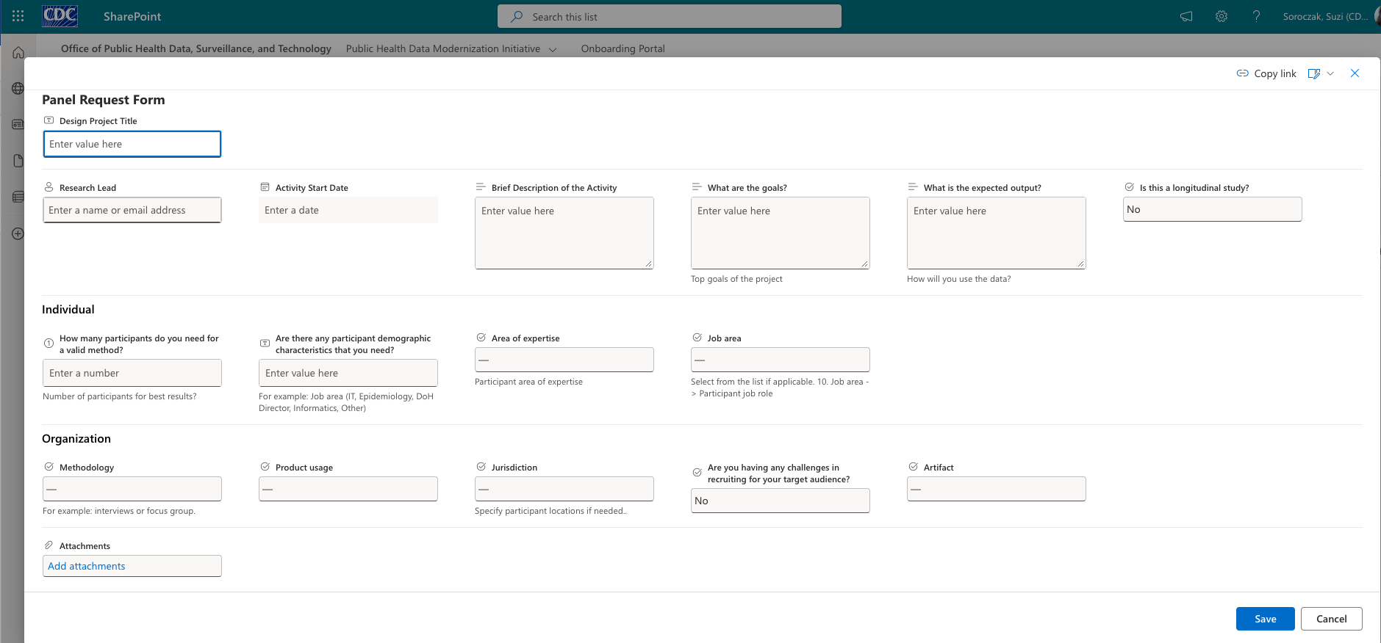
Engagement Panel
Grew panel to 250 members by invited past participants to opt-in
Dedicated mailbox for engaging with customers
Internal panel request form is accessible to the office via our HCD SharePoint
In use

Slide 13
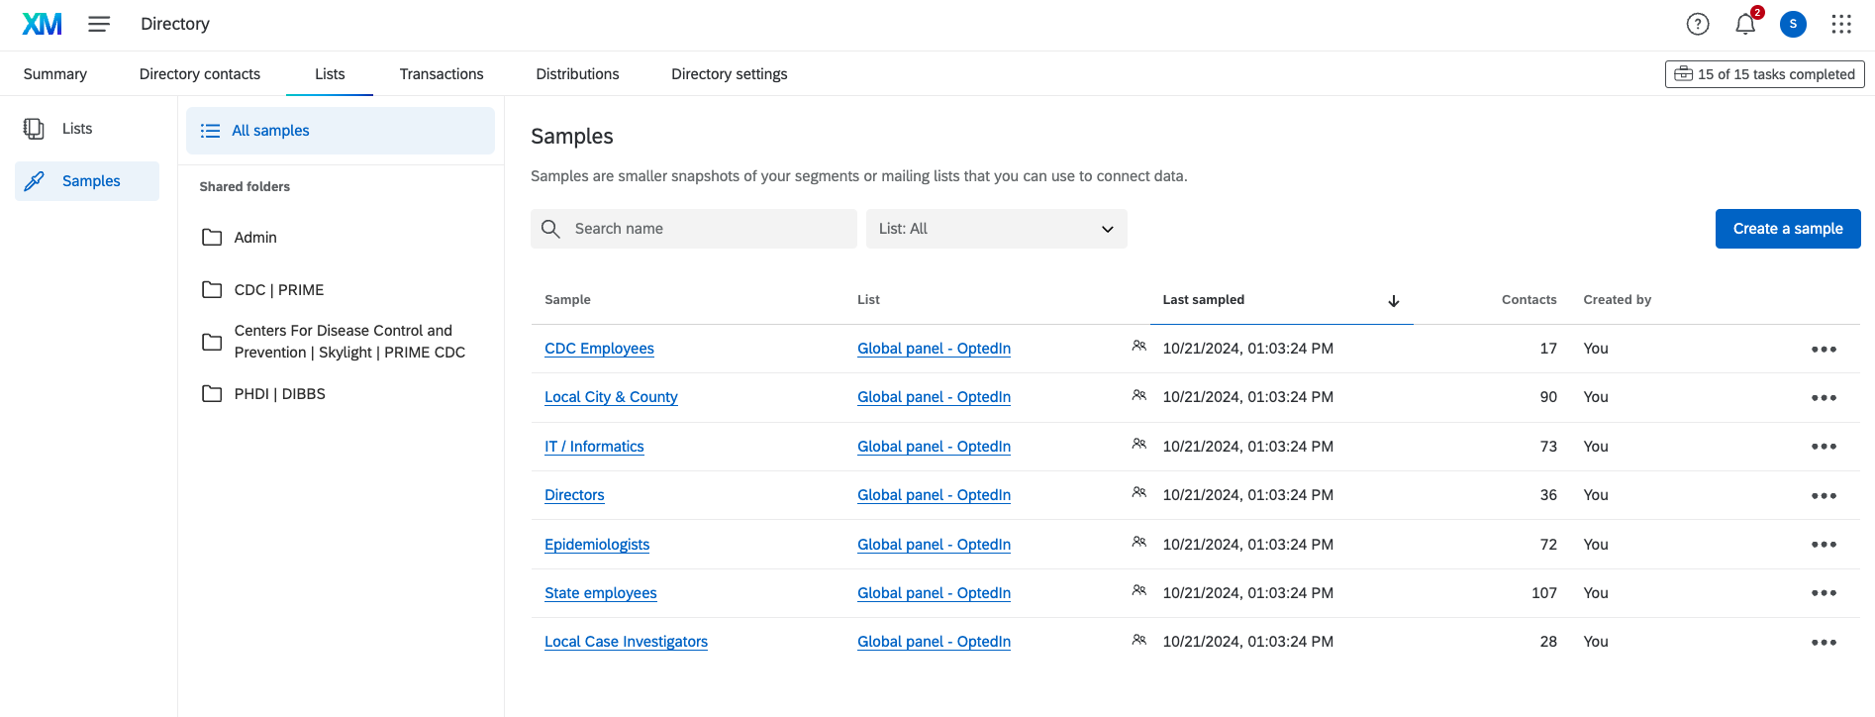
Current lists and samples

Slide 14
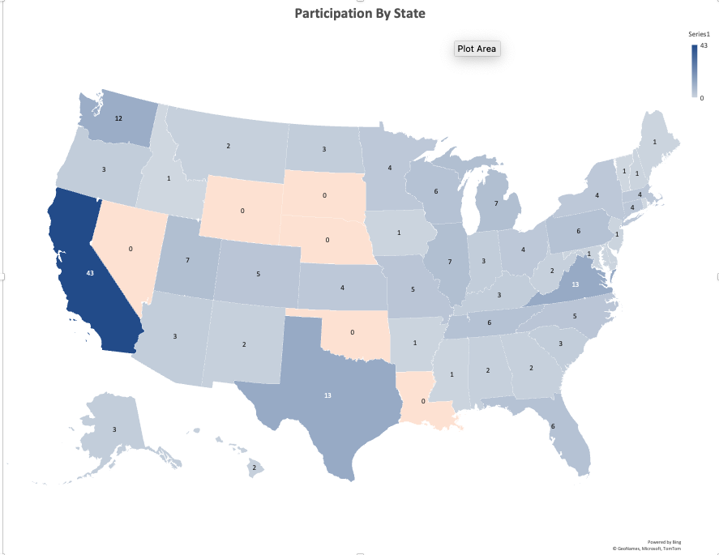
Demographics
Reach
Territory or Tribal Nation | Count
Commonwealth of the N Mariana Islands | 1
Chickasaw Nation | 1
Notes:
We can now easily see which public health departments we haven’t solicited for product participation

Slide 15
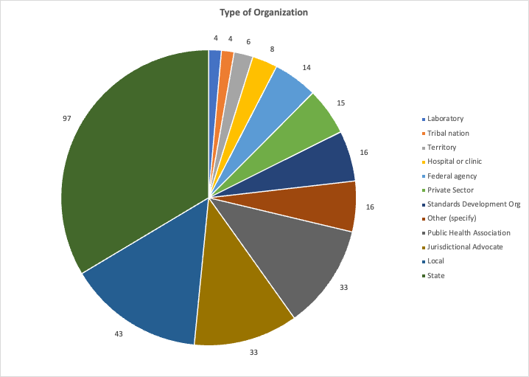
Demographics
Organization type

Slide 16
Tooling & Cost Comparison
Notes:
I'm agnostic to tooling – really. I just know that we need the ability to A) track our engagements and B) manage our lists of customers and participants and C) screen participants for activities

Slide 17
Survey Tool Comparison
REDCap
On prem, CDC-hosted instance
CDC maintained & supported
HIPAA compliant
Data export types: Excel / .CSV, SPSS, SAS, Stata, R
More complex to learn, designed for programmers and statisticians
Requires support from the REDCap team to publish surveys and extract data
Includes scheduling, audit trail/logging
Free $
Qualtrics XM
FedRAMP'd
Centrally hosted instance in cloud
24/7 technical support
HIPAA compliant
Data export types: Excel / .CSV, SPSS, JSON
Easy to use UI, fast generation & deployment of surveys for UX
Designers / PMs can launch without support
SMS, QR codes, dashboards
Panel management features
  Distributions lists, templating, gratuity payments
$1850 license
SurveyMonkey / SurveySparrow
Not FedRAMP'd
More affordable alternatives
Quick survey tools, with basic branching
HIPAA compliant
Data export types: Excel, CSV, PDF
Easy to use UIs, fast deployment
Does not support more complex survey branching
Basic list management
$2700 for 3 users / $3000 for 5 users

Slide 18
Questions?

