Slide 1

HHS Customer Experience (CX) Initiative
November 14, 2024

Slide 2
Agenda
State of CX in government - Lauren
What is the CXI at HHS - Jon
What is the CX capacity at HHS - Lauren
CXI wins - Jon
Ways to get plugged in - Jon

Slide 3
CX Across Government

Slide 4
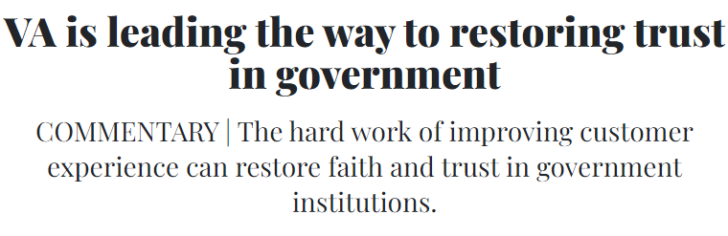
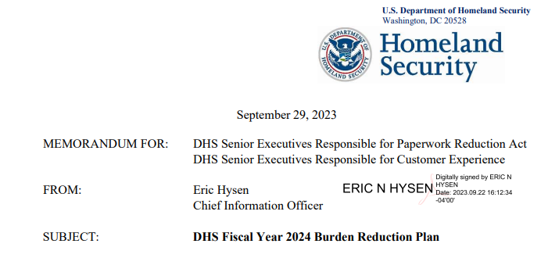
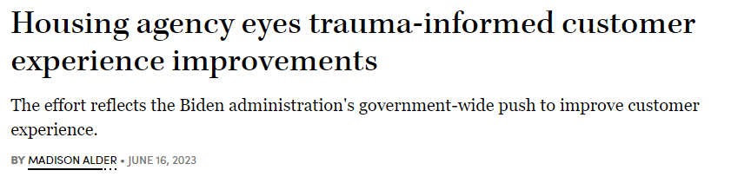


CX Around the Government

Slide 5
CX Across Government
Executive Order
In December 2021, President Biden signed Executive Order 14058 on Transforming Federal Customer Experience and Service Delivery to Rebuild Trust in Government.
High Impact Service Provider (HISP)
are selected due to the scale and critical nature of their public-facing services. (38 HISPs total)
Life Experiences
Is a new model of the Federal delivery system working together— across agencies and across government — driven by customer (“human-centered design”) research.
Notes:
Life Experiences
Requires Federal delivery system working together—within agencies, across agencies, even across levels of government — driven by customer research, rather than within bureaucratic silos and pre-conceived solutions, to solve problems.

Slide 6
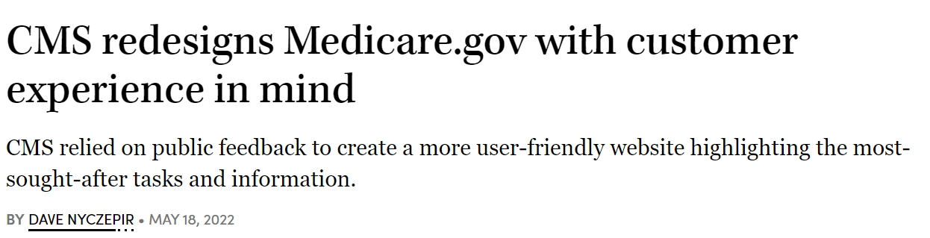
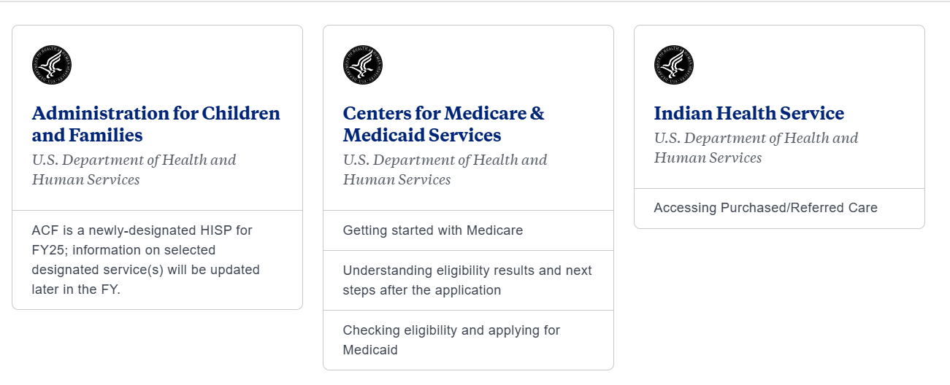
CX at HHS

Slide 7

Work across HHS: Simpler grants/NOFOs
https://simplergrants.hhs.gov/

Slide 8

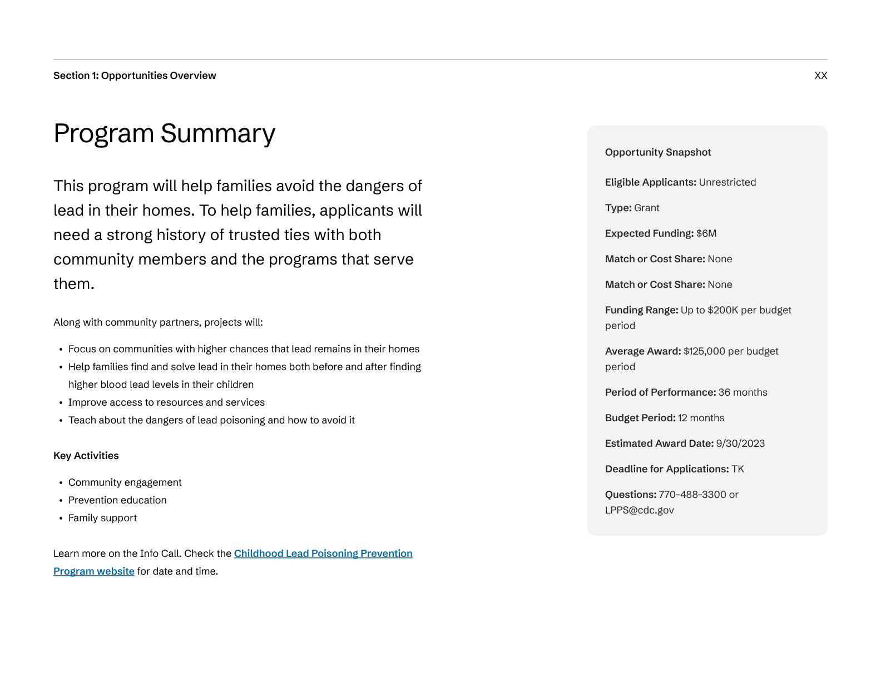
Simpler Grants/NOFOs
Goal
To make NOFOs easier for people to access, understand, and complete.
Solutions
Created and evaluated four simplified NOFO prototypes, scaling to 100 NOFOs in FY24
Hired a designer to provide CX design leadership
Prototype Improvements
60% average reduction in word count
Reduced page count by 71%, from 80 pages to 23
Reduced reading level from college sophomore to 10th grade
CDC prototype cover and summary page

Slide 9
CX Initiative at HHS

Slide 10
What is the CX Initiative at HHS
By using the Agency Priority Goal structure, we are working to build organizational CX capacity across HHS and improve our services to the American people.
The CX Agency Priority Goal is tracking 14 projects across every Operating Division at HHS for 2 years.

Slide 11





Project Overview
Tracking 14 projects as part of the CX Agency Priority Goal:
Private Sector Partners
ASFR, ASPR, ARPA-H
Grantees
CDC, AHRQ, ACL, ACF
Improving Digital Experiences FDA, HRSA, SAMHSA
Physical Visitors
NIH
Reducing Clinical Burden
CMS, IHS
Since starting in FY 2024 project teams have conducted over 250 customer interviews.

Slide 12

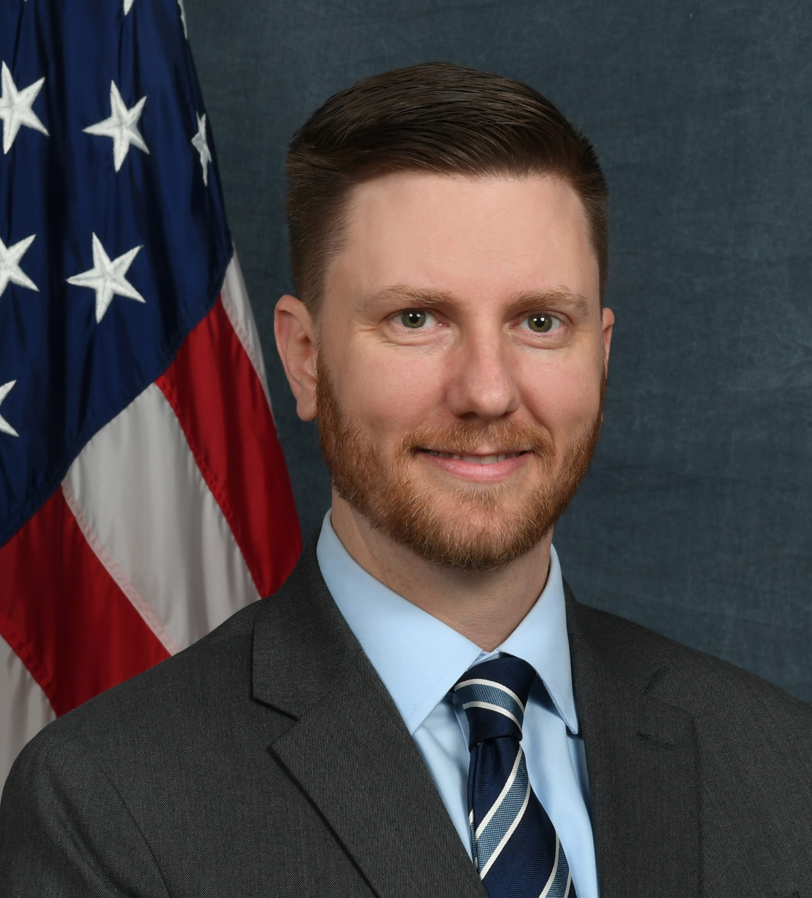
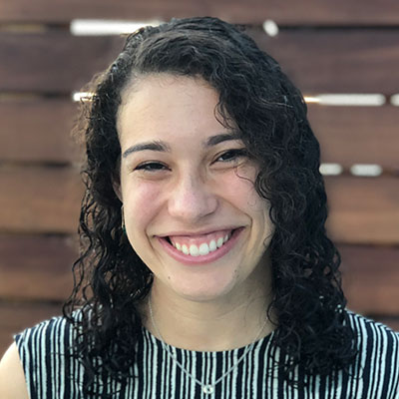
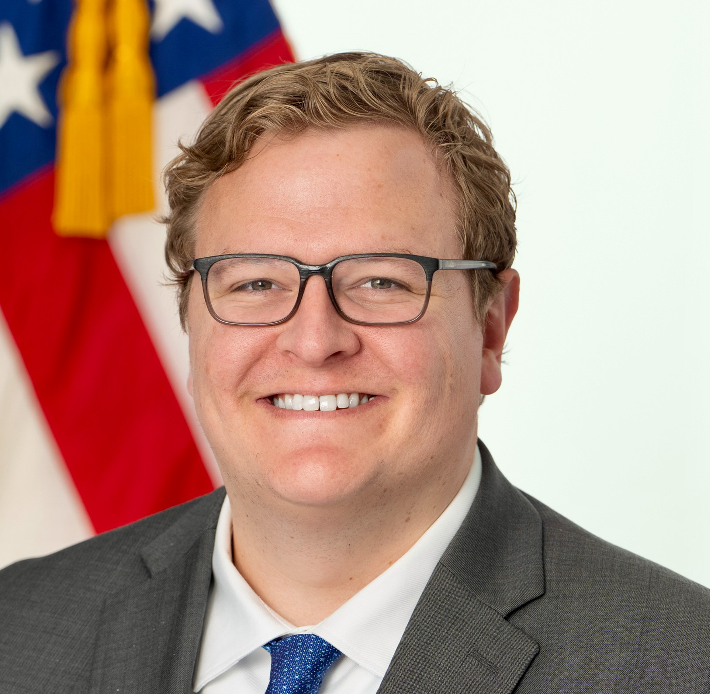
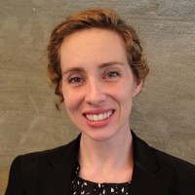

CXI Team Contacts
Julie Wiegandt
Senior Management and
Policy Advisor
Julie.Wiegandt@hhs.gov
Michael Bernier
HHS Deputy Performance
Improvement Officer and
CX APG Goal Leader
Michael.Bernier@hhs.gov
Ariele Faber
Chief Experience Officer, CMS
CX APG Deputy Goal Leader
Ariele.Faber@cms.hhs.gov
Jon Breems
Senior CX Strategist
Jonathan.Breems@hhs.gov
Lauren Anderson
Performance Analyst
Lauren.Anderson@hhs.gov
Lyndsay Brooks
Performance Analyst
Lyndsay.Brooks@hhs.gov

Slide 13
Steering Committee Members
Thank you to our Steering Committee members!
Tim Breland, CMS
Sarah Esty, IOS
Ariele Faber, CMS
Craig Gravitz, ARPA-H
Emily Ianacone, ASFR
Veronica Jones, CMS
Emily Mella, ACF
Jaime Oliva-Williams, ASPE
Jennifer Wendel, OCIO
Alphabetically by last name

Slide 14
CX Initiative Goals and Structure
Build HHS-wide CX capacity
Goal: Build CX capacity across HHS programs and job functions
Activities: Training, hiring support, CX awards, community of practice (COP), reduce barriers
OpDiv CX projects
Goal: Build CX capacity in all OpDivs by developing flagship CX projects that align with OpDiv priorities and level of CX maturity
Activities: Identify priority customers, develop project plan and goals, quarterly reports on progress over the next 2 years

Slide 15
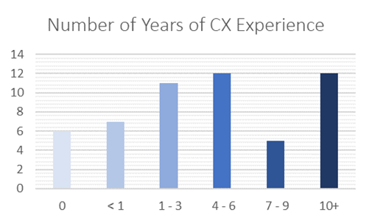
Community of Practice
Launched in June of this year
Meets monthly and includes training, resources, project spotlights, opportunities to connect across OpDivs etc.
Past Topics
FDA, Visioning Session, PRA, Simpler Grants
Future Topics
SAMHSA, SBA, FAFSA, ACF, ongoing administrative barriers
Email CX@hhs.gov to join the distribution list and get access to the COP’s sharepoint site.

Slide 16






Sharing Resources:
CX SharePoint
Guides and Toolkits
Education and Training
Upcoming Events
CX Hiring Support
FAQs

Slide 17
CXI Training Program
6-month training and coaching program with Civilla on CX best practices for 14 project teams. Trainings included:
  Customer interviews & research
  Downloading and synthesizing feedback
  Brainstorming and prototyping
  User testing
  Story telling and implementation
Final Expo for teams to present learnings from their customer research and user testing on Nov. 21

Slide 18
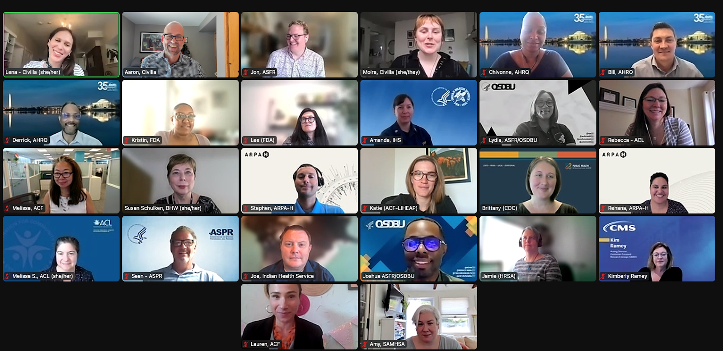
CXI Training Program

Slide 19
Capacity Assessment Findings

Slide 20
Open ended question: What do you think are the main ways people reported capturing customer feedback? Type in the chat.

Slide 21


Customer Understanding
Capturing Customer Feedback
OpDivs primarily collect customer feedback through:
  Surveys (8)
  Focus groups/direct consultation with customers (4)
  Social media and other types of online feedback (2)
They also use:
  “Contact Us” options on websites
  Formal Requests for Information
  Message testing
  Regular grants management check-ins and grantee surveys
OpDivs generally have a good understanding of their customers, especially when they have specific projects in mind

Slide 22


Use of AI
Web Traffic, Social Media, and Sentiment Analysis
There was interest and excitement about using AI to improve CX across most OpDivs
5 OpDivs are using any sort of AI to collect and analyze customer feedback
All OpDivs report measuring web traffic and social media engagement in some way, but sophistication varies widely

Slide 23


Recognizing CX and Leadership Support
Social Infrastructure and Support
All OpDivs report a high level of support for CX from leadership
  Generally expressed through awards and strategic planning/prioritization
Most OpDivs reported having some way to recognize CX achievements:
  CX awards (4)
  CX Center of Excellence (1)
  PMAPs (1)
  CX Innovation Challenge (1)
6 OpDivs already have CX Communities of Practice or similar workgroups that an HHS-wide group could build on

Slide 24
Open ended question: What do you think are the barriers to increasing CX capacity? Type in the chat.

Slide 25


Training
Barriers to Increasing CX Capacity
4 OpDivs reported offering training specifically on CX or UX
All OpDivs expressed interest in additional training opportunities
Funding (5)
Staffing (5)
Barriers associated with Paperwork Reduction Act (1)
Organizational siloes (1)
Culture change (1)

Slide 26


Hiring and Performance Plans
Funding CX Initiatives
5 reported that they did have CX staff, including:
  Chief Customer Experience Officer
  CX and User Experience (UX) designers and experts
Almost all OpDivs reported interest in hiring more CX experts; most reported needing more help to recruit and hire
Using contractors for CX projects is common
CMS is the only OpDiv that reported substantial dedicated funding for organization-wide CX
Most OpDivs pay for CX improvements within project budgets or using existing staff/contractor time

Slide 27
CX Initiative wins

Slide 28

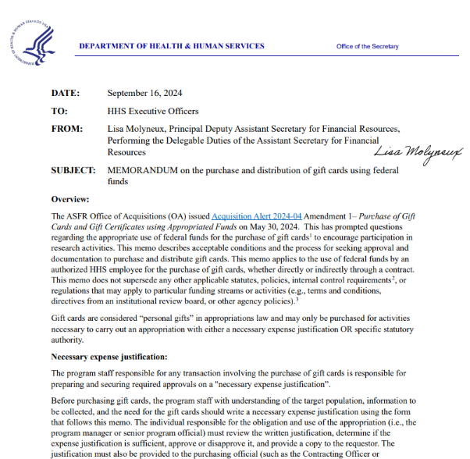
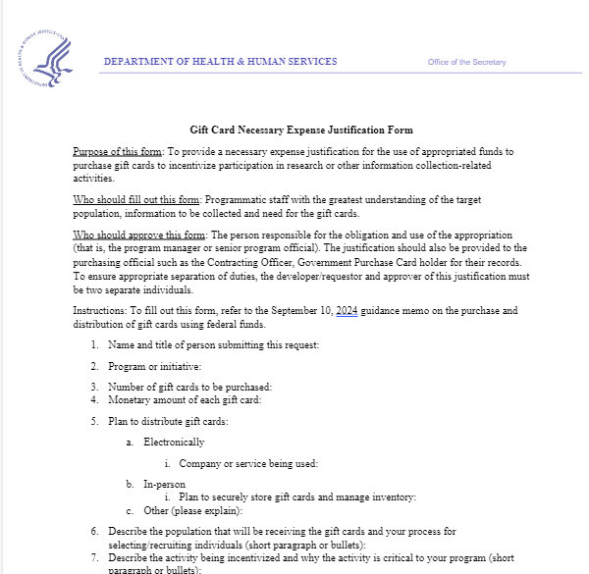
Participant Incentive Memo
(gift cards)
Using gift cards responsibly ensures that HHS can reach a diverse pool of potential research participants or customers to inform and improve HHS’s services. Both the memo and form are always available on the CX Sharepoint site.

Slide 29
PRA Tools
Last month we heard from OMB about the process to submit under HHS’ generic clearance for CX work. ASFR also developed an Aid describing the process, a FAQ document, and a Process Map. Those resources and OMB’s presentations are always available on the CX Sharepoint site.
Paperwork Reduction Act (PRA) Generic Clearance for Improving CX Aid
PRA Generic Clearance for CX FAQ
PRA Generic Clearance for CX Process Map
CMS PRA questions should be directed to Bill Parham and please see the CMS CX and Paperwork Reduction Act Playbook

Slide 30
CXI’s Future work
Develop a CX Award
Grow the HHS CX COP
Continue supporting the CX projects across OpDivs through FY25
Exploring CX priorities with the new administration

Slide 31
Ways to get plugged in

Slide 32
Polling question: Do you currently participate in a CX Community of Practice?

Slide 33
Ways to get involved
Join the HHS CX Community of Practice
  Email CX@hhs.gov
Join the GSA CX Community of Practice
  https://coe.gsa.gov/communities/cx.html Or google “GSA CX COP”

Slide 34
Thank you for joining
Please email CX@hhs.gov with any questions, suggestions, or to join listserv

