Slide 1
The Magic Matrix
How a “Matrix” HCD model can drive design strategy on highly technical programs.
T-MSIS HCD | CCSQ World Usability Day 2024

Slide 2


Hello! We lead the T-MSIS HCD Team
Amani Moaz
CMS HCD Lead
UX leader advocating for driving innovation in the public sector, leveraging experience modernizing the SSA design system and building cross functional teams.
amani.moaz@cms.hhs.gov
Jesse Michel
HCD Lead
Former business owner and civic tech leader, bringing a pragmatic, delivery-focused approach to design strategy.
jesse.michel@esimplicity.com

Slide 3
Here’s what we’ll cover today
What does HCD look like on T-MSIS?
Centralized vs Decentralized vs Matrixed
What does the Matrix Model help us do?
A quick case study
Shortcomings and challenges of the Matrix
Mobilizing the Matrix
45 min

Slide 4
What does HCD on T-MSIS look like?

Slide 5
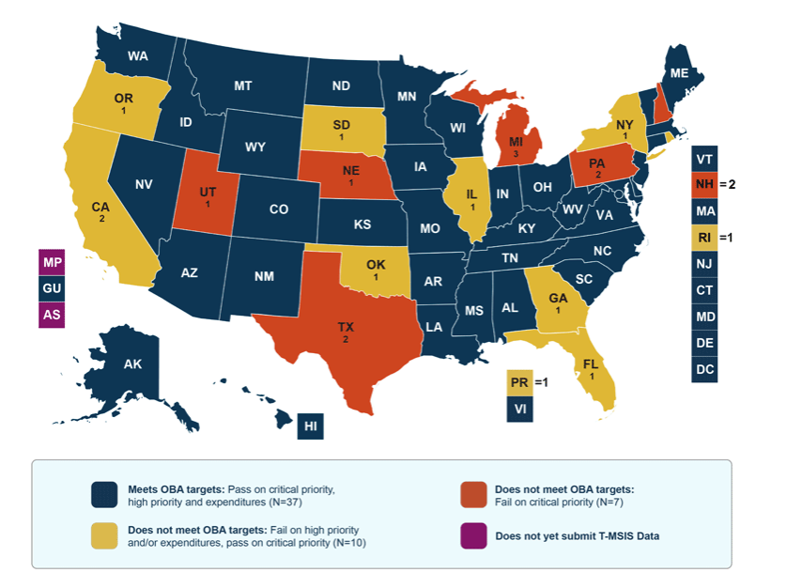
T-MSIS is a massive data ingest
54 states and territories submit their Medicaid data to T-MSIS on a monthly basis. We check the data using automated rules and measures logic, and make it available to various groups and tools for reporting, analysis, and political advisory.
Source: https://www.medicaid.gov/

Slide 6




HCD on T-MSIS is a ✨fun challenge✨
1 – Heterogeneous users
We design products and services across multiple audiences means there are rarely silver bullets that will address everyone’s needs.
2 – Large and technical ecosystem
T-MSIS operates a number of products and services that utilize a complex cloud architecture. Subject matter includes state and federal policy, data integrity, state Medicaid systems, state vendors, trading partners, and data utilization.
3 – Infrastructure and security are the top priorities.
Data Quality and cost reduction are also priorities.
4 – Dev backlog
The program is undergoing modernization improvements. This is a big technical lift that uses a lot of engineering resources.

Slide 7
Our HCD team has also grown and evolved, and we needed a framework to help us adapt to the transition.

Slide 8
How the T-MSIS HCD matrix was formed
Where it started…
Prior to 2023, T-MSIS had 1 HCD practitioner who was embedded on a product team.
2. Growth and centralization
The HCD team then grew to 7 practitioners and was established as an entirely separate product team on the program.
3. Growing pains as we enter the Matrix
After some shuffling, the team was reconfigured in a matrix model, with practitioners across multiple teams, but operating as a cohesive practice.
Note: This is where Jesse joined the project.
4. Embrace of the Matrix
The concept of reforming a separate team was floated, but by building strong partnerships across the program, the practice hit its stride in this model and has fully leaned into it.

Slide 9
3 HCD team Structures
(According to Nielsen Norman)

Slide 10
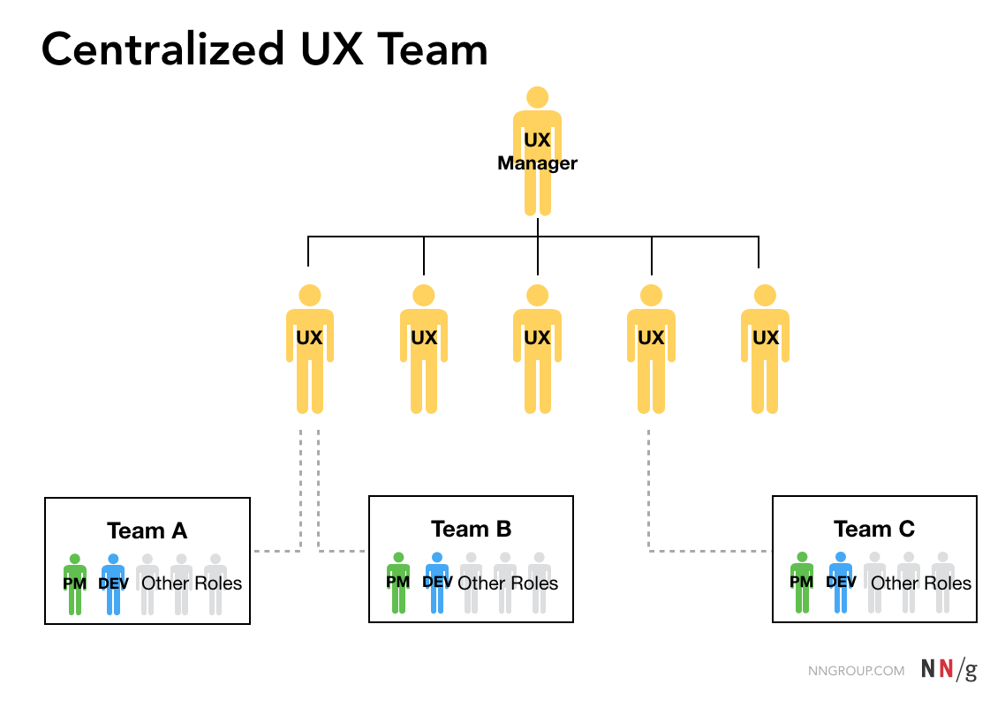
Centralized UX team
Benefits
Consistent Operations
Strength in numbers
Program-level
Simpler to manage
Challenges
Team can be “on an island”
Lack of immersion
Work sometimes "thrown over the fence"

Slide 11
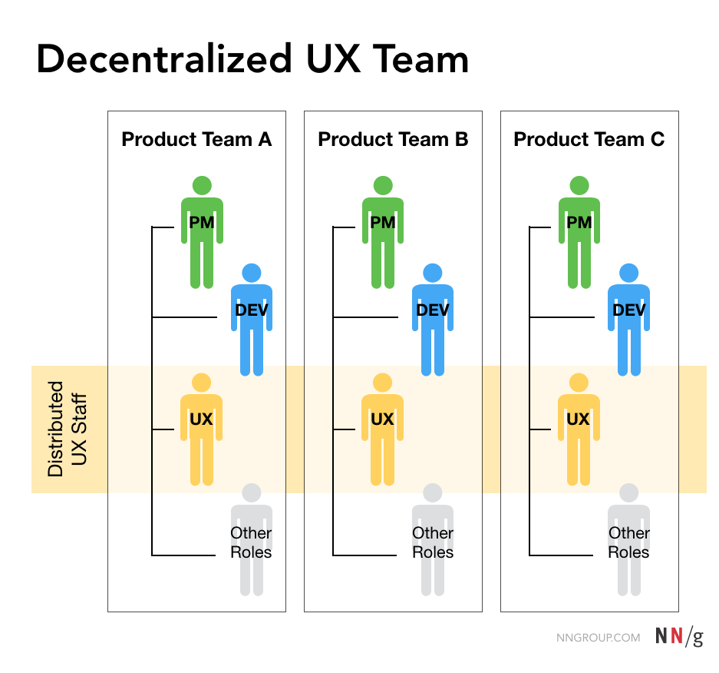
Decentralized UX team
Benefits
Integrated with product teams and planning
Full immersion with product teams
Challenges
Lack of program-wide alignment
Practitioners may feel isolated

Slide 12
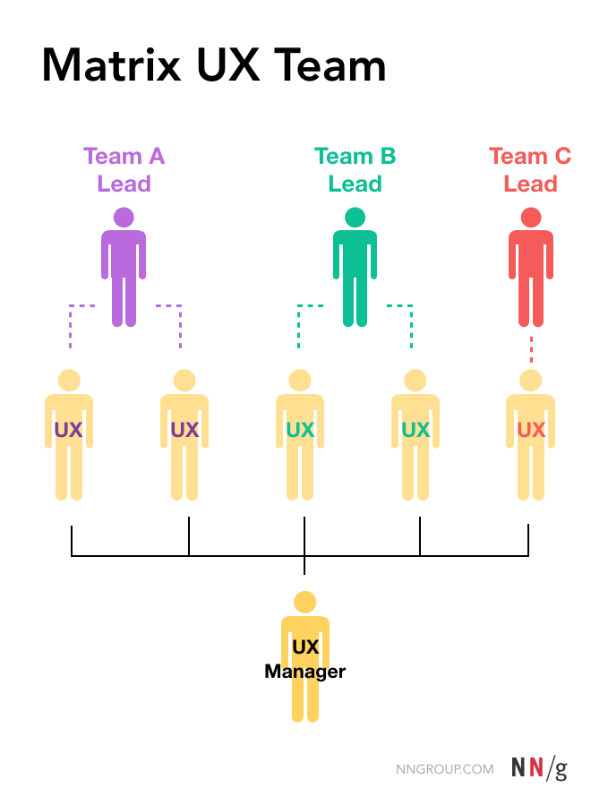
Matrix UX team
Benefits
Immersion with product teams
Practice-wide operations, standards, and strategies
Challenges
Meeting overhead
More complex to manage

Slide 13
Quick poll: What model does your HCD team operate in?

Slide 14
The Matrix model has been a major key to our success.*
*And I really never thought I’d be saying that…

Slide 15
What does HCD on T-MSIS need to do?
We need to design and deliver self-service tools that improve adoption rates and reduce program burden.
We need to identify and establish critical feedback loops to track performance and drive decision-making.
We need to communicate clearly and effectively to help users adopt requirements and remain compliant.
We need to de-risk program initiatives by prioritizing around business and user needs.
We need to drive increased maturity across the various products and services within the T-MSIS ecosystem.
The Matrix model helps us mobilize many different initiatives to address these needs...

Slide 16
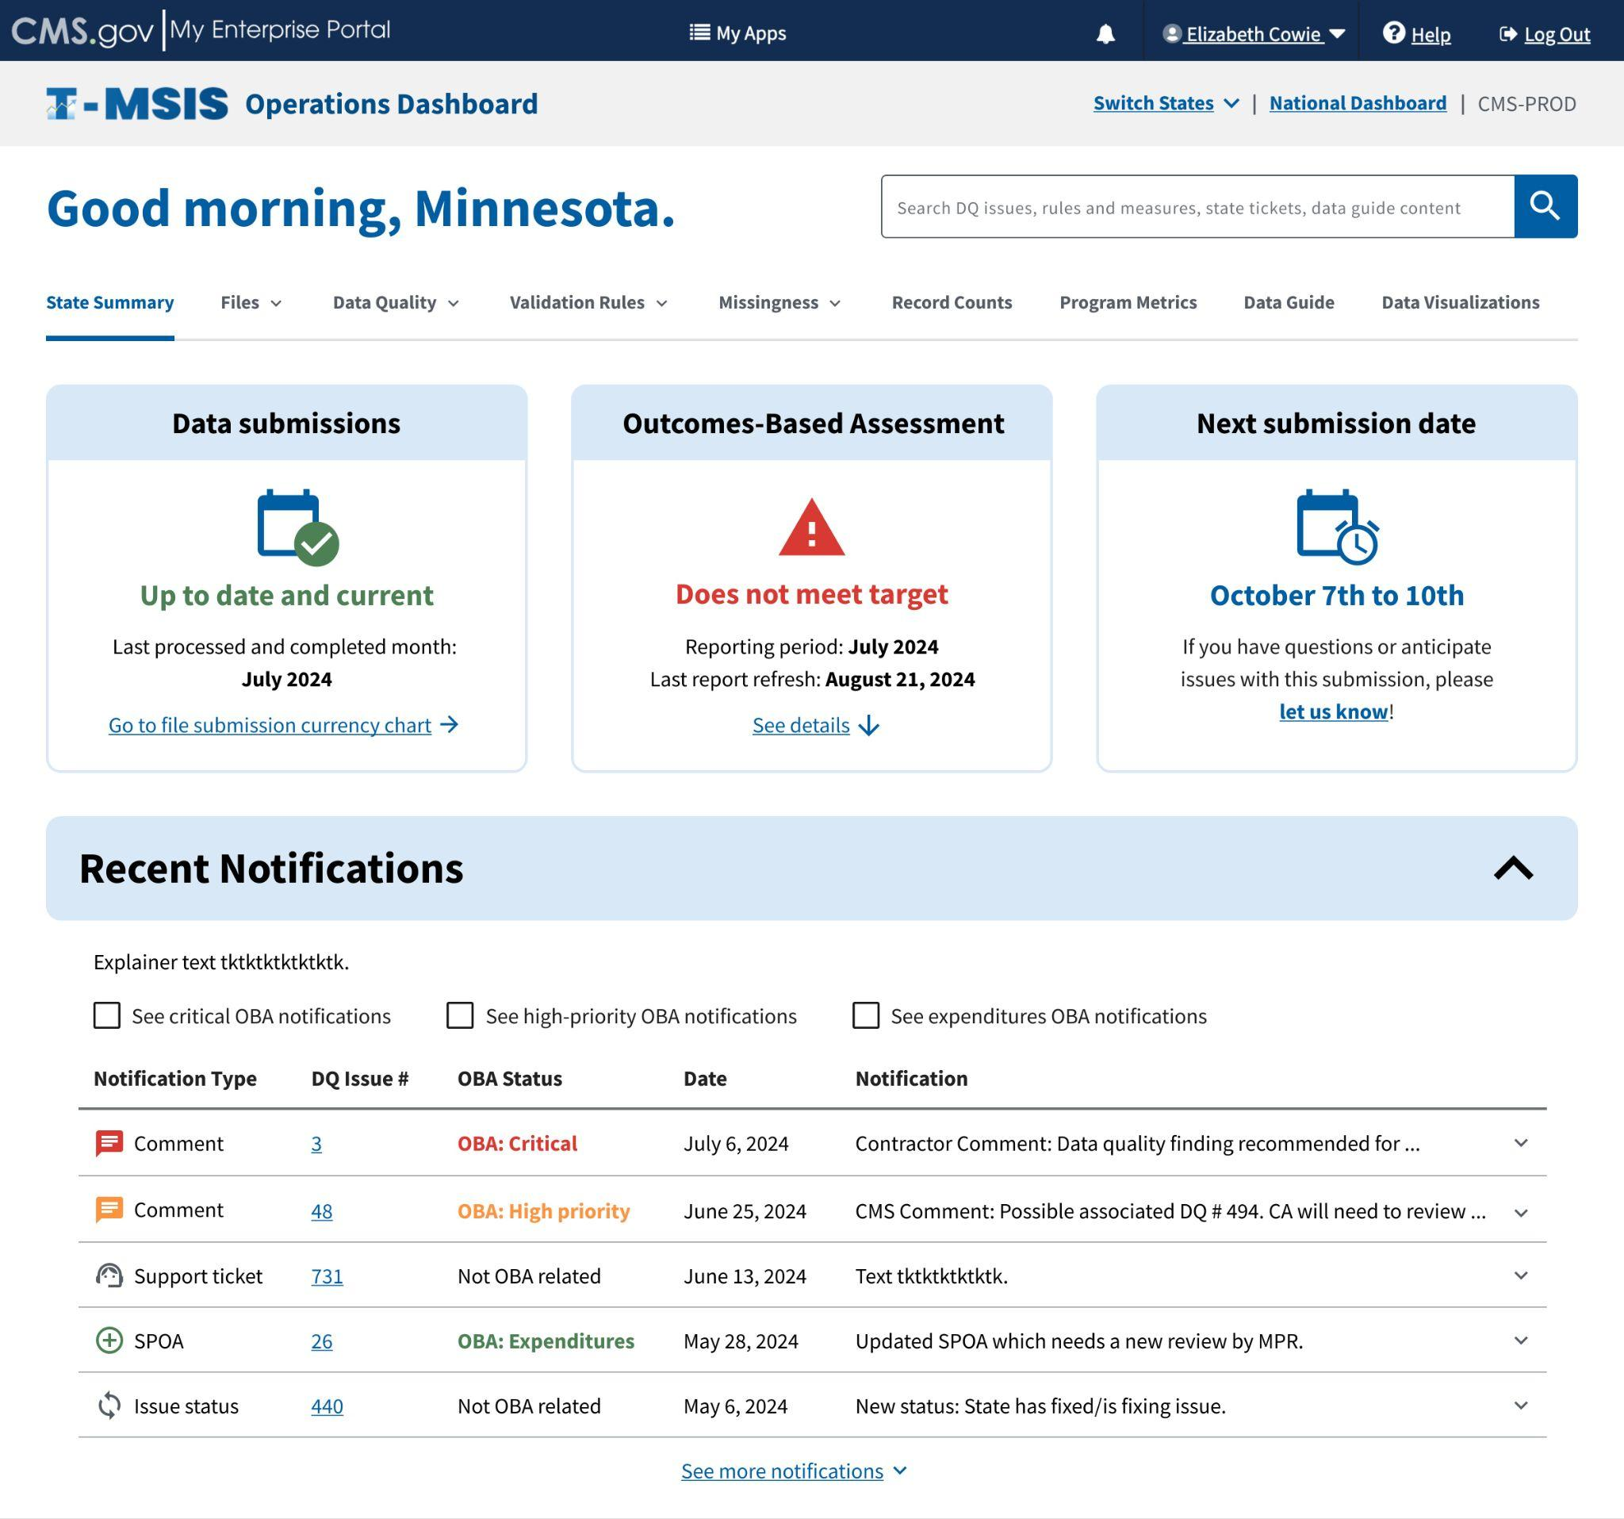
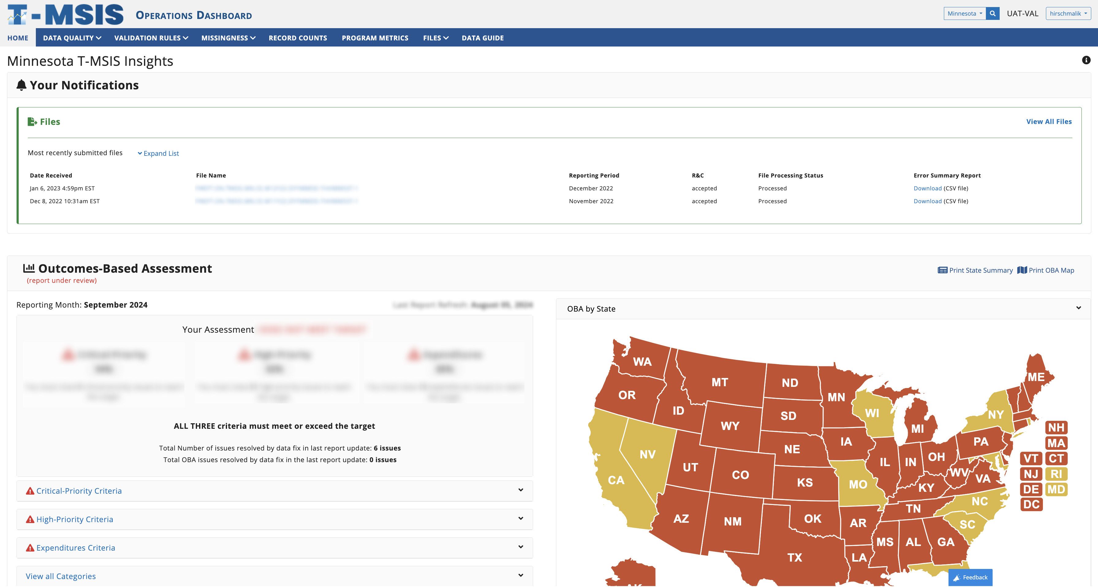
We work with engineers to deliver product design recommendations
Proposed concept

Slide 17
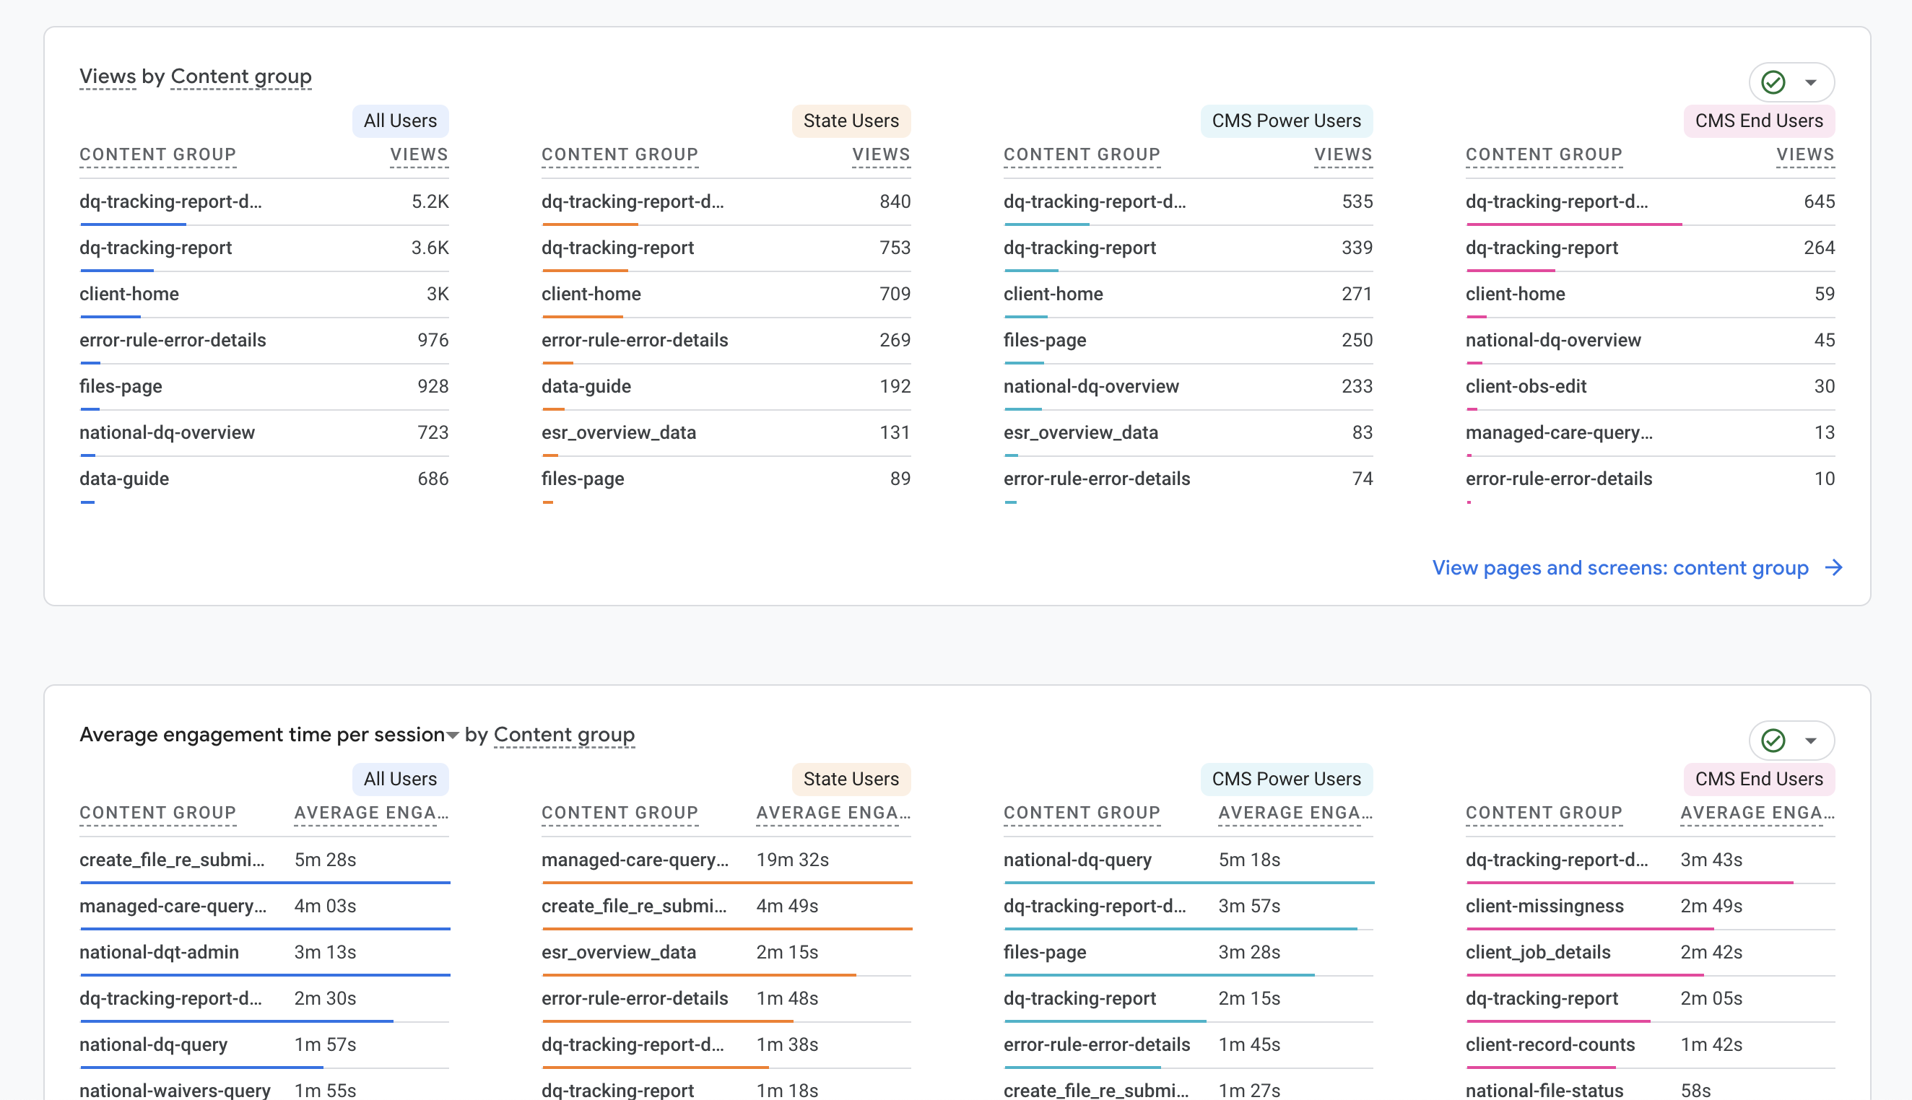
We establish critical feedback loops through instrumentation and user engagement.

Slide 18
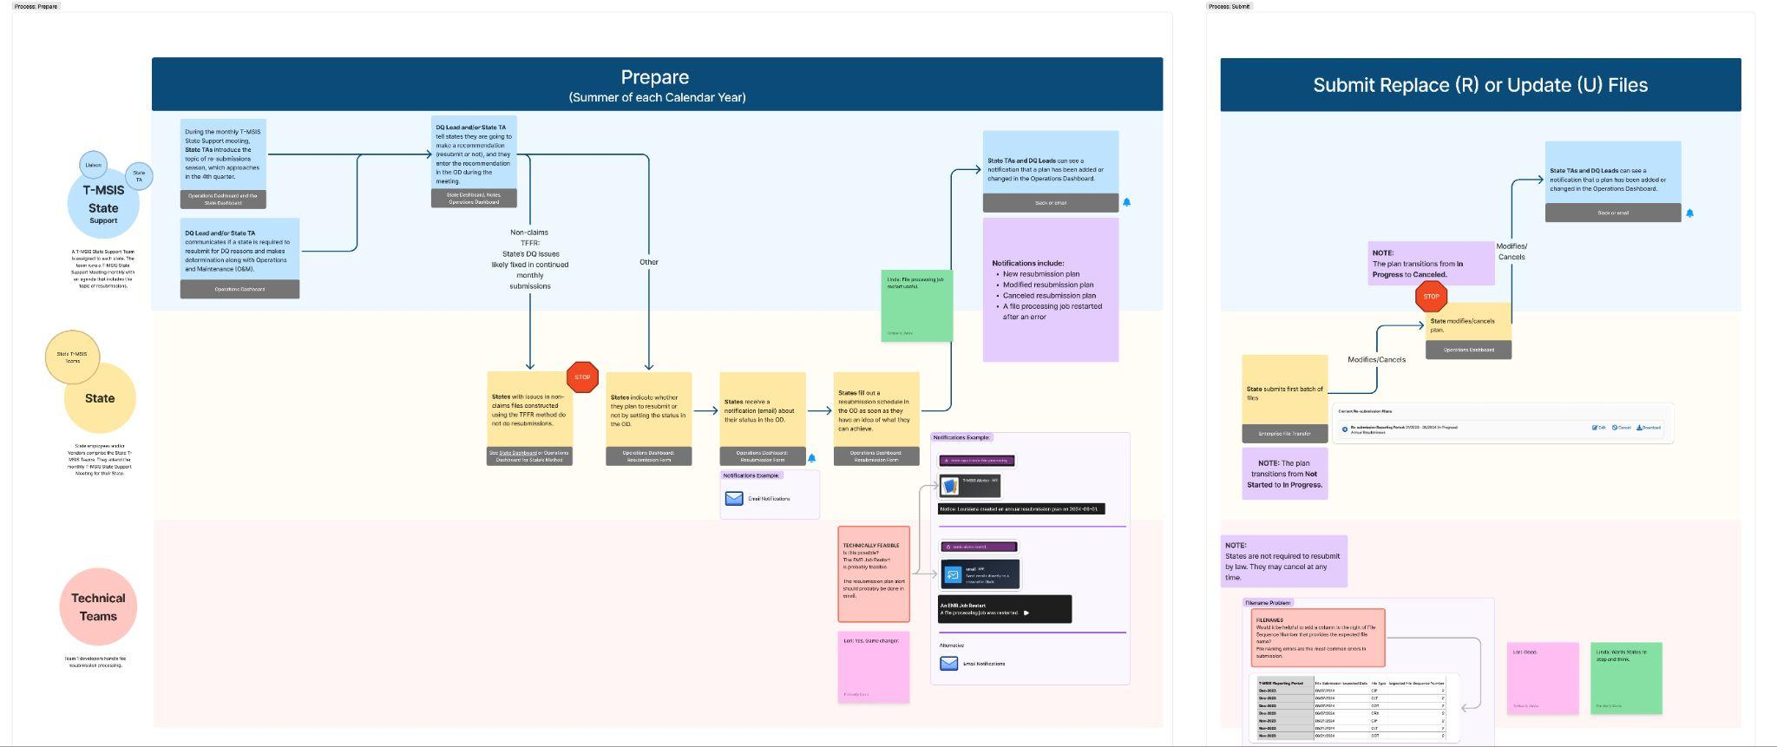
We build mental models around services and processes so that we may measure and enhance them.

Slide 19
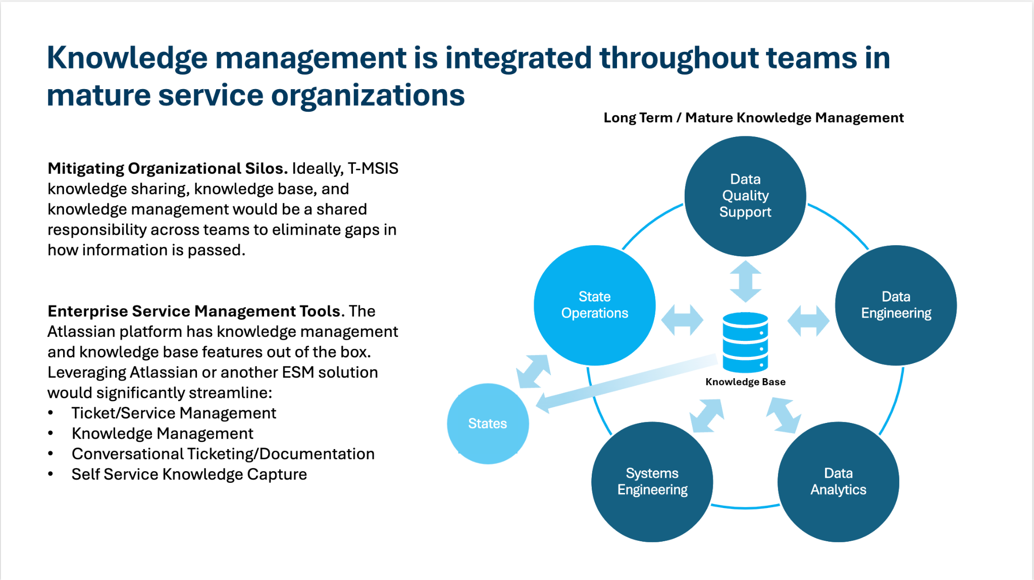
We conduct research to de-risk program initiatives, establish success metrics, and understand challenging problems.

Slide 20
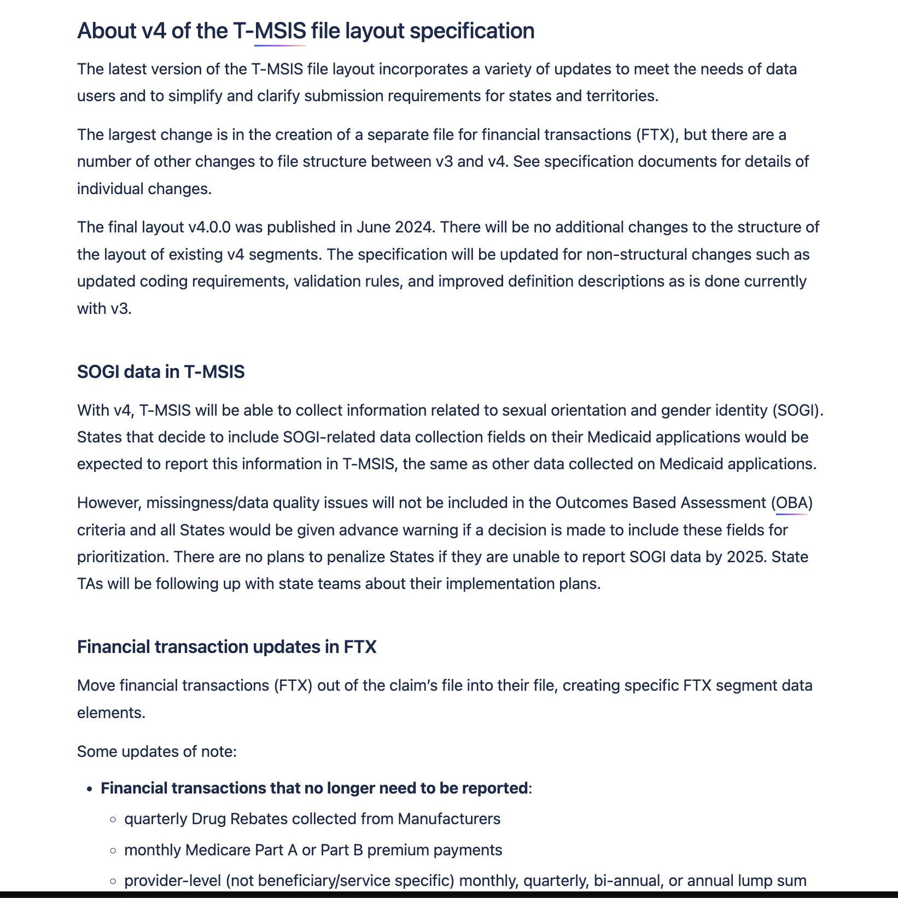
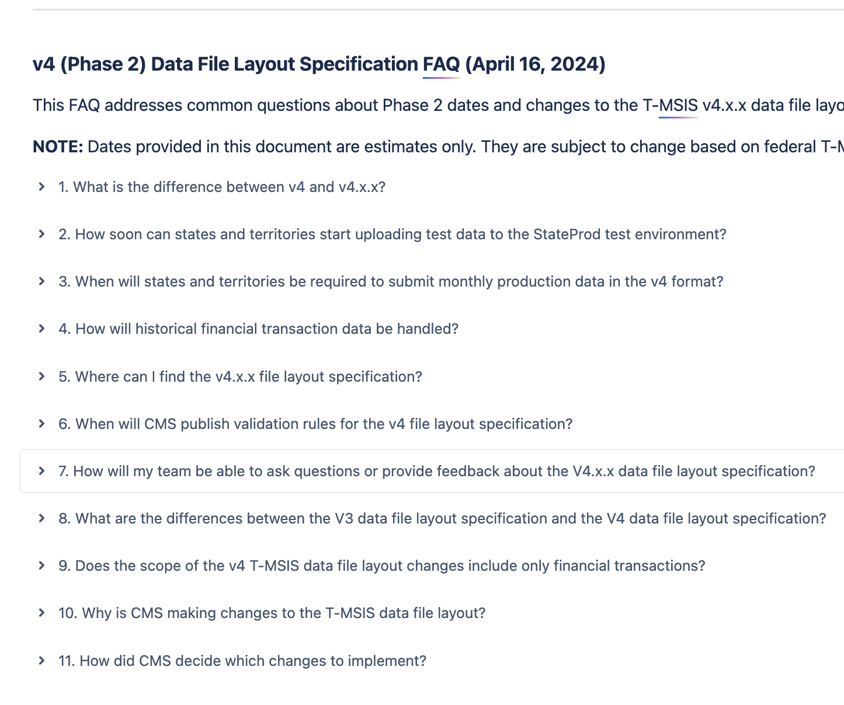
We apply content design and strategy to both internal and user-facing tools, resources, and support channels

Slide 21
Where does the Matrix Model come in? And what makes it so ✨special✨?

Slide 22
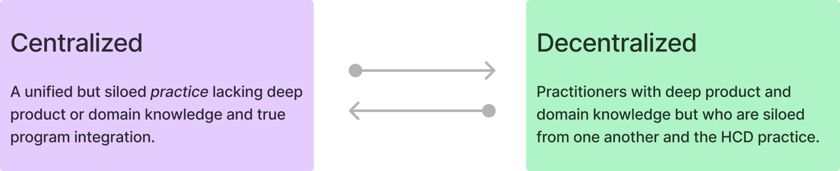
The Matrix Model has helped us avoid this trade-off

Slide 23
T-MSIS HCD operates as individuals on separate teams and as a cohesive practice.

Slide 24

We build strategic relationships by immersing ourselves with our product teams
Practitioners are fully immersed in their product teams’ Agile ceremonies and day-to-day work
Working this way, HCD is able to gain a deep understanding of the subject matter that we use to drive best practices across cross-functional workstreams.

Slide 25
What does this look like?
Prioritization of work based on business value/user needs
Deploying instrumentation to measure feedback loops
Culture, partnership, and relationship-building

Slide 26
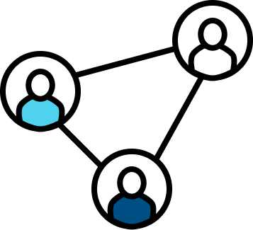
We build strong HCD culture at the practice level.
Practitioners routinely work together at the practice level to discuss strategies and approach
This also helps us maintain happy and healthy relationships with our work and with each other

Slide 27
What does this look like?
Learning & growth
Alignment
Operations & delivery
Vibe checks
Space-making

Slide 28

We leverage SAFe/Agile to make the Matrix work for us
Embracing Agile and SAFe as the program’s framework has been critical to operationalizing and maintaining the Matrix model.
Measuring business value and outcomes through feedback loops is a key part of our job.

Slide 29
What does this look like?
Continuous delivery
Sequencing
Just in Time (JIT) planning
Business value, success metrics, and outcomes

Slide 30
Poll: What tools, processes, technologies, or methodologies have helped you grow your HCD practice or your product practice?

Slide 31
Case study 1: v4 Solutions

Slide 32
V4 is a pretty big deal for us...
It's the biggest data "layout" change in the history of T-MSIS
It makes state Medicaid data significantly more usable for our data consumers
It constitutes a big lift on the part of states to adopt this format
The program needs ideas to help states prioritize work, allocate resources, and accelerate adoption

Slide 33
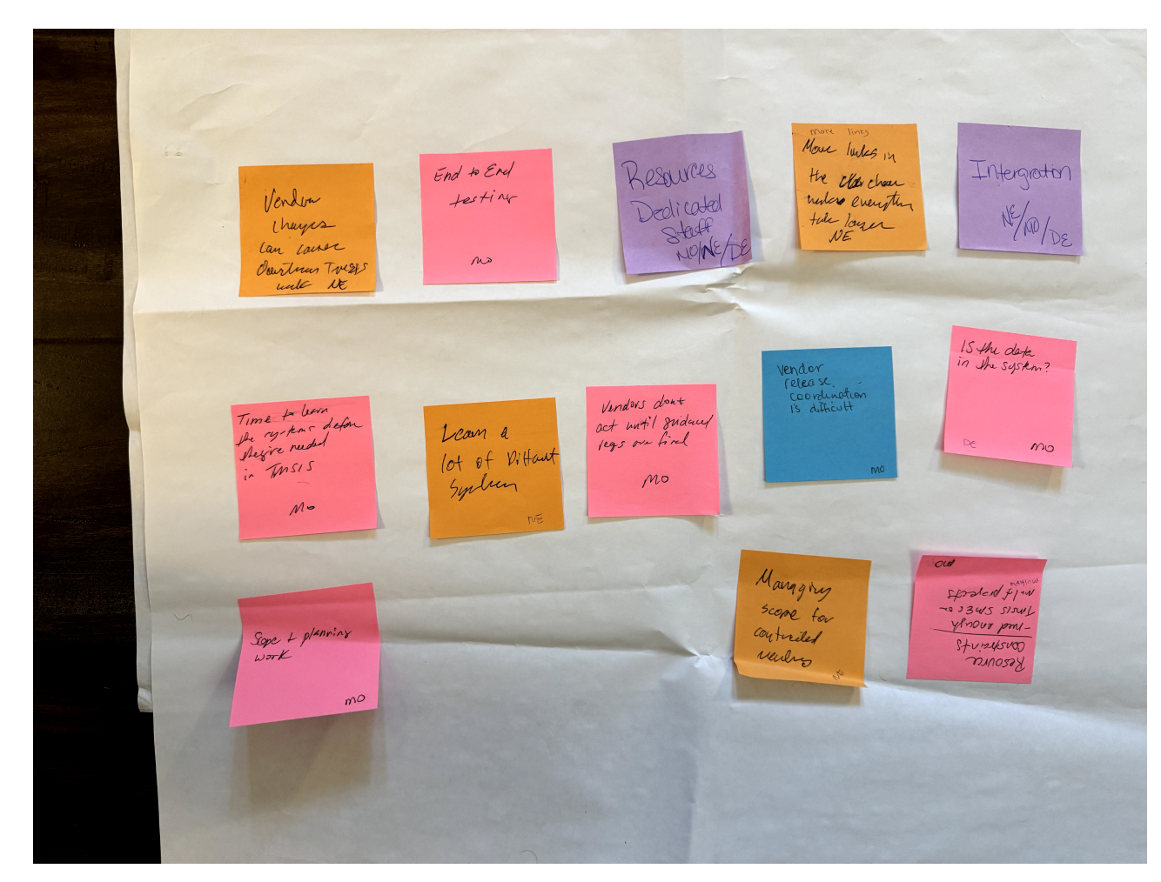
MESC was a major opportunity for us
Prior to MESC:
HCD developed the top-5 user pain points to lead a workshop on.
Additionally, HCD researchers on Team 4 worked closely with data engineers on Team 2 to develop a v4-specific workshop to evaluate enablers and blockers for adoption efforts.
We came away with a LOT of data (much of it in terrible handwriting...)

Slide 34
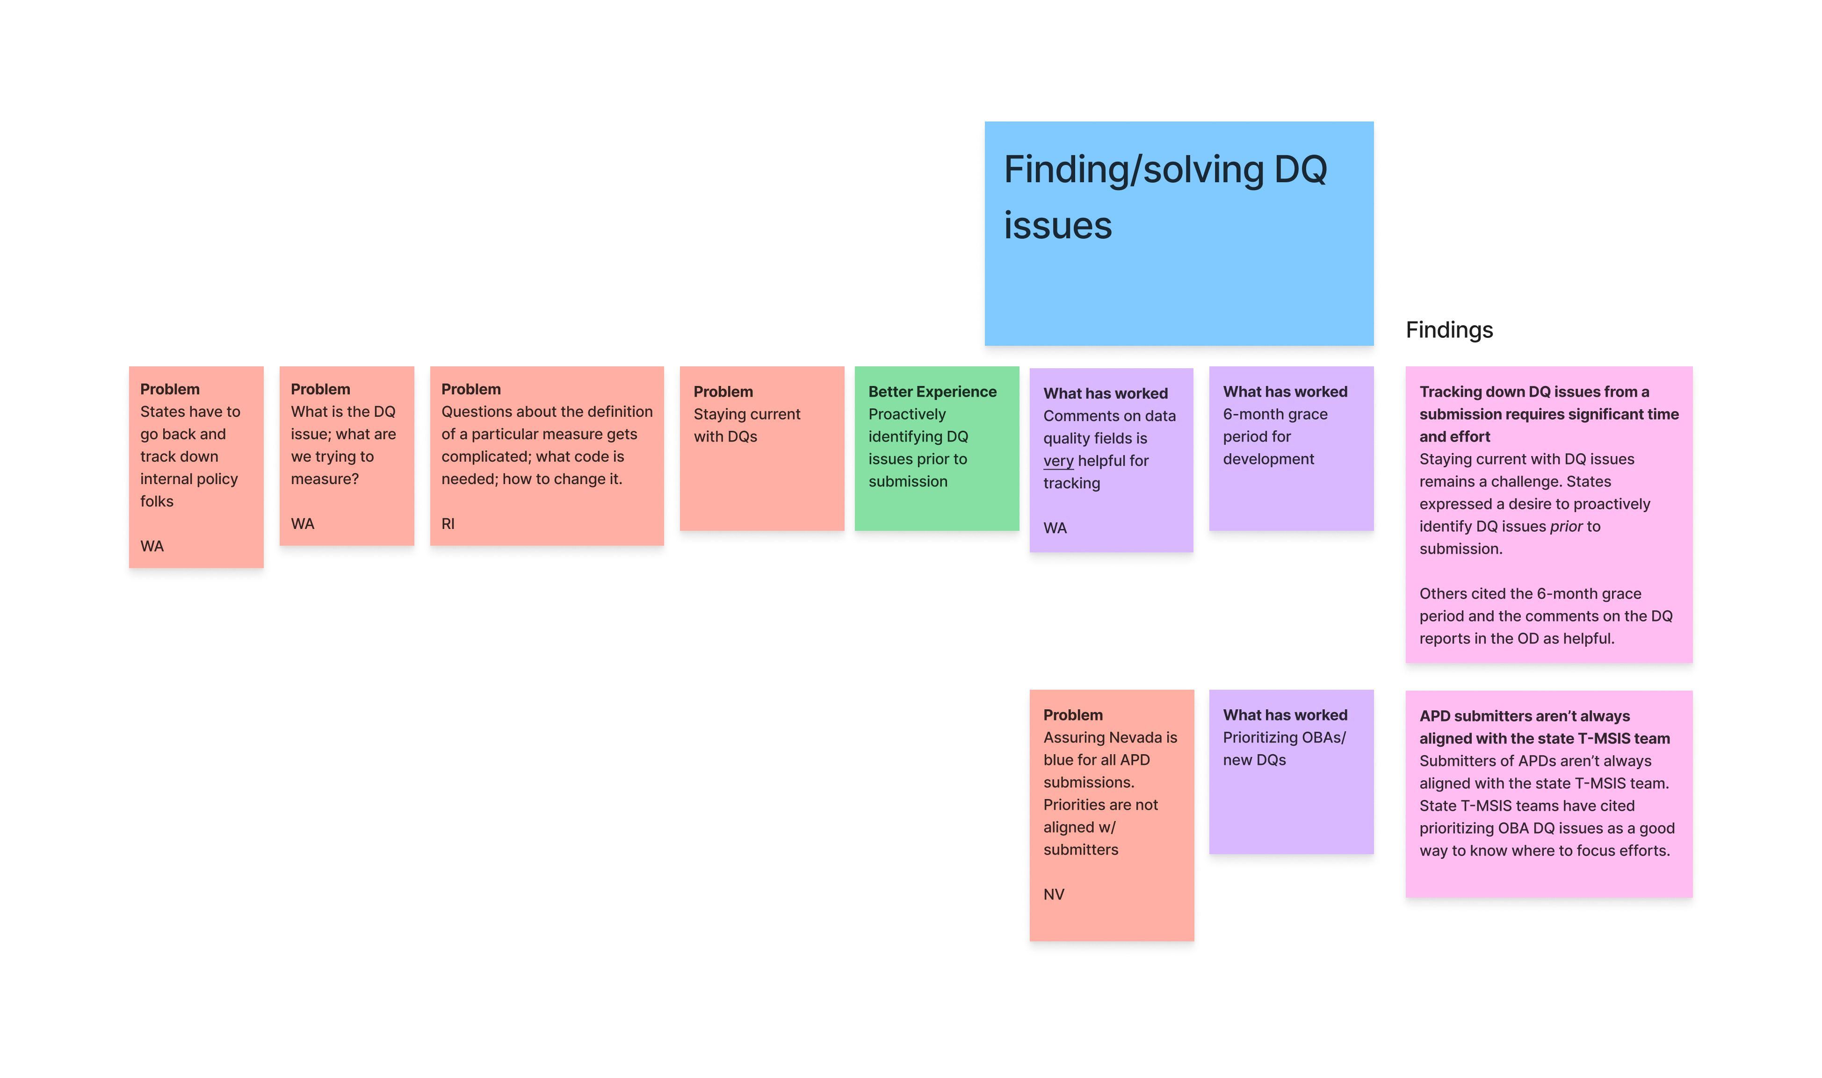
We worked across teams to synthesize
Working once again with data engineers on Team 2, HCD researchers on Team 4 digitized and synthesized the feedback we received into several insights and key takeaways.

Slide 35
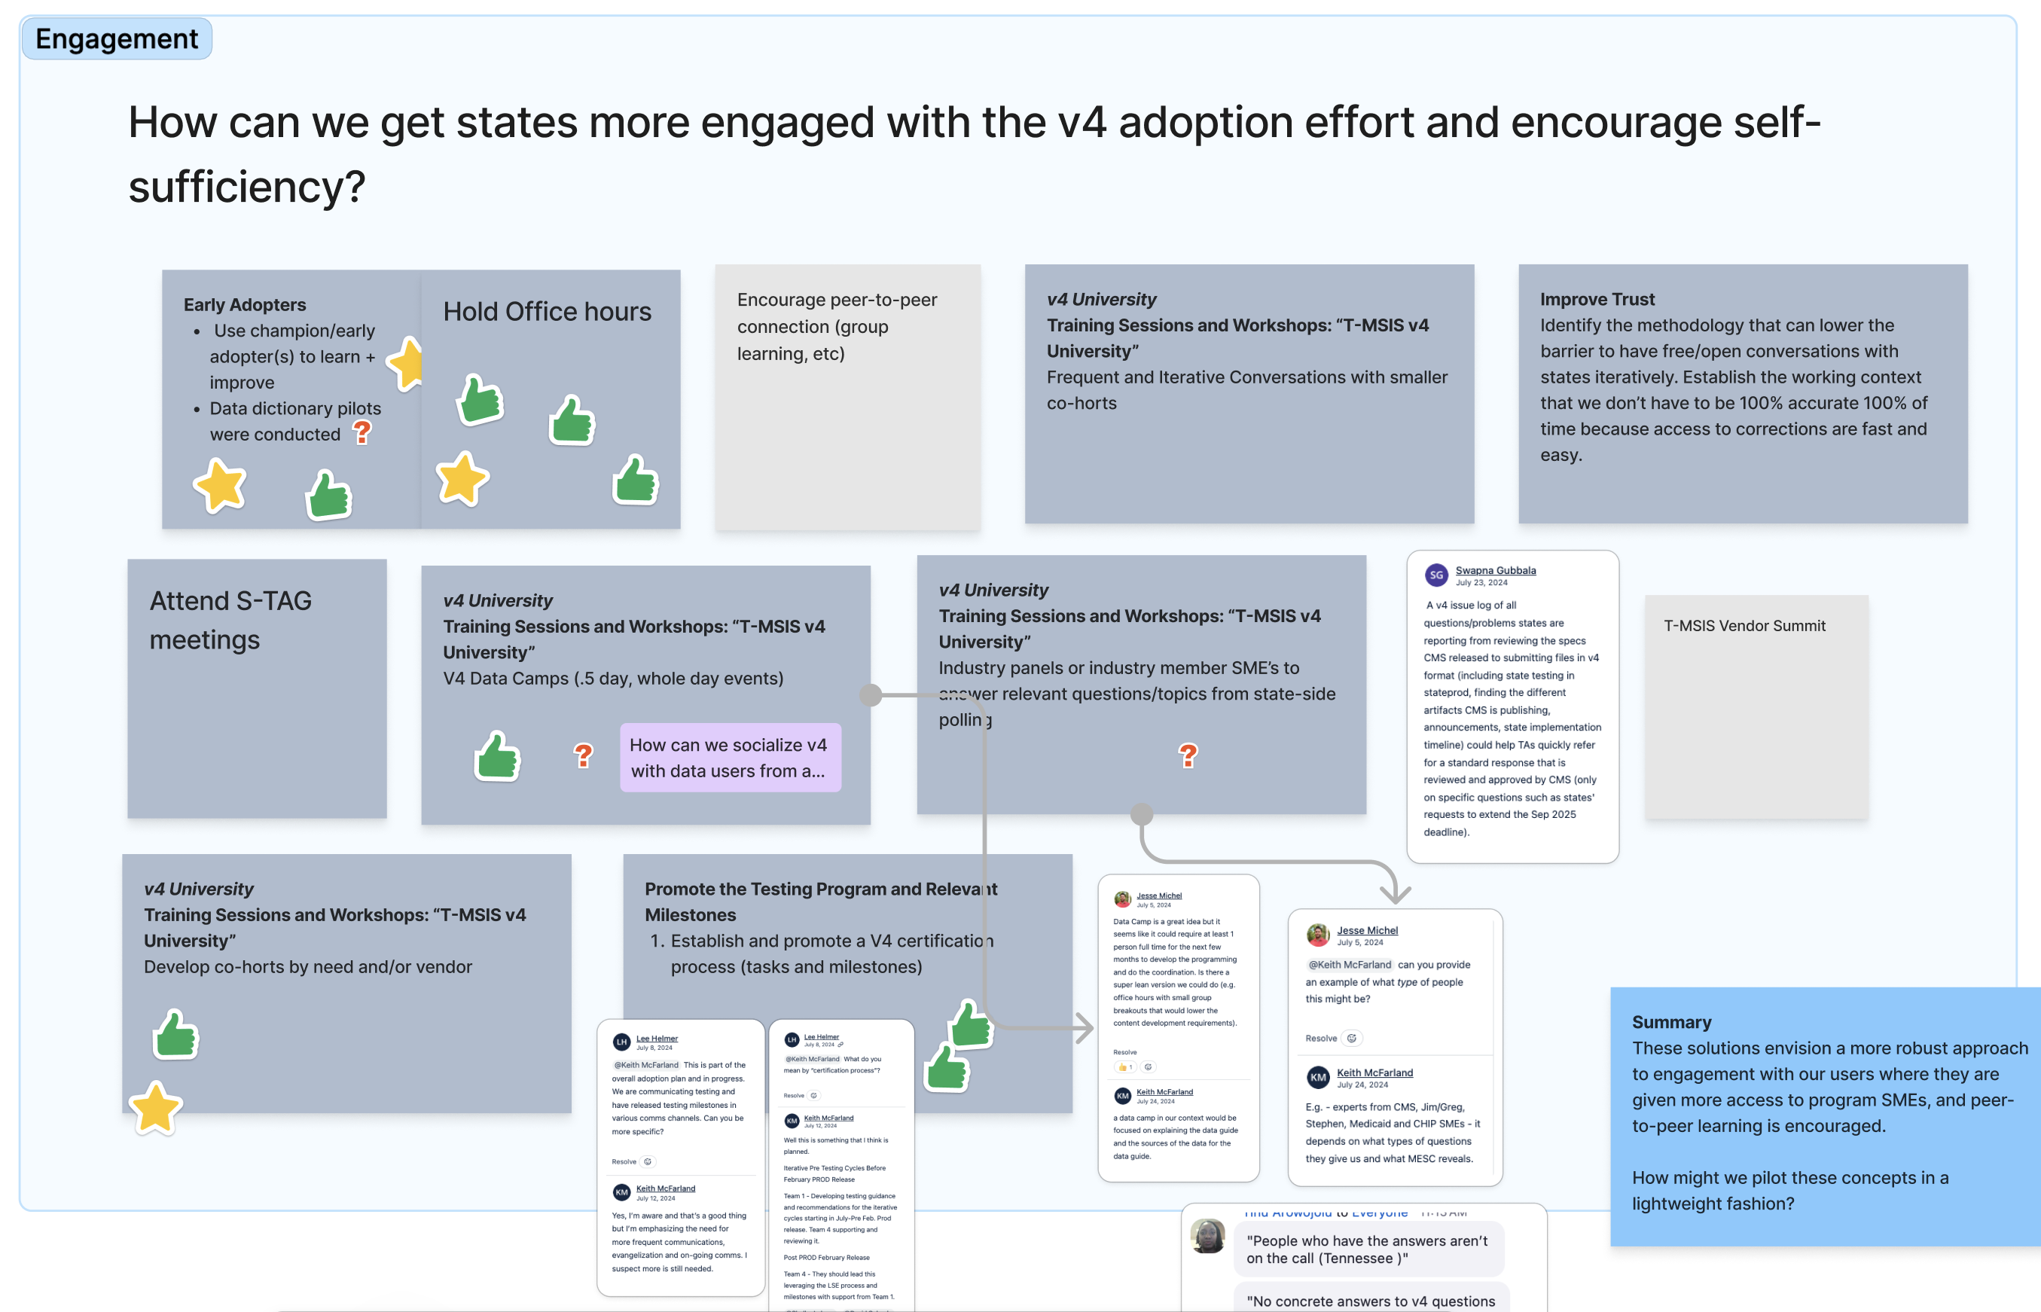
We developed a solutions workshop
Working closely with our program's product Lead, HCD researchers on Team 4 developed a 2-session workshop to identify solutions we felt would be most effective, based on the goals we wanted to achieve.

Slide 36
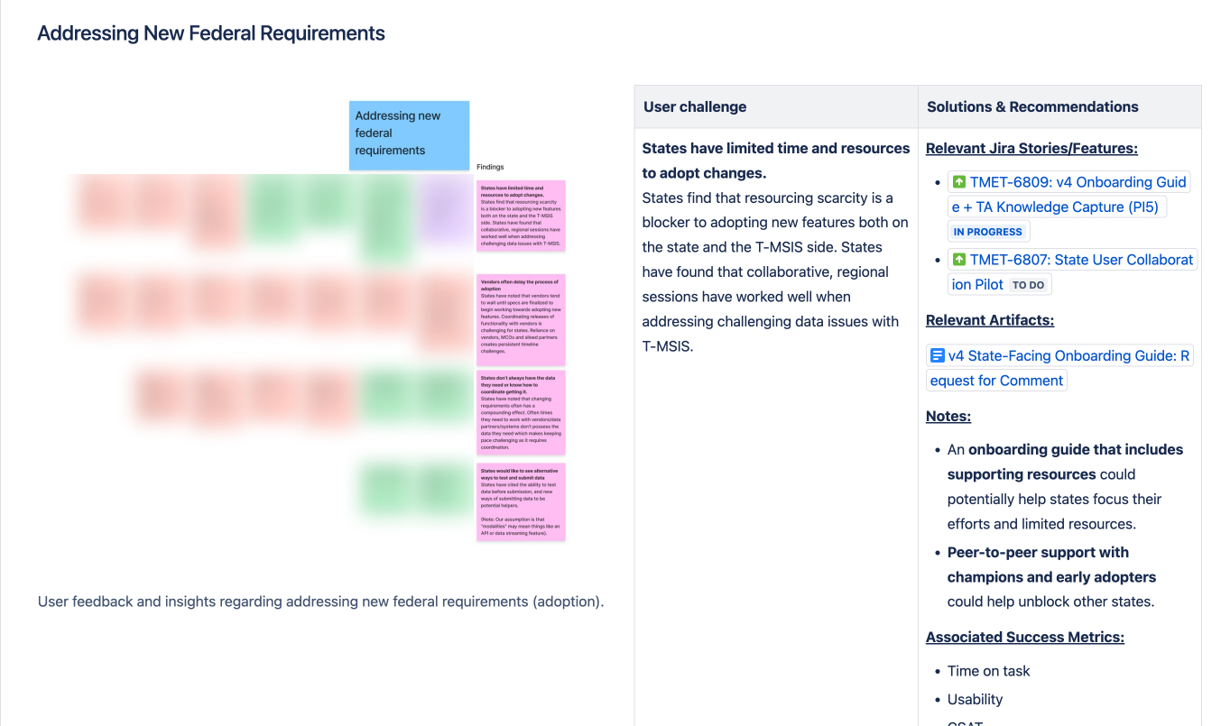
We operationalized the work
Working with our program's product lead as well as cross-functional partners on Team 4, we were able to build out a roadmap for the most critical work we identified, incorporate it responsibly into our workplan, and identify partners across the program who could support.

Slide 37
How was the Matrix helpful here?
Flexibility
While this initiative began at the program/practice level, we were able to engage product teams at critical points to drive the work using the domain knowledge and expertise of SMEs across the program.
Follow through & operationalization
The outcome is a program-approved disposition of work that is rooted in direct user feedback. This work is co-owned by cross-functional teams, and officially incorporated into our product roadmap.

Slide 38
Case study 2: Driving solutions when content strategy exposes problems

Slide 39
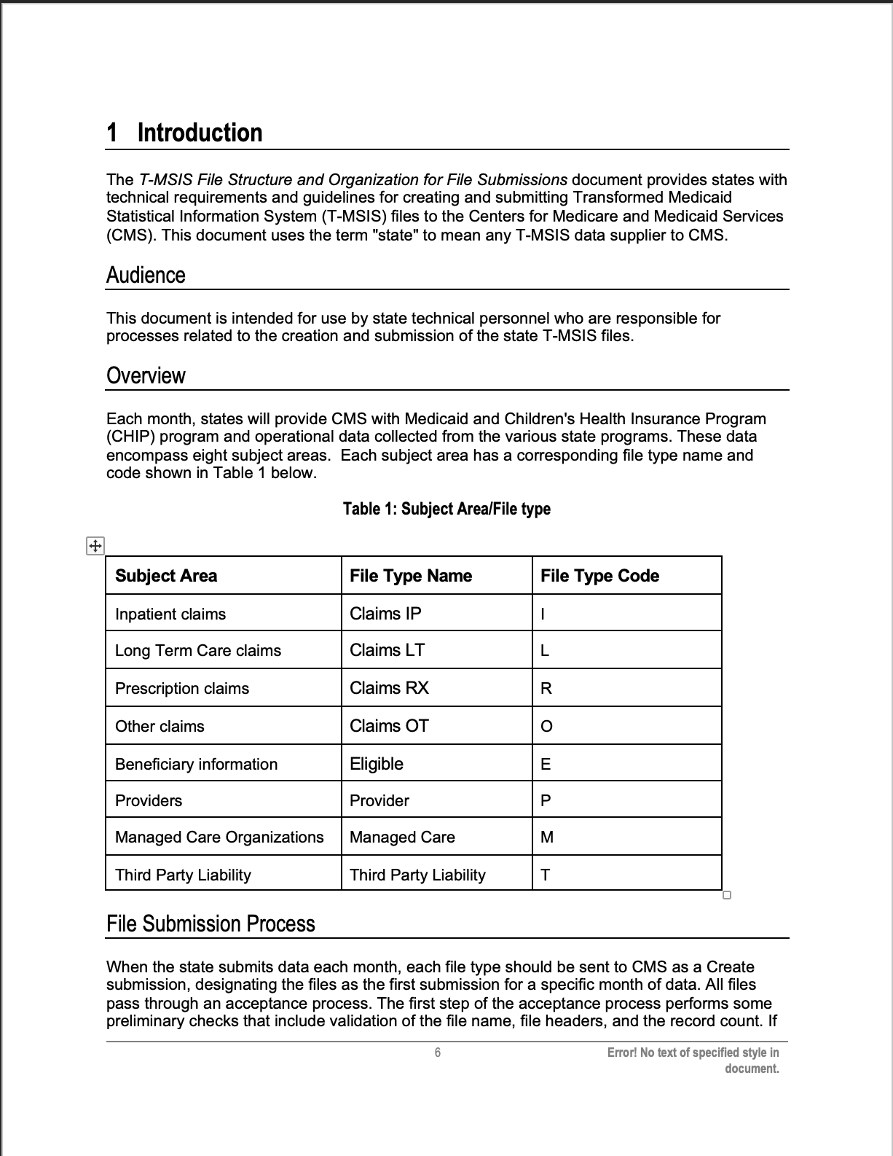
We needed users to be able to find this

Slide 40
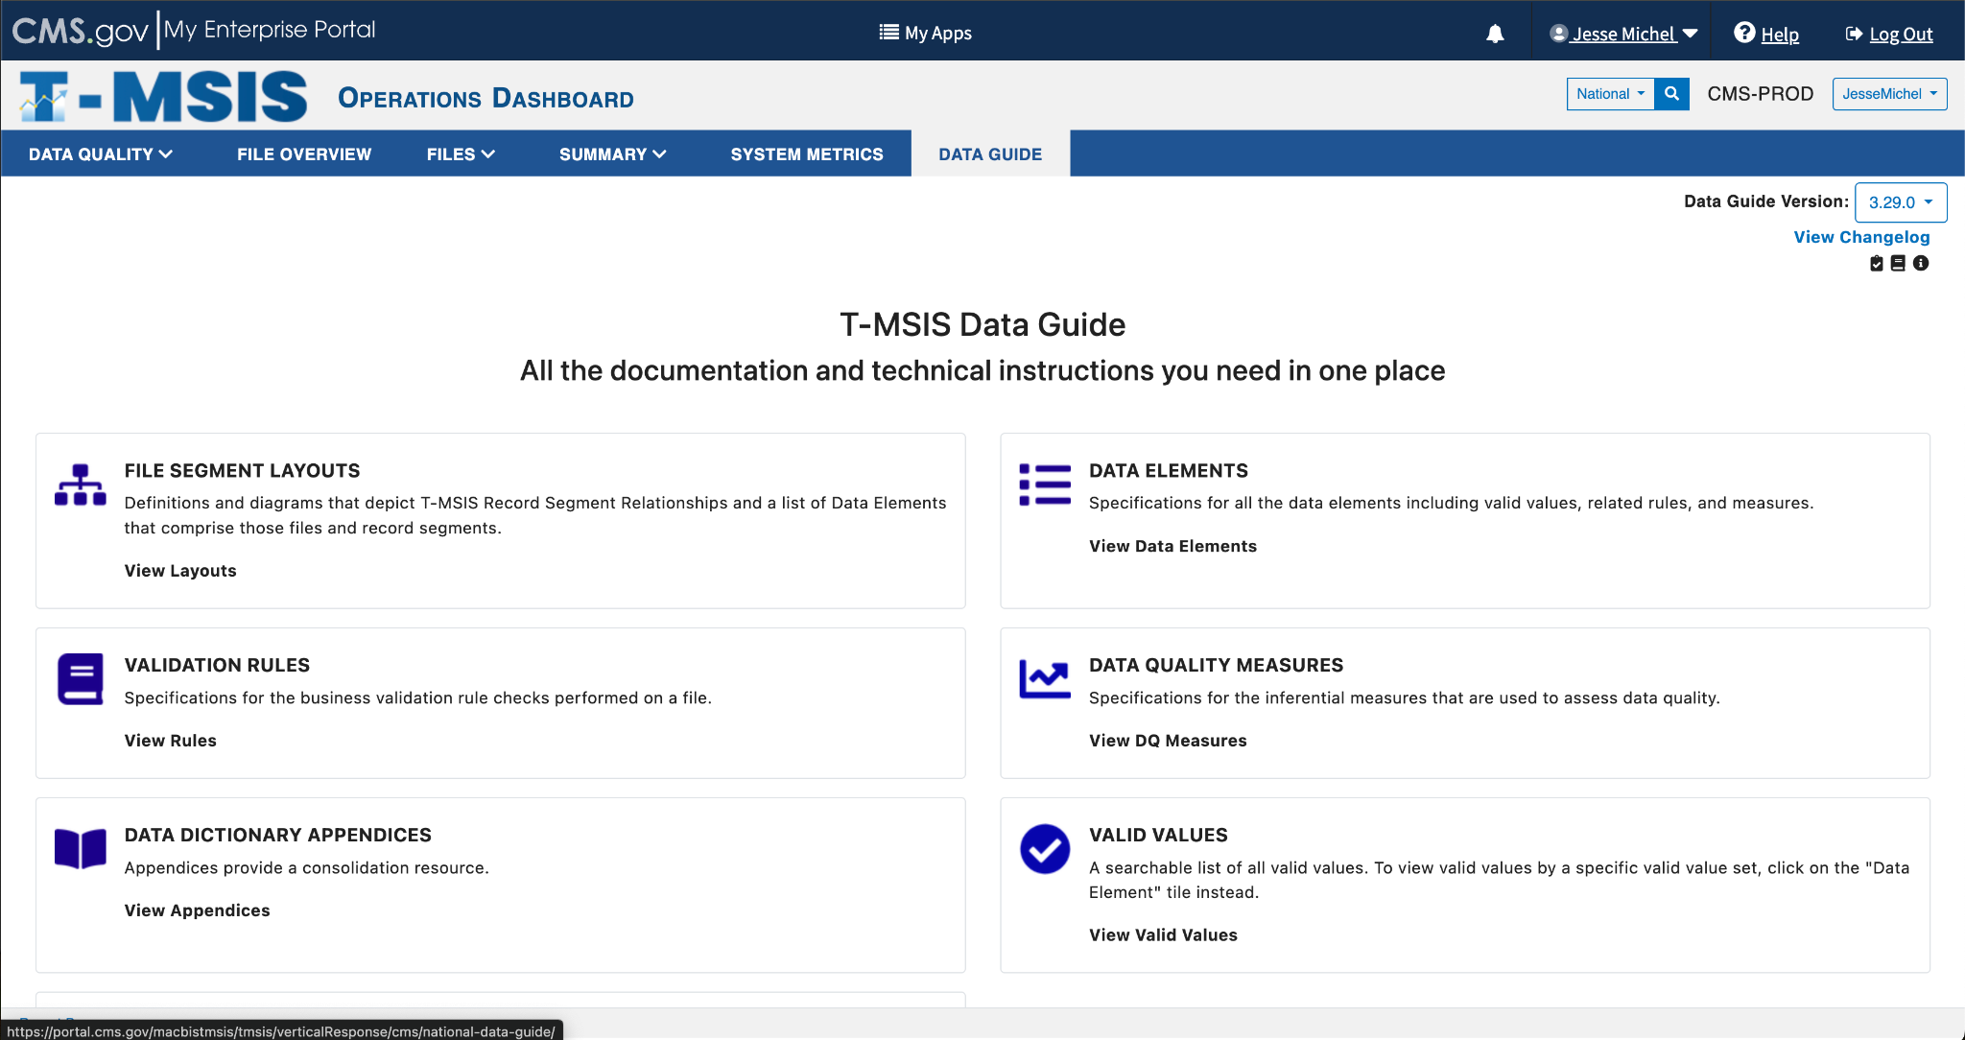

Slide 41
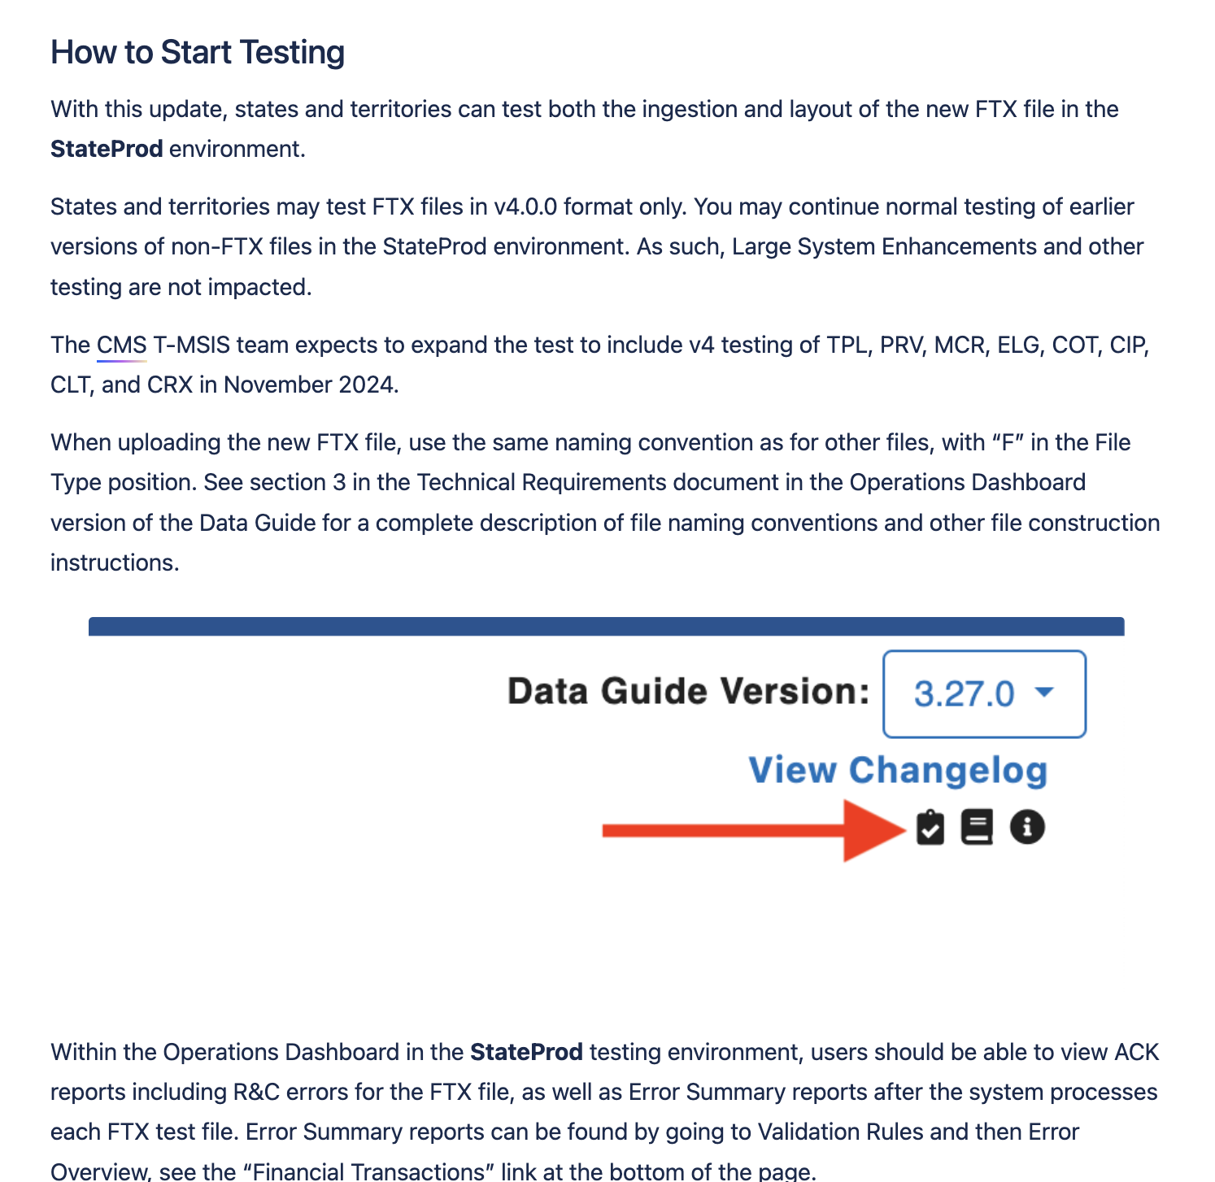
How do you communicate this to users?

Slide 42
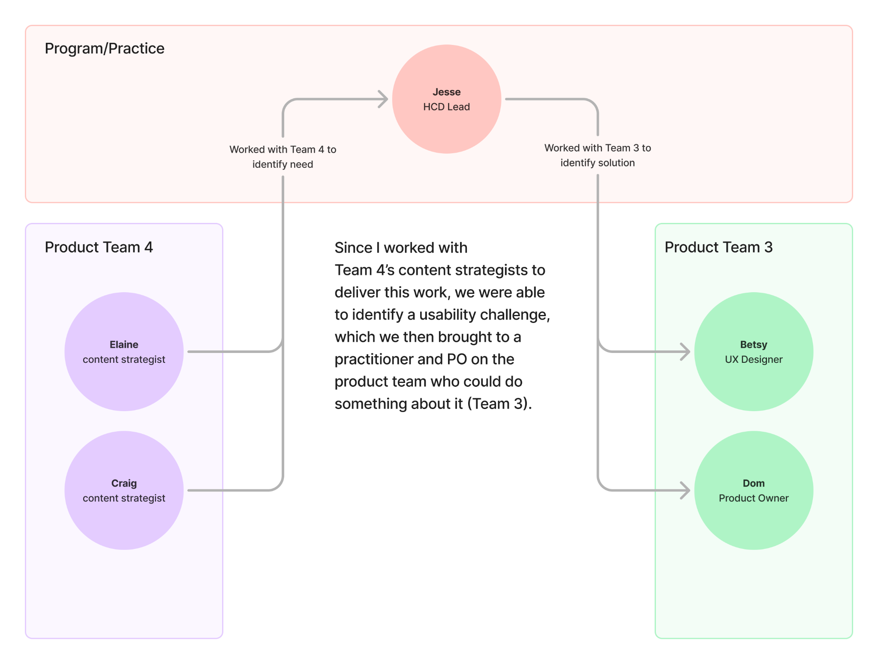
By uncovering a specific challenge at the product level, we were able to elevate it to the practice level, then work with another product team on an implementation plan.

Slide 43
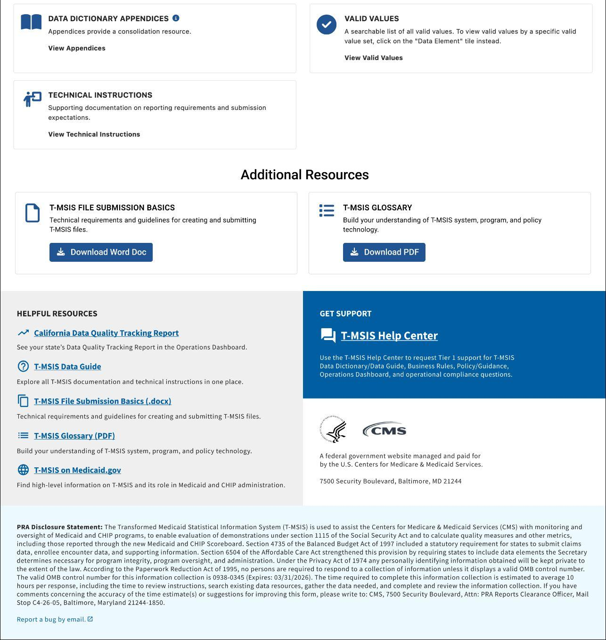
We are implementing a global footer to make it easy to refer users to critical documentation from anywhere on the site.
This was a low-risk design proposal based on first-principals and our own observations.
By adding key content that is available globally, we can more easily drive users to the information they need.
Future/proposed concept

Slide 44
How was the Matrix helpful here?
Escalating problems to the practice level
HCD practitioners with deep knowledge of the problem were able to bring an issue to the wider team, where we could triage it and determine how to address it as part of already-planned work.
Routing work to the right team
Practitioners on Team 4 aren't on the team that could address this problem. By escalating the issue, however, we were able to bring it to the product owner on the appropriate team, and get it incorporated into our product roadmap.

Slide 45
The Matrix is awesome but…

Slide 46
…It’s not all sunshine and rainbows 🌞🌈

Slide 47
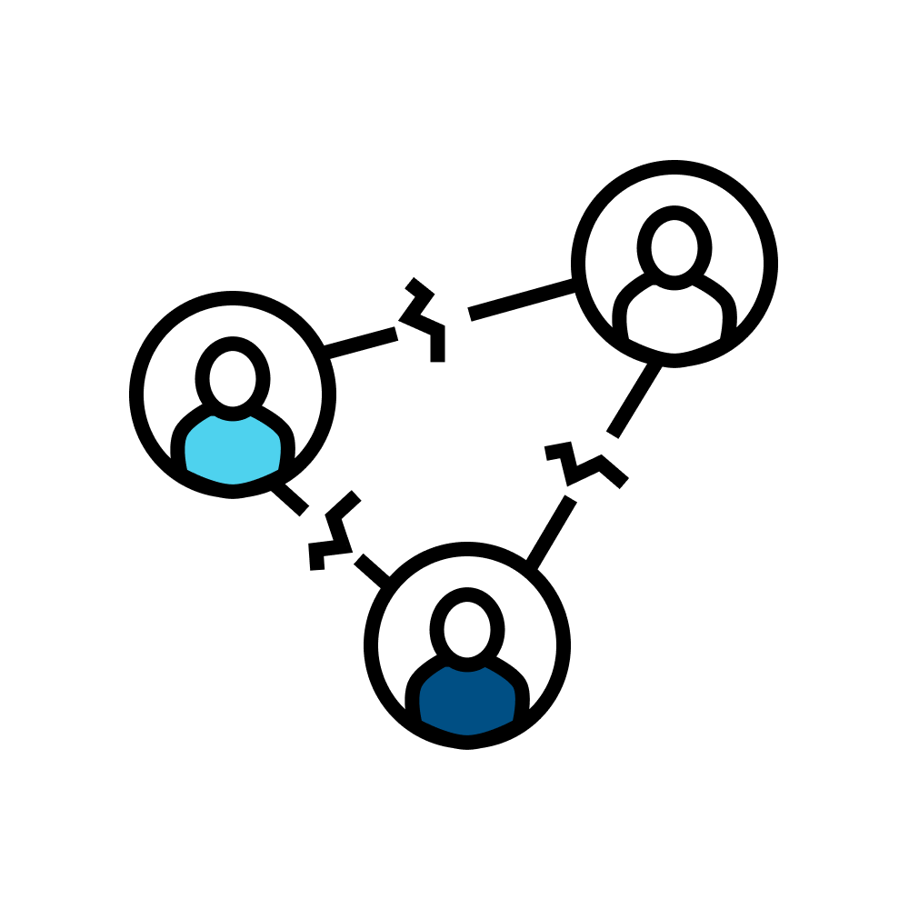
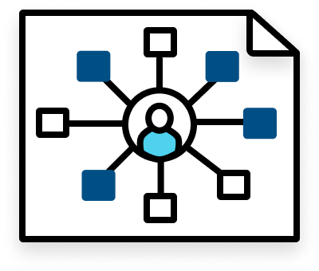

The matrix can be tough on practitioners
1 – You may feel as if you have two “families”
which can make them feel disconnected from both teams.
2 – You may end up with a lotttttt of meetings
Team ceremonies plus HCD practice meetings.
3 – You may encounter extra steps to delivery
Work gets reviewed and approved at the practice level in addition to the product team level.

Slide 48



The matrix can be tough on HCD Leads
1 – You'll wear many hats
As an HCD Lead on a matrixed team, you'll likely be expected to drive product, program, and delivery efforts like OKRs and PI planning when working in this way.
2 – You'll Juggle a lot of concurrent work and support a lot of people-to-people connections
Coordinating and managing work across multiple product teams.
3 – You probably won't get to do much individual contributor work
Matrix team leads will likely be unable to augment product team HCD capacity in surge times due to the operational overhead.

Slide 49
So what’s the verdict on the Matrix?
The Matrix might be a good choice if you need to “level up” in the following areas:
You would like to achieve greater alignment with your program and accelerate delivery
You would like to build strategic relationships across your program
You need to find a "point of ingress" for HCD
You’d like to acquire more domain knowledge
You’d like to incorporate more product strategy
You’d like to support product teams in more specific ways

Slide 50
How to mobilize the matrix
Step 1: Talk to your HCD team
Step 2: Talk to your program leadership
Assess whether your team feels they could produce work more effectively or achieve program alignment in a Matrix model.
See if it’s possible to arrange your practitioners in a matrix across the program.
Step 3: Make a plan
Step 4: Start matrixing
Embedded practitioners will require new working arrangements on each product team, and with the program as a whole. Work with the product leadership to ensure a smooth transition.
Embed your practitioners. They’ll attend their embedded product team’s ceremonies, plan work with their respective team, and report to their product owner for day-to-day work.

Slide 51

Step 5: Maintain alignment
Touchpoints that have worked for us:
Brief Story/Feature reviews to unblock/approve work
Operations/Best Practices (Design, Research, Content Strategy)
Office Hours (Open door meeting)
Co-working (typically crit/internal approval)
Practitioner 1<>1s

Slide 52

It doesn’t have to be complicated…
You can start operationalizing Matrix model concepts using small steps.

Slide 53
Questions/Discussion

