Slide 1


Slide 2
DHS Accessible Plain Language (APL)
Sharon Attipoe-Dorcoo November 2024

Slide 3
Language, Accessibility, & Customer Experience Intersection
Language Services
Language Access Plan/Program
Accessible Plain Language
Customer Experience
Customer Experience: Placing people at the center of everything we do.
Language Services: Overall communication systems and approaches across DHS to support services (training, plain language, interpretation, translation, accessibility).
Language Access Plans and Programs: Communicating effectively with individuals, including those with limited English proficiency and disabilities, across DHS services.
Accessible Plain Language: Centering people’s experiences in language services beyond plain communication.
Notes:
Language Access Plan: Language Access | Homeland Security (dhs.gov)
Disability Access Plans: DHS Component Disability Access Plans | Homeland Security

Slide 4
What is Accessible Plain Language (APL)?
Notes:
Accessible Plain Language is centering people’s experiences in language services beyond plain communication. We want people, especially individuals with Limited English Proficiency and persons with disabilities, to get the information they need and use it meaningfully.
The characteristics of accessible plain language are:
• People: You, me, our nation
• Equity: Consistent and systematic treatment of all individuals in a fair and impartial manner
• Accessibility: Consistent and systematic inclusion and equal opportunity for persons with disabilities
• Customer Experience: Placing people at the center of everything we do
• Engagement: Working side by side with partners

Slide 5
APL Skit
https://section508testing.org/AD2024/APL%20Skit%20Updated.mp4
Notes:
Video link : https://section508testing.org/AD2024/APL%20Skit%20Updated.mp4

Slide 6
How was APL Applied?

Slide 7
Guiding Framework: ISO Plain Language Standard
Notes:
ISO (the International Organization for Standardization), a worldwide federation of national standards has released the First International Plain Language Standard.

Slide 8
Governing principle and guidelines: Relevance
Before
Building a more human-centered culture requires awareness and intentional efforts to ensure organizational transformation. Because a human-centered culture needs employees who are aware and strive for organizational transformation, embedding Customer Experience (CX)-related duties and KSAs into non-CX project descriptions, as well as adding CX goals to leadership and GS performance plans can improve the experiences and touchpoints with customers.
People get what they need.
After (plain language)
A human-centered culture needs employees who are aware of and strive for organizational transformation. To improve experiences with customers, DHS will do the following:
  Embed Customer Experience (CX)-related duties into projects
  Include Knowledge, Skills, and Abilities related to CX in job descriptions
  Add CX goals to employee performance plans

Slide 9
Governing principle and guidelines: Findable
Before
A human-centered culture needs employees who are aware of and strive for organizational transformation. To improve experiences with customers, DHS will do the following:
  Embed Customer Experience (CX)-related duties into projects
  Include Knowledge, Skills, and Abilities related to CX in job descriptions
  Add CX goals to employee performance plans
People find what they need.
After (made accessible with header)
A human-centered culture needs employees who are aware of and strive for organizational transformation. To improve experiences with customers, DHS will do the following:
  Embed Customer Experience (CX)-related duties into projects
  Include Knowledge, Skills, and Abilities related to CX in job descriptions
  Add CX goals to employee performance plans

Slide 10
Governing principle and guidelines: Understandable
Before (header and at Grade 11)
A human-centered culture needs employees who are aware of and strive for organizational transformation. To improve experiences with customers, DHS will do the following:
  Embed Customer Experience (CX)-related duties into projects
  Include Knowledge, Skills, and Abilities related to CX in job descriptions
  Add CX goals to employee performance plans
People understand what they need.
After (header and at Grade 10)
DHS will be human-centered and improve customer experience (CX), by doing the following:
  Embed Customer CX-related duties into projects
  Include Knowledge, Skills, and Abilities related to CX in job descriptions
  Add CX goals to employee performance plans

Slide 11


Governing principle and guidelines: Useable
People can use
the information.

Slide 12
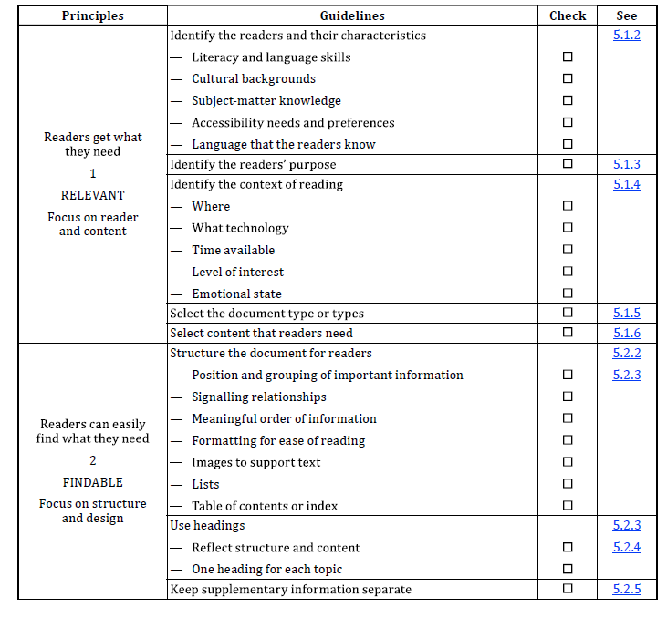
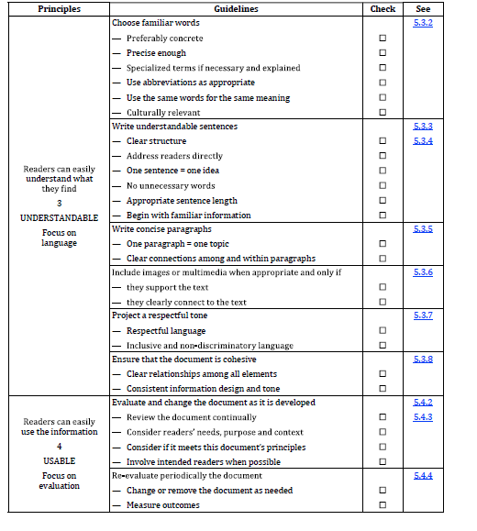
Sample Checklist
https://dhs-gov.libguides.com/ld.php?content_id=72424017
Notes:
The accompanying checklist to help you use the Standard

Slide 13
What can each of us do?

Slide 14
Culture of Practice
Interdisciplinary
approach
communications,
Grounded in equity & accessibility
fairness, reduced
Supported by evidence
Driven by policy
burden, and civic
participation
service, design,
equity, and
accessibility
accountability,
and compliance
necessity, and CX
inclusive, human
transparency,
APL
Notes:
Supported by the following policies:​
Title VI, enacted as part of the landmark Civil Rights Act of 1964. It prohibits discrimination on the basis of race, color, and national origin in programs and activities receiving federal financial assistance​
Executive Order 13166, "Improving Access to Services for Persons with Limited English proficiency". ​
3. Rehabilitation act (from ada.gov)​
Section 504 states that “no qualified individual with a disability in the United States shall be excluded from, denied the benefits of, or be subjected to discrimination ​
Section 508 was enacted to eliminate barriers in information technology, to make available new opportunities for people with disabilities and to encourage the development of technologies that will help achieve these goals
Clear and Concise Content Act of 2023: requires the use of plain writing when the federal government provides information about benefits and services. S.717 - 118th Congress (2023-2024): Clear and Concise Content Act of 2023 | Congress.gov | Library of Congress
President’s Management Agenda: Priority 2: Delivering excellent, equitable, and secure Federal services and customer experience | (performance.gov)
EO 14058: Executive Order on Transforming Federal Customer Experience and Service Delivery to Rebuild Trust in Government | (whitehouse.gov)
OMB A-11 Part 6 Section 280: Managing Customer Experience and Improving Service Delivery | (whitehouse.gov)

Slide 15
Summary
We can apply these principles and accessibility tools for our customers to navigate our systems meaningfully and feel heard.
Commitment to accessible plain language goes beyond stylistic choices.
Language is a powerful tool of engagement, and we all must continuously improve accessibility in all the meanings of the word.

Slide 16
Resources
  USCIS plain language videos: https://www.uscis.gov/plainlanguage
  Plain Language Action and Information Network (including Federal Plain Language Guidelines and a list of technical words with simpler alternatives): https://www.plainlanguage.gov
  5 Steps to Plain Language: https://centerforplainlanguage.org/learning-training/five-steps-plain-language
  “A Plain English Handbook,” Securities and Exchange Commission: https://www.sec.gov/pdf/handbook.pdf
  General Services Administration 18F Content Guide, “Use plain language”: https://content-guide.18f.gov/plain-language
  Plain Language Web Writing Tips: https://digital.gov/resources/plain-language-web-writing-tips
  DHS Language Access Plans: Language Access | Homeland Security (dhs.gov)
  DHS Disability Access Plans: DHS Component Disability Access Plans | Homeland Security
  Language Access Public Service Announcement – YouTube
  Lera Boroditsky: How language shapes the way we think | TED Talk

Slide 17


DHS CX Community & Resources
Connect: CX Community
CX Support Hours: Informally connect with peers and CX experts every Thursday at 3 pm EST.
CX Newsletter: Receive monthly CX updates and highlights of CX efforts across DHS.
Learn: Training & Resources
CX Learning: Learn CX basics, at your own pace.
CX Resources: Access guides, toolkit and glossary of CX terms.
CX Research Guide: Learn about CX at DHS, how to search for CX resources and access journals and e-books.

