Slide 1
EQR Program Working Group
Program Increment 15 Plans and EQRS Roadmap
July 28, 2021

Slide 2
Agenda
EQRS Roadmap
What work impacts EDI Submitters?
Program Increment 15
PI15, PI16, PI17

Slide 3
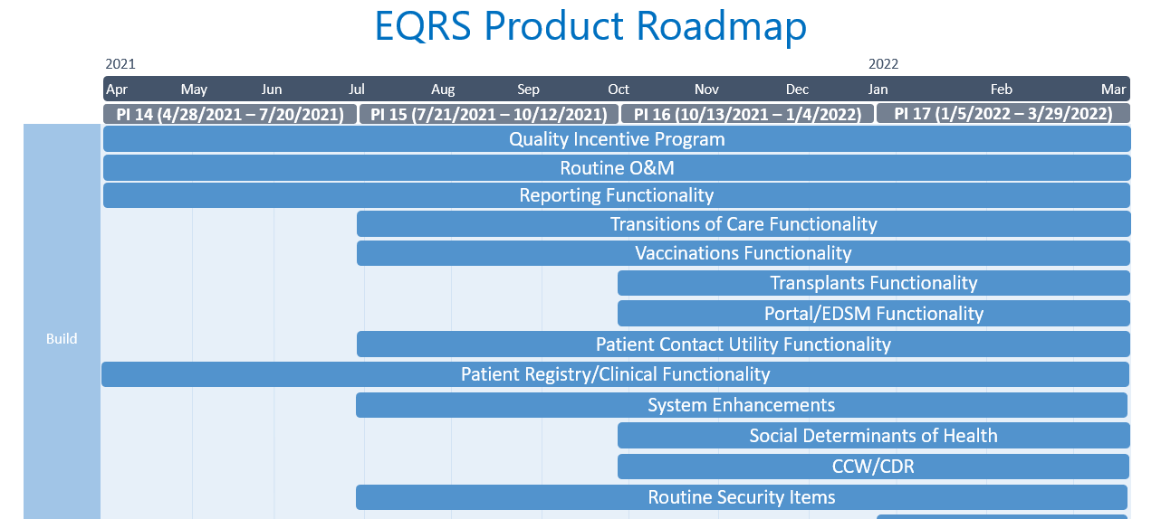
EQRS Roadmap
Notes:
PI 15 Epics/Themes (from 07/7/21 SMT meeting)
Design/Build ESRD Patient Repository
QIP PY 2022 Preparation
Updates to iQIIG Contract Work
Ongoing DevOps Improvements

Slide 4
Data Quality Initiatives
Enhance Form 2728
Admit / Discharge Rules; First admission should be New to ESRD
Modify the Facility Dashboard Logic so that it more closely aligns with the form 2728 prompting logic
ESRD Patient Repository within the ESRD Patient Registry
Re-entitlement and Supplemental logic for patients
Root Cause Analysis and research on ESRD Patient Registry data quality
Design and develop a RCA and plan for global data cleanup; source of truth on defining ESRD patient attributes within the ESRD Patient Registry
Auto Accept and Update EDB Identifiers; Auto-populate EQRS patient data with EDB data
Patient Matching
Notes:
Enhancement: Auto Accept & Update EDB Identifiers
Functionality that will ensure that EQRS patient data is auto populated with EDB data. For example, If EDB knows about a Death Date, it should populate the death date in EQRS and close down any open admissions. Additionally, if an EQRS record only has an MBI and no SSN or HICN and matches to the EDB record, missing identifiers should be populated in EQRS with the EDB values. This should be true for any missing values. Consideration could also be given to overwriting existing identifiers that do not align with EDB values. E.g. if a Patient first name is Harry in EQRS but is Henry in EDB, what should EQRS auto population do?
Enhancement: First admission should be New to ESRD
ESRD Patient Admissions track where a patient is located in EQRS. When a patient begins dialysis the first admission reason should be 'New to ESRD'. This feature clean up any data where the patient does not have 'New to ESRD' as the first admission reason.
Enabler: Enhance Form 2728
For example, dashboard users are asked to submit a 2728 form due to changes to existing admit/discharge records,. When users click the dashboard item to add the form in current CW, the form is either already submitted or CW does not actually expect a form and does not prompt to add. Example ServiceNow incident is INC0133511.
Note: This is a request from CDDS and CMS based on takeaways from the Data Cleanup work-group.
Enabler: Design/Build an ESRD Patient Repository within the ESRD Patient Registry (Umbrella Feature)
Give CMS, EDI, ESRD Network and facility users and stakeholders in the ESRD Patient Registry the confidence level needed to move forward in various industry and program initiatives. Ensure that the source of truth for ESRD patients creates a defined set of fields, algorithms, and system processes that support the patient repository needs and those fields support the ESRD Patient Registry.

Slide 5
Upcoming Data Collections
PPSV23 Pneumococcal Vaccination Data
Move PPSV23 Pneumococcal vaccination data collection to follow the patient
Telemedicine Usage
Identify the number of clinics offering telemedicine as a service.
Nursing Home Identifier
Identify ESRD patients residing in a nursing home. Initial data will be populated using MDS.
Identify & Visually Display Depressed Patients
Identify patients who were screened for depression and were classified as depressed.
Additional Kt/V Methods for Clinical Adequacy Values
Add the “Standard” method for measuring Kt/V to support the UFR measure
Identify patients using telemedicine to communicate with their nephrologist or dialysis clinic.
Notes:
Pneumococcal Vaccination Data (iQIIG)
There will be vaccinations for Pneumococcal illness and the administration should be able to see how many of these patients are getting these vaccinations.
Telemedicine Usage
To support the use of telemedicine to connect dialysis patients to services through internet or telephonic means; thus providing the ability to receive assessment, diagnosis, and care remotely.
Nursing Home Identifier
Dialysis in nursing homes in growing at a rapid rate and we don't have good visibility into where that is occurring or how well. There needs to be the ability to identify these types of patients in EQRS. If patient becomes acute later then they will be dropped from EQRS.
Identify & Visually Display Depressed Patients
To provide facilities and networks with a monthly report that contains statistics for patients who have had Depression Screening and qualify as depressed. Patients identified as depressed will receive the resources and support that they need.
Additional Kt/V Methods for Clinical Adequacy Values
Currently there exist 2 Kt/V Methods for Hemodialysis (UKM and Daugirdas II). One additional method is needed which is the “Standard” method. Provides ESRD Facilities the ability to select/enter all applicable methods for calculating Hemodialysis Kt/V in support of UFR measure.

Slide 6
Questions Received
Auditing 20% of facility’s Patient Medical Records
Work is duplicative of the Data Validation and Reliability Study in QIP – The DVR contractor reviews data for QIP in a small sample. This is to review the data in the ESRD Patient Registry due to billing concerns from the LDOs.
Comparing EHR data to EQRS is redundant since data is electronically submitted – Recent audits have shown errors in submission of data. Additionally, concerns have been voiced about patient record data reliability as patients transfer between facilities.
Limitations with clinics sharing patient medical records and extremely burdensome on our clinicians – Need clarity on the question, but will work with facilities to reduce burden
Admission Rate expectations
Facilities have minimal, if any, impact as it is controlled by EDSM submissions for >90% of facilities – The Data Management guidelines state that admissions and discharges are to be entered in 5 business days. This has been in place since the previous registry system.
Network goals get harder each year - Easier records and greater improvement would be expected on the front-end not as count decreases. The expectation is as the Network works with a facility over the 5 year contract, the facility will improve as they follow guidance.
ESRD Networks’ guidance potentially conflicting with internal organization Policy & Procedures. Is there an example of where your corporate policy for data submission is conflicted?
CMS contractor uses calendar days to calculate rate but CMS guidance uses business days – We will review this.
Transplant data in EQRS
EQRS doesn’t currently track waitlist status, what data source is used? EQRS uses the UNOS data to present transplant waitlist data
Data is available but not yet integrated in EQRS front-end for user to see. CMS is aware. CMS will review for addition in upcoming PI planned work.
Current EQRS Waitlist data doesn’t include Active/Inactive to know true status. CMS is aware. CMS will review for addition in upcoming PI planned work.
Notes:
Pneumococcal Vaccination Data (iQIIG)
There will be vaccinations for Pneumococcal illness and the administration should be able to see how many of these patients are getting these vaccinations.
Telemedicine Usage
To support the use of telemedicine to connect dialysis patients to services through internet or telephonic means; thus providing the ability to receive assessment, diagnosis, and care remotely.
Nursing Home Identifier
Dialysis in nursing homes in growing at a rapid rate and we don't have good visibility into where that is occurring or how well. There needs to be the ability to identify these types of patients in EQRS. If patient becomes acute later then they will be dropped from EQRS.
Identify & Visually Display Depressed Patients
To provide facilities and networks with a monthly report that contains statistics for patients who have had Depression Screening and qualify as depressed. Patients identified as depressed will receive the resources and support that they need.
Additional Kt/V Methods for Clinical Adequacy Values
Currently there exist 2 Kt/V Methods for Hemodialysis (UKM and Daugirdas II). One additional method is needed which is the “Standard” method. Provides ESRD Facilities the ability to select/enter all applicable methods for calculating Hemodialysis Kt/V in support of UFR measure.

Slide 7
Questions Received
Flu Vaccination project
FMC and DaVita do not report HCP Influenza Vaccination Summary data to NHSN – As this was a previous QIP measure and was previously tracked, do you still have a mechanism to share this data?
This was removed as a QIP measure because it was topped out – This is an administration priority across many care settings in CMS.
Is CMS adding NHSN reporting requirements to all providers? All dialysis facilities will need to report vaccination data.
COVID-19 Vaccination project
Is this expected to be met in 2021 or what is the Base Period vs Option Period 1? The goal of 80% vaccinated patients is for the base period.
What is the data source as this data isn’t reported to EQRS but it’s listed as the source used? We will review.
How to prioritize transitioning EQRS from a data repository to a system that drives quality improvement?
Notes:
Pneumococcal Vaccination Data (iQIIG)
There will be vaccinations for Pneumococcal illness and the administration should be able to see how many of these patients are getting these vaccinations.
Telemedicine Usage
To support the use of telemedicine to connect dialysis patients to services through internet or telephonic means; thus providing the ability to receive assessment, diagnosis, and care remotely.
Nursing Home Identifier
Dialysis in nursing homes in growing at a rapid rate and we don't have good visibility into where that is occurring or how well. There needs to be the ability to identify these types of patients in EQRS. If patient becomes acute later then they will be dropped from EQRS.
Identify & Visually Display Depressed Patients
To provide facilities and networks with a monthly report that contains statistics for patients who have had Depression Screening and qualify as depressed. Patients identified as depressed will receive the resources and support that they need.
Additional Kt/V Methods for Clinical Adequacy Values
Currently there exist 2 Kt/V Methods for Hemodialysis (UKM and Daugirdas II). One additional method is needed which is the “Standard” method. Provides ESRD Facilities the ability to select/enter all applicable methods for calculating Hemodialysis Kt/V in support of UFR measure.

Slide 8

This Photo by Unknown Author is licensed under CC BY-NC-ND

