Slide 1
Slack Workflows

Slide 2
Be sure to join us in QualityNet Slack at: #qnet-slack-workflows-training-
We will be practicing together in the channel during the training.

Slide 3

Agenda
What are Workflows?
Building Workflows
  Triggers
  Adding Steps
  Buttons & Variables
  Custom Icon
  Collaborators
  Setting, Workflow, & Activity Tabs
Tracking
Demos of Building Workflow with Different Triggers
Miscellaneous info and workflow examples
Glossary
Q & A

Slide 4
What are Workflows?

Slide 5
What are Workflows?
A no-code automation tool to run routine processes in the QualityNet Slack workspace
A type of message sent in Slack
A sequence of steps

Slide 6
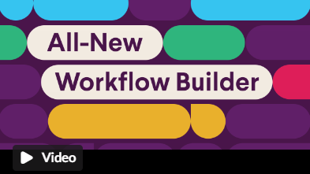
Notes:
This links to YouTube.

Slide 7
What are Workflows?
Workflows allow you to create consistent communications triggered by a certain event.
Time of day
Time of week
Specific action triggers
Daily Reminders about meetings
Sprints
Onboarding information for new channel users on your team
Access to documents

Slide 8
Workflow Advantages
No coding required!
As simple or complex as you'd like
Can connect to other apps and services used to get work done

Slide 9
Use Cases
Onboarding
Reminders
Sending Documents
Polling
Suggestion Box
Distributing Meeting Notes
Status Report Reminders
Birthday Greetings
Checklists
Feedback
Travel Requests
Recurring Messages
Incident Reports
Project Updates

Slide 10
Building Workflows

Slide 11
Workflow Building Steps
Decide how your workflow will start – its trigger.
Create your workflow steps. (actions your workflow can take)
    Create and deliver forms
    Create and deliver messages
Customize steps with buttons and variables.
Choose your channel where the workflow will be available.
    You will be prompted to customize, depending on the trigger.
    Workflows are channel-specific and can only be used in the channel you choose.
    Cannot construct one workflow to run in multiple channels.
Add a custom workflow icon.
Add collaborators.
Pick a name for your workflow. (e.g., “Welcome to the team!”; “Meeting time”; “Agenda”)
Publish.
Test your workflow and make any necessary edits.

Slide 12
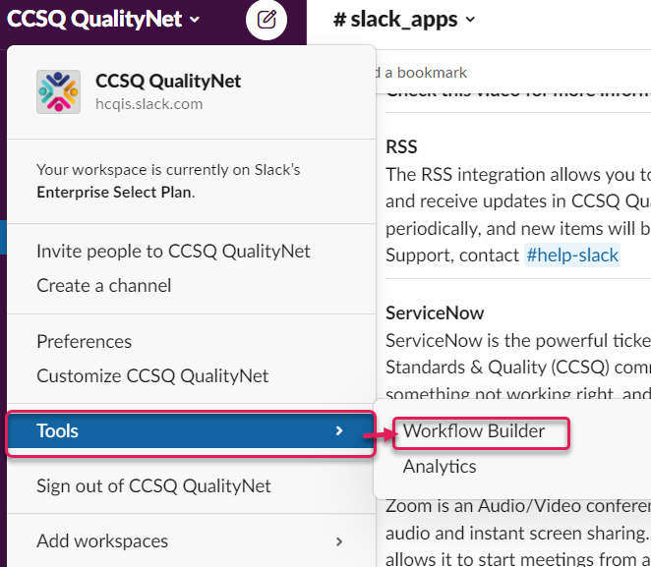
Beginning a Workflow
Open Workflow Builder:
From your desktop, click the CCSQ workspace name in the top left.
Select Tools from the menu.
Select Workflow Builder, which will open in a new window.

Slide 13

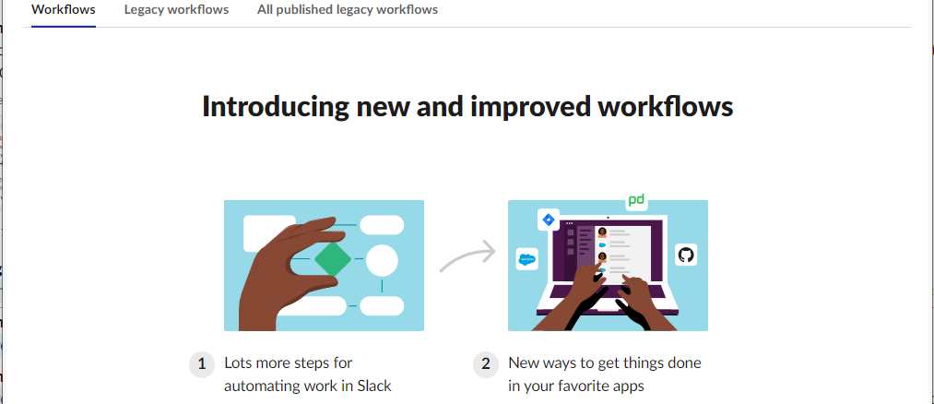

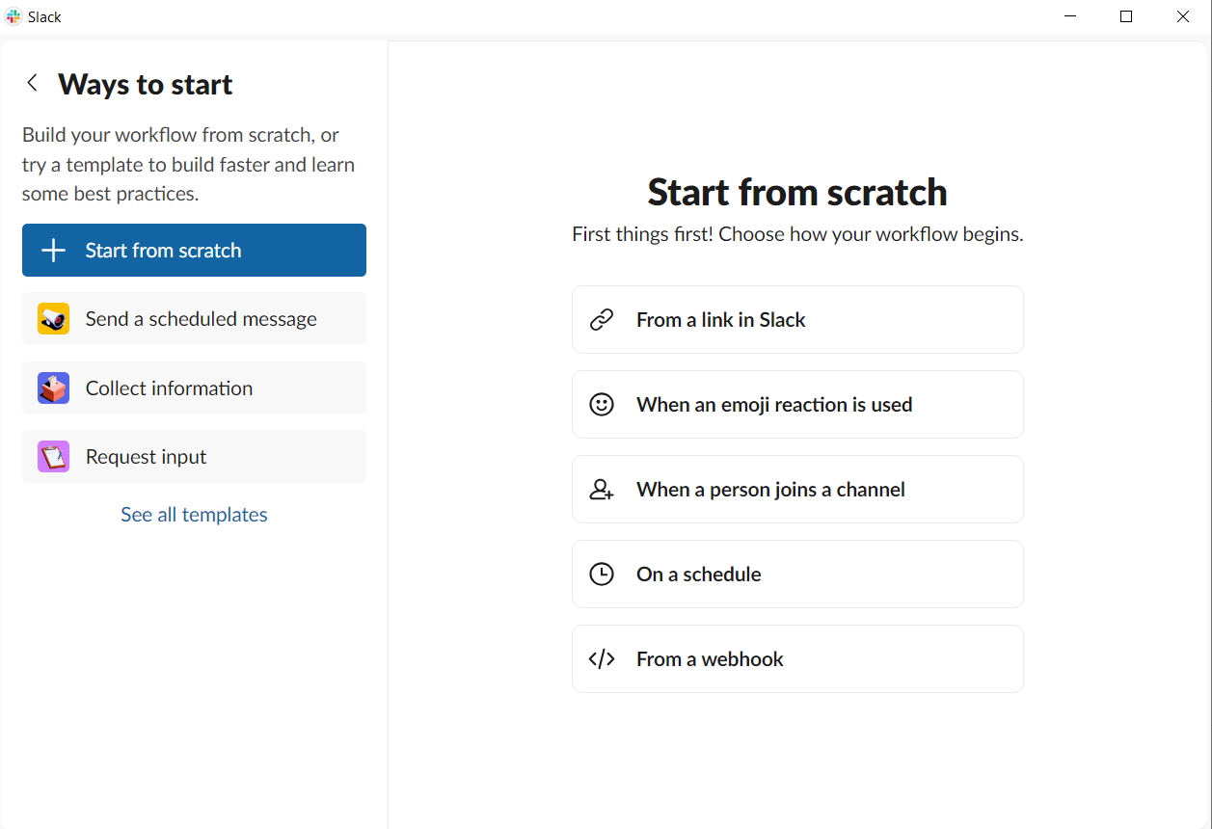
Selecting a Workflow Trigger
Choose your trigger:
  From Workflow Builder, click Create in the top right.
  Select Workflow Builder, which will open in a new window and select your trigger.
Workflow Builder

Slide 14
Triggers
Templates are available in addition to starting from scratch

Slide 15

Trigger - From a Link in Slack
For on-demand workflows
Once workflow link is created:
  Post link in channel or a canvas
  Or use slash commands /[workflow name]
    Will post message in channel allowing anyone to run in the channel
    Press “Start Workflow”
Can run multiple times.
**Note: Your workflow determines how each trigger will start in the specific channel you’ve chosen

Slide 16


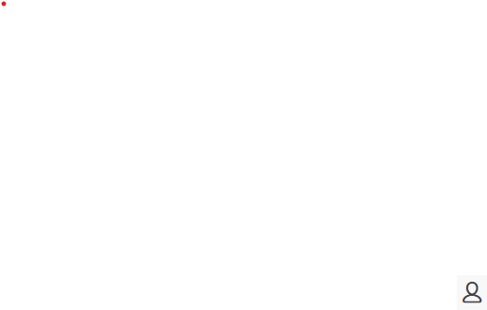

Other Triggers
More Folder
  Your workflow starts when someone selects Automations from the More… folder’s dropdown menu.
  These workflows are easily accessible by members of a channel and can be used anytime.
Emoji Reaction
  Your workflow starts automatically when someone in the channel adds a certain emoji reaction to a message.
New Channel Member
  Your workflow starts automatically when someone joins the channel.
Scheduled Date & Time
  Your workflow starts automatically at a set date and time.
Webhook
  Workflow starts automatically when a custom webhook sends a web request to Slack from another app or service.
  Creating workflows with webhooks requires more technical expertise.
**Note: Your workflow determines how each trigger will start in the specific channel you’ve chosen

Slide 17
Beginning a Workflow (1st way)
Open Workflow Builder
From your desktop, click the CCSQ workspace name in the top left.
Select Tools from the menu.
Select Workflow Builder, which will open in a new window.

Slide 18
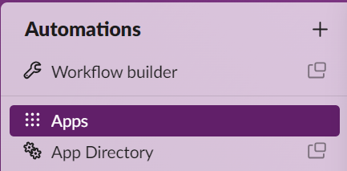
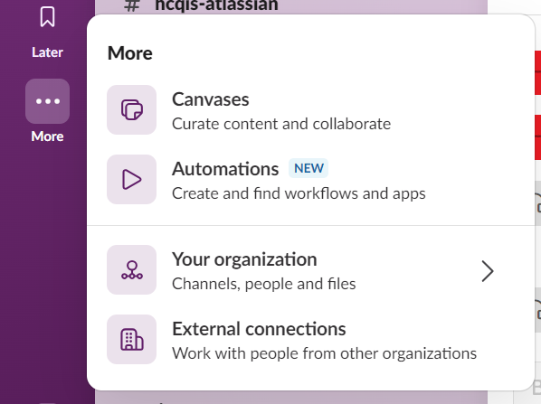
Beginning a Workflow (2nd way)
Open Workflow Builder
From your desktop, click More… in the bookmark bar.
Select Automations from the menu.
Select Workflow Builder, which will open in a new window.

Slide 19
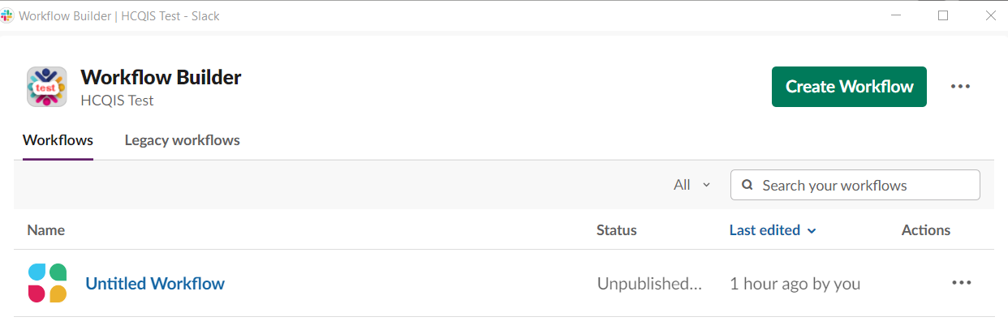
Begin Your Workflow
  From Workflow Builder, click Create Workflow in the top right.

Slide 20

Select Trigger
Choose your workflow trigger.

Slide 21
Trigger Setups
Links
Select Links as your trigger.
Copy the link to place in any channel or canvas.
Click Run.
New Channel Member
Select a channel for your workflow from the drop-down menu.
Click Next.
Finish workflow setup
Each trigger has a slightly different setup.
Emoji
Click Add Emoji and select the emoji you’d like to trigger your workflow.
Add a channel(s) for your workflow from the drop-down menu.
Click Continue.
Add a Step.
Date & Time
Select a date from the drop-down menu, then pick the time you’d like your workflow to start.
Open the Frequency drop-down menu to choose how often your workflow will run.
Click Next.

Slide 22
Trigger Setups
Webhook
A webhook is a simple way to post messages from external sources into Slack
Allows a service, like Jira, to send info or a ticket to display in a Slack channel.
Requires developer expertise or some experience with code to create a webhook.
Refer to https://slack.com/help/articles/360041352714-Create-more-advanced-workflows-using-webhooks for more details.
If you have no developer experience, you can reach out to #help-slack and we can help you get set up with a webhook.
Finish workflow setup
Each trigger has a slightly different setup.

Slide 23
Steps
Steps are a series of actions taken to complete a workflow.
Add a step that launches right after someone starts your workflow.
Once your workflow starts, your steps appear in the order you specify.
Steps can collect or send information in Slack, or between Slack and other services.
Six types of steps:
  Channels
  Messages
  Forms
  Users
  Workflow Control
  Steps from apps installed to your workspace

Slide 24
What Each Step Does
Channels
Manage channels with workflows.
Actions include:
  Add a Bookmark to a channel
  Add users to a channel
  Archive a channel
  Create a channel
  Pin a message
  Update the channel topic
Messages
Send messages to communicate information to the person who kicked it off, or others in Slack who need to take action from the information.
Messages can be sent to:
  Specified people (Direct messages)
  Channels
  Threads
Messages only visible to recipient(s)
Messages are automatically formatted and can include hyperlinks.

Slide 25
What Each Step Does
Users
Create a user group or add or remove users from a user group.
Forms
Add forms to organize and collect information.
Forms can include custom responses, or prompt people to choose options from a list.
Completed forms can be sent to a channel or specific person via DM.
Note: Form responses cannot be edited once submitted via Workflows.
Answer types supported for questions include:
Workflow Control
Ability to delay your workflow by adding a timer in minutes.
Causes workflow to wait that selected time.
Line of text
Paragraph
A User
Multiple users
A Channel
Multiple Channels
Dropdown
Multiple Choice
Checkboxes
Date and Time
A Number

Slide 26
Additional Apps
Native integration for some common apps like Outlook, Lucid, Giphy are available.
Unique, custom workflow steps.
Connect a workflow in Slack to other services in specific ways.
Note: If you don't see the option to add steps from apps, make a request for them in the #help-slack channel.
.

Slide 27
Customize with Buttons & Variables
Buttons
Workflow won’t proceed until button is clicked.
Buttons can only be clicked once per workflow.
Don’t add when multiple people use the workflow — e.g., a scheduled date & time workflow reminder for a team to share daily status updates.
Customize steps with buttons and variables.
Helps reference information.
Allows pausing at a certain step while people take an action.
Variables
Allow you to insert information from previous steps in your workflow in subsequent steps, giving more flexibility to personalize workflows and connect information across various steps.
Available variables depend on:
  how the workflow starts
  who interacts with steps at various points
  information requested (like responses to a form)

Slide 28
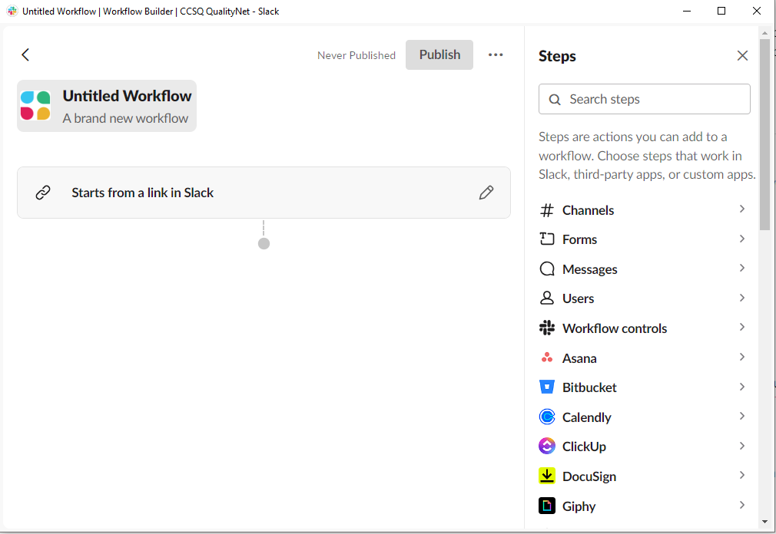
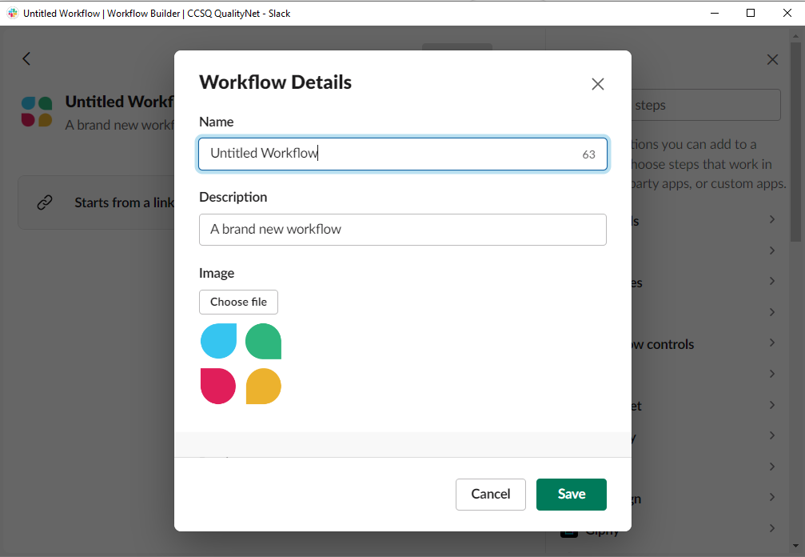
Add a Custom Icon
Add a custom workflow icon
Open your workflow in Workflow Builder.
Click the workflow icon.
Select Choose File to upload a file.
Crop your icon if you’d like.
Click Save.

Slide 29
Collaborators
Grant others permission to manage a workflow.
Collaborators have same permissions as the workflow creator.
  Change a workflow's name and custom icon
  Edit or remove workflow steps
  Unpublish or delete a workflow
  Manage workflow collaborators
    Add and remove other collaborators, including admins
Workspace Owners and Admins can add themselves as collaborators on any published workflow in their workspace.
  If they add themselves in private channels they don't belong to, they won't be able to see the name of the channel
**Tip: Only collaborators can view a workflow before it’s published!

Slide 30
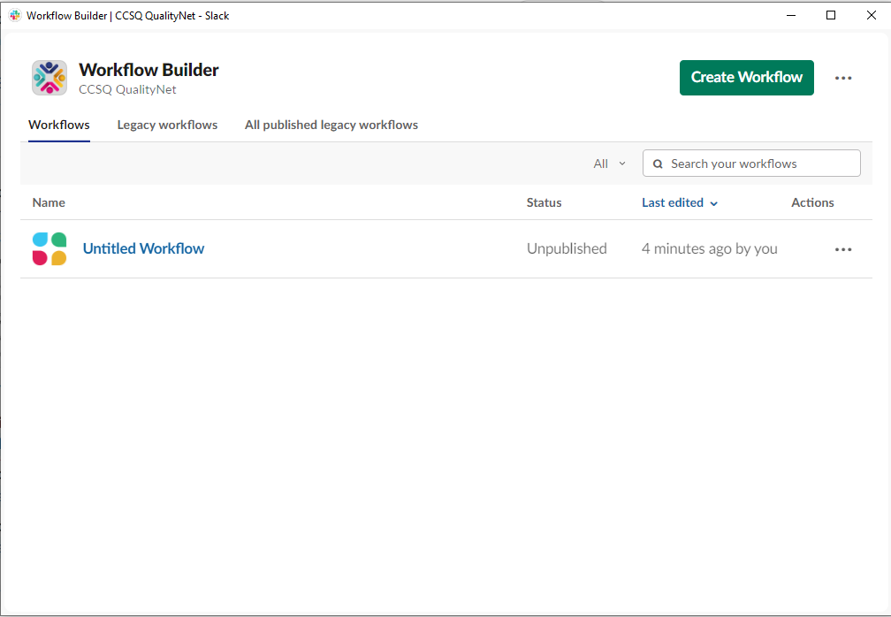
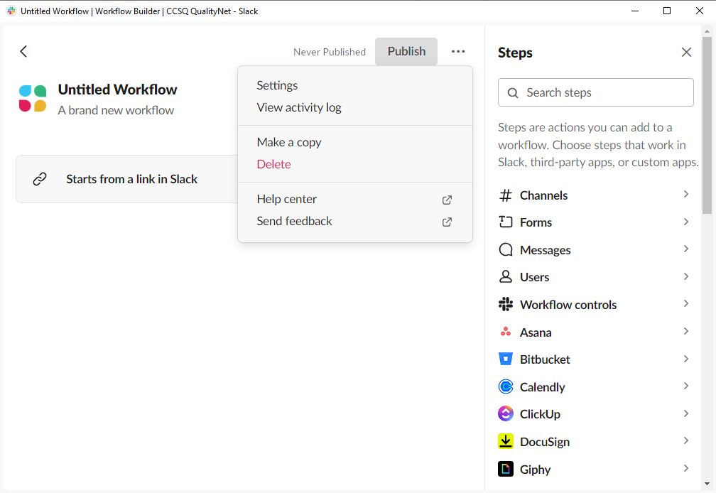
Adding Collaborators
Steps 1-3
Select Tools from the CCSQ Workspace menu, then click Workflow Builder.
Click Your Workflows tab at the top of the screen, then select a workflow from the list.
Click Settings tab.

Slide 31
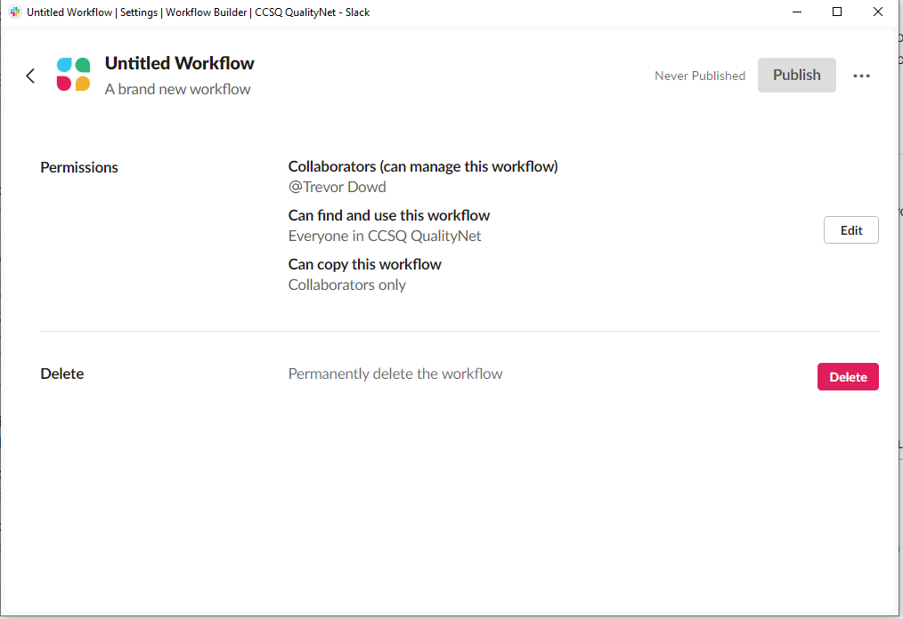
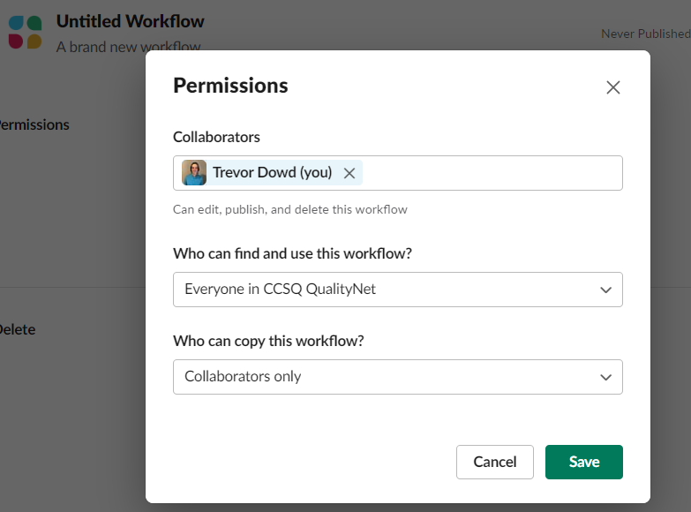
Adding Collaborators
Steps 4-7
Click Edit next to the Permissions section.
Search for people you’d like to add, then select their names from the drop-down menu.
Slackbot will notify each person to let them know they’ve been added as a collaborator.
Click Close.
*Note: You can always remove collaborators by clicking the x next to the name of any collaborator.

Slide 32
Testing Workflows Before Publishing
Want to check how your workflow behaves?
Add it to a test channel.
Try it out.
Click Edit to make changes.
Move the workflow to your preferred channel.
Publish the changes.

Slide 33
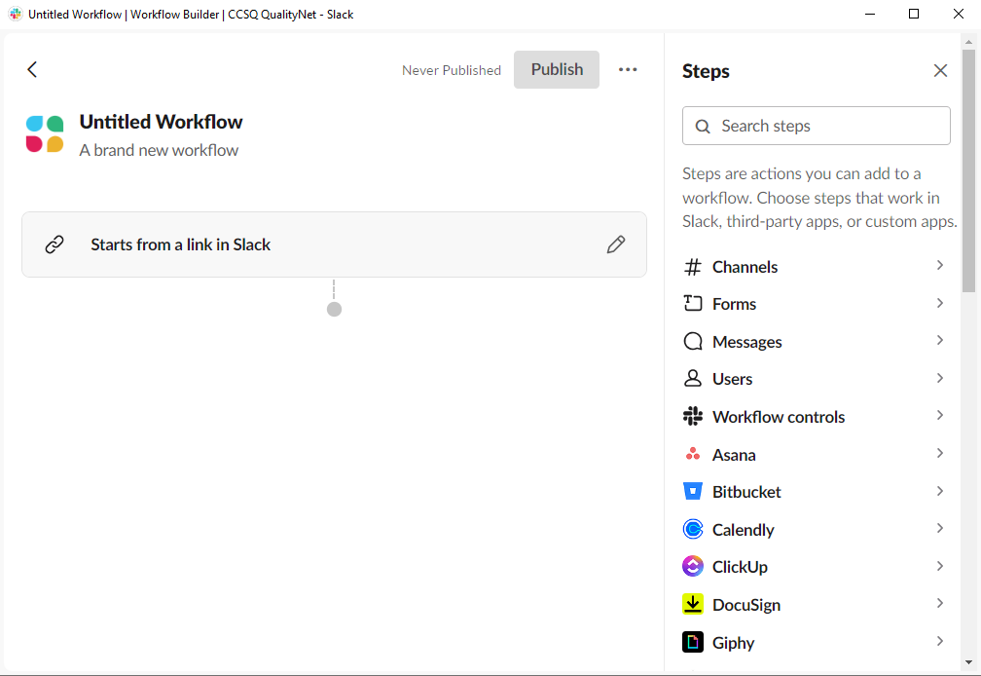
The Workflow Tab
The Workflow tab allows you to edit the trigger’s starting channel and each step.

Slide 34
The Workflow Tab
It's not possible to change a workflow’s trigger, but you can change the channel where a workflow starts.

Slide 35
Publishing Workflows
Pick a name for your workflow. (e.g., “Welcome to the team!”; “Meeting time”; “Agenda”) before publishing.
Once a workflow is published, it will launch each time it’s triggered.
Your workflow will post a message to the channel to let all members know it's been added.

Slide 36
Tracking Workflows

Slide 37
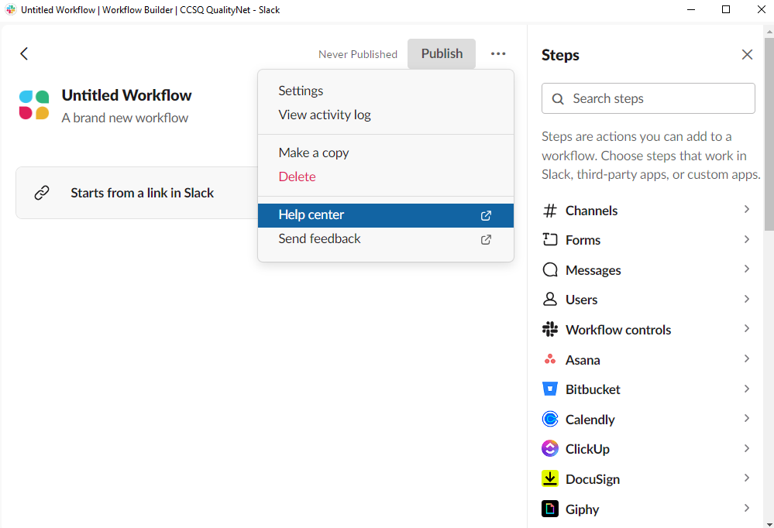
The Activity Tab
The View activity log tracks each time a workflow is activated.

Slide 38
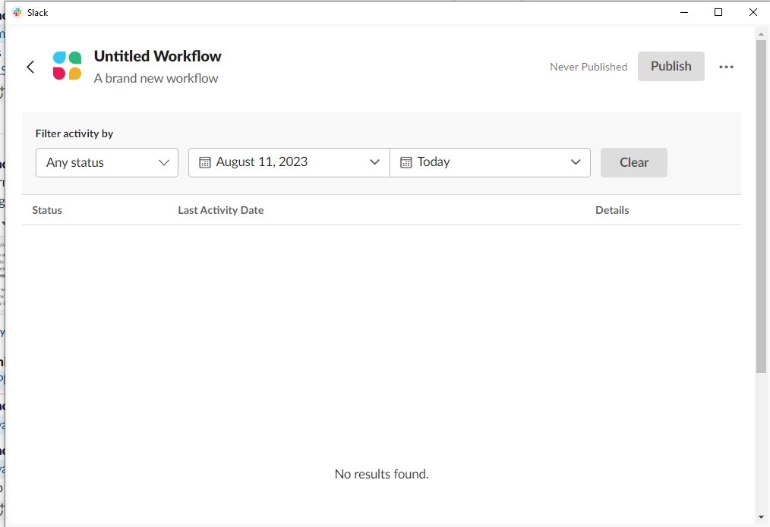
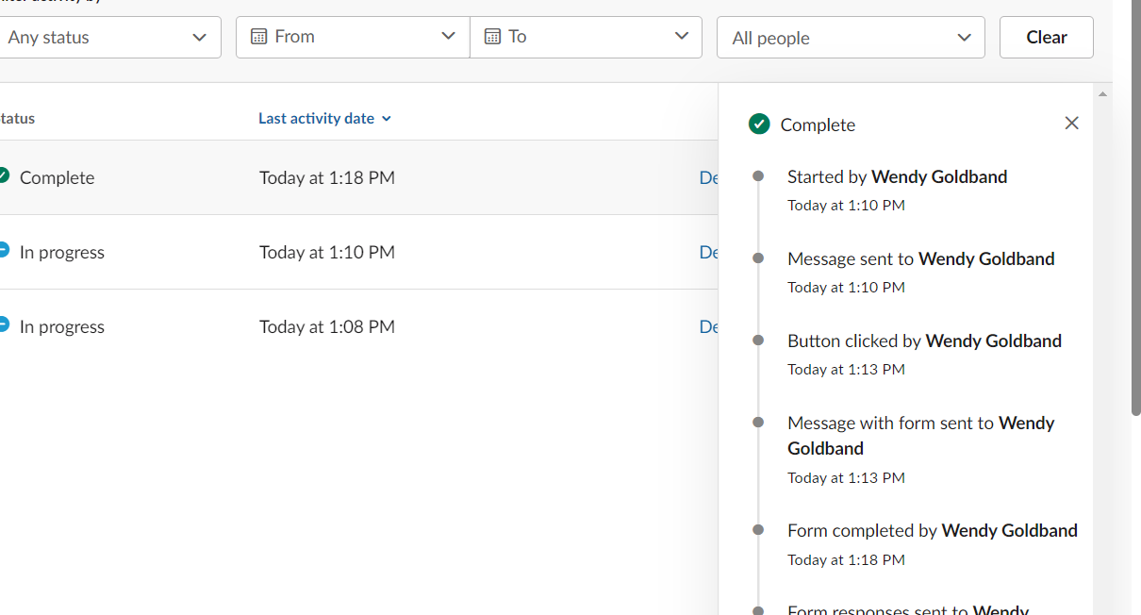
Tracking a Workflow in the View Activity Log
Details
Tracking workflow activity
Open your workflow in Workflow Builder.
Click Activity tab at the top of the screen.
Click Details next to each activity date.
Variables chosen like name and time will be in the details for each Status listing.
Variables

Slide 39
Download Form Responses as a CSV File
Click the top left CCSQ workspace menu.
Select Tools.
Click Workflow Builder.
Find the workflow you’d like to download under the Workflow tab.
Click the three dots icon.
If your workflow includes multiple forms, you must select only one at a time from the drop-down menu.
Receive a direct message from Slackbot with a link to the file when it’s ready.
Select Download form responses.
Click Save.

Slide 40
Let’s run through Workflows with Different Triggers
Attachments and Shortcuts Menu
  Your workflow starts when someone selects Automations from the More… dropdown menu.
  These workflows are easily accessible by members of a channel and can be used anytime.
New Channel Member
  Your workflow starts automatically when someone joins the channel.
Emoji Reaction
  Your workflow starts automatically when someone in the channel adds a certain emoji reaction to a message.
Scheduled Date & Time
  Your workflow starts at the scheduled date and time

Slide 41
New Channel Member Trigger

Slide 42
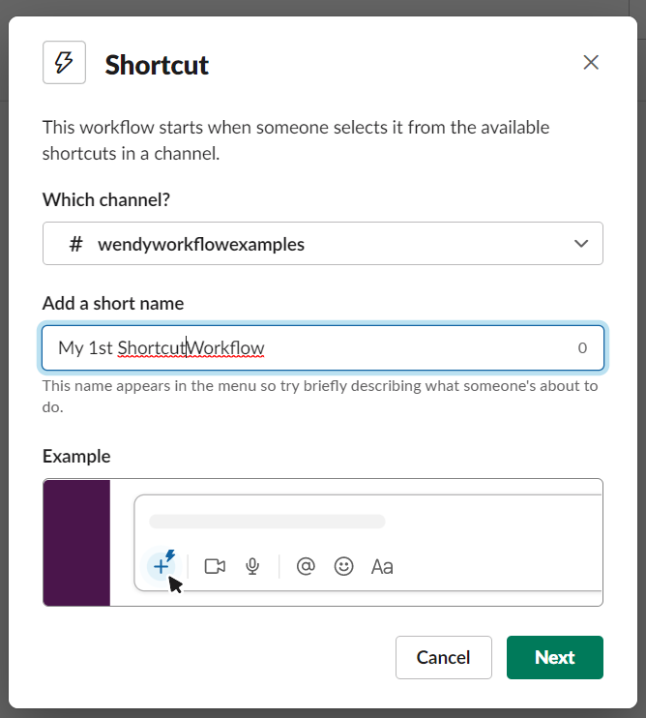
New Channel Member Trigger
1. Select your trigger.
2. Customize your trigger.

Slide 43
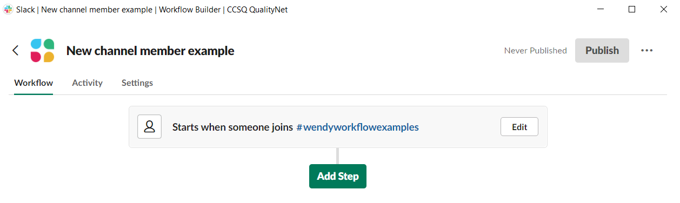
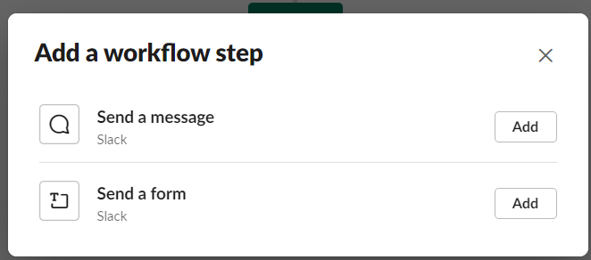
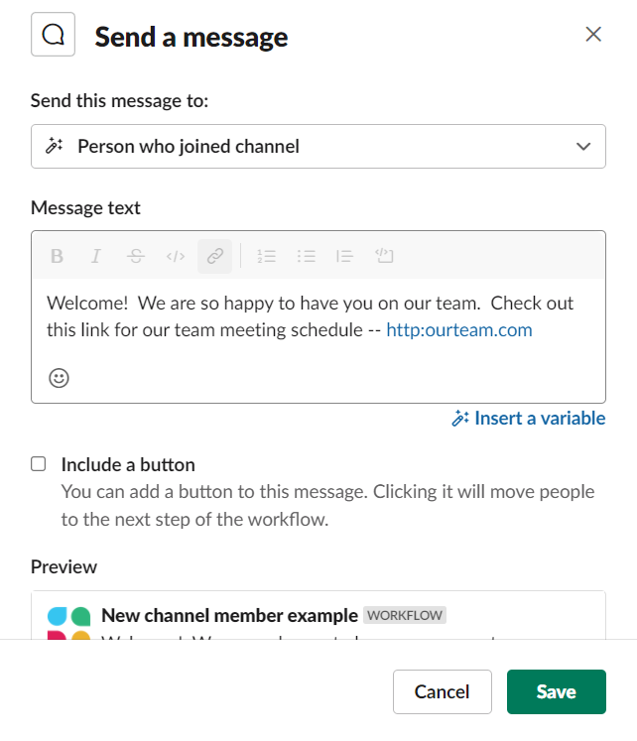
New Channel Member Trigger
1. Click Add Step.
2. Select your Step.
3. Customize Step 1.

Slide 44
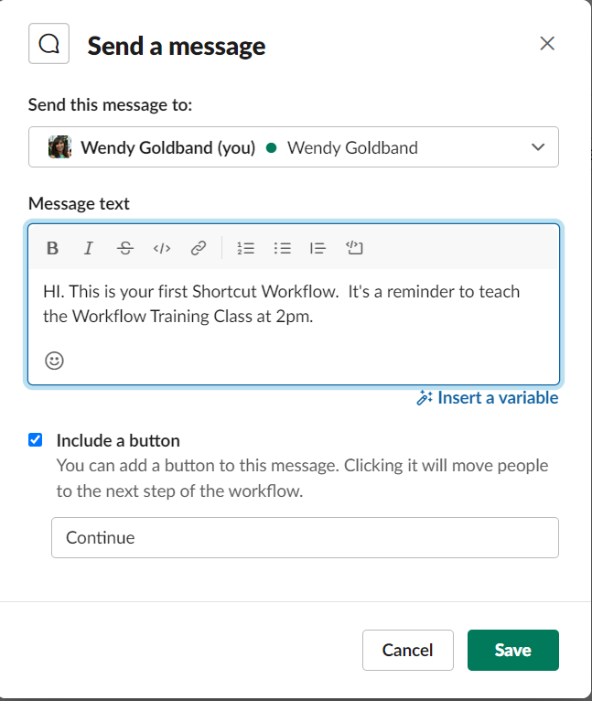
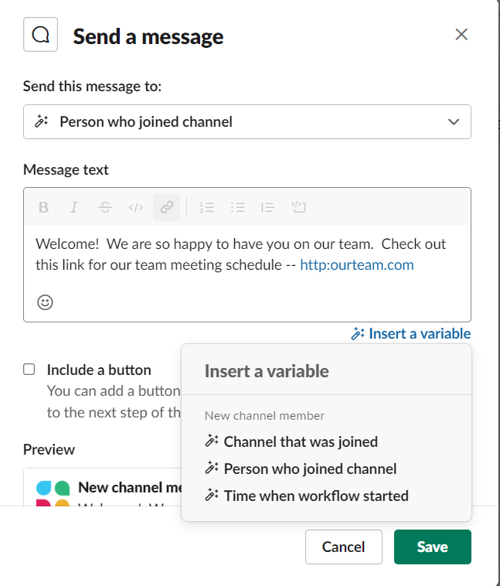
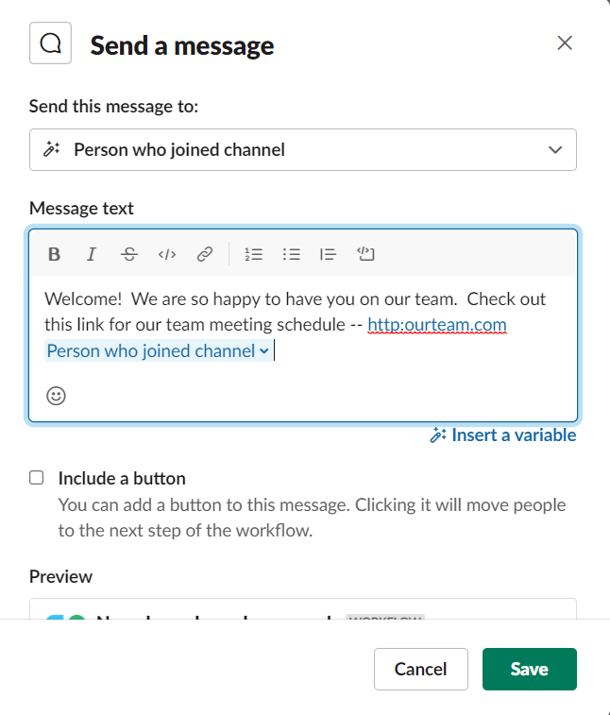
New Channel Member Trigger
Send a message
1st step selected and customized
Option to insert variables
One variable chosen

Slide 45
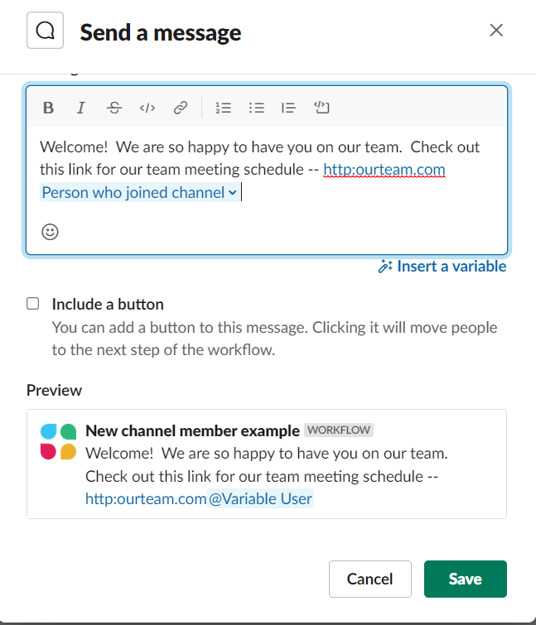
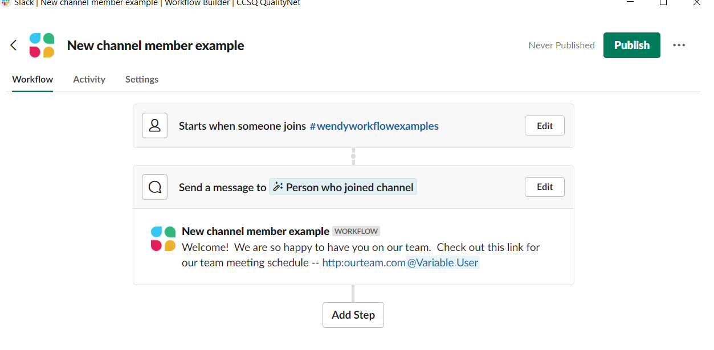
New Channel Member Trigger
Choose to add another step or Publish.
Preview the step.

Slide 46
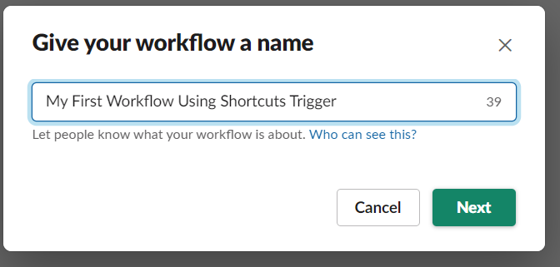
Final Steps
1. Give your workflow a name.
2. Publish.

Slide 47
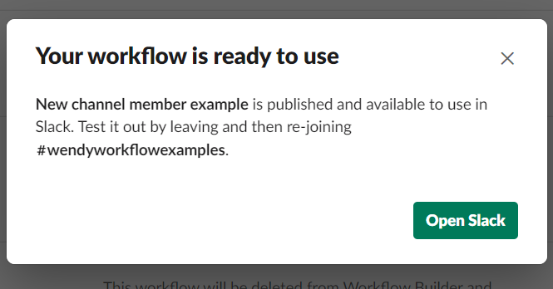
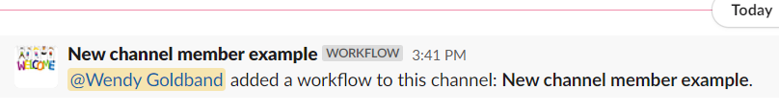
Published Workflow
New Channel Member Trigger
Published workflow message displayed in channel
(Note the custom icon.)
Workflow published

Slide 48
Emoji Reaction Trigger

Slide 49
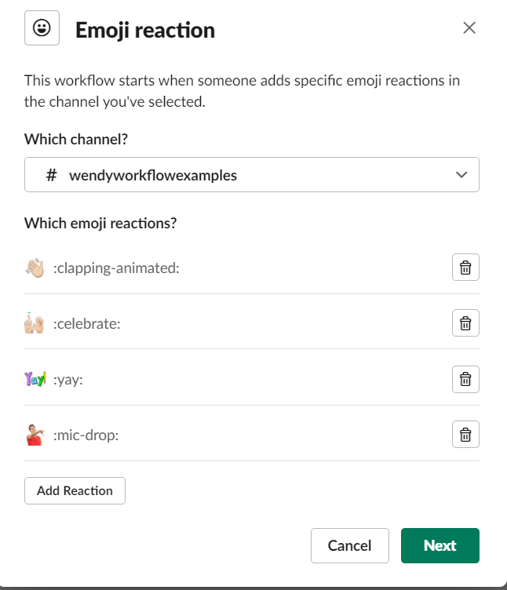
Emoji Reaction Trigger
Customize your trigger.
Select your channel.
Add emoji reaction(s).
Select your trigger.

Slide 50
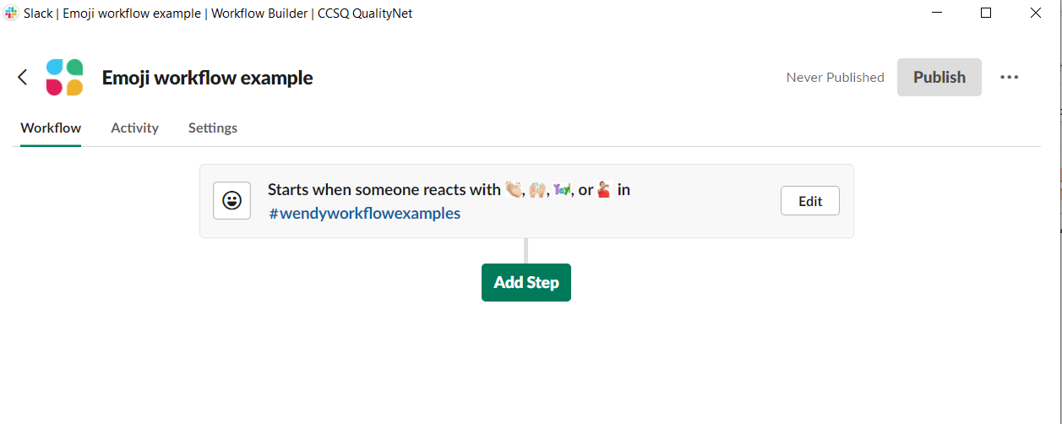
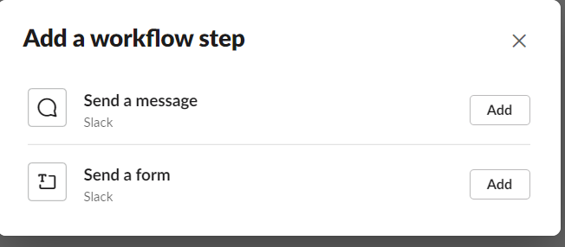
Emoji Reaction Trigger
2. Select your Step.
1. Click Add Step.
3. Customize Step 1.

Slide 51
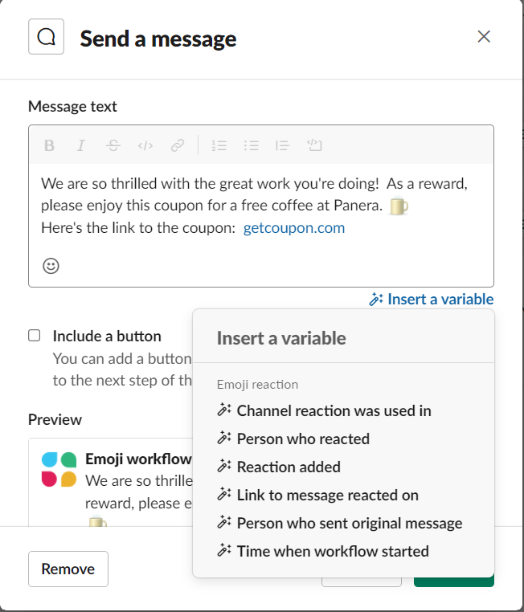
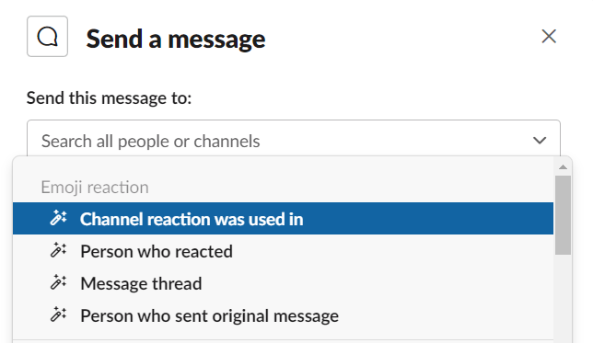
Emoji Reaction Trigger
*Note greater recipient and variable selection for Emoji Reaction step when sending message.

Slide 52
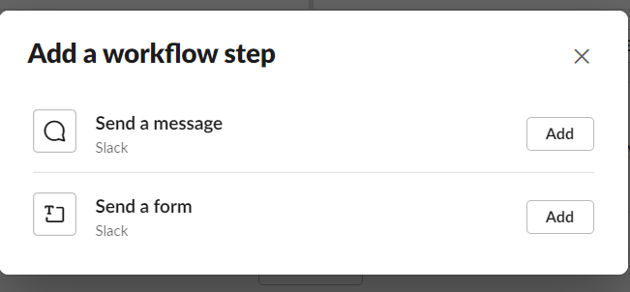
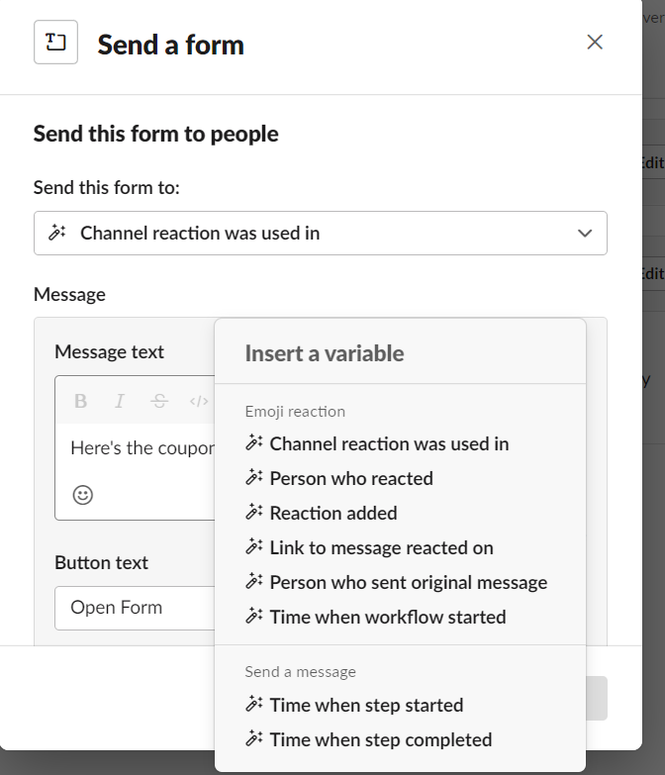
Emoji Reaction Trigger
Option to add another step.
Here are some of the variables for sending a form in the Emoji reaction trigger.

Slide 53

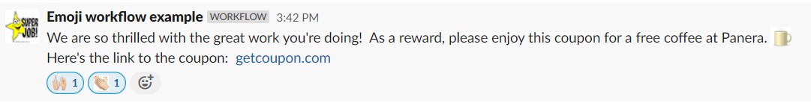
Published Emoji Reaction Trigger
Message that Emoji workflow was published is displayed in channel (Note the custom icon.)
Here is the message triggered by an emoji reaction in the channel.
**Note: Emoji must be placed as a reaction to another comment in order for the trigger to work. The emoji cannot be in a separate message of its own for the workflow to be triggered.

Slide 54
Scheduled Date & Time Trigger

Slide 55
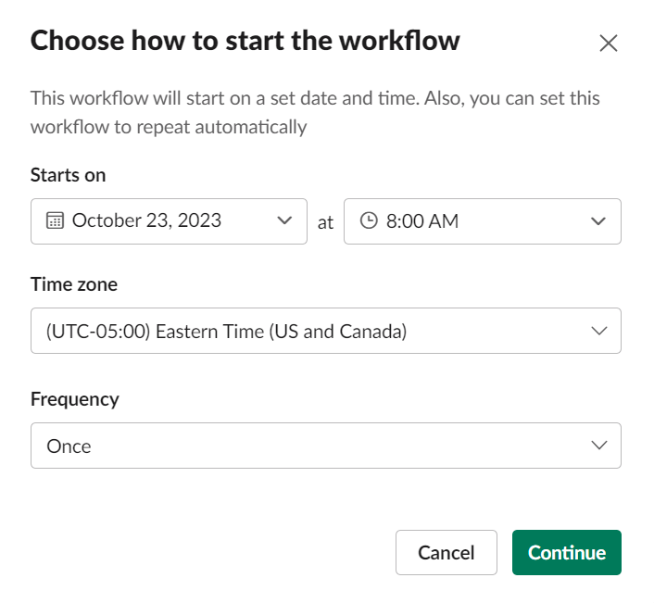
Scheduled Date & Time Trigger
1. Select your trigger.
2. Customize your trigger.

Slide 56
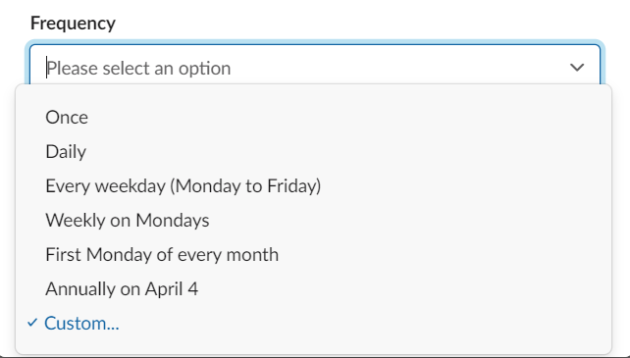
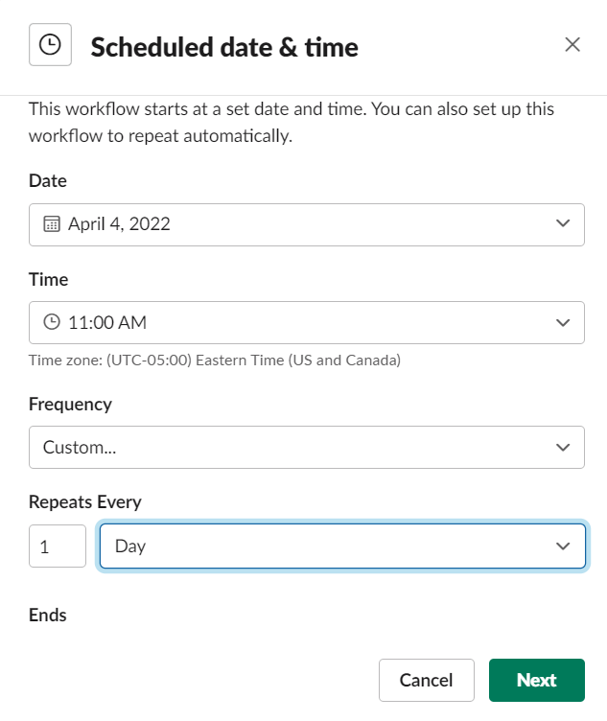
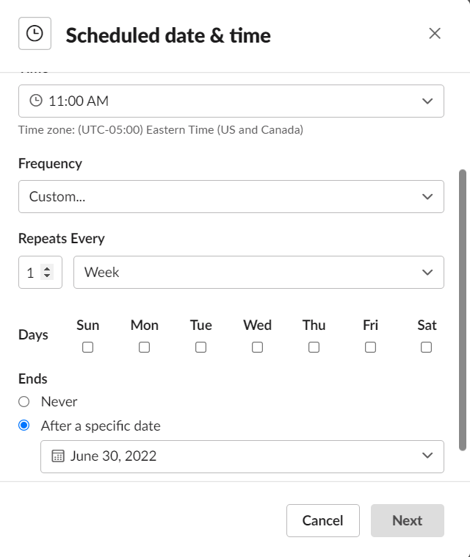
Scheduled Date & Time Trigger
Select your Frequency.
Custom Frequency
Select date, time, how often repeats, & end date.

Slide 57
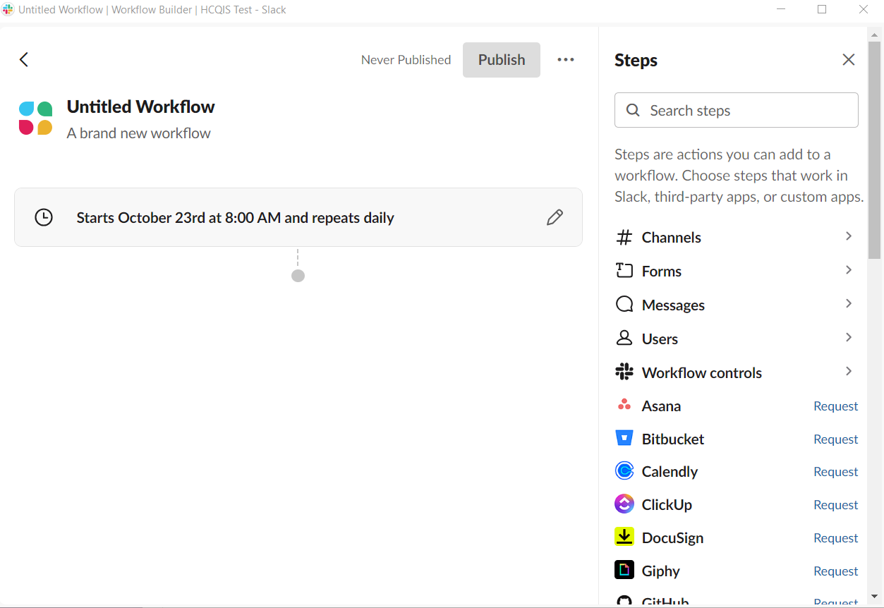
Scheduled Date & Time Trigger
Steps are located in the right sidebar.
Click to add a Step.

Slide 58
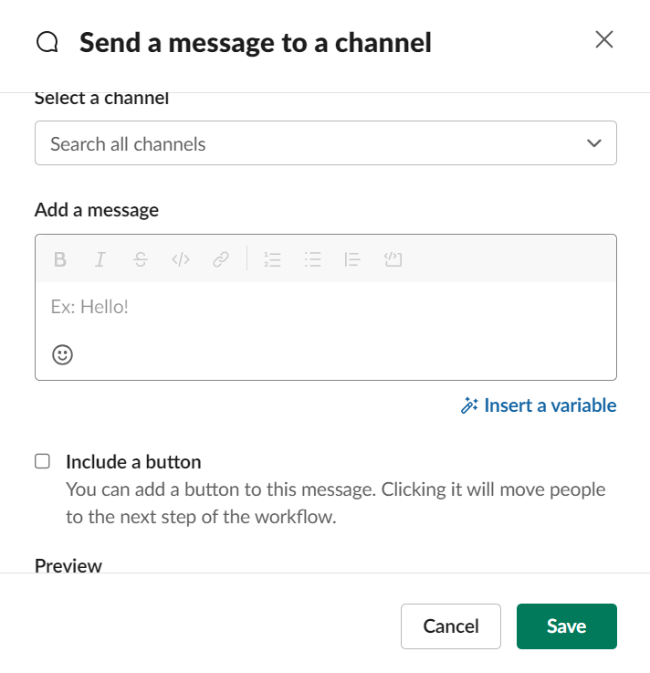
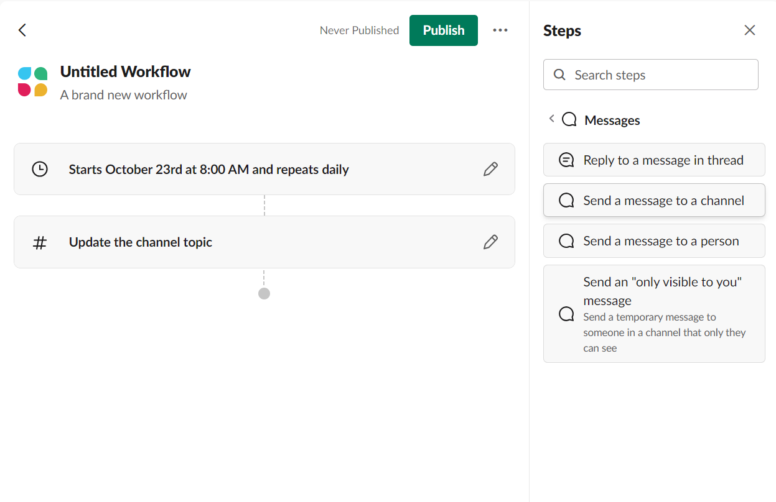
Scheduled Date & Time Trigger
Select a Step.
Complete the details for the Step.

Slide 59
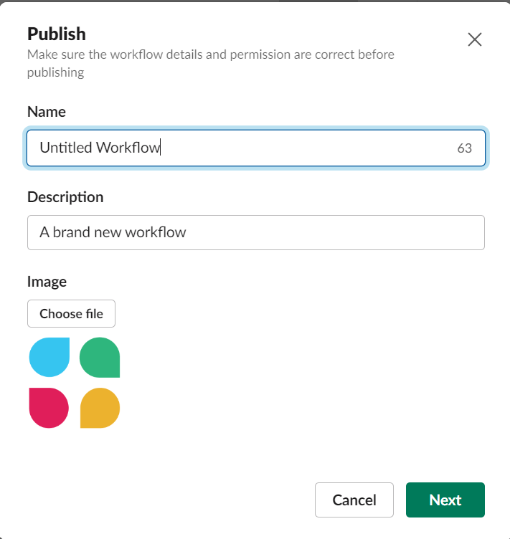
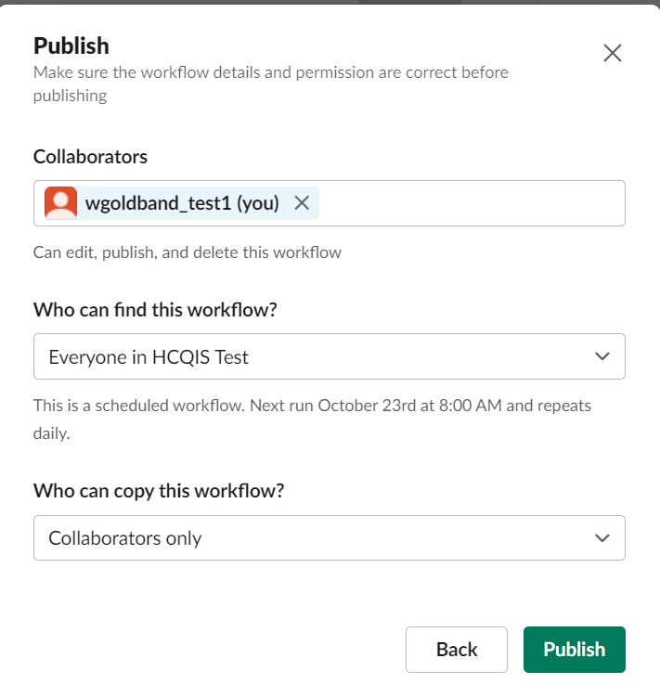
Name Workflow and Publish

Slide 60
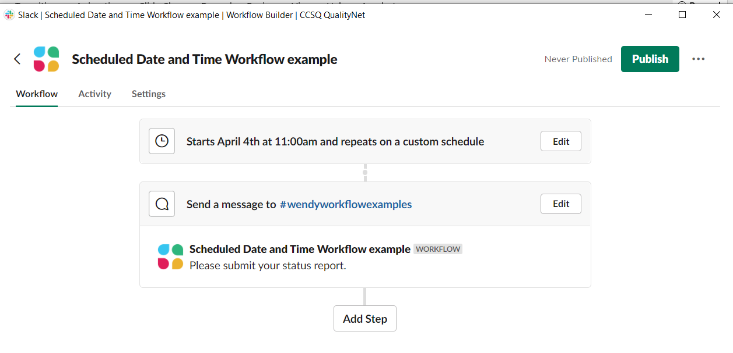
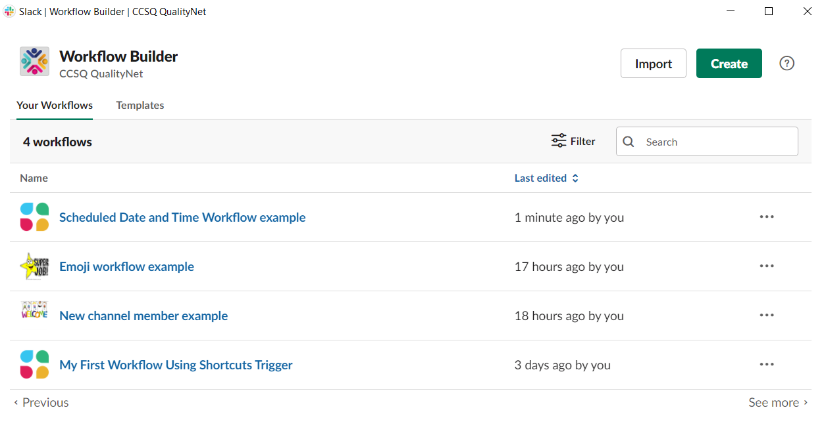
Published Scheduled Date & Time Trigger
Listed in Workflow Builder once published

Slide 61
Miscellaneous Info & Examples

Slide 62
Workflow Templates
You can also create a workflow from available templates.
Click on workspace name CCSQ QualityNet.
Click Tools.
Click Workflow Builder.
Select your template.

Slide 63
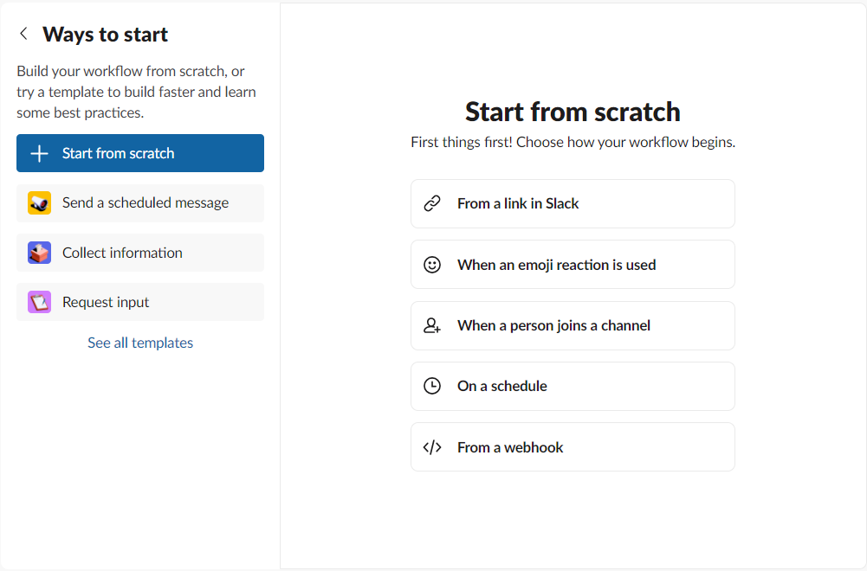
Workflow Templates

Slide 64
Customize a Workflow Template
Find prebuilt workflows that you can customize at: https://slack.com/slack-tips/workflow-builder-examples

Slide 65
Creating Your Own Workflow
If you're a developer, visit Slack API for details on building workflow steps for a Slack app.

Slide 66

Example of
Standup Form

Slide 67

Example of
Message
to go with
Standup Form
Note the variables you can include for tracking

Slide 68

Example of
Project Status Workflow

Slide 69

Example of
Project Status Workflow
Each response seen in channel

Slide 70

Example of
Healthy
Reminder
Workflow
This is a message posted daily in channel by the Workflow.

Slide 71
Workflow Glossary
Trigger | How your workflow will start. You can choose a shortcuts menu trigger to launch your workflow from the menu in a channel, or another trigger to start your workflow automatically when a certain action is taken.
Step | How people interact with your workflow. You can add steps that send messages, custom forms, or use steps from Slack apps to link your workflow to other tools.
Variable | Information submitted to your workflow that can be referenced in steps. More variables will be available to choose from as you add steps to your workflow.
Collaborator | A member of your workspace with permission to manage your workflow. Any collaborator can change or remove steps, manage other collaborators, and unpublish or delete a workflow.

