Slide 1
QualityNet Jira Admin Training
Karen Wheeler, PM3 II
September 2023

Slide 2

Today’s Objectives
Today we will be covering the following topics:
  Project Settings
  Permissions
  Configuring boards
  Enriching Issues
  Setting up sprints
  Searching, JQL, Filters
  Reports and Dashboards

Slide 3

Project Settings
in Jira

Slide 4
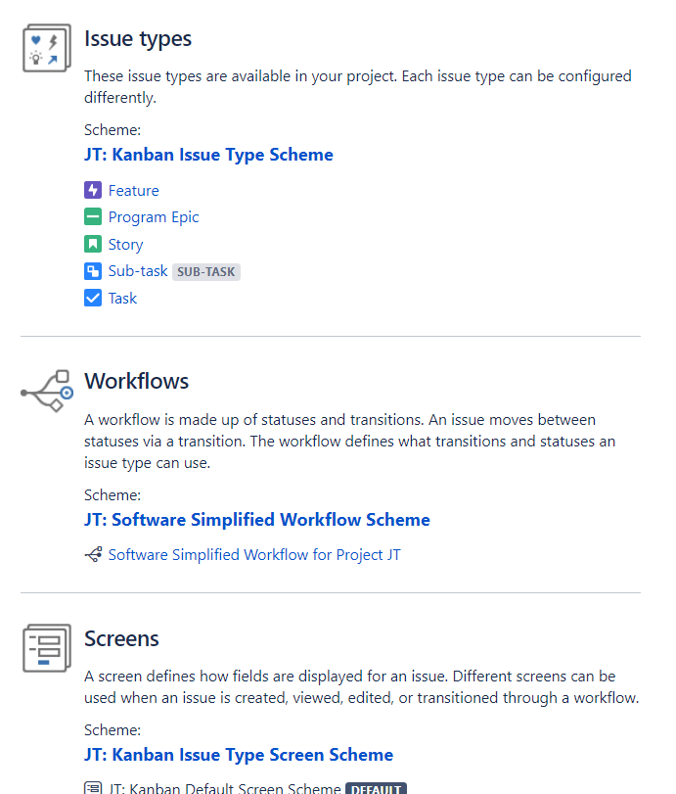
Project Settings
Project administrators can manage permissions within the project, sprints, etc.
Only System Administrators can make project configuration changes (such as workflow updates). If your project requires any change like this, reach out to the #help-atlassian channel.
There are two different default project configs, one is Kanban and other is Scrum.
  If your project was created originally as Kanban, then it will have slightly different fields (like no Sprint).
  You can have both types of boards in your project, but if your project started out as Kanban, then you need to have Sprint field added in order for it to show on the issue/be able to edit it from the issue.

Slide 5
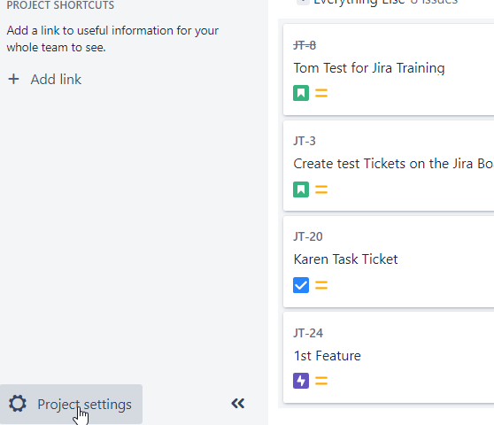
Project Settings Cont.
Need Atlassian Team:
  Issue Types
  Workflows
  Screens
  Fields
  Notifications
  Development Tools
  Priorities
  Permissions
Jira Project Admin Control:
  Versions
  Components
  Roles

Slide 6
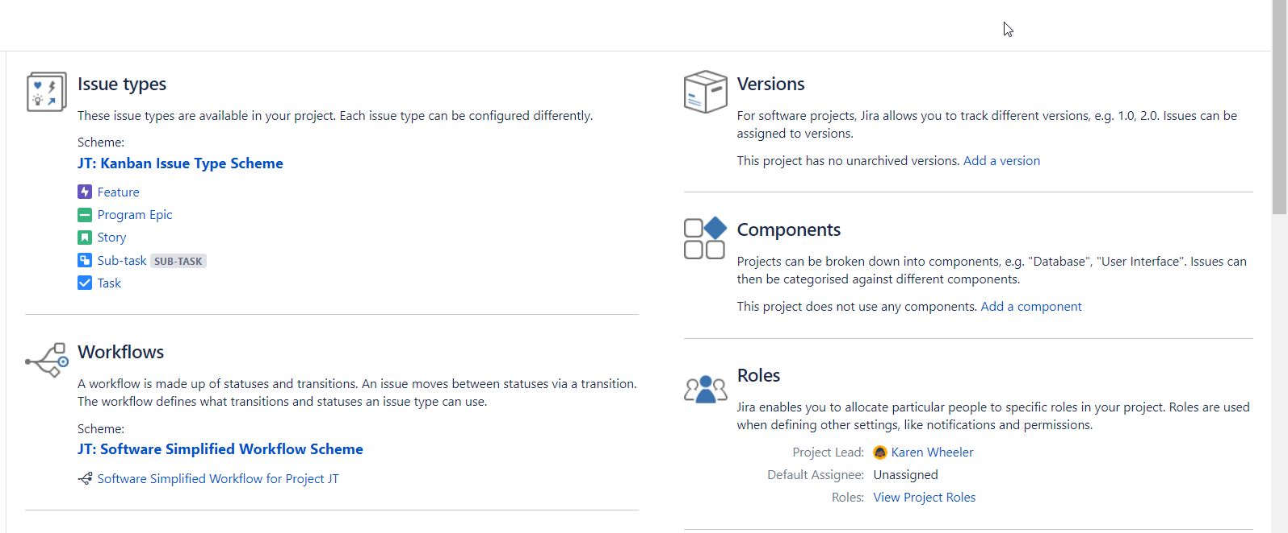
Project Settings Cont.

Slide 7
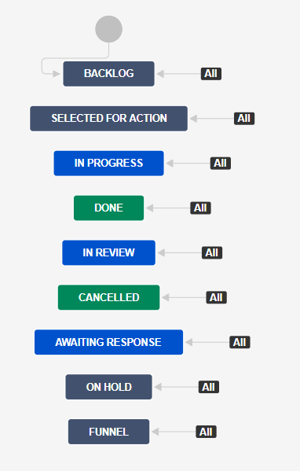
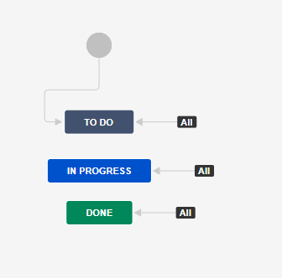
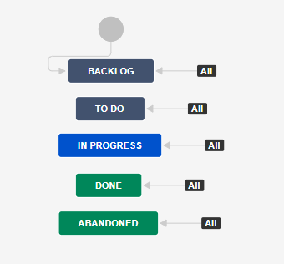
Defining a Jira Project – Workflow Scheme
A Jira workflow is a set of statuses and transitions that an issue moves through during its lifecycle, and typically represents a process within your team.

Slide 8
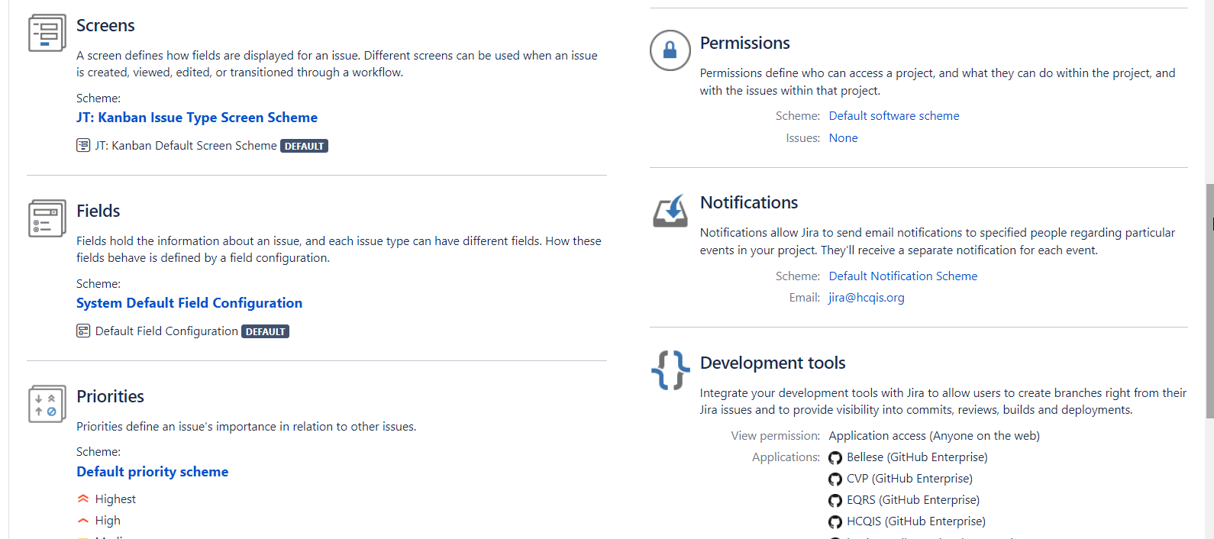
Project Settings Cont.

Slide 9

Demo Project Settings in Jira https://qnetjira.cms.gov/secure/RapidBoard.jspa?projectKey=JT&rapidView=2083

Slide 10
Permissions in Jira

Slide 11
Defining a Jira Project – Permission Scheme
Every Jira project has a permission scheme.
Setting permissions at the project level defines who can access, what team members can do within the project, and with the issues within that project (e.g., who can see the project's issues, create, edit and assign them)
While project admins can assign users to a project, they can't customize the permission schemes for a project.
Global permissions - apply to Jira as a whole.
Issue security permissions - can let you set up types of issues that can only be seen by project admins or users in specific groups.

Slide 12
Defining a Jira Project – Permission Scheme
Board permissions can be divided into two parts — board administration permissions and board usage permissions.
Board administration permissions cover functionality for changing the configuration of a board. For example, changing columns, customizing cards, etc. Board administration can be assigned to groups or users.
By default, the administrator of a board includes the person who created it.
A board administrator is a user that has been added to the Administrators for a particular board.
Board usage permissions cover functionality for the usage of a board. For example, creating sprints, ranking issues, etc.
Board usage permissions are derived from project permissions.
What role aligns with what permission
Assigning team members to roles
How to update permissions on a filter for a board
See Permissions overview for more information.

Slide 13
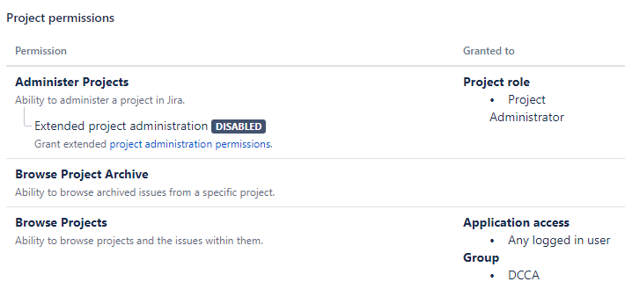
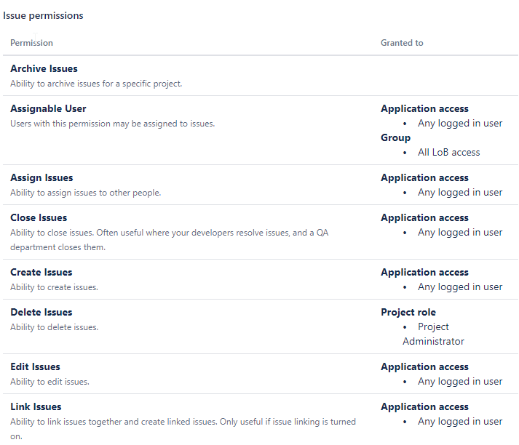
Defining a Jira Project – Permission Scheme

Slide 14
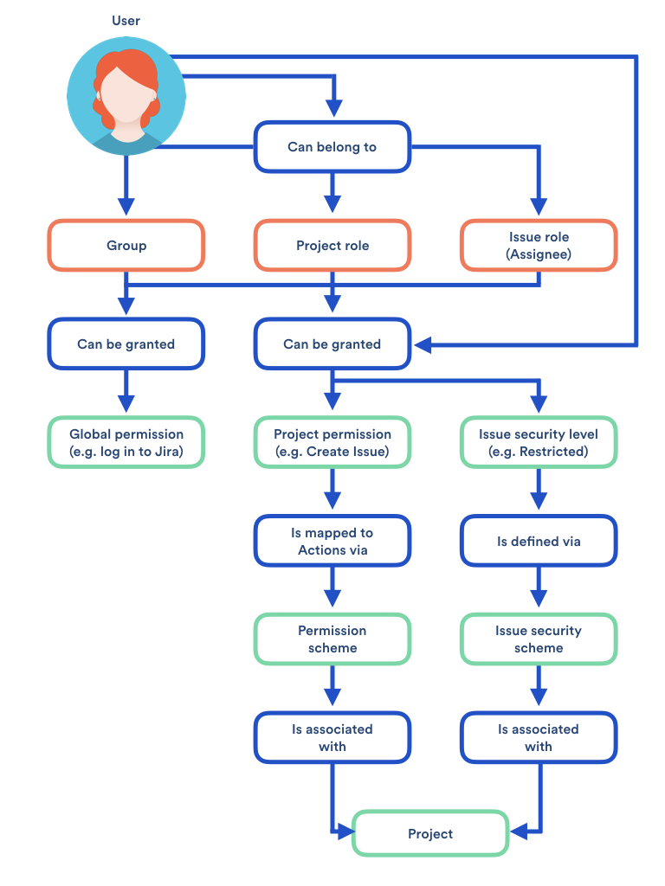
Defining a Jira Project – Permission Scheme

Slide 15
Demo Permissions in Jira https://qnetjira.cms.gov/secure/RapidBoard.jspa?projectKey=JT&rapidView=2083

Slide 16
Configuring Boards
in Jira

Slide 17
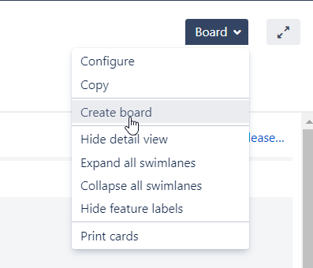
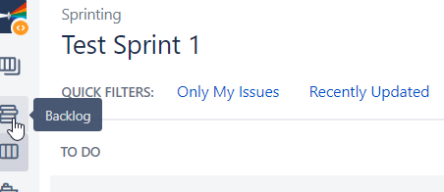
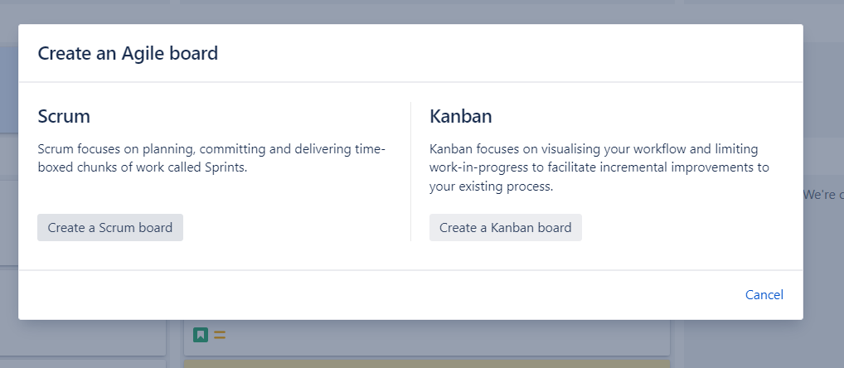
Creating Boards
You need a board so that you can view and work on issues in Jira.
A board displays issues from one or more projects.
You can also copy a board that someone else has created.
Anyone in the project can create a board either from the Board dropdown on an existing board in their project or by clicking "View all boards" from the Boards dropdown in the Jira banner.
There are two types of boards:
  Scrum boards are for teams that plan their work in sprints.
  Kanban boards are for teams that focus on managing and constraining their work-in-progress. Because work is not planned in advance using discrete time periods or versions, Kanban boards do not have a Backlog screen.

Slide 18
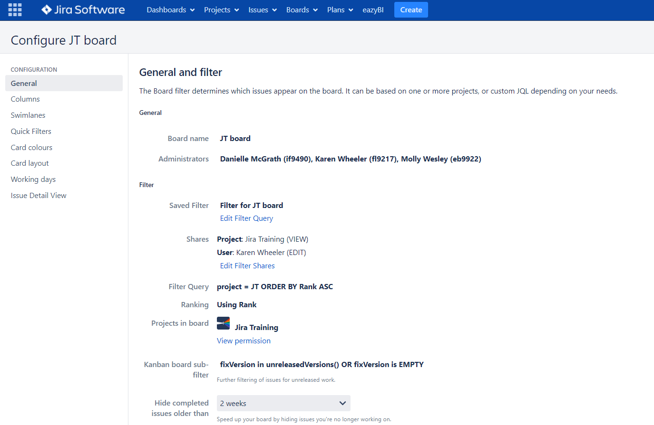
Configuring Boards
Project Administrators can configure project boards
Note: Project admins can configure project boards, but project admins are not necessarily board admins. Whoever created the board would need to add other people as board admins to allow other users to be able to configure the board.
Configuring a board allows you to:
  Map workflow statuses to columns of a board
  Add/Remove/Edit Columns
  Add Swimlanes
  Add Quick filters
  Customize the card colors and displayed issue fields.

Slide 19
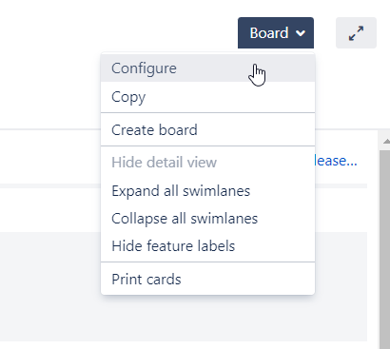
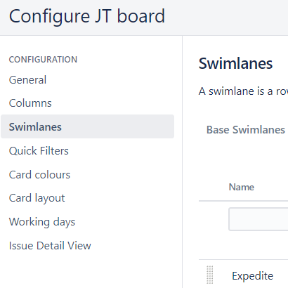
Configuring Boards Contd.
To Access a Board’s Configuration:
  Go to the desired board, then click Board > Configure on top right of screen.
  On the Board Configuration screen, select the desired tab (Columns, Swimlanes, etc.).
More Here: https://confluence.atlassian.com/jirasoftwareserver/configuring-a-board-938845252.html

Slide 20
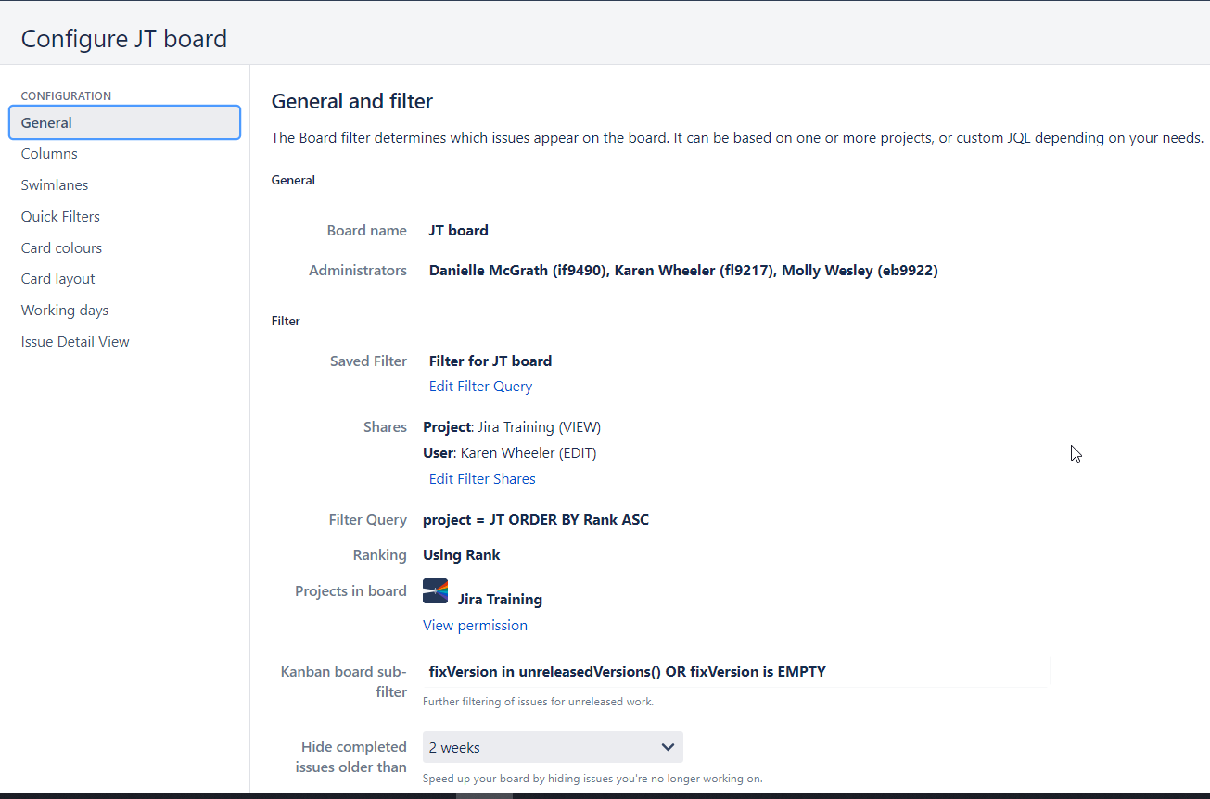
Configuring Boards General
Edit the Filter Query
View Permissions
Timeframe for hiding issues (Kanban Only)

Slide 21
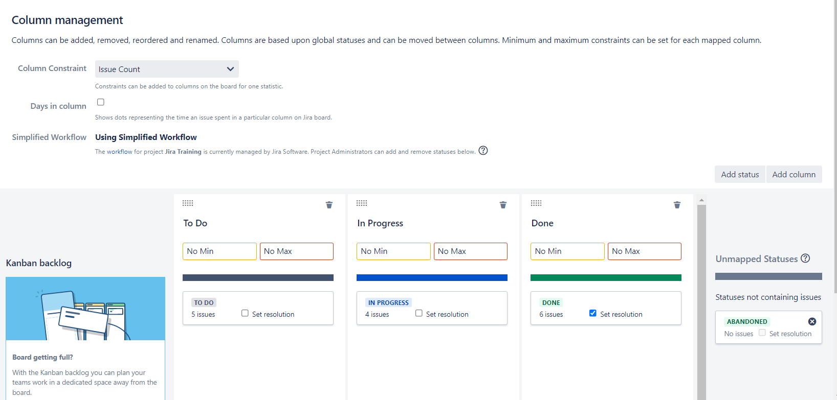
Configuring Boards Columns
The vertical columns in both the Active sprints of a Scrum board and the Kanban board represent the workflow of your board's project.
The default columns in the Active Sprints of a Scrum board are To Do, In Progress, and Done.
The default columns on a Kanban board are Backlog, Selected for Development, In Progress, and Done.
You can add, delete, rename, or move these columns.
You can also choose which Jira workflow status or statuses each column is mapped to.

Slide 22
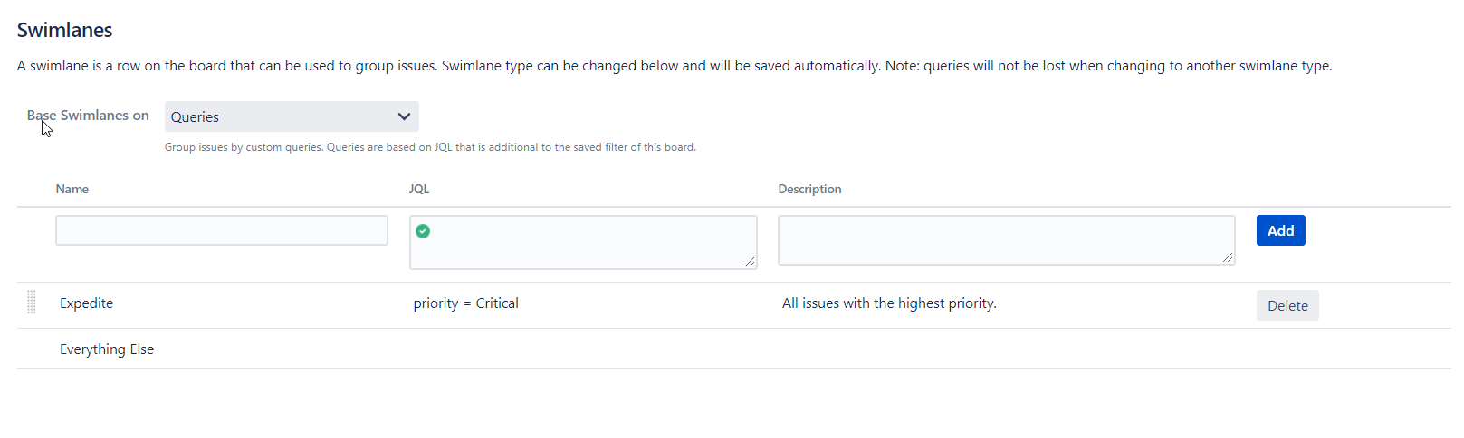
Configuring Boards Swimlanes
A swimlane is a horizontal categorization of issues in the Active sprints of a Scrum board, or on a Kanban board.
Can use to help you distinguish tasks from different workstreams, users, etc.
Options per Swimlane:
  Queries - One JQL query
    Expedite —Priority = Blocker
    Everything Else —cannot be deleted. All issues that do not match the swimlanes above it, hence it has no JQL specified.
    Can create additional swimlanes that map to other values of your Jira 'Priority' field or use a different field to categorize your swimlanes
  Stories - One parent issue
  Assignees - One per
  Epics – One per

Slide 23
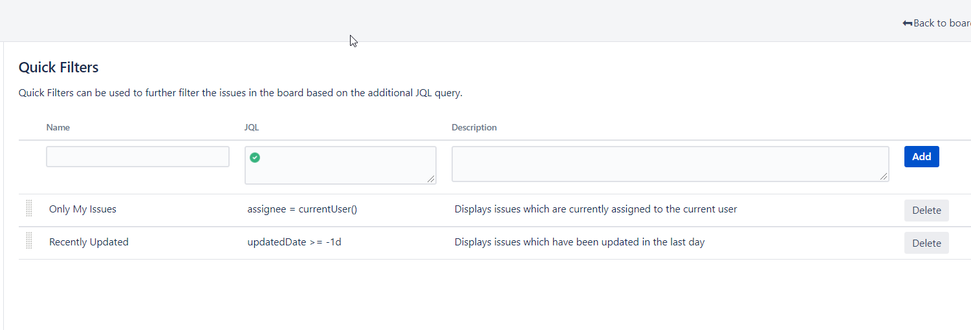
Configuring Quick Filters
Quick Filters allow you to further filter the collection of issues appearing on a Scrum board or Kanban board.
Use Quick Filters to switch between different issue types (e.g. show only bugs), or to show team-specific views of a common backlog.
By default, a board contains two Quick Filters, called 'Only My Issues' and 'Recently Updated’.
Default Quick Filter | Default JQL | Notes
Only My Issues | assignee = currentUser() | Displays issues assigned to the person who is currently viewing this board
Recently Updated | updatedDate >= -1d | Displays issues that have been updated in the last 24 hours

Slide 24
Demo - Configuring Boards in Jira https://qnetjira.cms.gov/secure/RapidBoard.jspa?projectKey=JT&rapidView=2083

Slide 25
Enriching Issues
in Jira

Slide 26
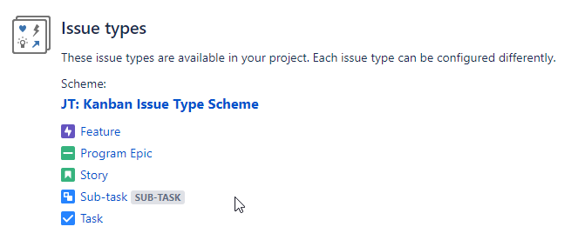
Enriching Issues – Issue Scheme
Issue types distinguish different types of work in unique ways, and help you identify, categorize, and report on your team’s work across Jira. They can help your team build more structure into your working process.

Slide 27
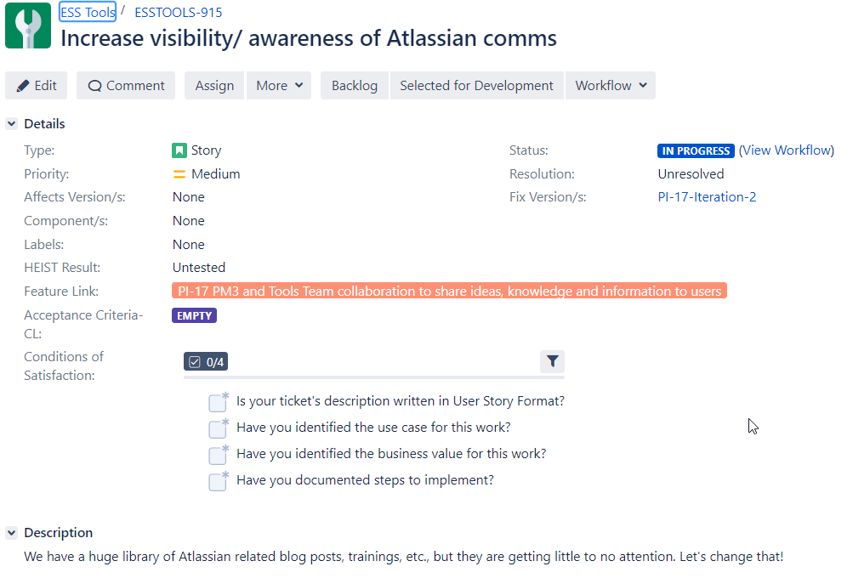
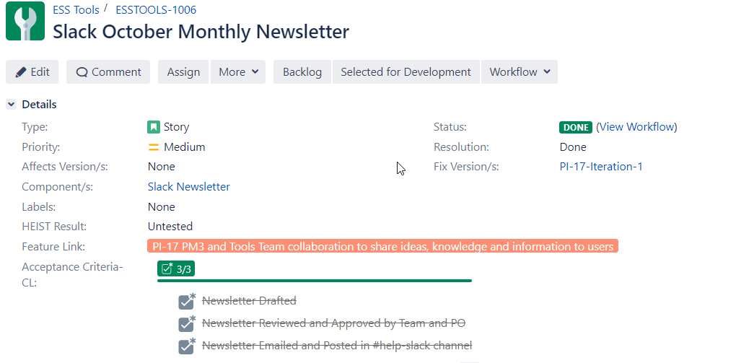
Use of Custom Fields - Checklist
There are many styles of custom fields, but one of our favorites is the Checklist style field.
We use this type of field frequently, but our most popular Checklist fields are "Acceptance Criteria" and "Conditions of Satisfaction", Can request add of a ‘Checklist’ in Acceptance Criteria or Conditions of Satisfaction field – reach out to #help-Atlassian
More on Checklist: https://qnetconfluence.cms.gov/display/HAKSS/2019/09/20/Checklists+for+Jira%3A+Simplifying+How+You+Track+Tasks

Slide 28
DEMO: Enriching Issues https://qnetjira.cms.gov/secure/RapidBoard.jspa?projectKey=JT&rapidView=2083

Slide 29
Setting up sprints in Jira

Slide 30
Sprints
A sprint is a fixed time period where teams complete work from their product backlog.
Sprints only apply to Scrum boards.
Sprint actions require the Manage Sprints permission.
  There are more granular permissions that give users the right to edit the goal and name of a sprint (Edit sprints) and start and end a sprint (Start/Complete sprints).
  There are also some sprint actions (e.g. adding issues to sprints, removing issues from sprints) that require the Schedule Issues and Edit Issues permissions.

Slide 31
Creating a Sprint
Step 1: Create a sprint
Go to the Backlog of your Scrum project.
Click the Create Sprint button at the top of the backlog.
Note that you can create more than one sprint, if you want to plan work several weeks in advance.

Slide 32
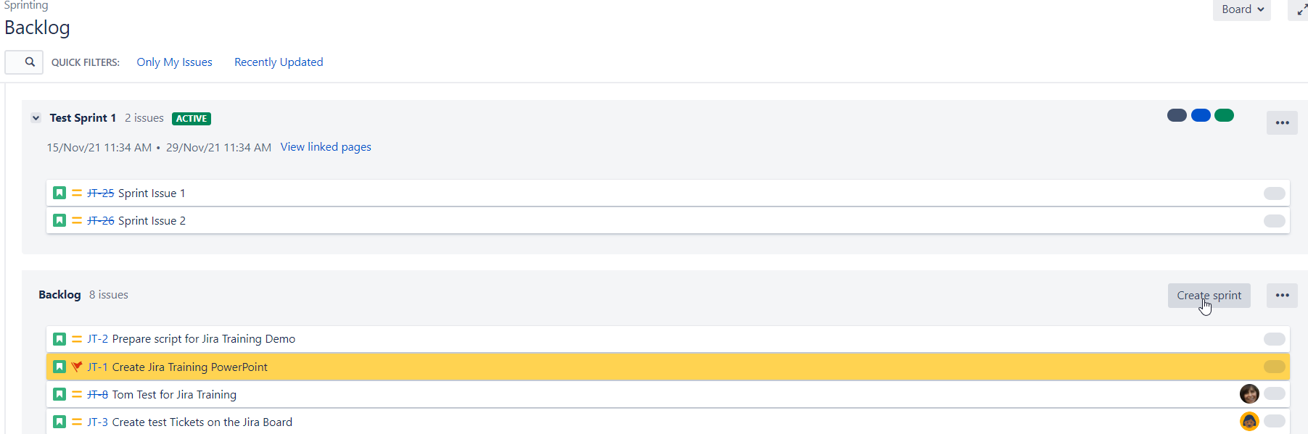
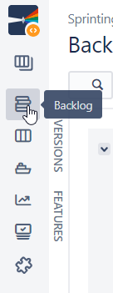
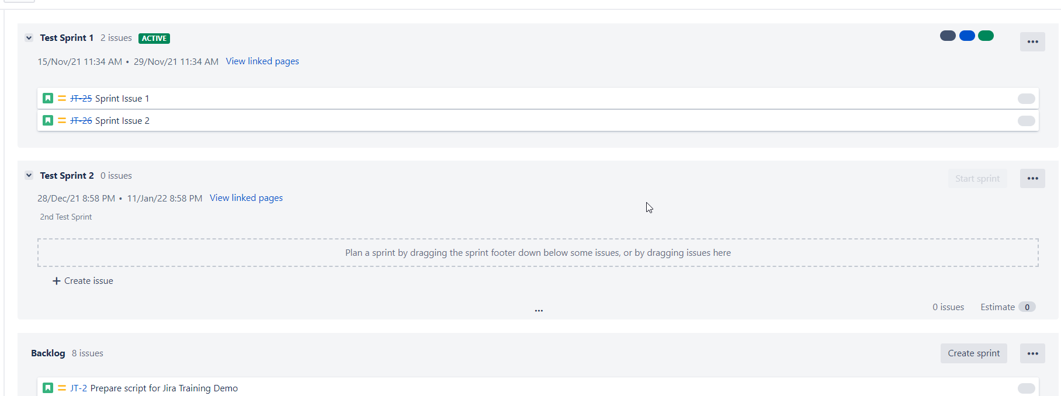
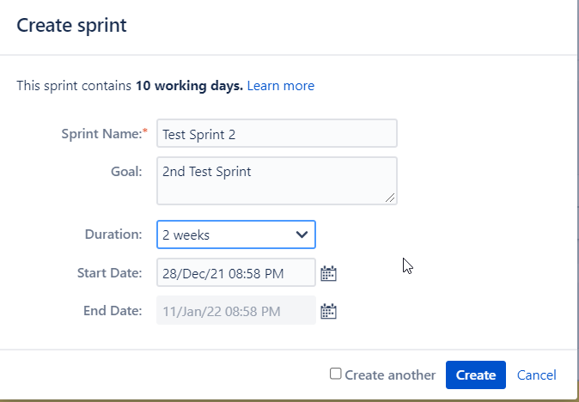
Creating a Sprint in Pictures
1
2
3
4

Slide 33
Adding Issues to a Sprint
Fill your sprint with stories from the backlog
Once you've created your sprint, you'll need to fill it with issues.
Before you do this, sit down with your team and discuss what work you'd like to commit to doing.
To add stories to your sprints
  Navigate to the Backlog.
  Drag and drop issues from the Backlog onto your sprint.
  Note that you can also add an issue to your sprint by editing the issue and updating the Sprint field.

Slide 34
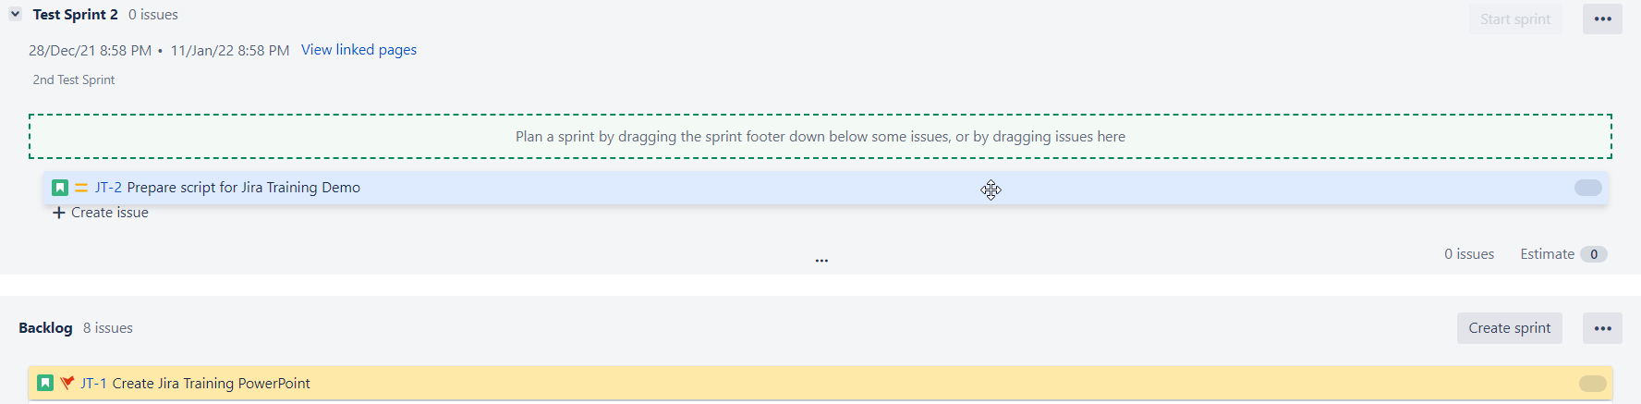
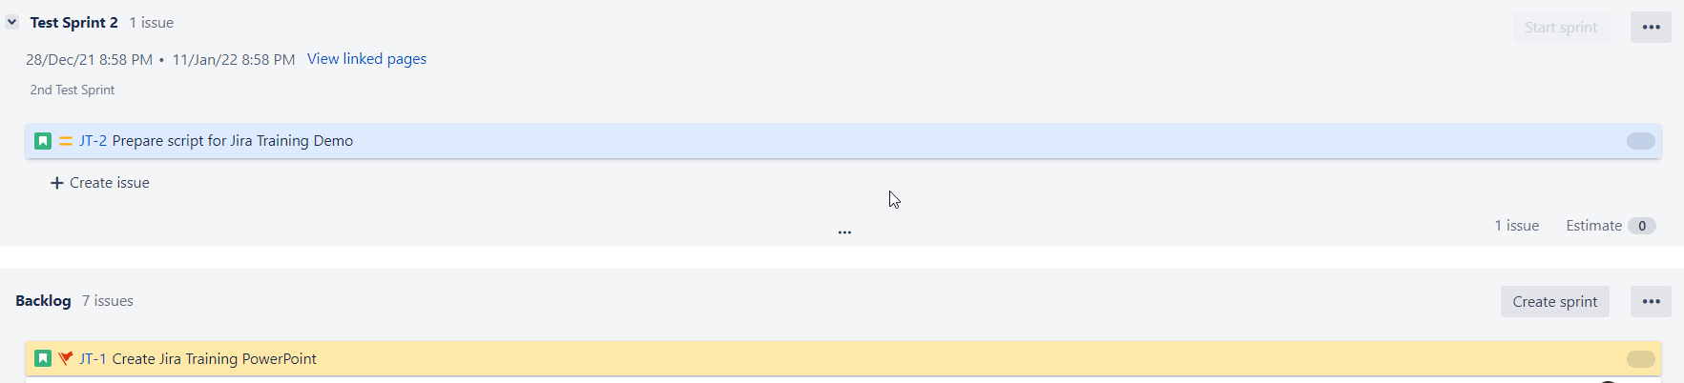
Adding Issues to a Sprint in Pictures
1
2

Slide 35
Start Sprint
Once you've added issues to your sprint and the team is ready to work, you'll need to start the sprint.
Note, you can only start a sprint, if:
  You haven't started one already.
  The sprint is at the top of the backlog.
    If you want to start a planned sprint that is lower down, you'll need to reorder your sprints to move it to the top.
To start a sprint
  Go to the Backlog of your Scrum project.
  Find the sprint that you want to start and click Start Sprint.

Slide 36
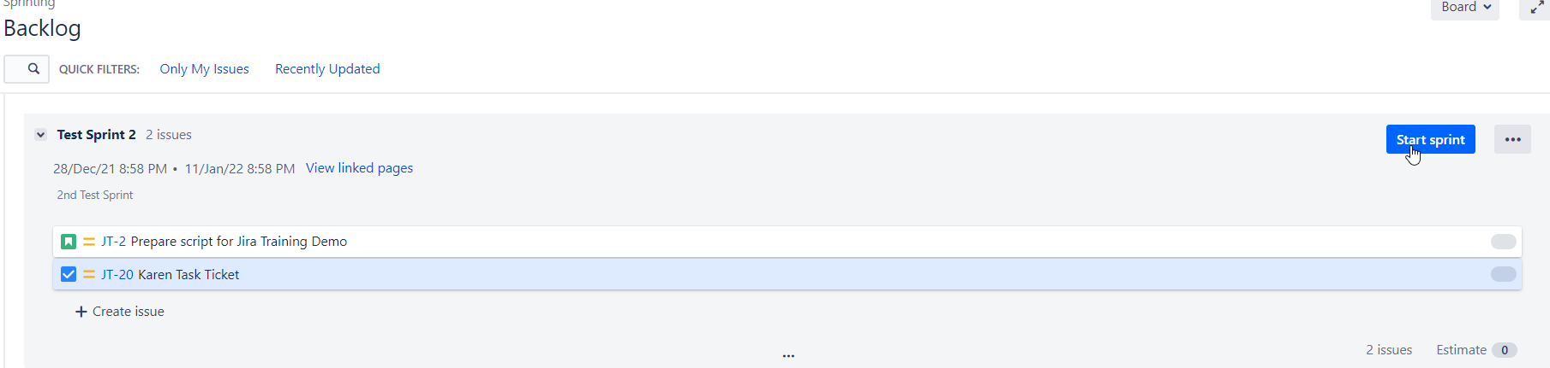
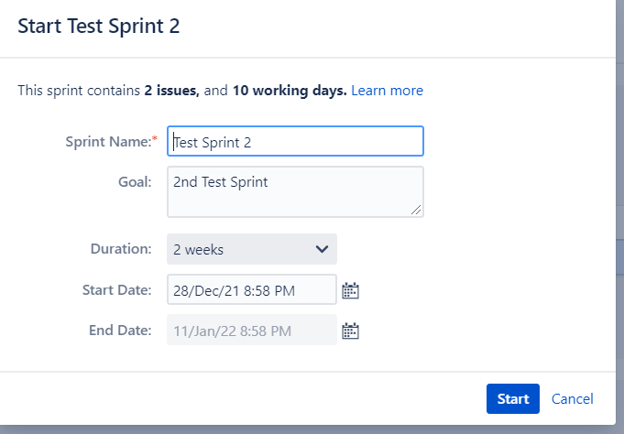
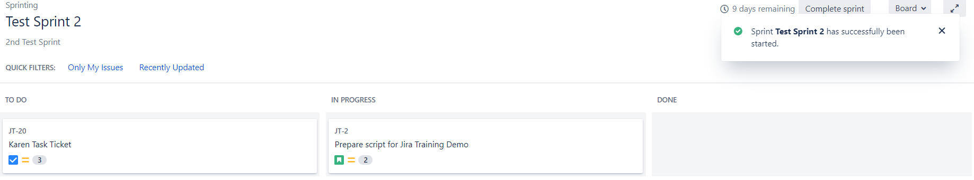
Starting a Sprint in Pictures
1
2
3

Slide 37
Completing Sprint
To Complete/Close a sprint
Navigate to the Active sprint of your Scrum board.
Click Complete Sprint.
  All completed issues will move out of Active sprints.
  You will be notified if there are issues that are not completed.

Slide 38
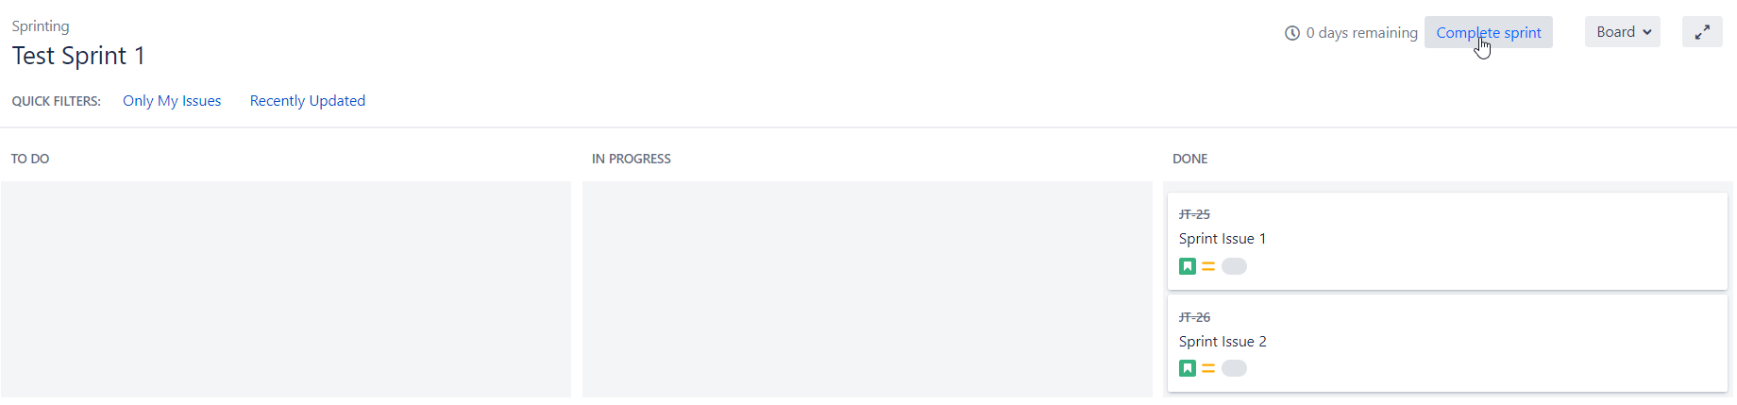
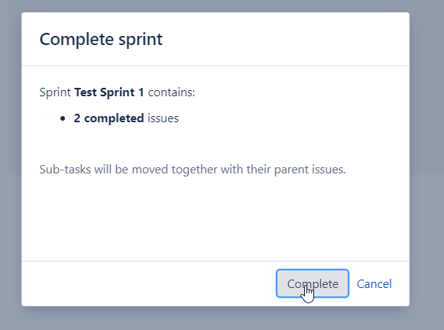
Completing a Sprint in Pictures
1
2

Slide 39
Additional Sprint Topics
Editing, reordering, or deleting a sprint
Viewing the issues in a sprint
Sprint Report

Slide 40
DEMO: Sprints https://qnetjira.cms.gov/secure/RapidBoard.jspa?projectKey=JT&rapidView=2083

Slide 41
Searching, JQL, Filters in Jira

Slide 42
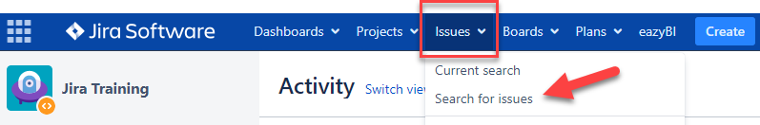
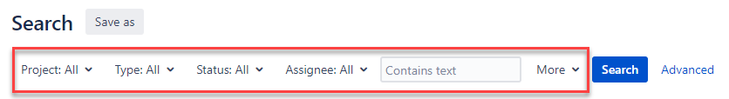
Searching Issues – Basic Search
Basic search is more precise than a quick search but easier to use than the advanced search. It provides a user-friendly interface that allows the user to define complex queries without needing to know how to use Jira Query Language (JQL). To use the basic search:
Navigate to Issues (in the header/banner).
Click Search for issues.
Enter your search criteria in the attributes and/or Contains text section provided.

Slide 43
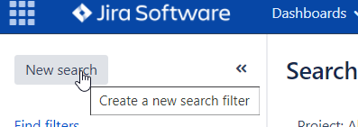
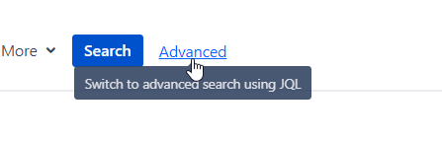
Searching Issues – Advanced Search
Build structured queries using the Jira Query Language (JQL) to search for issues.
You can specify criteria that cannot be defined in the quick or basic searches (e.g. ORDER BY clause).
  If you don't have complex search criteria, use quick search instead.
  If you are not comfortable with the Jira Query Language (JQL), use basic search instead.
To start:
Navigate to Issues (in header) > Search for issues.
  If there are existing search criteria, click the New Search button to reset the search criteria.
  If the basic search is shown instead of the advanced search, click Advanced (next to the Search button).
Enter your JQL query. As you type, Jira will offer a list of "auto-complete" suggestions based on the context of your query.
Press Enter or click Search to run your query. Your search results will display in the issue navigator.

Slide 44
Constructing JQL Queries
A simple query in JQL (also known as a 'clause') consists of a field, followed by an operator, followed by one or more values or functions. For example:
  project = "TEST"
  This query will find all issues in the "TEST" project. It uses the "project" field, the EQUALS operator, and the value "TEST".
A more complex query might look like this:
  project = "TEST" AND assignee = currentuser()
  This query will find all issues in the "TEST" project where the assignee is the currently logged in user. It uses the "project" field, the EQUALS operator, the value "TEST", the "AND" keyword and the "currentuser()" function.
For more information on fields, operators, keywords and functions, see the Reference section: https://confluence.atlassian.com/jirasoftwareserver/advanced-searching-939938733.html#Advancedsearching-reference

Slide 45
Demo: Searching, JQL, Filters

Slide 46
Reports and Dashboards in Jira

Slide 47
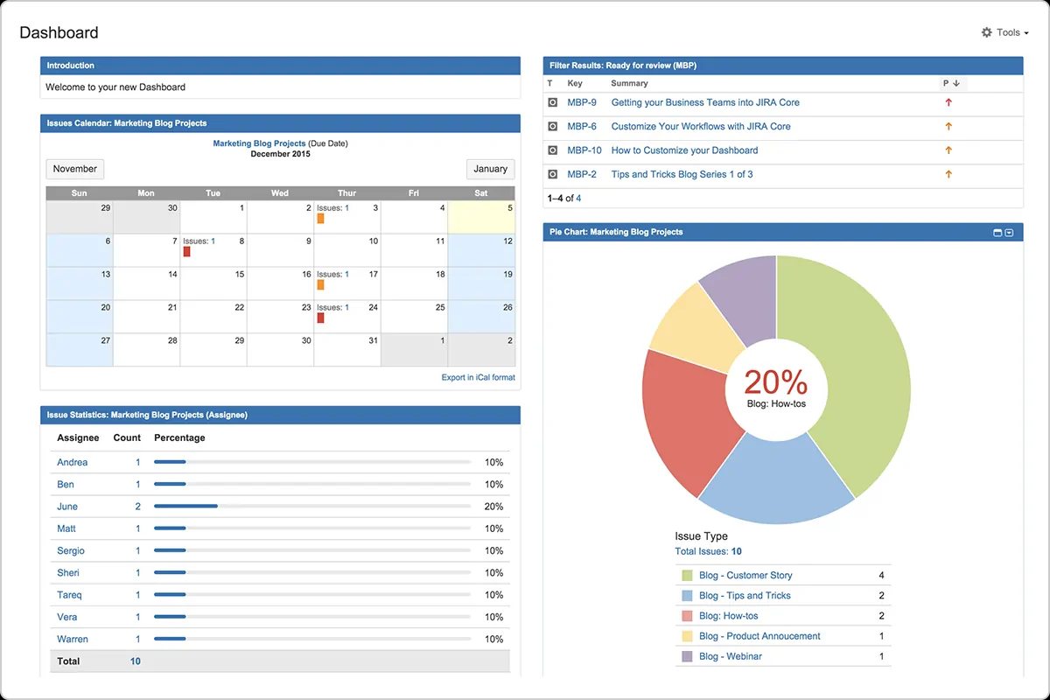
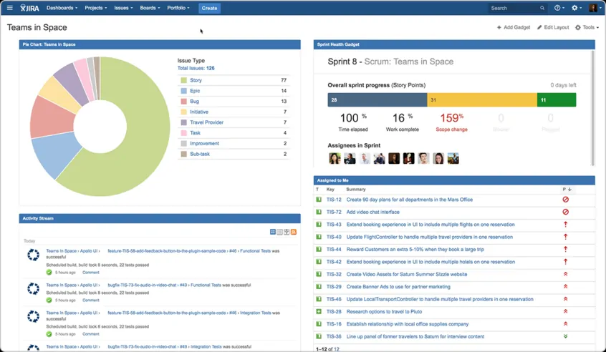
What is a Jira Dashboard?
Dashboards are designed to display gadgets that help you organize your projects, assignments, and achievements in different charts. Note: Your dashboard is the main display you see when you log in to your project.
You can create multiple dashboards for different projects or multiple dashboards for one big project.
You can see all publicly available dashboards by selecting the Dashboards drop-down from the Jira header.

Slide 48
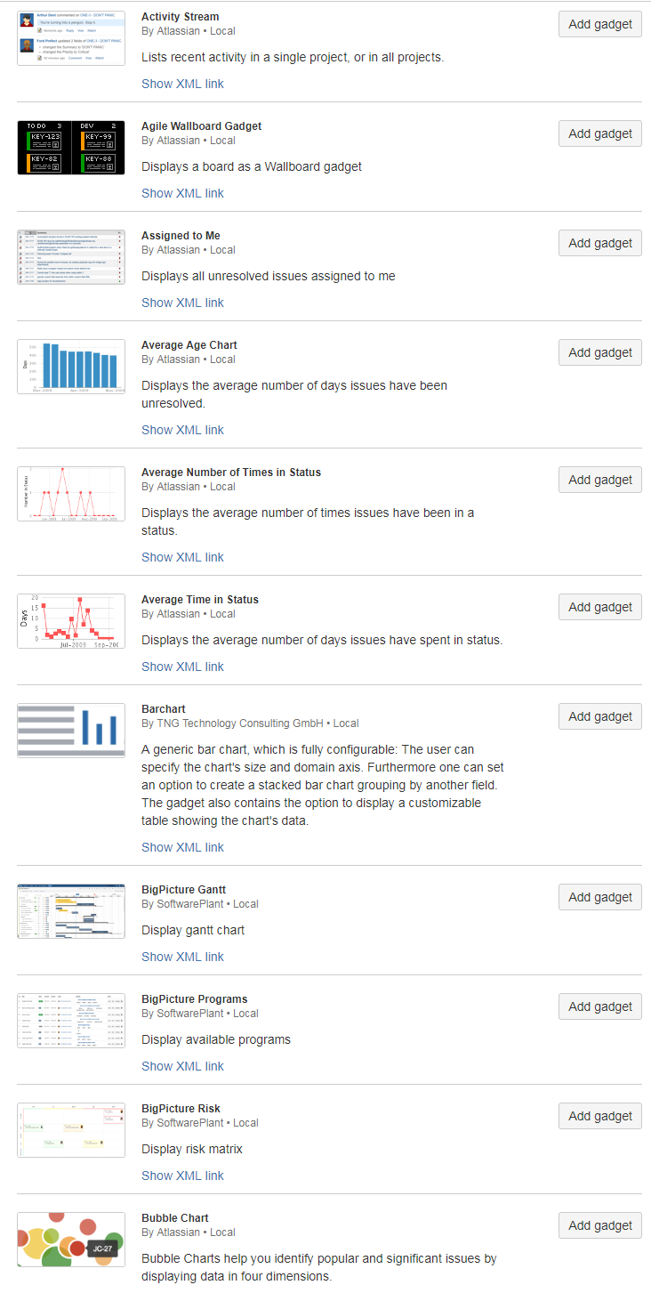
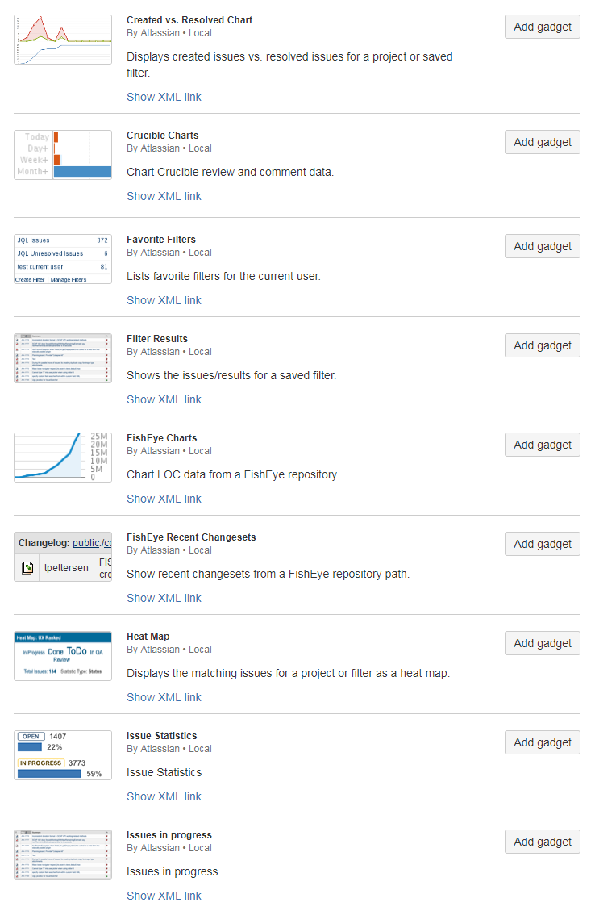
Selecting Gadgets for the Dashboard
Dashboards are collections of gadgets which display Jira data
Gadgets are often based on a filter, a project, or a board
Building a dashboard is a matter of identifying “useful” gadgets and knowing/defining which data you want to present
  Many gadgets are more appropriate for help desk types of operations

Slide 49
When creating a Dashboard…
Many dashboards are built off Jira information that you have filtered. Be sure to share your filter with other people!
  If you forget to share a filter, you will be the ONLY one able to see it
It’s the same with the Dashboard itself – make sure you share the Dashboard with other users!
Please see the following for detailed instructions on getting started with Jira Dashboards: https://qnetconfluence.cms.gov/display/HAKSS/JIRA+Dashboards+Basics

Slide 50
DEMO: Dashboards https://qnetjira.cms.gov/secure/Dashboard.jspa?selectPageId=24507#

Slide 51
Rules / Best Practices / Need to Know
Rules – No PII/No PHI
  Security Policy: https://qnetconfluence.cms.gov/display/HAKSS/QualityNet+Atlassian+Security+Policy
There is a known bug in Confluence where MS files will timeout, need to save frequently when working in Word, PowerPoint, and Excel files in Office.

Slide 52
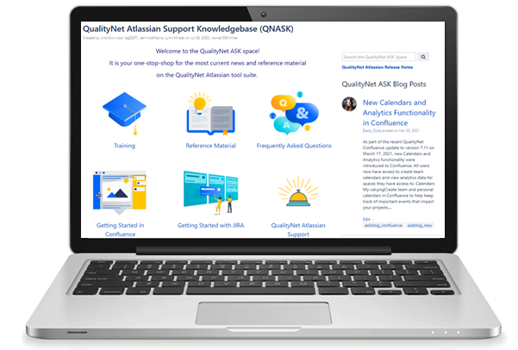
For More Information
QualityNet Atlassian Support Knowledgebase (QNASK)
Your one-stop-shop for news and reference material on the QualityNet Atlassian tool suite.
https://qnetconfluence.cms.gov/display/HAKSS

Slide 53

Help?
For questions using QualityNet Atlassian, contact the team in QualityNet Slack at #help-Atlassian.
For issues accessing Atlassian? Contact the QualityNet Help Desk at ServiceCenterSOS@cms.hhs.gov or
1-866-288-8912.

Slide 54

Questions?

Slide 55
Appendix - Requesting a New Jira Project
Submit a request to the Atlassian team in the #help-atlassian channel in QualityNet Slack. Provide the following information:
  Project Name
  Project Lead
  Project Administrators (responsible for setting permissions for the rest of the team)
  Issue Types
  Workflow Options

Slide 56
Appendix – Additional JQL Reference
 | Description | Reference
Fields | A field in JQL is a word that represents a Jira field (or a custom field that has already been defined in Jira). | Fields reference page Show list of fields
Operators | An operator in JQL is one or more symbols or words that compare the value of a field on its left with one or more values (or functions) on its right, such that only true results are retrieved by the clause. Some operators may use the NOT keyword. | Operators reference page Show list of operators
Keywords | A keyword in JQL is a word or phrase that does (or is) any of the following: joins two or more clauses together to form a complex JQL query alters the logic of one or more clauses alters the logic of operators has an explicit definition in a JQL query performs a specific function that alters the results of a JQL query. | Keywords reference page Show list of keywords
Functions | A function in JQL appears as a word followed by parentheses, which may contain one or more explicit values or Jira fields. A function performs a calculation on either specific Jira data or the function's content in parentheses, such that only true results are retrieved by the function, and then again by the clause in which the function is used. | Functions reference page Show list of functions

