Slide 1

QualityNet Atlassian 101
QualityNet Confluence Overview
for SOG

Slide 2
Welcome to Atlassian!
Atlassian is a collaboration and planning service which includes the following tools:
Jira: A work management system which provides the ability for individuals and teams to create and manage tasks.
Confluence: A group collaboration and content management tool that provides content spaces with blog and repository functionality.
There will be a training session for Jira next week, and today we will focus on Confluence.

Slide 3
Agenda (Order of Demo)
Logging into Confluence
Confluence terminology and fundamental organization
Your Account Profile
Using Confluence
Permissions
Working with Images and Files
Resources
PM3 SOG Confluence Space Walkthrough
Helpful Spaces
Q & A

Slide 4
Before we jump in…
Why we use Confluence
  Centralized content management for teams
  Collaborative editing
  Integrates with Jira for more seamless information sharing
Why Confluence for SOG?
Notes:
Confluence offers centralized content management for teams
All SOG content is found in the same space – resources, communications materials, meeting notes, etc.
Makes it easy to keep track of SOG work – decisions log, media requests, data analytics reporting, etc.
Collaborative editing
Teams can edit content in Confluence and documents that have been uploaded to Confluence
Integrates with Jira for more seamless information sharing

Slide 5
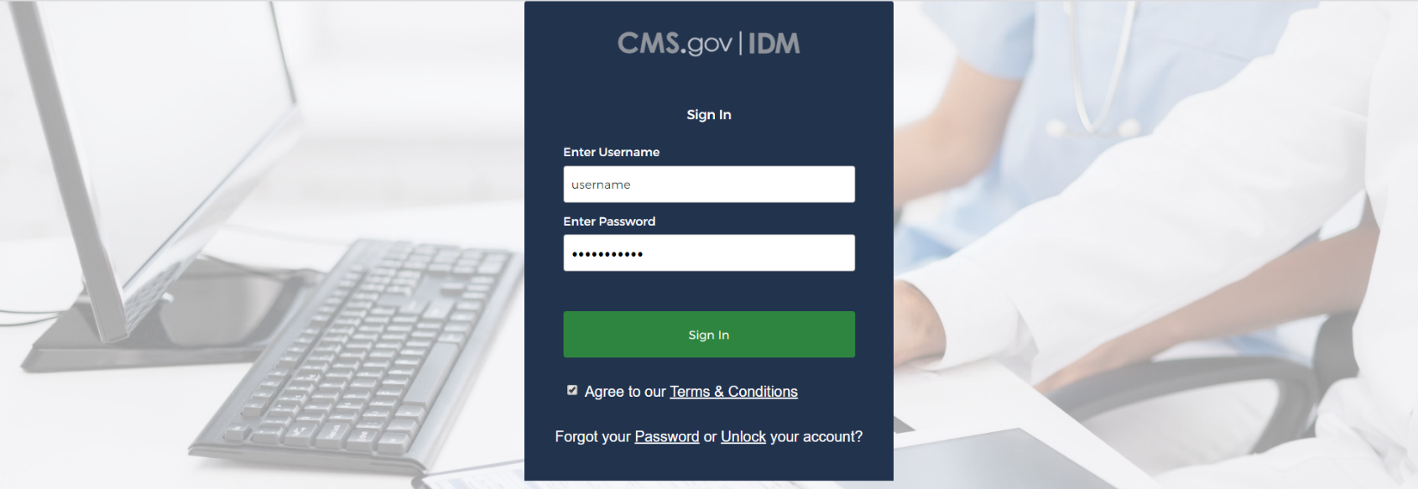
Logging into Confluence
QualityNet Confluence URL: https://confluence.hcqis.org
Click Log In in the upper right corner
Log in with your HARP credentials
Let’s Check
It Out
Notes:
*Before you can log in, you will first need to create a HARP account and request a QualityNet Atlassian User Role
After logging in, you will be redirected to Confluence

Slide 6
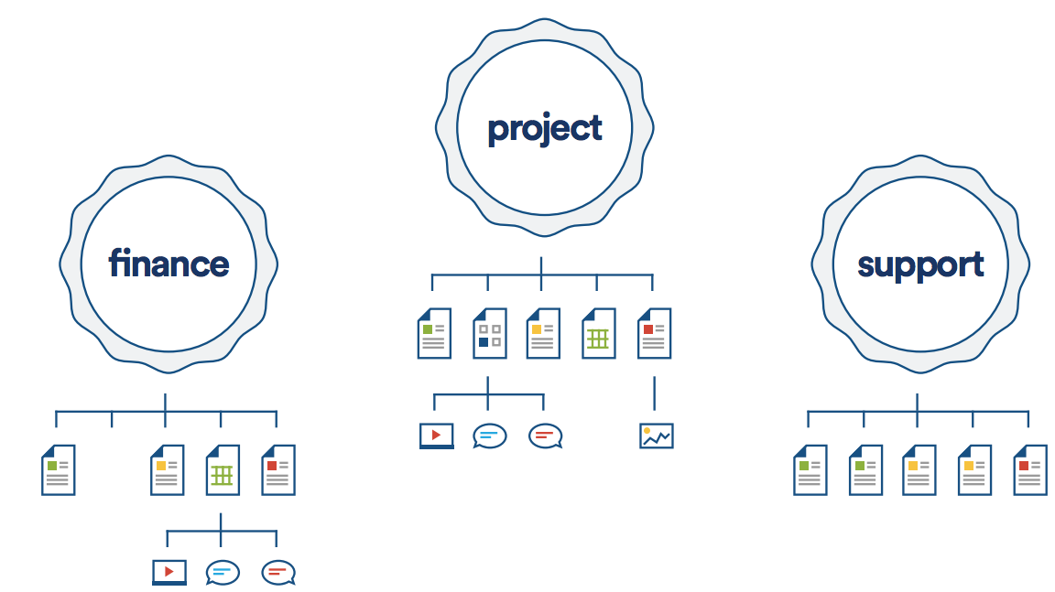
Confluence Terminology and
Fundamental Organization
Space: Highest level of organization in Confluence; made up of a collection of pages and subpages
  NOTE: in QualityNet Confluence, only Atlassian admins can create a space
Page: Adds content to spaces; has unique URL
  NOTE: pages can have subpages in addition to files
File: Individual documents and multimedia items (videos, images, etc.) that can be attached to pages
Space
Pages
Files

Slide 7
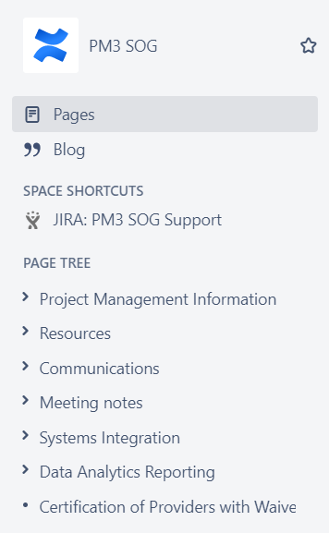
Confluence Terminology and
Fundamental Organization
SOG Space
Pages within
the SOG Space
Notes:
Pages with arrows next to them also have sub-pages

Slide 8
Confluence Terminology and
Fundamental Organization
Spaces dropdown menu: Shows a list of spaces you have recently visited
Search: The Search bar at the top allows you to search for users, spaces, pages, and files
  Search can be filtered by content space
  location, last modified date, and
  type of content
  Additional filters can also be added
Let’s Check
It Out
Notes:
Spaces dropdown menu: Shows a list of spaces you have recently visited
Space directory: Shows a list of all of the spaces in the HCQIS Collaboration Space
Found by clicking the spaces dropdown menu at the bottom
Search: The Search bar at the top allows you to search for users, spaces, pages, and files
Search for pages by who has edited them
Search can be filtered by content space location, last modified date, and type of content
Additional filters can also be added

Slide 9
Your Account Profile
See your personal information and recent activity
View pages you have saved for later and the pages/spaces you are watching
View page drafts that you have been working and resume or discard them
See the people you are following
on Confluence and update your
personal info
Let’s Check
It Out
Notes:
Your profile is a centralized location for your personal information and all of the information you are keeping track of in Confluence
Found by clicking your profile icon in the upper right hand corner
See your personal information and recent activity in the Profile tab
View pages you have saved for later and the pages/spaces you are watching
View page drafts that you have been working and resume or discard them in the Drafts tab
See the people you are following on Confluence or start following people, and update your personal info

Slide 10
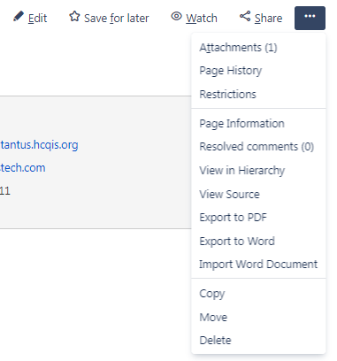
Using Confluence
Edit: Enter edit mode in a page
Save for later: Save a page for later, accessible in your profile
Watch: Keep tabs on a page and be notified of changes
Share: Share a page with other users
Ellipses (…): More options
  View page attachments
  View page history
  See restrictions on page
  Export, copy, move, delete
Notes:
All pages have a number of options at the top
Edit: Enter edit mode in a page
Save for later: Save a page for later, accessible in your profile
Watch: Keep tabs on a page and be notified of changes, also accessible in your profile
Share: Share a page with other users on Confluence or get a shareable link to the page
Ellipses (…): More options
View page attachments
View page history
See restrictions on page
Export, copy, move, delete

Slide 11
Collaborating via Confluence
Send feedback directly in Confluence with inline comments
Up to 12 collaborators at one time
  User mentions (using “@” to notify) can be used in the page itself and the comments
Confluence shows when there are other people working on the same page
Let’s Check
It Out
Notes:
Another feature of editing pages in Confluence is that you can send feedback directly
Up to 12 collaborators at one time working on one page
User mentions (using “@” to notify) can be used in the page itself and the comments
Confluence shows when there are other people working on the same page
Create an inline comment by highlighting text on a page and clicking the comment option
Create a comment on the page by using the comment box at the bottom

Slide 12
Working with Images and Files
Attachments Page
  Paperclip icon above the page title or click the ellipses → click Attachments
  See all the files already attached to the page
  Upload files at the bottom of the page
  Edit files in Office
Let’s Check
It Out
Notes:
View the attachments of a specific page by clicking the paperclip icon or going to the Attachments page by clicking on the ellipses on the right side of the page
The attachments page shows all the files attached to the page
Previous versions – versions are added when a file gets reuploaded
File size
Who uploaded the file
When it was uploaded
Labels
Comments
View, Edit file in Office, Properties, Delete
Download all files
Upload files
Either browse for files on your device by clicking Choose File on the left side of the page
Or drag and drop files into the box on the right side of the page

Slide 13
Working with Images and Files
Working with files in Edit mode
  Files can also be uploaded in Edit mode
  Inserting and formatting images and files
    Files can be displayed as thumbnails or links
    Images can be displayed at different sizes
  Images and files can be linked
Let’s Check
It Out
Notes:
I’m going to walk through inserting and formatting images and files
Linking to pages in Confluence and outside of Confluence
Link to an internal page (copy and paste from browser or search)

Slide 14
Resources
The PM3 Atlassian Support Knowledgebase (ASK) is a resource for learning how to use Confluence
  PM3 ASK Space
  Getting Started in Confluence
  QualityNetAtlassianSupport@hcqis.org
SOG Slack Channel: #help-sog-atlassian

Slide 15
SOG Confluence Space Walkthrough
Resources
Knowledge Transfer Library
PHE Certification Action Team Communications
Training Materials
Waiver Certification Issue Answer Repository
Waivers for Healthcare Providers
Let’s Check
It Out
Notes:
Resources
Go-to section for most of your needs. Includes contact lists, a knowledge transfer library, the PHE Certification Action Team Communications, and schedules for recurring meetings.
Knowledge Transfer Library - Page for shared knowledge. Acronyms and Terms List and will continue to add more helpful resources as the project progresses.
PHE Cert Action Team Comms - Where we store all official communications produced by the PCAT team, including the certification checklists.
Training Materials - Page housing all slide decks and recordings for facility trainings conducted in April 2020
Waiver Cert Issue Answer Repository – stores all issue answers reviewed and approved by the PCAT team and disseminated via email. Can search keywords, issue ID, or by facility type.
Waivers for Healthcare Providers – Where we store information about the waiver process. This section is still be developed, but we’ll continue to build out these pages as the work progresses.

Slide 16
Helpful Spaces
CCSQ Lean Agile Center of Excellence (LACE) - https://confluence.hcqis.org/x/5bI8Ag
Human-Centered Design (HCD) Center of Excellence - https://confluence.hcqis.org/x/ARFUAg
Enterprise Communications Toolkit - https://confluence.hcqis.org/x/yiGeB
Lean Agile: an iterative approach to project management that helps teams deliver value to faster and with fewer headaches
Human-Centered Design (HCD): HCD at CMS is the process CSSQ IT Product and Support Teams (CIPST) uses to understand the people for whom we are writing policies and creating programs and services.

Slide 17

Q & A
Any questions?

