Slide 1



VALUE STREAM MAPPING

Slide 2
In today’s session, you will:
Gain and understanding of the benefits
of organizing around value
Recognize the types of value streams
Examine the steps to map a value stream
Explore methods to improve the flow of value
Learn to manage, maintain, and improve a value stream

Slide 3
What is your favorite food (on the list)?
When the Zoom Poll Appears, select your favorite food on the list.
  Pizza
  Cheeseburgers
  Tacos
  Spaghetti with homemade sauce
  Sub Sandwich
  Chili

Slide 4
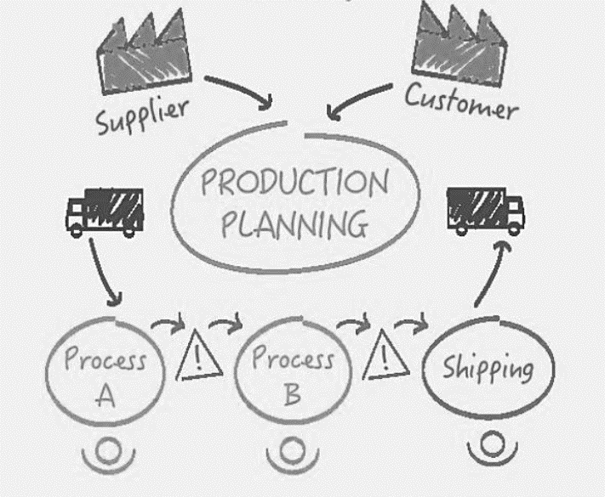
The Value Stream
VALUE STREAM BASICS
A value stream is everything required to satisfy a customer request, from the time of the request to the fulfillment of the request.
It includes every:
Person
Asset
Resource
Process
And All Information

Slide 5
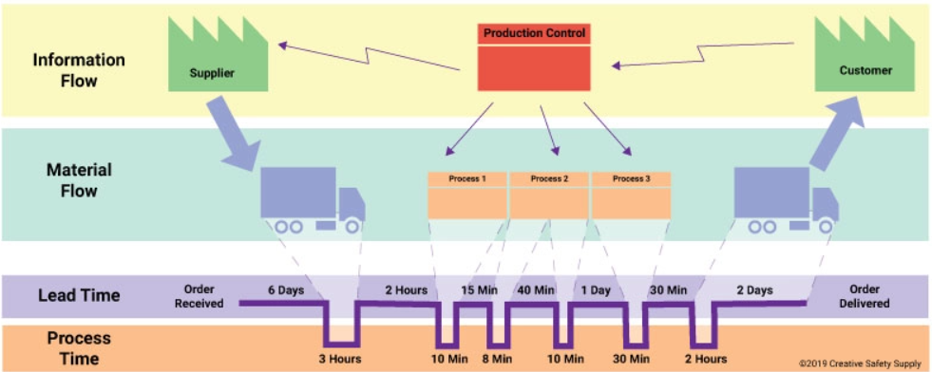
Value Stream Maps
Value Stream Maps are a tool with roots in LEAN practices and methodologies.
The maps help organizations identify and visualize the flow of materials, information, and activities required to deliver value to customers.

Slide 6
Organize Around Value
Organizing around value is a fundamental principle of LEAN and Agile methodologies, including scrum, SAFe (Scaled Agile Framework)
Programs and teams should align their activities and objectives around delivering value to the customer
This approach, in contrast to traditional project management, approaches that focus on delivering features, meeting deadlines, and staying within budget
Benefits include:
Increased customer satisfaction
Enhanced collaboration
Reduced waste
Increased agility
Budgeting Flexibility

Slide 7
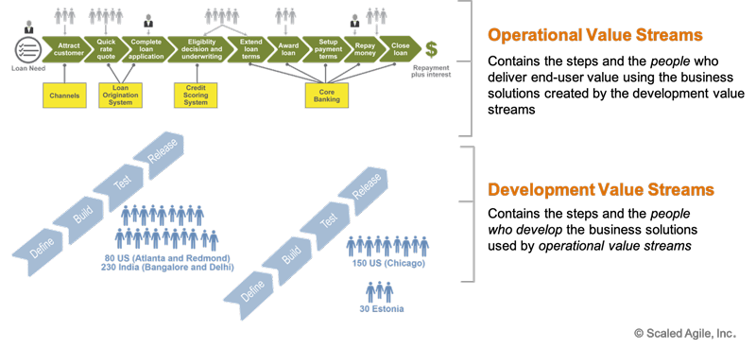
Types of Value Streams
Enabling Value Streams
Enabling value streams refer to the processes and activities that support the operational and development value streams. These processes may include human resources, finance, and administration

Slide 8
EXECUTING VSM
Executing Value Stream Mapping
Define the Scope
Map the Current State
Analyze the Current State
Design the Future State
Implement the Future State
Continuously Improve
Prepare: Define the scope
Evaluate, Adjust, & Improve
Map the current state
Implement the future state
Analyze the current state
Design the future state

