Slide 1
Contracting for Agile – Quick Modules

Slide 2

Module : Ceremonies
Module User Story
As a contracting specialist/officer, I want to understand sprint ceremonies, so that I can understand their value.

Slide 3
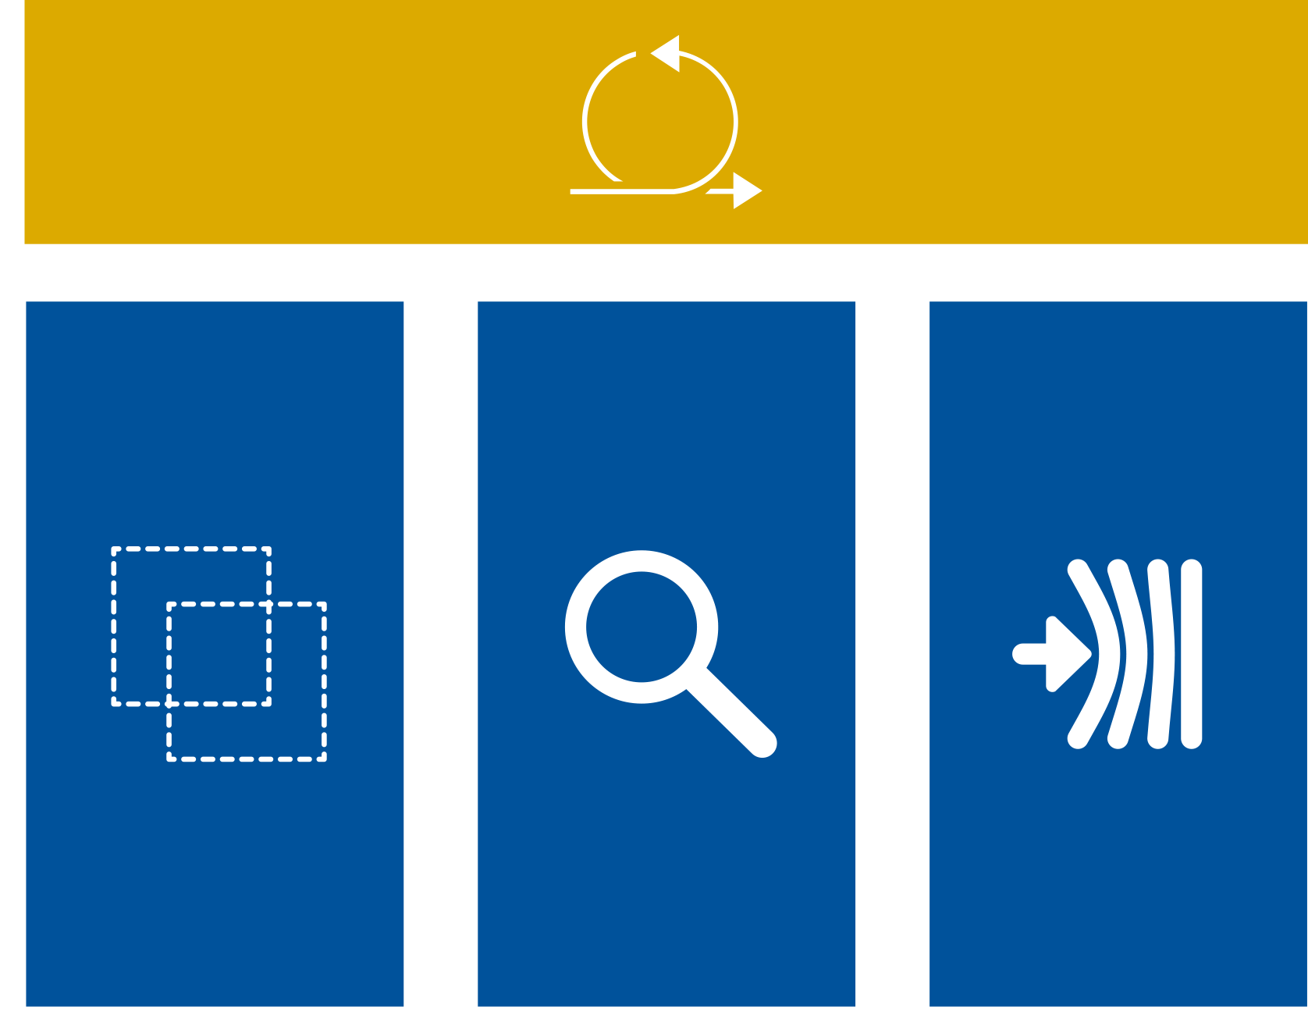
Three Pillars of Scrum
Transparency
Inspection
Adaption

Slide 4

Sprint
The Heart of scrum – a time boxed period where a ‘done’ useable and potentially releasable product increment is created
Consistent duration once set. Normally 2, 3 or 4 weeks
Never longer than 30 days
New sprint starts immediately at conclusion of prior sprint (Next work day)

Slide 5

Daily Scrum Meeting
A 15 minute, time boxed event for the development team to synchronize activities and create a plan for the next 24 hours.
Done by inspecting the work since the last daily scrum and forecasting the work that could be done before the next one
Held at the same time and place each day.

Slide 6
Daily Scrum Meeting
During each Daily Scrum meeting, each team member explains:
  What has been accomplished since the last meeting
  What will be done before the next meeting
  What obstacles are in the way

Slide 7

Daily Scrum Meeting
Leaders may attend (for transparency) but are not allowed to speak or interrupt the team
Focus is on self-governance and moving tasks forward.
During each Daily Scrum meeting, each team member explains:
  What has been accomplished since the last meeting
  What will be done before the next meeting
  What obstacles are in the way

