Slide 1
Contracting for Agile – Quick Modules

Slide 2

Module : HCD
Module User Story:
As a contracting specialist/officer, I want to understand Human Centered Design, so that I can ensure a great user experience.

Slide 3
It all starts with Empathy
Understanding your user is paramount
Do not guess what they want, ask them
Embrace both Quantitative and Qualitative data including ethnographic research
3 repeating phases
    Hear – Listen to your users in as many ways as possible
    Create – build prototypes and MVP’s based on user input
    Deliver – Launch as soon as a minimum feature set is reached and continue to iterate over time as the demands of your users change.

Slide 4
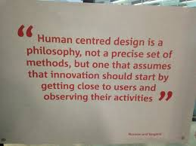
Human Centered Design (HCD)
Human Centered Design begins with the user and involves them throughout development
After release, user input increases in importance as designers and developers ravenously collect a consistent flow of end user feedback and usage data
Imperative for designers to adapt as the user evolves
This deck details key concepts, and describes tools used at each phase of Human Centered Design

Slide 5
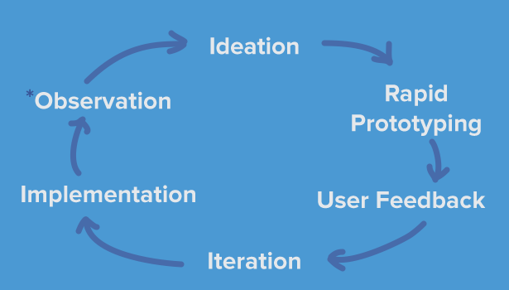
The basic cycle of HCD

