Slide 1
Contracting for Agile – Quick Modules

Slide 2
Module: What is Agile?
Module User Story:
As a contracting specialist/officer , I want to understand what Agile is, so that I can feel confident about buying it to provide increased value to our stakeholders.

Slide 3
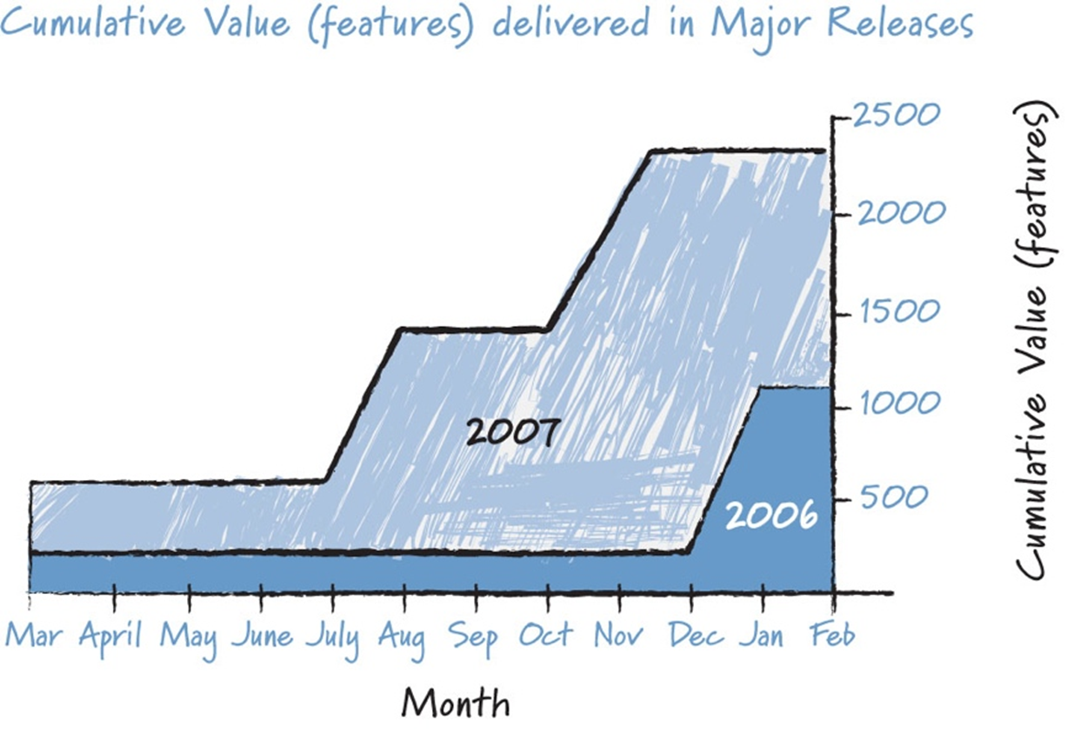
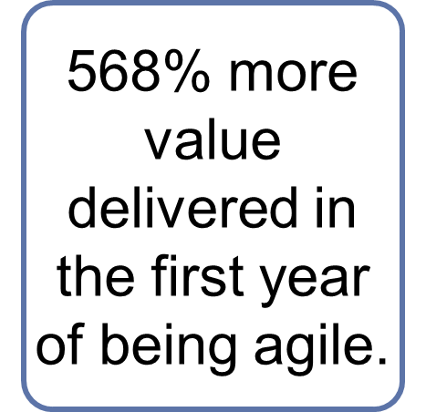
Why?
70% of requirements obsolete to end-users!
45% - 50% of contract spend on waterfall requirements is on avoidable rework
Buying outcomes rather than effort
Source: Greene and Fry 2008.

Slide 4
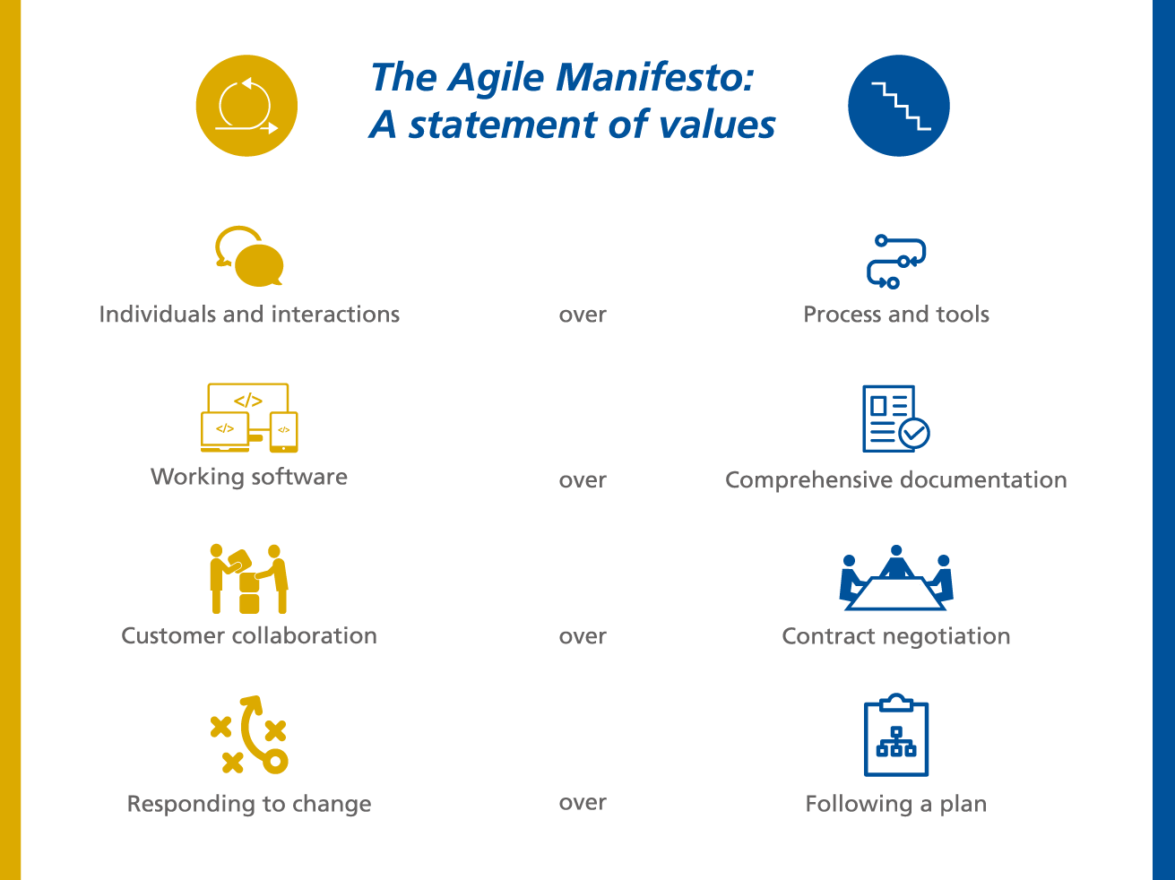
Agile Manifesto

Slide 5
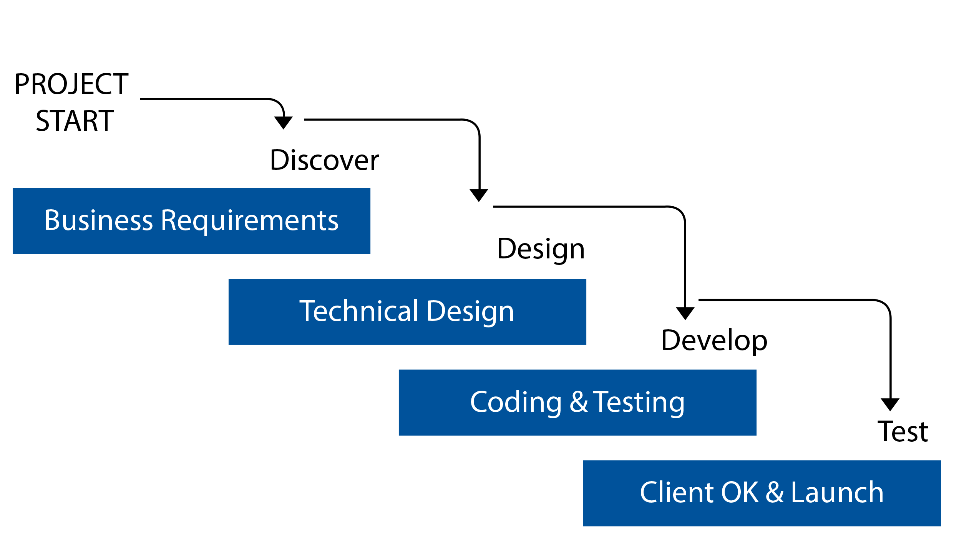
Waterfall = Predictive
Plan out the whole project in advance
Predictive
Relies on in depth pre-planning
Users do not see product until very late in dev cycle.

Slide 6
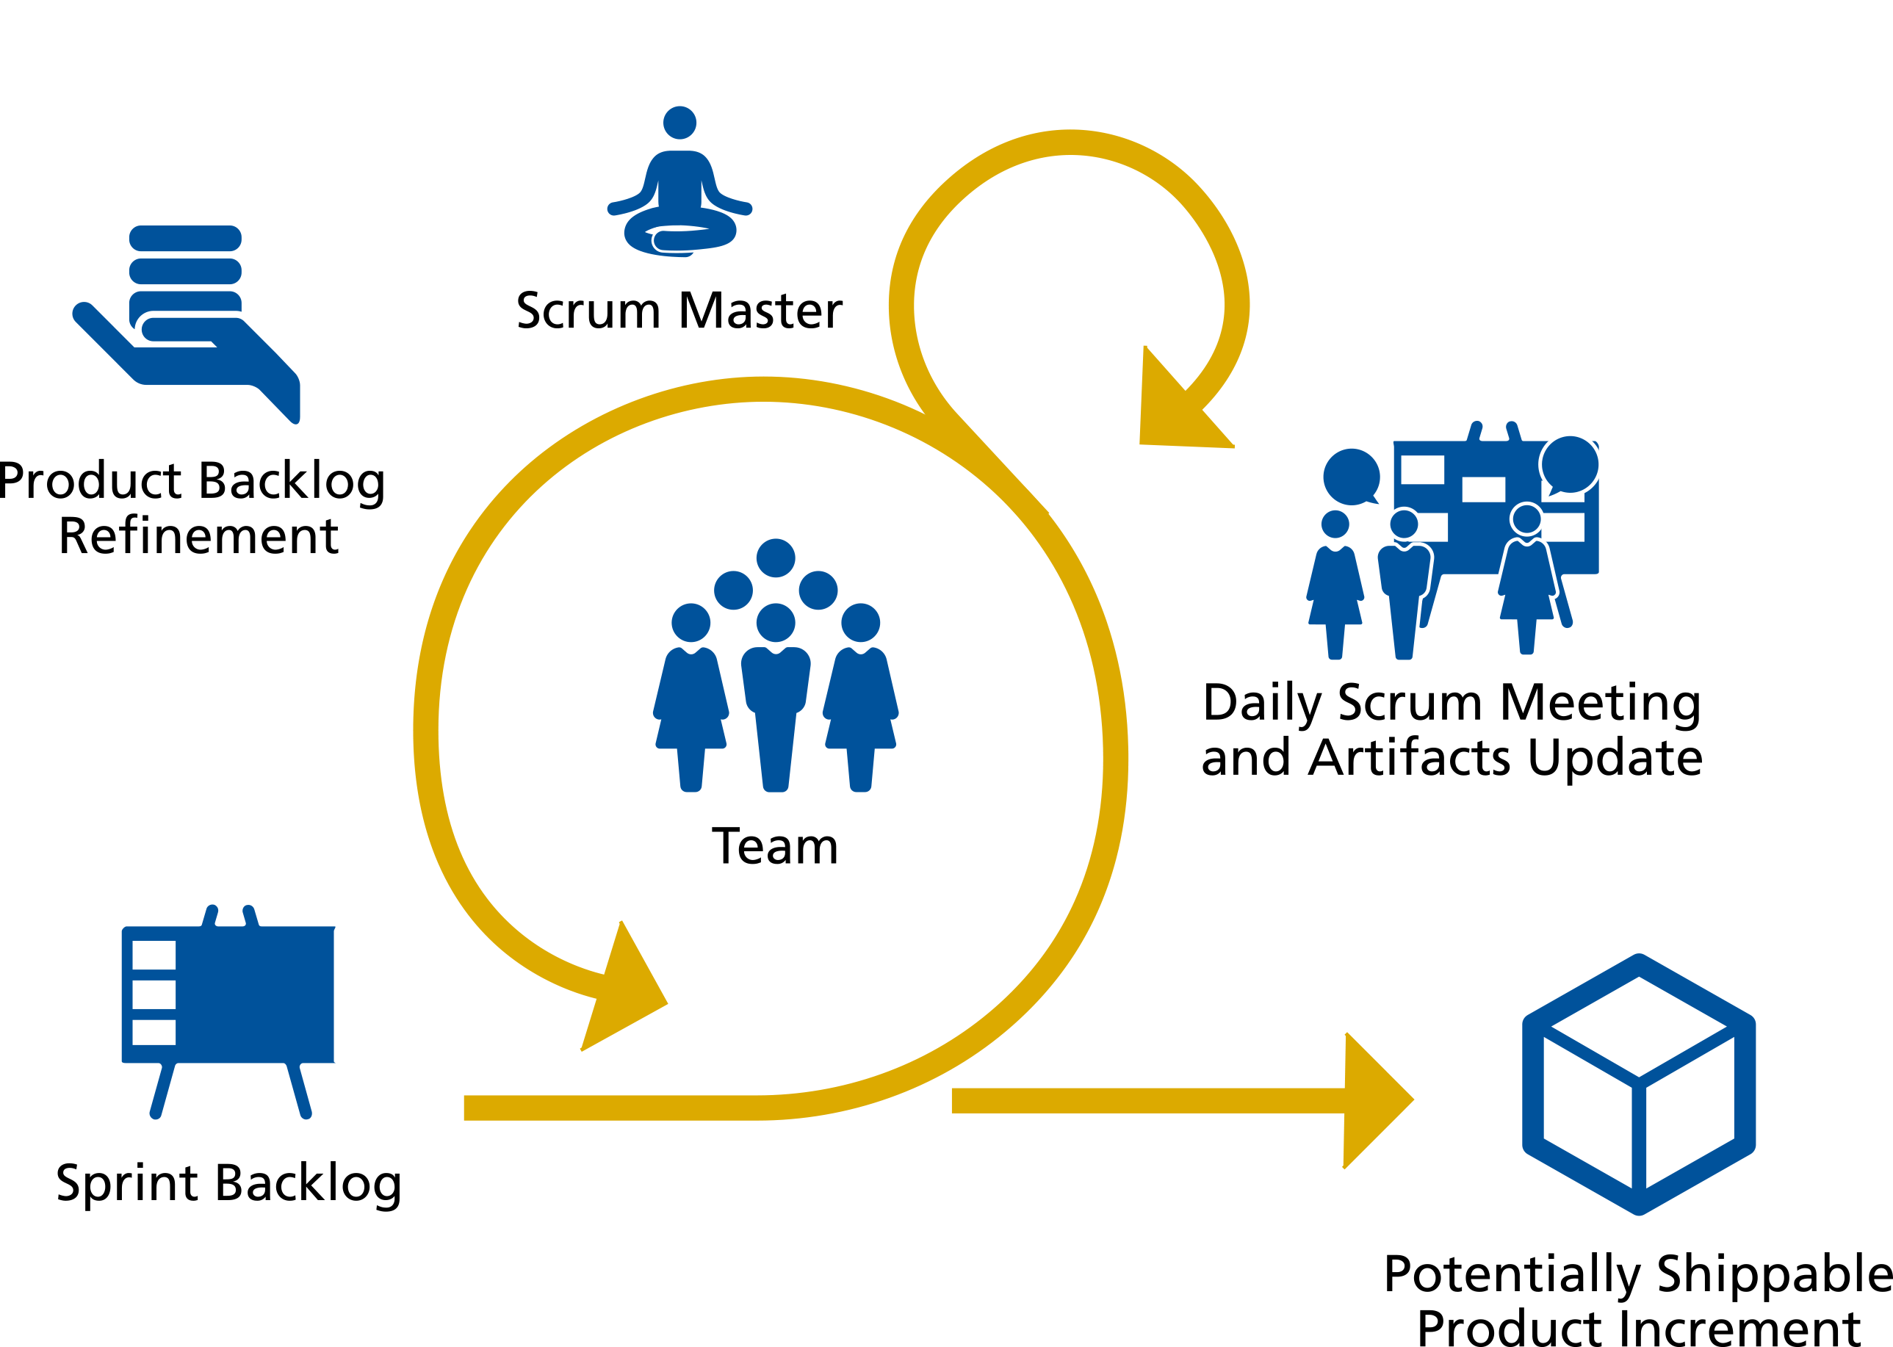
Agile = Empirical
Iterative
Develop in 2-4 weeks increments
Frequent customer / stakeholder input shapes emerging product

Slide 7


Waterfall vs. Agile….
Waterfall based on the idea that a group of experts can correctly predict at the outset of a project what a customer wants and the development team needs.
Scrum is based on the idea of regularly checking-in to see if the development team is headed in the right direction – as determined based on regular customer or stakeholder input.

