Slide 1





CCSQ ENTERPRISE METRICS
CCSQ Agility
Metrics Setup
Guide
Tips on navigating Dashboards for your teams

Slide 2

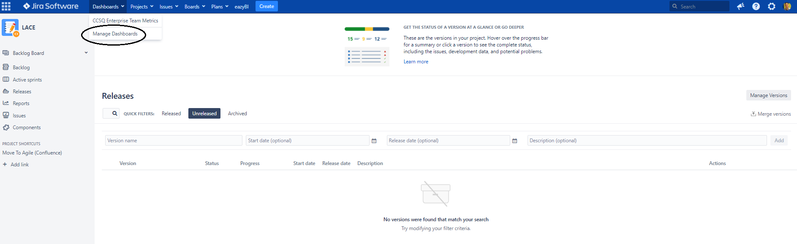
CCSQ ENTERPRISE METRICS
CCSQ ENTERPRISE METRICS
Find the Dashboard in Jira
In the blue bar at the top of Jira, open the Dashboards menu
Select Manage Dashboards from the menu
Notes:
Adding Dashboards

Slide 3
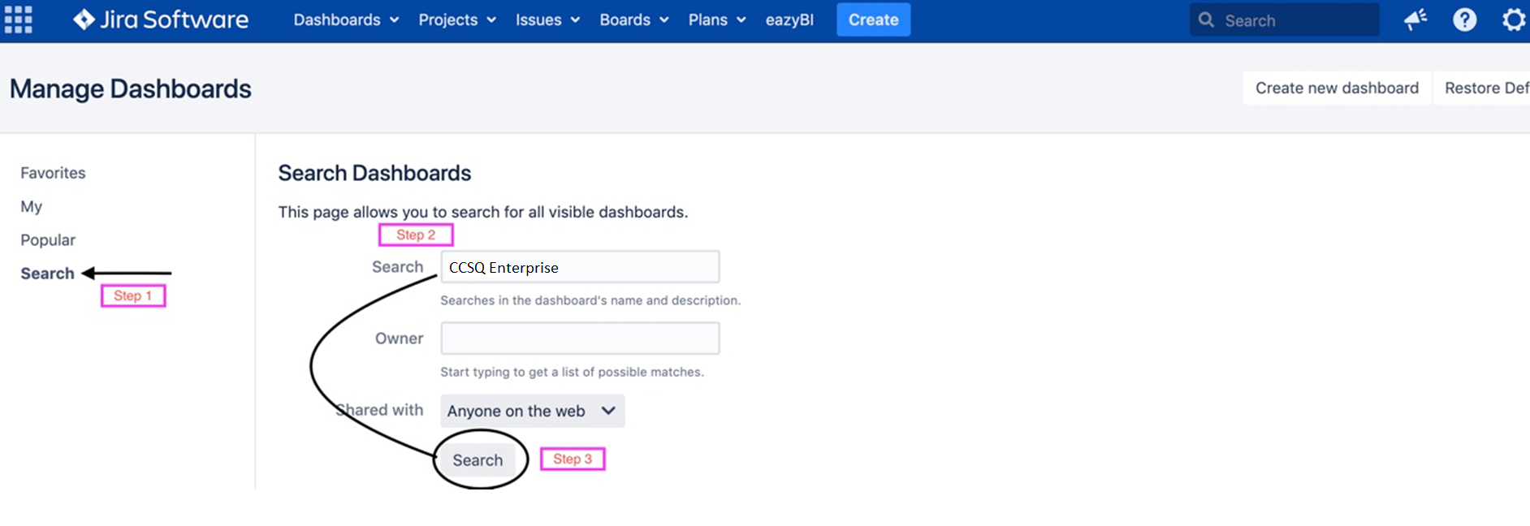
CCSQ ENTERPRISE METRICS
Using Dashboard Search
Select “Search" on the left side navigation
If each of your teams has their own project, search for "CCSQ Enterprise“
If your program is using Jira Portfolio, search for “CCSQ Portfolio”

Slide 4
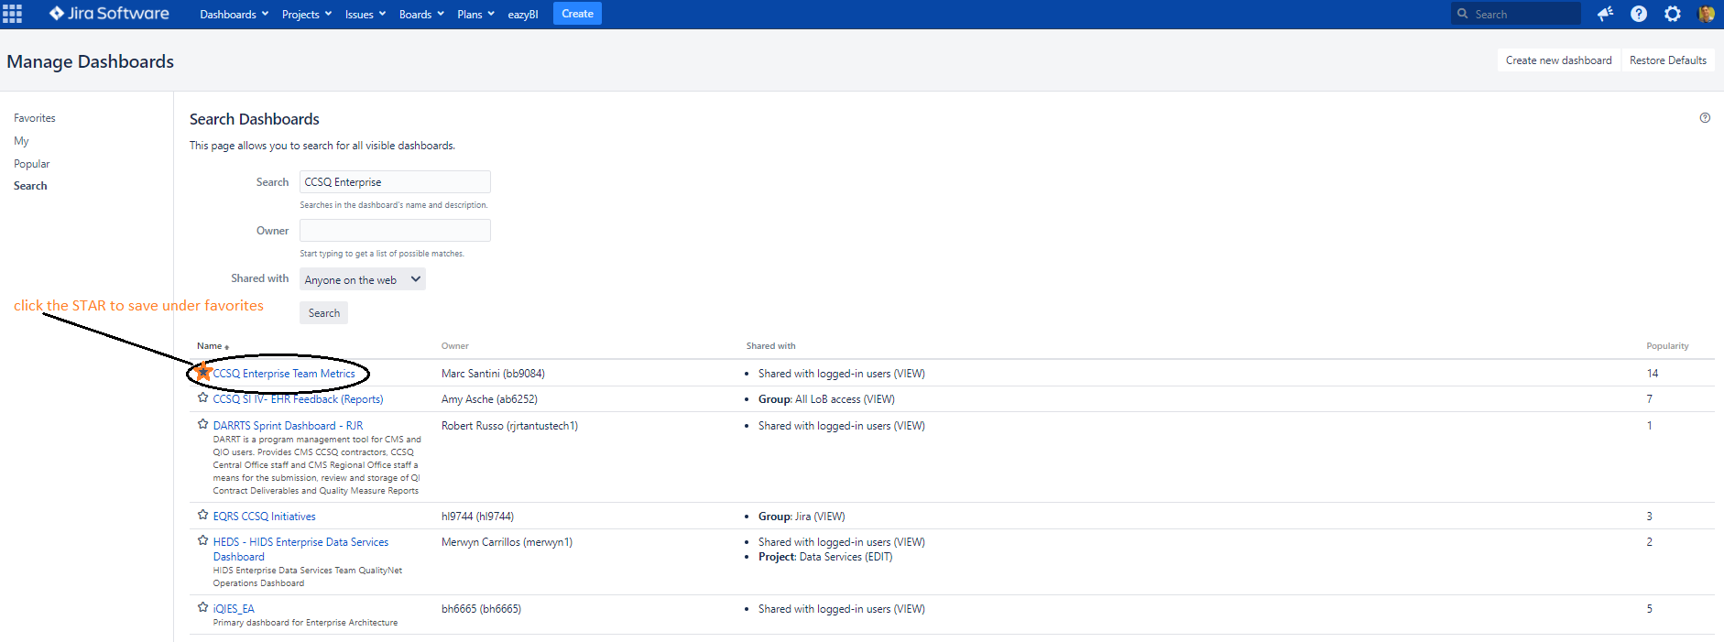
CCSQ ENTERPRISE METRICS
Accessing the Dashboard in Jira
Locate the dashboard in the search results
Select the star icon to the left of the dashboard to add it to your favorites

Slide 5
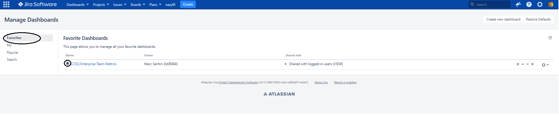
CCSQ ENTERPRISE METRICS
Accessing the Dashboard in Jira
Select “Favorites” in the menu on the left
Confirm that you see the dashboard in your favorites list

Slide 6
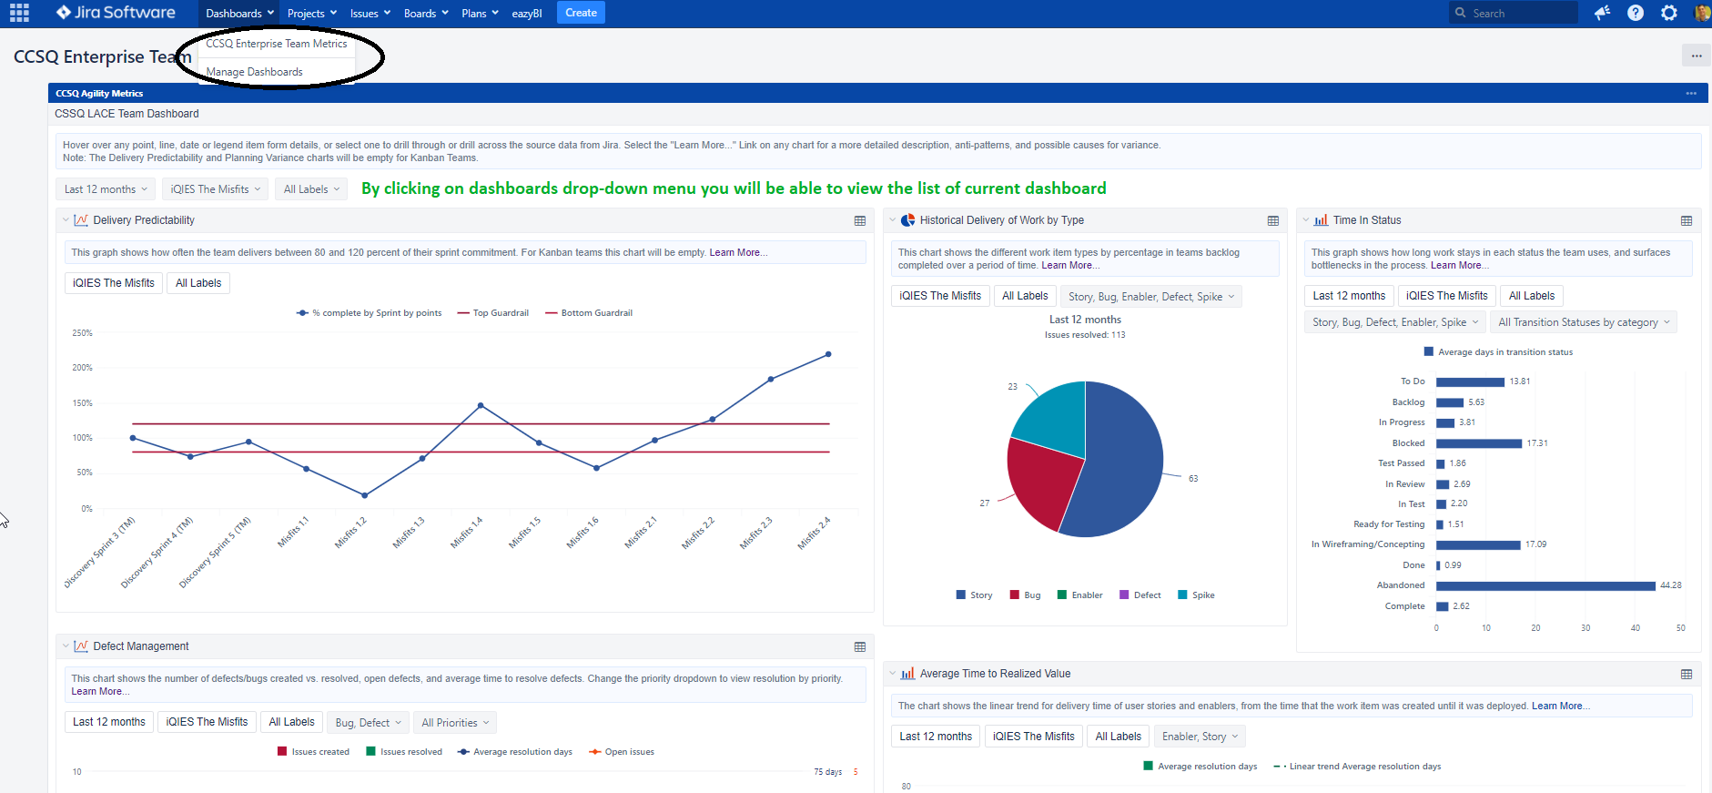
CCSQ ENTERPRISE METRICS
Accessing the Dashboard in Jira
You will now see the dashboard link in the Jira Dashboards menu.
Team
Team
Team
Team
Team
Team

Slide 7
CCSQ ENTERPRISE METRICS
What’s Next
Click the “Learn More…” link at the top of every chart to get deeper explanations of the metrics on the LACE Confluence space
Enterprise Team Dashboards Explained Learning Sessions
Dashboard Clinics: dive deeper into your team metrics with LACE coaches
  To be scheduled monthly, visit https://qnetconfluence.cms.gov/display/LACE/Upcoming+Events
  Reach out via Confluence to schedule: https://qnetconfluence.cms.gov/display/HUB/CCSQ+LACE
Team
Team

Slide 8
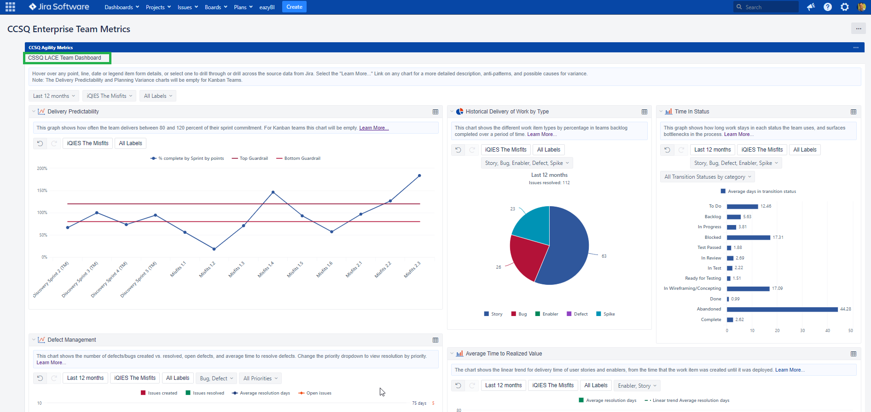
CCSQ ENTERPRISE METRICS
CCSQ Enterprise Agility Metrics Dashboards
Select “Favorites” in the menu on the left
Confirm that you see the dashboard in your favorites list
Team
Team
Team
Team
Team
Team

Slide 9

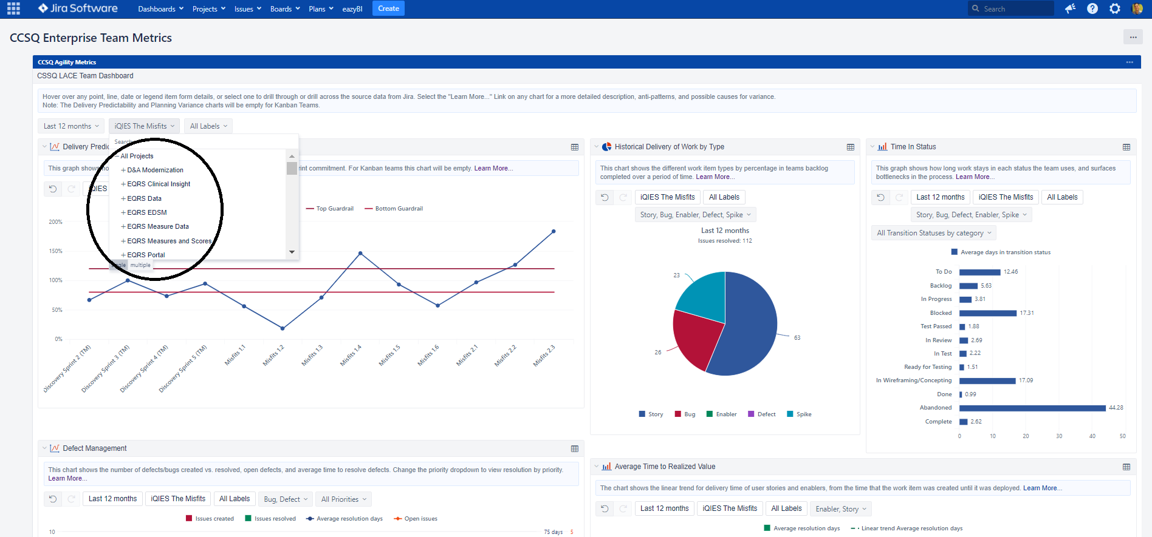
CCSQ Enterprise Agility Metrics Dashboards
Click the search bar to locate your team under (CCSQ LACE Team Dashboard)
Note: user can select “Scrum/ Kanban” teams
Team
Team
Team
Team
Team
Team

Slide 10
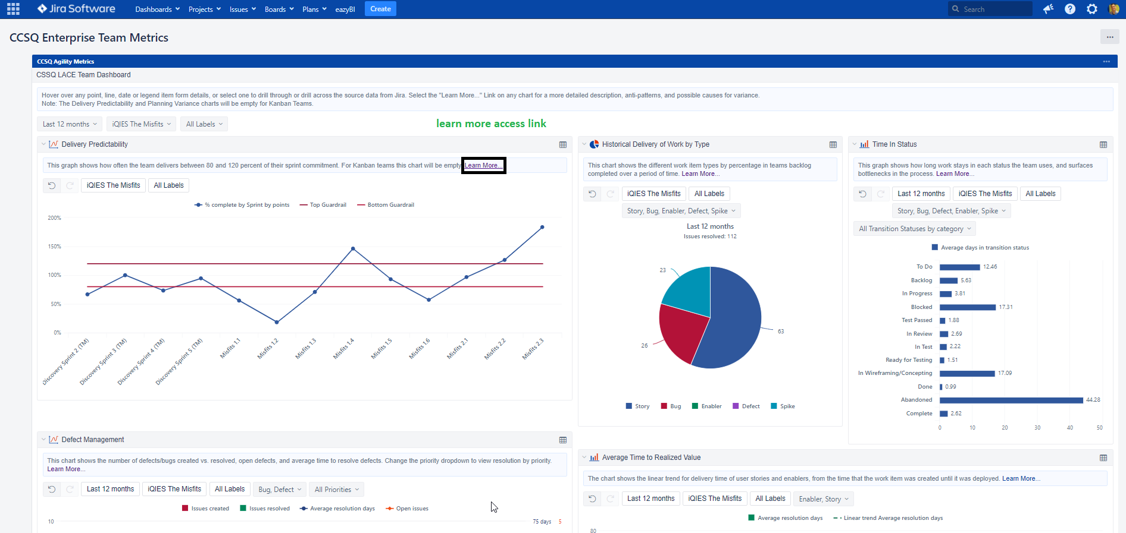
Metrics Dashboard Chart Details
Click the learn more access link to locate resource page in confluence for Metrics
https://qnetconfluence.cms.gov/display/LACE/Metrics+Dashboard+Chart+Details#MetricsDashboardChartDetails

Slide 11

CCSQ Agility
Metrics
Set-up Guide
Tips on navigating Dashboards for your teams

Slide 12
Thank you

